Slide 2
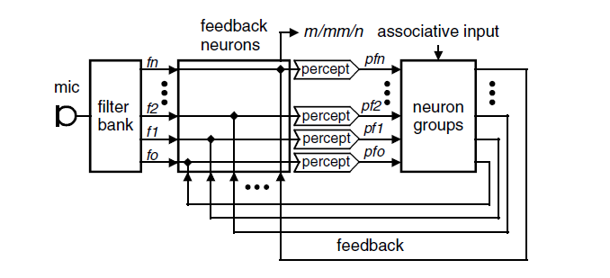
The Sound Perception
The perception of frequencies (simplified)

Slide 3
Speech Recognition Scheme
associative input
WM8731
f₁
pf₁
filter bank
feature detector
f₂
feedback neurons
pf₂
neuron groups
ADC
mic
f₃
pf₃
Analog-to-digital converter
Band-pass filter
Rectifier
Low-pass filter
feedback

Slide 4
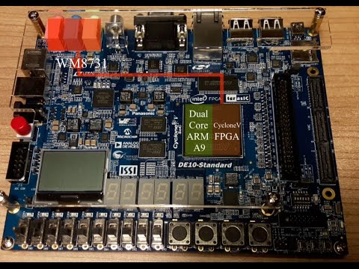
Analog-to-digital converter
WM8731 - Portable Internet Audio CODEC
Stereo 24-bit multi-bit sigma delta ADC
Digital audio input word lengths from 16-32 bits
Sampling rates from 8kHz to 96kHz
Programmable Audio Data Interface - I2S, Left, Right Justified

Slide 5
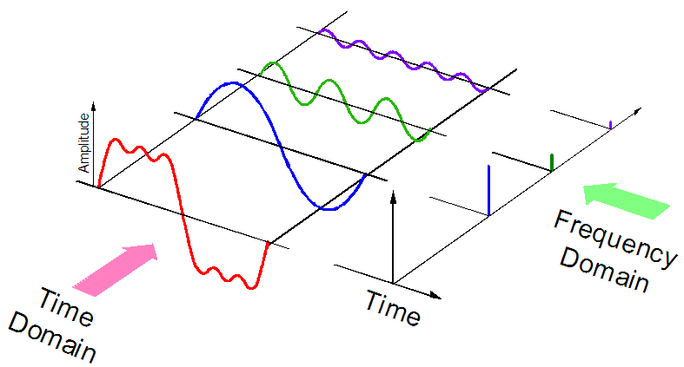
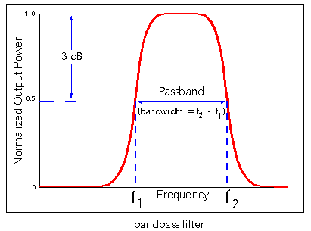
Signal processing
After ADC – digital signal d(t)
Problem: how to get d(freq) function?
Solution:
Fourier Transformation
Band-pass filters using
Resonator banks using
Our approach: band-pass filters using

Slide 6
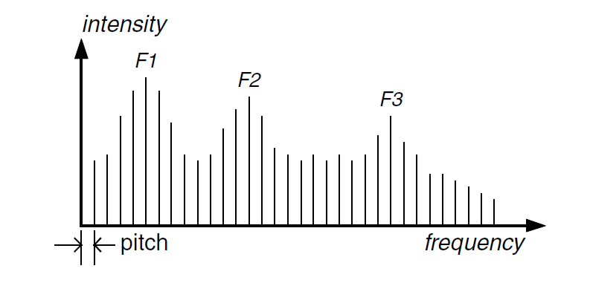
Feature detecting
After Filter bank – digital signal d(freq)
Problem: how to get features?
Solution: using of human voice properties (Vowels Formants)
pitch – fundamental frequency
male voice: 80–200 Hz
female voice: 150–350 Hz
Formant is a concentration of acoustic energy around a particular frequency in the speech wave
Red ->
Green ->
Blue ->

Slide 7
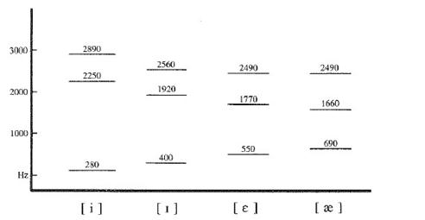
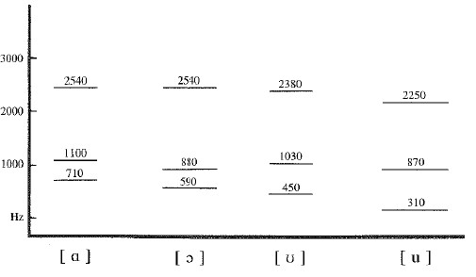
Feature Detecting. Formants
2<n<=4
Red ->
Green ->
Blue ->
Two Formants – too few
Four Formants – always enough
frequency
frequency

Slide 8
Detailed Scheme of Sound Signal Processing
Analog signal, s(t)
Digital signal, d(t)
Digital signal, d(freq)
Sound wave
WM8731
red
filter bank
feature detector
green
feedback neuron
ADC
blue
mic
Analog-to-digital converter
Band-pass filter
Rectifier
Low-pass filter
Formants
of vowels
FPGA

