Slide 1


Key Features and Technologies for Online Examination Platform
This presentation outlines essential features and technologies that comprise a robust online examination platform, designed for efficient learning and assessment. The platform leverages modern technologies to deliver a seamless user experience, facilitate secure assessments, and provide valuable insights.
by vasim biradar

Slide 2

1. User Management
1
User Registration & Login
2
Profile Creation & Management
Streamlined user registration and login processes allow for easy access to platform features.
Users can create personalized profiles, update their information, and manage their account settings.
3
Role-Based Access Control
Role-based access control ensures appropriate permissions for students and instructors, promoting secure and efficient platform use.

Slide 3
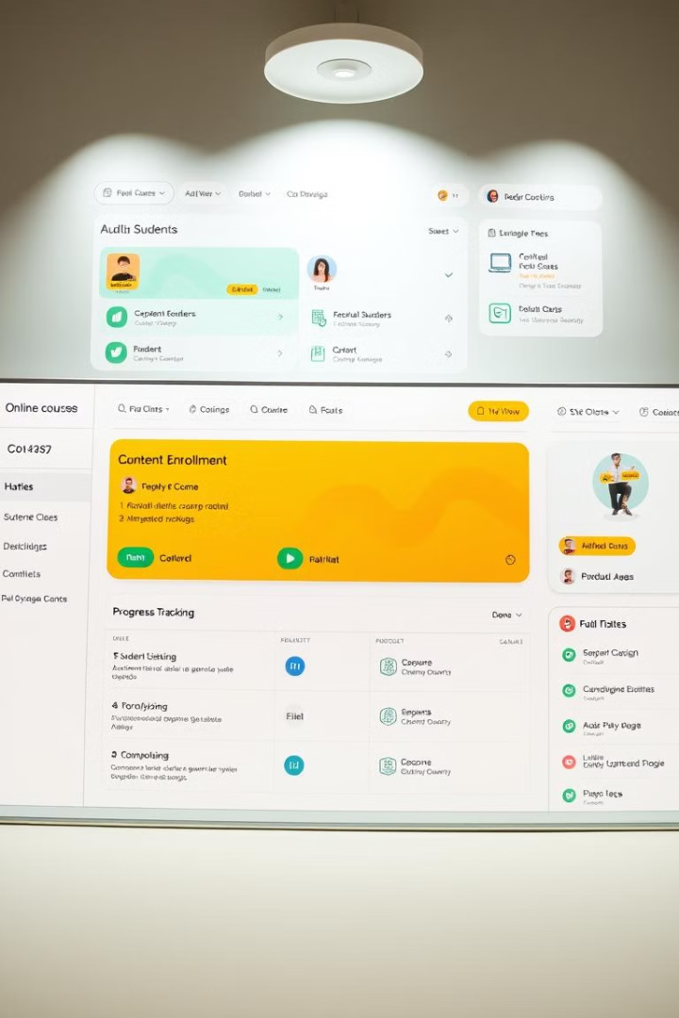
2. Course Registration & Management
1
Course Creation & Editing
Instructors create and edit courses, adding sections, lessons, and rich multimedia content.
2
Sections & Lesson Organization
Courses are structured with logical sections and lessons, providing a clear path for learners.
3
Content Upload
Instructors upload a variety of content formats, including text, images, videos, and interactive assessments.
4
Course Scheduling & Enrollment
Courses can be scheduled, allowing students to register and enroll at designated times.

Slide 4
3. Payment & Subscription
UPI Integration
Subscription & Plan Pricing Models
Payment Processing & Receipt Generation
UPI integration enables seamless and secure payment processing for Indian users.
Flexible subscription and plan pricing models cater to different user needs and budgets.
The platform handles payment processing, generating receipts for successful transactions.

Slide 5




4. Learning Management System (LMS)
Content Delivery
The LMS delivers various content formats, including quizzes, text, and videos, for interactive learning experiences.
Progression Tracking & Reporting
The platform tracks user progress through courses, providing valuable insights and reports.
Certificate Generation
Upon successful completion, users receive digital certificates acknowledging their achievements.

Slide 6
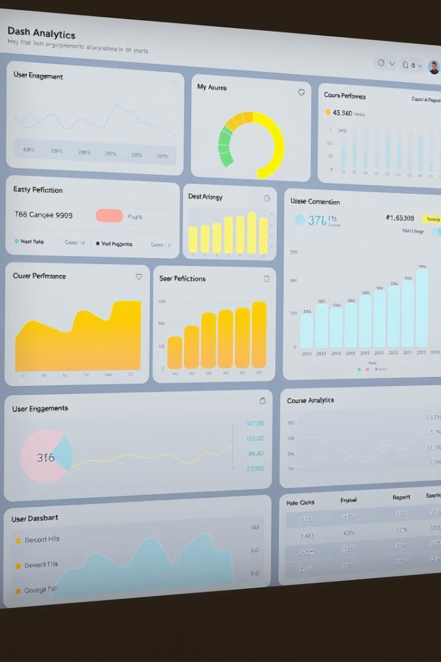
5. Analytics & Reporting
User Analytics
Tracks user engagement, activity, and progress within the platform.
Course Performance Metrics
Provides insights into course completion rates, student engagement, and overall effectiveness.
Revenue & Sales Reports
Generates reports on revenue generated, subscription models, and sales performance.

Slide 7
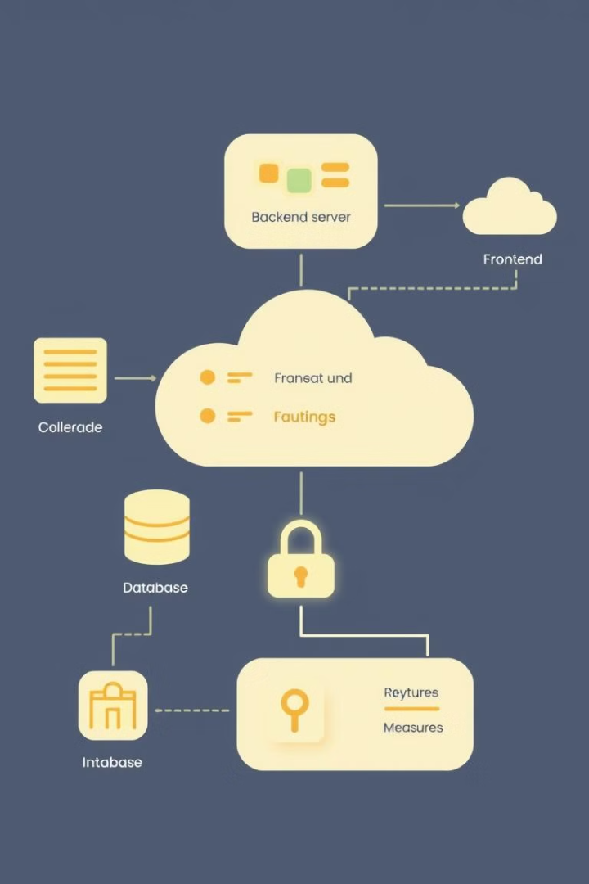




6. Technology Stack
Frontend
Backend
A user-friendly interface built with modern technologies, providing a seamless experience.
The backend handles data processing, user authentication, and communication with the database.
Cloud Infrastructure
Security Considerations
Utilizes cloud services for scalability, reliability, and secure data storage.
Comprehensive security measures are implemented to protect user data and ensure platform integrity.

