Slide 1
Image Super-Resolution Using Deep Convolutional Networks
- Group 9

Slide 2
Introduction
In this paper, a single image super resolution using deep learning method is proposed.
This method learns an end-to-end mapping between the low/high-resolution images.
The mapping is represented as a deep convolutional neural network (CNN) that takes the low-resolution image as the input and outputs the high-resolution one.
Establishes a relationship between deep-learning-based SR method and traditional sparse-coding-based SR method.

Slide 3
Sparse-Coding based method
One of the representative external example-based SR methods.
First, overlapping patches are densely cropped from the input image and pre-processed (e.g., subtracting mean and normalization).
These patches are then encoded by a low resolution dictionary.
The sparse coefficients are passed into a high-resolution dictionary for reconstructing high resolution image.
The overlapping reconstructed patches are aggregated (e.g., by weighted averaging) to produce the final output.

Slide 4
CNN Method
Doesn’t explicitly learn dictionaries or manifolds for patching space
Implicitly achieved via hidden layers Original / PSNR Bicubic / 24.04 dB
Simple and superiorly accurate
Fully feed-forward network
SRCNN surpasses Bicubic baseline
with few training iterations
Outperforms SC based method with
moderate training
SC / 25.58 dB SRCNN / 27.95 dB

Slide 5
n1 feature maps of low-resolution image, n2 feature maps of high-resolution image
Low resolution High resolution
Image (Input ) image (Output)
Patch extraction Non-linear mapping Reconstruction
and representation
Given an image Y, first convolutional layer of the SRCNN extracts a set of feature maps
The second layer maps these feature maps nonlinearly to high-resolution patch representations.
The last layer combines the predictions within a spatial neighborhood to produce the final high-resolution image F(Y).

Slide 6
Formulation of SRCNN
Bicubic Interpolation – upscale low-resolution image to desired size.
Interpolated image – Y
Recover Y from F(Y) which is similar to ground truth image X
Patch extraction and representation
extracts patches from the low-resolution image Y and represents each patch as a high dimensional vector.
These vectors comprise a set of feature maps, of which the number equals to the dimensionality of the vectors.
our first layer is expressed as an operation F1:
F1(Y) = max(0,W1*Y+B1)
where W1 = filters, B1 = biases, * = convolutional operation
W1 corresponds to n1 filters of support cXf1Xf1; c= no. of channels in the input image, f1= spatial size of a filter

Slide 7
Non-linear mapping
From 1st stage we obtain an n1-Dimensional feature for each patch
The 2nd stage we map each of these n1-Dimentional vector into an n2-Dimentional one.
Equivalent to applying n2 filters.
The operation of the second layer is:
F2(Y) = max(0,W2*F1(Y)+B2)
Here W2 contains n2 filters of size n1Xf2Xf2, and B2 is n2-dimensional.
Each of the output n2-dimensional vectors is conceptually a representation of a high-resolution patch that will be used for reconstruction.
It is possible to add more convolutional layers to increase non-linearity.
Increases complexity

Slide 8
Reconstruction
Here we define a convolutional layer to produce the final high-resolution image. This image is expected to be similar to the ground truth X.
convolutional layer defined to produce final high-resolution image is,
F(Y) = W3* F2(Y)+B3
Here W3 corresponds to c filters of a size n2Xf3Xf3, and B3 is a c-dimensional vector.
If representation of HR patches are in image domain, then the filter acts like an averaging filter
If represented in other domain first W3 projects the coefficient into image domain and then perform averaging.
All these 3 operations together form a convolutional neural network (CNN)

Slide 9
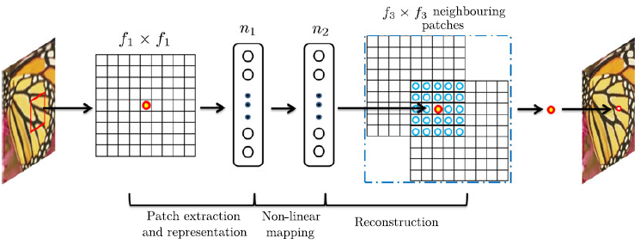
Sparse-Coding-Based method in view of CNN
An f1Xf1 low-resolution patch is extracted from the input image.
Then the sparse coding solver will first project the patch onto a (low-resolution) dictionary.
If the dictionary size is n1, this is equivalent to applying n1 linear filters (f1X f1) on the input image

Slide 10
The sparse coding solver will then iteratively process the n1 coefficients.
The outputs of this solver are n2 coefficients
These n2 coefficients represent the high-resolution patch.
The above n2 coefficients are then projected onto another dictionary to produce high resolution patch.
The overlapping high-resolution patches are then averaged
If the high-resolution patches used for reconstruction are of size f3xf3, then the linear filters have an equivalent spatial support of size f3xf3
The sparse coding solver is not feed forward, it is an iterative algorithm.
On the contrary, our non-linear operator is fully feed forward and can be computed efficiently.

Slide 11

Training
Learning the end-to-end mapping function F requires the estimation of network parameters like Θ={W1,W2,W3,B1,B2,B3}.
This is achieved through minimizing the loss between the reconstructed images F(Y;Θ) and the corresponding ground truth high-resolution images X.
Given a set of high-resolution images {Xi} and their corresponding low-resolution images {Yi}, we use mean squared error (MSE) as the loss function:
where n = no. of training samples
The loss is minimized using stochastic gradient descent with the standard backpropagation.

Slide 12
Training Data
Initially, super-resolution is only applied on the luminance channel (Y channel in YCbCr color space)
A relatively small training set that consists of 91 images, and a large training set that consists of 395,909 images from the ILSVRC 2013 ImageNet detection training partition, are used.
Set5 as the validation set.
Similar trend even for the larger Set14.
The upscaling factor is 3.
Sparse-coding-based method as the baseline, which achieves an average PSNR value of 31.42 dB

Slide 13
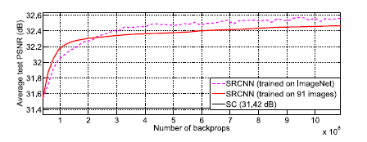
The test convergence curves of using different training sets are shown below
SRCNN+ImageNet achieves 32.52 dB, higher than 32.39 dB yielded by that trained on 91 images.
The results positively indicate that SRCNN performance may be further boosted using a larger training set(sometimes leads to high level vision problems).

Slide 14
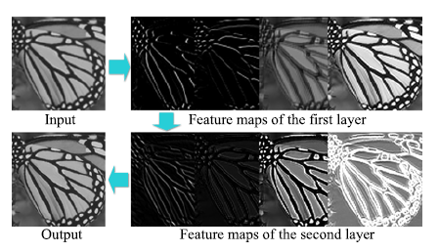
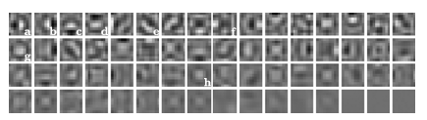
Learned filters for Super-Resolution
The figure (left) shows first-layer filters trained on ImageNet with an upscaling factor 3. The filters organized based on respective variances
Example feature maps of different layers are shown below(right). Obviously, feature maps of the first layer contain different structures (e.g., edges at different directions), while that of the second layer are mainly different on intensities.

Slide 15
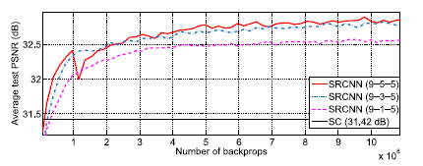
Model Performance and Tradeoffs
Filter number
Adding more filters improves the performance
Filter size
Larger filter size leads to better results
But deployment speed will decrease.
Number of layers
Deeper networks benefit but not always
When we go deeper (e.g., four or five layers), we find it hard to set appropriate learning rates that guarantee convergence.

Slide 16
Demo

Slide 17
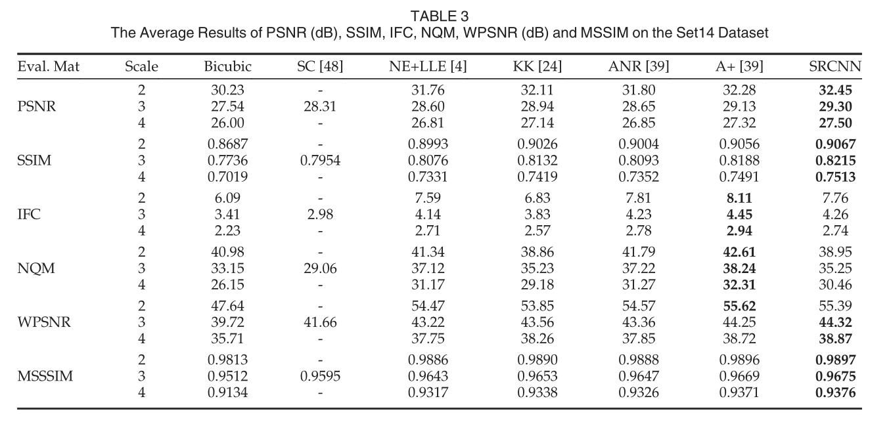
Comparison to state-of-the-arts
The proposed SRCNN yields the highest scores in most evaluation matrices in all experiments

Slide 18
Experiments on color channels
Super-resolution performance can be improved if we jointly consider all three channels in the process.
Y only: This is our baseline method, which is a single-channel (c = 1) network trained only on the luminance channel. The Cb, Cr channels are upscaled using bicubic interpolation.
YCbCr: Training is performed on the three channels of the YCbCr space.
Y pre-train: First, to guarantee the performance on the Y channel, we only use the MSE of the Y channel as the loss to pre-train the network. Then we employ the MSE of all channels to fine-tune the parameters.
CbCr pre-train: We use the MSE of the Cb, Cr channels as the loss to pre-train the network, then fine-tune the parameters on all channels.
RGB: Training is performed on the three channels of the RGB space.

Slide 19
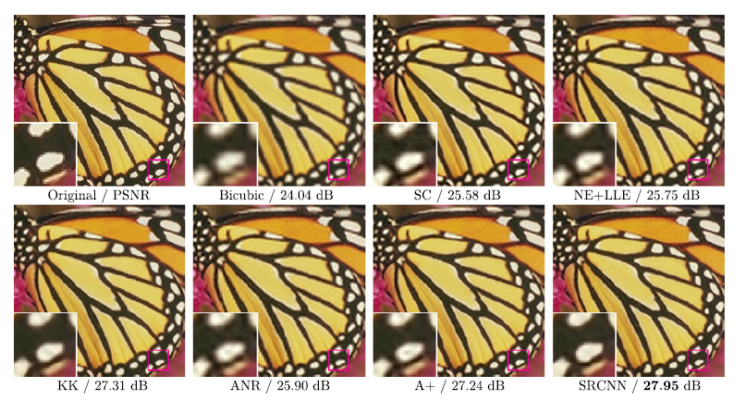
The “butterfly” image from Set5 with an upscaling factor 3.

Slide 20
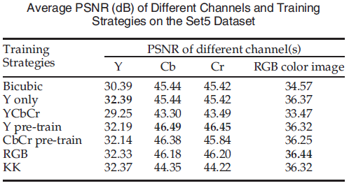
Results on color channels
Training on the YCbCr channels leads to worse results than that of bicubic interpolation.
Pre-training on the Y or Cb, Cr channels improves the performance finally, but is still not better than “Y only” on the color image.
Cb, Cr channels have higher PSNR values for “Y pre-train” than for “CbCr pretrain”.
Training on the RGB channels achieves the best result on the color image.

Slide 21
Conclusion
A deep learning approach for single image SR.
With a lightweight structure, the SRCNN has achieved superior performance than the state-of-the-art methods.
Additional performance can be further gained by exploring more filters and different training strategies.
Advantages of simplicity and robustness
Can be applied to other low-level vision problems like image deblurring or simultaneous SR+denoising.

Slide 22
THANK YOU

