Slide 1

Operating System
Chapter 11 I/O Management and Disk Scheduling

Slide 2
Chapter 11 I/O Management and Disk Scheduling
11.1 I/O Devices
11.2 Organization of the I/O Function
11.3 Operating System Design Issues
11.4 I/O Buffering
11.5 Disk Scheduling
11.6 RAID
11.7 Disk Cache
11.8 Summary

Slide 3
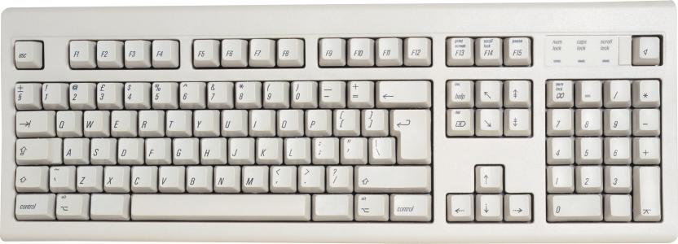
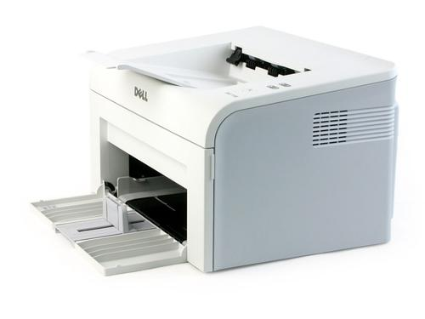
11.1 I/O Devices(1/6)
Categories of I/O Devices(I/O设备分类)
1. Human readable(人可读)
Used to communicate with the user
Printers
Video display terminals
Display
Keyboard
Mouse

Slide 4
11.1 I/O Devices(2/6)
Categories of I/O Devices
2. Machine readable(机器可读)
Used to communicate with electronic equipment
Disk drives
Sensors
Controllers
Tape drives
Actuators

Slide 5
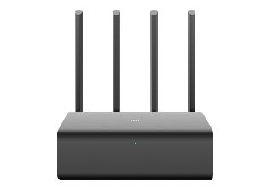
11.1 I/O Devices(3/6)
Categories of I/O Devices
3. Communication(通信)
Used to communicate with remote devices
Digital line drivers
Modems
Network device

Slide 6
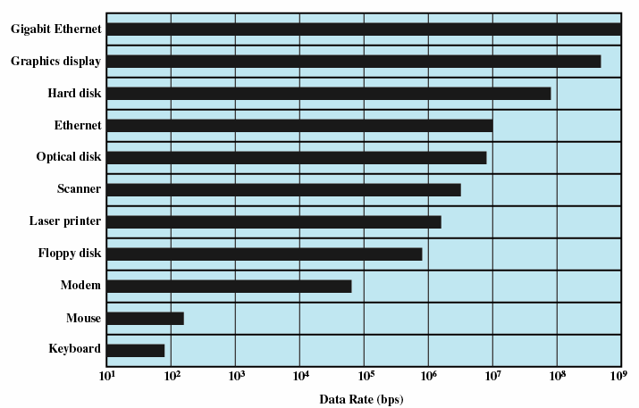
11.1 I/O Devices(4/6)
Differences in I/O Devices
1. Data rate：May be differences of several orders of magnitude(数量级) between the data transfer rates

Slide 7
11.1 I/O Devices(5/6)
Differences in I/O Devices
2. Application-specific
Disk used to store files requires file management software
Disk used to store virtual memory pages needs special hardware and software to support it
Terminal used by system administrator may have a higher priority
3. Complexity of control

Slide 8
11.1 I/O Devices(6/6)
Differences in I/O Devices
4. Unit of transfer
Data may be transferred as
a stream of bytes，e.g. terminal
in larger blocks, e.g. disk
5. Data representation
Encoding schemes
6. Error conditions
Devices respond to errors differently

Slide 9
Chapter 11 I/O Management and Disk Scheduling
11.1 I/O Devices
11.2 Organization of the I/O Function
11.3 Operating System Design Issues
11.4 I/O Buffering
11.5 Disk Scheduling
11.6 RAID
11.7 Disk Cache
11.8 Summary

Slide 10
11.2 Organization of the I/O Function
11.2.1 Techniques for Performing I/O
11.2.2 Evolution of the I/O Function
11.2.3 Direct Memory Access

Slide 11
11.2.1 Techniques for Performing I/O(1/4)
1. Programmed I/O(可编程I/O)
Programmed I/O happens when software running on the CPU uses instructions that access I/O address space to perform data transfers to or from an I/O device.
Each data item transfer is initiated by an instruction in the program.
In Programmed I/O processor executes a program that gives the direct control of I/O operation.
Process is busy-waiting for the operation to complete.

Slide 12
11.2.1 Techniques for Performing I/O(2/4)
2. Interrupt-driven I/O(中断驱动I/O)
I/O command is issued
Processor continues executing instructions
I/O module sends an interrupt when done
Asking for a input from the user would be an interrupt-driven I/O.
Notes:
PIO often uses an interrupt (from the device) to initiate each byte/word data transfer. This helps mitigate the CPU-intensive nature of PIO. A polled PIO transfer would otherwise totally consume CPU resources.

Slide 13
11.2.1 Techniques for Performing I/O(3/4)
3. Direct Memory Access (DMA,直接存储器访问)
DMA module controls exchange of data between main memory and the I/O device
Processor interrupted only after entire block has been transferred.
DMA's are mostly used when there is a demand of frequent transfer of big chunk of data.

Slide 14
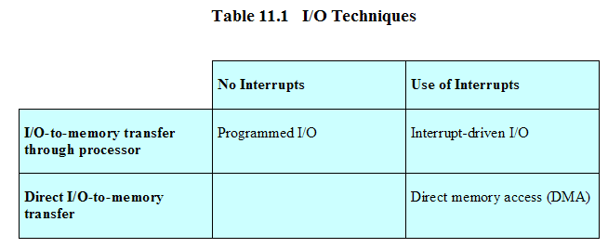
11.2.1 Techniques for Performing I/O(4/4)
Relationship Among Techniques

Slide 15
11.2 Organization of the I/O Function
11.2.1 Techniques for Performing I/O
11.2.2 Evolution of the I/O Function
11.2.3 Direct Memory Access

Slide 16
11.2.2 Evolution of the I/O Function(1/2)
1. Processor directly controls a peripheral device
Processor has to handle details of external devices
2. Controller or I/O module is added
Processor uses programmed I/O without interrupts
Processor does not need to handle details of external devices
3. Controller or I/O module with interrupts
Processor does not spend time waiting for an I/O operation to be performed

Slide 17
11.2.2 Evolution of the I/O Function(2/2)
4. Direct Memory Access
Blocks of data are moved into memory without involving the processor
Processor involved at beginning and end only
5. I/O channel
I/O module is to a separate processor
The central processing unit (CPU) directs the I/O processor to execute an I/O program in main memory.
6. I/O processor
I/O module is a processor with its own local memory
It's a computer in its own right

Slide 18
11.2 Organization of the I/O Function
11.2.1 Techniques for Performing I/O
11.2.2 Evolution of the I/O Function
11.2.3 Direct Memory Access

Slide 19
11.2.3 Direct Memory Access(1/6)
What is Direct Memory Access(直接存储器访问)?
Hardware mechanism that allows peripheral components to transfer their I/O data directly to and from main memory without the need to involve the system processor.
Why is Direct Memory Access important?
Use of this mechanism can greatly increase throughput to and from a device, because a great deal of computational overhead is eliminated

Slide 20
11.2.3 Direct Memory Access(2/6)
Hardware using DMA
disk drives, graphics cards, network cards, sound cards
What is the downside?
Hardware support is required – DMA controllers
DMA “steals” cycles (周期挪用) from the processor
The instruction cycle is suspended so data can be transferred o the system bus
The CPU pauses one bus cycle
No interrupts occur, does not need to save context
Synchronization mechanisms must be provided to avoid accessing non-updated information from RAM

Slide 21
11.2.3 Direct Memory Access(3/6)
Process of DMA

Slide 22
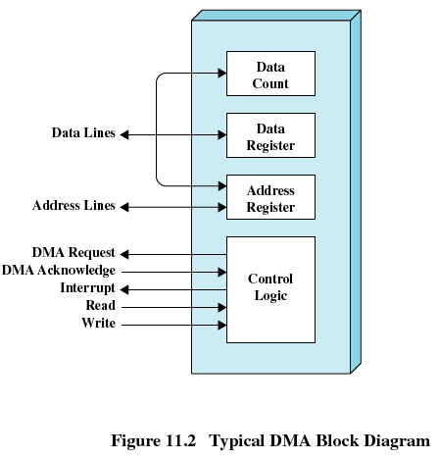
11.2.3 Direct Memory Access(4/6)
Typical DMA block diagram
Notes:
DMA既可以指内存和外设直接存取数据这种内存访问的计算机技术，又可以指实现该技术的硬件模块（对于通用计算机PC而言，DMA控制逻辑由CPU和DMA控制接口逻辑芯片共同组成，嵌入式系统的DMA控制器内建在处理器芯片内部，一般称为DMA控制器，DMAC）。
一般而言，DMA控制器将包括一条地址总线、一条数据总线和控制寄存器。高效率的DMA控制器将具有访问其所需要的任意资源的能力，而无须处理器本身的介入，它必须能产生中断。最后，它必须能在控制器内部计算出地址。

Slide 23
11.2.3 Direct Memory Access(5/6)
DMA Transfer

Slide 24
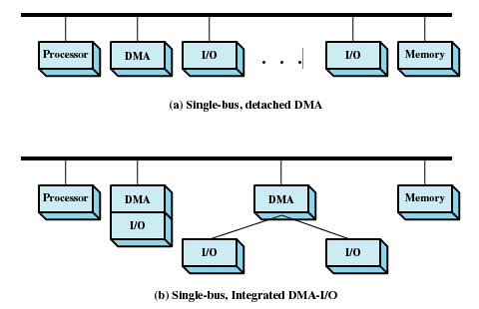
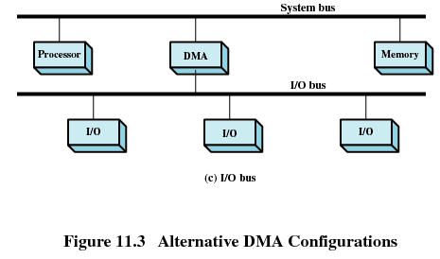
11.2.3 Direct Memory Access(6/6)
DMA Configurations

Slide 25
Chapter 11 I/O Management and Disk Scheduling
11.1 I/O Devices
11.2 Organization of the I/O Function
11.3 Operating System Design Issues
11.4 I/O Buffering
11.5 Disk Scheduling
11.6 RAID
11.7 Disk Cache
11.8 Summary

Slide 26
11.3 Operating System Design Issues
Efficiency and generality are most important objectives in designing the I/O facility

Slide 27
11.3 Operating System Design Issues
Efficiency (效率)
Most I/O devices extremely slow compared to main memory
Use of multiprogramming(多道程序) allows for some processes to be waiting on I/O while another process executes
I/O cannot keep up with processor speed
Swapping(交换) is used to bring in additional Ready processes which is an I/O operation
Optimise I/O efficiency – especially Disk & Network I/O

Slide 28
11.3 Operating System Design Issues
Generality (通用性)
Desirable to handle all I/O devices in a uniform manner(统一模式)
Both in the OS and in user applications
Hide most of the details of device I/O in lower-level routines so that processes and upper levels see devices in general terms such as read, write, open, close, lock, unlock

Slide 29
11.3 Operating System Design Issues

Slide 30
11.3 Operating System Design Issues
Layers of the I/O Software System

Slide 31
11.3 Operating System Design Issues
Layers of the I/O system and the main functions of each layer

Slide 32
11.3 Operating System Design Issues
Device-Independent I/O Software
Drivers use a defined interface to kernel services (e.g. kmalloc, install IRQ handler, etc.)
Allows kernel to evolve without breaking existing drivers
(a) Without a standard driver interface (b) With a standard driver interface

Slide 33
Chapter 11 I/O Management and Disk Scheduling
11.1 I/O Devices
11.2 Organization of the I/O Function
11.3 Operating System Design Issues
11.4 I/O Buffering
11.5 Disk Scheduling
11.6 RAID
11.7 Disk Cache
11.8 Summary

Slide 34
11.4 I/O Buffering
Reasons for buffering(缓存原因)
Processes must wait for I/O to complete before proceeding
Certain pages must remain in main memory during I/O
Define of I/O buffering
Performs input transfers in advance of requests being made and performs output transfers some time after the request is made(预输入，缓输出)

Slide 35
11.4 I/O Buffering
Block-oriented(面向块)
Information is stored in fixed sized blocks
Transfers are made a block at a time
Used for disks and tapes
Stream-oriented(面向流)
Transfers information as a stream of bytes
Used for terminals, printers, communication ports, mouse and other pointing devices, and most other devices that are not secondary storage

Slide 36
11.4 I/O Buffering
Single Buffer(单缓冲)
Operating system assigns one buffer in the system space for an I/O request
Block-oriented single buffering
Input transfers are made to buffer
Block is moved to user space when needed
Another block is requested immediately
Read ahead(预读), or anticipated input(预输入)

Slide 37
11.4 I/O Buffering
Block-oriented single buffer
Advantages
User process can process one block of data while next block is read in
Swapping can occur since input is taking place in system memory, not user memory
Disadvantages
Operating system keeps track of assignment of system buffers to user processes
The swapping logic is affected

Slide 38
11.4 I/O Buffering
Stream-oriented single buffer
Line-at-a-time fashion
Input from or output to a terminal is one line at a time with carriage return signaling the end of the line
Bye-at-a-time fashion
Input and Output follow the producer/consumer model

Slide 39
11.4 I/O Buffering
Single Buffer
Computation and transfer can be done in parallel
Speed up with buffering:
Assume
T is transfer time for a block from device
C is computation time to process incoming block
M is time to copy kernel buffer to user buffer

Slide 40
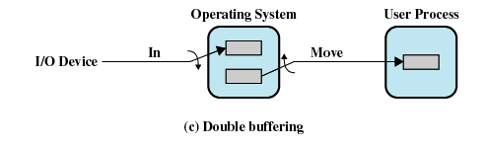
11.4 I/O Buffering
Double Buffer(双缓冲)
Use two system buffers instead of one
Computation and Memory copy can be done in parallel with transfer
Speed up with double buffering：
Usually M is much less than T giving a favourable result

Slide 41
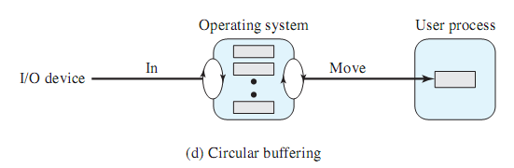
11.4 I/O Buffering
Circular Buffer(循环缓冲)
More than two buffers are used
Each individual buffer is one unit in a circular buffer
Used when I/O operation must keep up with process

Slide 42
Chapter 11 I/O Management and Disk Scheduling
11.1 I/O Devices
11.2 Organization of the I/O Function
11.3 Operating System Design Issues
11.4 I/O Buffering
11.5 Disk Scheduling
11.6 RAID
11.7 Disk Cache
11.8 Summary

Slide 43
11.5 Disk Scheduling
11.5.1 Disk Performance Parameters
11.5.2 Disk Scheduling Policies

Slide 44
11.5.1 Disk Performance Parameters(1/6)
To read or write, the disk head must be positioned at the desired track(磁道) and at the beginning of the desired sector(扇区)

Slide 45
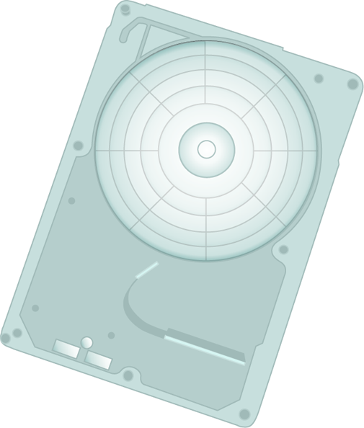
11.5.1 Disk Performance Parameters(2/6)
Seek time (寻道时间)
Time it takes to position the head(磁头) at the desired track
Notes:
Seek times describes the time it takes to position the read/write heads radially across the platter. The following specifications are often published: Full Stroke - the time it takes to move across the entire width of the disk, from the innermost track to the outermost. Average – the average time it takes to move from one random track to another (normally listed as the time for one-third of a full stroke). Track-to-Track – the time it takes to move between adjacent tracks.
Each of these specifications is measured in milliseconds (ms).

Slide 46
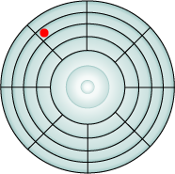
11.5.1 Disk Performance Parameters(3/6)
Rotational delay
Time its takes for the beginning of the sector to reach the head.
Rotational latency is dependent upon the rotation speed of the spindle 、
measured in milliseconds (ms)
Notes:
The actuator moves the read/write head over the platter to a particular track, while the platter spins to position the a particular sector under the read write head.
Rotational latency is the time that it takes the platter to rotate and position the data under the read/write head.
Rotational latency is dependent upon the rotation speed of the spindle and is measured in milliseconds (ms)
The average rotational latency is one-half of the time taken for a full rotation.
Like seek times, rotational latency has more of an impact on reads or writes of random sectors on the disk than on the same operations on adjacent sectors.
Instructor note: rotational latency is around 5.5 ms for a 5,400 rpm drive, and around 2.0 ms for a 15,000 rpm drive.

Slide 47
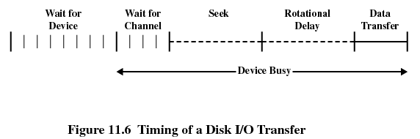
11.5.1 Disk Performance Parameters(4/6)
Timing of a Disk I/O Transfer

Slide 48

11.5.1 Disk Performance Parameters(5/6)
Access time(存取时间)
The time it takes to get in position to read or write
Sum of seek time (T_{s}) and rotational delay (1/2r)
Transfer time(传输时间, b/(rN) )
Data transfer occurs as the sector moves under the head
Thus the total average access time can be expressed as:
Ta：总平均存取时间, total average access time
Ts：平均寻道时间, aversage seeking time
r：旋转速度，转/秒, $ rotation speed, in revolutions per second
b：要传送字节数,number of bytes to be transferred
N：一个磁道的字节数, number of bytes on a track

Slide 49
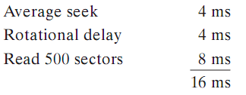
11.5.1 Disk Performance Parameters(6/6)
Sequential access:
Total time = 16+(4x12)=64ms
Random access
Total time = 2500 * 8.016 = 20,040 ms
5 adjacent tracks, 500 sectors/track, total 2500 sectors
It is clear that the order in which sectors are read from the disk has a tremendous effect on I/O performance.

Slide 50
11.5 Disk Scheduling
11.5.1 Disk Performance Parameters
11.5.2 Disk Scheduling Policies

Slide 51
11.5.2 Disk Scheduling Policies(1/10)
Seek time and rotational delay are the reasons for differences in performance
The key to increase performance of disk is to minimize seek time
Random scheduling
For a single disk there will be a number of I/O requests
It gives poor performance
Used to evaluate other techniques

Slide 52
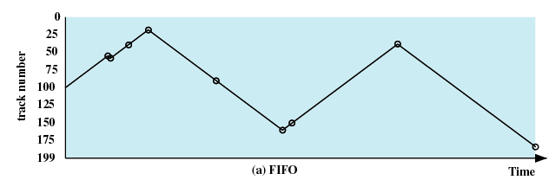
11.5.2 Disk Scheduling Policies(2/10)
First-in, first-out (FIFO)
Process request sequentially
Fair to all processes
Approaches random scheduling in performance if there are many processes
55、58、39、18、90、160、150、38、184

Slide 53
11.5.2 Disk Scheduling Policies(3/10)
Priority(PRI 优先级)
Not intended to optimize disk utilization but to meet other objectives
Short batch jobs may have higher priority
Provide good interactive response time
This type of policy tends to be poor for database systems.

Slide 54
11.5.2 Disk Scheduling Policies(4/10)
Last-in, first-out (LIFO)
Good for transaction processing systems
The device is given to the most recent user so there should be little arm movement
Possibility of starvation since a job may never regain the head of the line

Slide 55
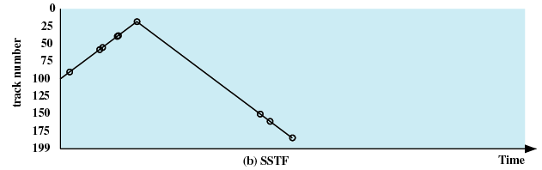
11.5.2 Disk Scheduling Policies(5/10)
Shortest Service Time First (SSTF)
Select the disk I/O request that requires the least movement of the disk arm from its current position
Always choose the minimum Seek time
55、58、39、18、90、160、150、38、184

Slide 56
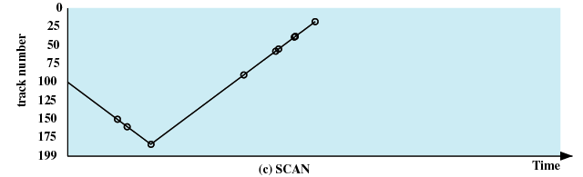
11.5.2 Disk Scheduling Policies(6/10)
SCAN
Arm moves in one direction only, satisfying all outstanding requests until it reaches the last track in that direction
Direction is reversed
55、58、39、18、90、160、150、38、184

Slide 57
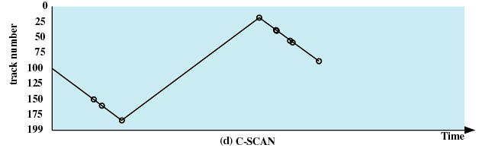
11.5.2 Disk Scheduling Policies(7/10)
C-SCAN (circular SCAN)
Restricts scanning to one direction only
When the last track has been visited in one direction, the arm is returned to the opposite end of the disk and the scan begins again
55、58、39、18、90、160、150、38、184

Slide 58
11.5.2 Disk Scheduling Policies(8/10)
N-step-SCAN
Segments the disk request queue into subqueues of length N
Subqueues are processed one at a time, using SCAN
New requests added to other queue when queue is processed
FSCAN
Two queues
One queue is empty for new requests

Slide 59
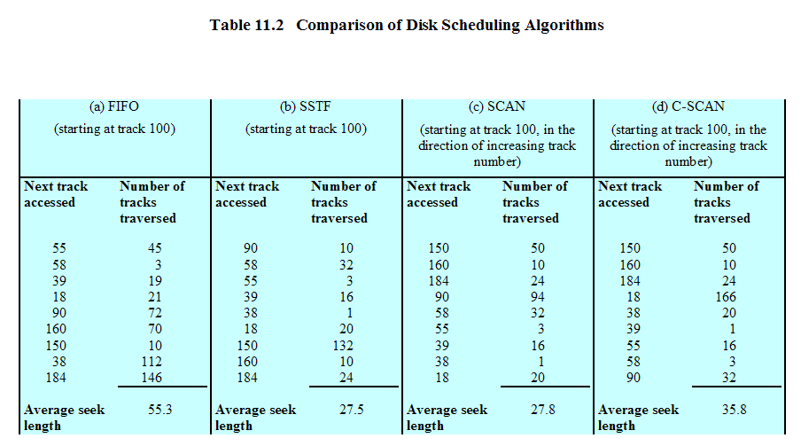
11.5.2 Disk Scheduling Policies(9/10)

Slide 60
11.5.2 Disk Scheduling Policies(10/10)

Slide 61
Chapter 11 I/O Management and Disk Scheduling
11.1 I/O Devices
11.2 Organization of the I/O Function
11.3 Operating System Design Issues
11.4 I/O Buffering
11.5 Disk Scheduling
11.6 RAID
11.7 Disk Cache
11.8 Summary

Slide 62
11.6 RAID(1/5)
Redundant Array of Independent Disks (独立冗余磁盘阵列) or Redundant Array of Inexpensive (廉价冗余磁盘整列)
Set of physical disk drives viewed by the operating system as a single logical drive
Redundancy is used to improve reliability.
The RAID scheme consists of seven levels, zero through six.
Notes:
组成磁盘阵列的不同方式称为RAID Level

Slide 63
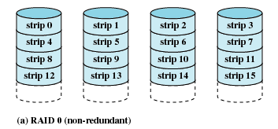
11.6 RAID(2/5)
RAID 0 (non-redundant)
The data are striped across the available disks
RAID 0 splits data evenly across two or more disks, without parity information, redundancy, or fault tolerance.
High data transfer capacity

Slide 64
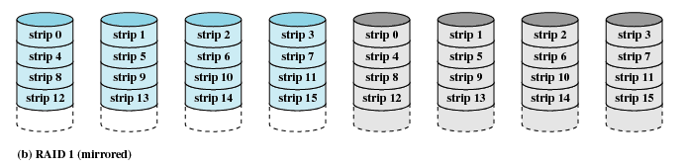
11.6 RAID(3/5)
RAID 1 (mirrored 磁盘镜像)
RAID 1 consists of an exact copy of a set of data on two or more disks.
This means that when you write a file, the file is actually written to two disks. If one of the disks fails, you simply replace it and rebuild the mirror.
The tradeoff with RAID 1 is cost.

Slide 65
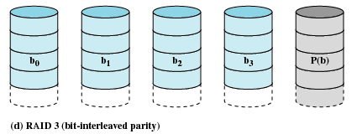
11.6 RAID(4/5)
RAID 3 (bit-interleaved parity)
rarely used in practice
consists of byte-level striping with a dedicated parity disk（专有校验磁盘）.
Notes:
One of the characteristics of RAID 3 is that it generally cannot service multiple requests simultaneously, which happens because any single block of data will, by definition, be spread across all members of the set and will reside in the same physical location on each disk.
Therefore, any I/O operation requires activity on every disk and usually requires synchronized spindles.

Slide 66
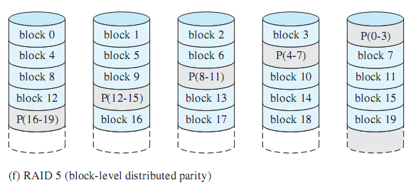
11.6 RAID(5/5)
RAID 5
A standard RAID level configuration that uses block-level data striping and distributes parity to all the disks.
It is currently one of the most commonly used RAID methods.

Slide 67
Chapter 11 I/O Management and Disk Scheduling
11.1 I/O Devices
11.2 Organization of the I/O Function
11.3 Operating System Design Issues
11.4 I/O Buffering
11.5 Disk Scheduling
11.6 RAID
11.7 Disk Cache
11.8 Summary

Slide 68
11.7 Disk Cache(1/3)
Buffer in main memory for disk sectors
Contains a copy of some of the sectors on the disk
Two design issues:
Method to transfer the block of data from the disk cache to memory assigned to the user process(缓存数据与用户空间交换)
Data move
Pointer passing
The replacement strategy(置换策略) when the disk cache is full for store new data

Slide 69
11.7 Disk Cache(2/3)
Replacement Strategy 1: Least Recently Used (最近最少使用)
The block that has been in the cache the longest with no reference to it is replaced
The cache consists of a stack of blocks
Most recently referenced block is on the top of the stack
When a block is referenced or brought into the cache, it is placed on the top of the stack
The block on the bottom of the stack is removed when a new block is brought in
Blocks don't actually move around in main memory，A stack of pointers is used

Slide 70
11.7 Disk Cache(3/3)
Replacement Strategy 2: Least Frequently Used (最不常用)
The block that has experienced the fewest references is replaced
A counter is associated with each block
Counter is incremented each time block accessed
Block with smallest count is selected for replacement

Slide 71
Chapter 11 I/O Management and Disk Scheduling
11.1 I/O Devices
11.2 Organization of the I/O Function
11.3 Operating System Design Issues
11.4 I/O Buffering
11.5 Disk Scheduling
11.6 RAID
11.7 Disk Cache
11.8 Summary

Slide 72
Question #1：课堂1题
There is sequence of disk track requests:96 58 82 36 168 130 150 25 184.
Assume that the disk head
is initially positioned over track 100
and is moving in the direction of increasing track number.
Question: For FIFO/SSTF/SCAN/C-SCAN
What is the tracking order?
What is Average Track Length?

Slide 73
Assignment: 课后两题
Question #1：课后习题11.3
Question #2：There is sequence of disk track requests:75 62 99 144 50 162 110 26 198.
Assume that the disk head
is initially positioned over track 100
and is moving in the direction of decreasing track number.
For FIFO/SSTF/SCAN/C-SCAN
What is the tracking order?
What is Average Track Length?

