Slide 1
BCA CAPSTONE PROJECT (Review I) Community App
Submitted to the Presidency University, Bengaluru in partial fulfillment for the award of the degree of Bachelor of Computer Applications(BCA)
Project Team No : 78
Under the supervision of
Mr.Sakthi S Assistant Professor, School Of Computer Science And Engineering
Name | Roll Number
Rishita | 20231BCD0058
Keneilhounuo Sanchu | 20231BCD0013
Aswin PV | 20231BCD0003
Ghan Shyam Pal | 20231BCD0052

Slide 2
Content
Problem Statement
Literature Survey
Tools and Technologies to be used
Timeline of the Project
References
Conclusion & Github Link

Slide 3
Problem Statement
In this generation there is a community app but its not easy to use , clustered and unorganized.
Existing community app make it hard to use it.
A reliable, mobile app named VASKPARG can bridge this gap by making it more simplified and organized and people can use it easily.
Objective: Develop a mobile app that provides people to interact in a centralized space .
Proposed Solution: App develops better easy communication.
Expected Outcome: Improves communication , sharing content , event coordination and collaboration.

Slide 4
Literature Review
Paper name | Author(s) | Year | Methodology | Advantages | Disadvantages
Uncovering Latent Social Communities in Software Development | Damian A. Tamburri Patricia, LagoHans van Vliet | 2022 | The study uses a decision tree to uncover latent social communities in software development, analyzing and validating findings through a multisite case study. | Comprehensive Overview , Formal Modeling , Real-World Application , | ComplexityUser, FatigueLimited , User Control , Security Risks
Virtual Community Support Officers: Community Policing in the Digital Space | Christopher J., HeadleandJulian Free ,Sam Farndale , Matthew Hall | 2021 | The study proposes Virtual Police Community Support Officers (VPCSOs), analyzing community-driven policing and digital spaces to enhance online law enforcement. | Increased Accessibility,Cost-Effective,Anonymity for Reporting | Limited Physical Presence , Cybersecurity Risks, Digital Divide Trust Issues

Slide 5
Literature Review (Cont)
Paper name | Author(s) | Year | Methodology | Advantages | Disadvantages
Towards Understanding iOS App Store Search Advertising | Siming Su, Haoyu Wang, Guoai Xu | 2021 | The study examines ASA adoption, keyword trends, and app competition, finding low usage (7.5%) and strong competition through branded and shared keywords. | Increased App Visibility ,Targeted Advertising,Higher Conversion Rates Data | High Cost Per Acquisition, Limited Organic Growth, Algorithm Dependency,Ad Fraud Risks
Design and Implementation of Intelligent Community Management System | Ning Wang1 , Yuan Long1 | 2023 | The study developed an intelligent community management system using PHPStudy and MySQL, tested via white-box debugging and user feedback for efficiency. | Improved efficiency, Cost reduction, User friendly, Comprehensive services, | Tech barrier Security risks Implementation hurdles System downtime

Slide 6
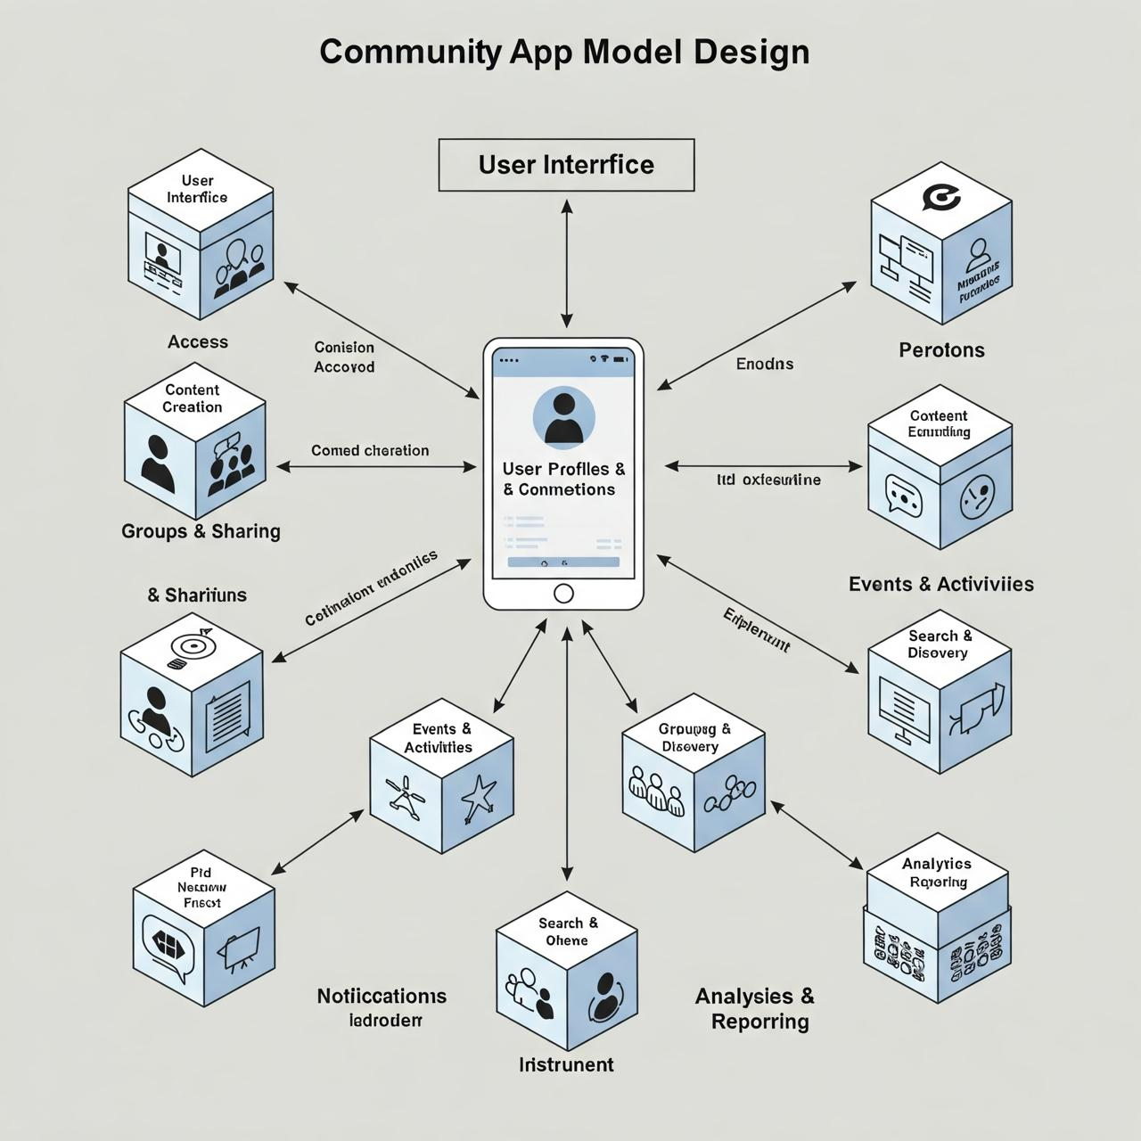
Module Visual Design

Slide 7
Module Design
User Management Module :
In this we have user authentication through sign up , login and permissions and having user profile (their interests,hobbies,bio etc).
Community & Groups Module:
It will have create/join/leave groups.
It will have group categories and tags
Admin controls (approving members, setting rules) for the app
Post & Content Management Module:
It will have Text, images, videos, polls, and events which will be in the app.
Comments, likes, and shares it will control the post

Slide 8
Module Design(Cont)
Chat & Messaging Module
One-on-one and group messaging
Real time notifications
Media sharing in chats
Events & Activities Module
Create schedule and manage events
RSVP and event reminders
Event discussion and update
Notifications & Alerts Module
Push notifications for mentions, messages, and updates
Customisable notification setting

Slide 9
Module Design(Cont)
Moderation & Reporting Module
Report inappropriate content/users
Automated moderation with AI filters
Manual review tools for admins
Monetization & Subscription Module
Membership tiers & subscriptions
Donations and crowdfunding
Marketplace for community-related sales
Analytics & Insights Module
User engagement stats
Community growth tracking
Admin dashboard for insights

Slide 10
Module Design(Cont)
1. User Management Module
Handles user authentication, profiles, and role-based permissions for seamless access control.
Purpose: Manages user authentication, profiles, and access control. Key Feature: Sign-up/login, social authentication, role-based permissions.
Importance: Ensures secure access and personalized user experiences.
2. Community & Groups Module
Allows users to create, join, and manage groups with category-based organization and admin controls.
Purpose: Enables users to create and manage groups for discussions and collaboration. Key Feature: Group creation, joining, admin controls, and category-based organization
Importance: Encourages niche-based interactions and user engagement.
.

Slide 11
Module Design(Cont)
3. Post & Content Management Module
Supports posting text, media, and polls while enabling interactions like comments, likes, and shares.
Purpose: Allows users to share content and interact within the community. Key Feature: Supports text, images, videos, polls, likes, comments, and sharing.
Importance: Drives engagement and fosters community discussions.
4. Chat & Messaging Module
Facilitates real-time one-on-one and group messaging with media sharing and notifications.
Purpose: Facilitates real-time communication among users. Key Feature: One-on-one and group chats with media sharing and notifications.
Importance: Enables seamless and instant user interactions.

Slide 12
Module Design(Cont)
5. Events & Activities Module
Enables users to create, schedule, and RSVP for events with built-in reminders and discussions.
Purpose: Helps users create, manage, and participate in events. Key Feature: Event scheduling, RSVP system, and reminders.
Importance: Enables seamless and instant user interactions.
6. Notifications & Alerts Module
Sends real-time push notifications for mentions, messages, and important updates with user preferences.
Purpose: Keeps users informed about updates and interactions. Key Feature: Push notifications, in-app alerts, and custom settings.
Importance: Ensures users stay informed and engaged.

Slide 13
Module Design(Cont)
7. Moderation & Reporting Module
Provides tools for reporting inappropriate content, AI-based moderation, and admin review systems.
Purpose: Ensures a safe and respectful community environment. Key Feature: Content reporting, AI moderation, and admin review
Importance: Maintains a positive and respectful community space.
8. Monetization & Subscription Module
Supports paid memberships, donations, and marketplace transactions to generate revenue.
Purpose: Enables revenue generation through memberships and transactions. Key Feature: Paid tiers, donations, and marketplace integration.
Importance: Supports platform sustainability and growth.

Slide 14
Tools And Technologies To Be Used
- Development Tools: Visual Studio, React Native, Android Studio
- Programming Languages: Python, Java, PHP,
- Frameworks/Libraries: React.js, Django, Firebase
- Database: MySQL, Firebase
- Version Control: Git, Github
- Additional Tools: Google Maps API, Notification API

Slide 15
GITHUB LINK
https://github.com/Vaskparg

Slide 16
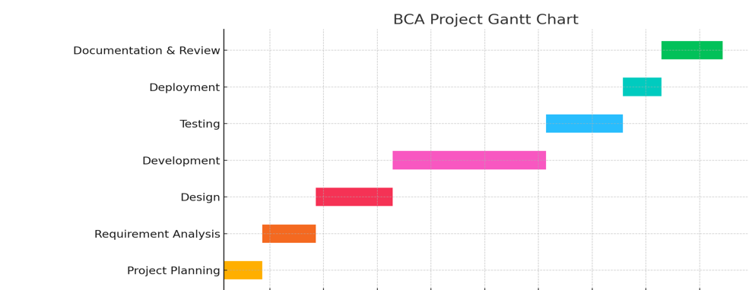
Timeline of the Project (Gantt Chart)
10-Feb-2025
25-Mar -2025
25-Mar to 22-Apr-2025
28-Feb-2025
5-May-2025
25-Mar-2025
22-Apr-2025

Slide 17
References
Christopher J. Headleand , Julian Free , Sam Farndale , Matthew Hall : Year : 2021, Name of the paper - Virtual Community Support Officers: Community Policing in the Digital Space , About : Increased Accessibility, Cost-Effective, Anonymity for Reporting, Faster Response , Data-Driven Policing .
Damian A. Tamburri ,Patricia LagoHans van Vliet , Year : 2024 , Name of the paper : Uncovering Latent Social Communities in Software Development . About : Increased Accessibility, Cost-Effective, Anonymity for Reporting ,Faster Response , Data-Driven Policing.

Slide 18
References (Cont)
3. Ning Wang, Yuan Long1,Xingmei Xu 2,Hong wei 1,Jiaqi li , Year : 2023 , Name of the paper : Design and implementation of intelligent community and management system . About : The purpose of intelligent community is to provide better, efficient and convenient intelligent services for community residents.
4. Siming Su , Haoyu Wang , Guoai Xu , Year :2021 , Name of the paper : Towards Understanding your IOS App Store Search Advertisement. About : This paper explores the mechanics of iOS App Store search advertising, analyzing its effectiveness, targeting strategies, and impact on app visibility

Slide 19


