Slide 1
BCA CAPSTONE PROJECT (Review II) TITLE OF THE PROJECT
Submitted to the Presidency University, Bengaluru in partial fulfillment for the award of the degree of Bachelor of Computer Applications(BCA)
Project Team No :
Under the supervision of
Mr. Sakthi S Assistant Professor Schhol of Computer Science and Engineering
Name | Roll Number
Aswin P V | 20231BCD0003
Keneilhounuo Sanchu | 20231BCD0013
Ghan shyam | 20231BCD0052
Rishita Kumari | 20231BCD0058

Slide 2
Content
Project Overview
Modular design
Timeline of the Project
Progress Update & Github Link
Team Member Contributions

Slide 3
Project Overview
Restate the Project Goal/Problem:
Many existing community apps are cluttered and hard to use.
This creates barriers to effective communication and engagement.
VASKPARG aims to solve this by offering a simple, organized, and user-friendly platform
Review the Scope:
The project aims to develop a user-friendly mobile app for community interaction.
It will focus on communication, content sharing, and event coordination.
The scope is limited to core features needed for effective and organized engagement

Slide 4
Module Design
Modular Breakdown
Module 1 User Authentication (Login & Sign-Up)
Functionality: Enables users to securely register and access the app. Includes features like sign-up, login, password recovery, and user session management.
Importance : Ensure secure access and personalized user experience.
Status: Completed

Slide 5
Module 2: Community Feed & Content Sharing
Functionality : The community feed in apps displays real-time updates like posts, announcements, and shared content from members, enabling interaction via likes, comments, and shares. It supports multimedia uploads and personalized content filtering to enhance user engagement.
Importance : The feed fosters community engagement by providing a dynamic space for sharing ideas and updates.
Status: In Progress

Slide 6
Module 3 Event Coordination
Functionality: Event coordination in community apps streamlines organizing, promoting, and managing events like meetups or webinars. Features include registration, attendee tracking, push notifications, and communication tools to boost engagement.
Importance: Allows users to create, manage, and join community events. Enhances engagement and streamlines event planning.
Status: ⏳ Yet to Start

Slide 7
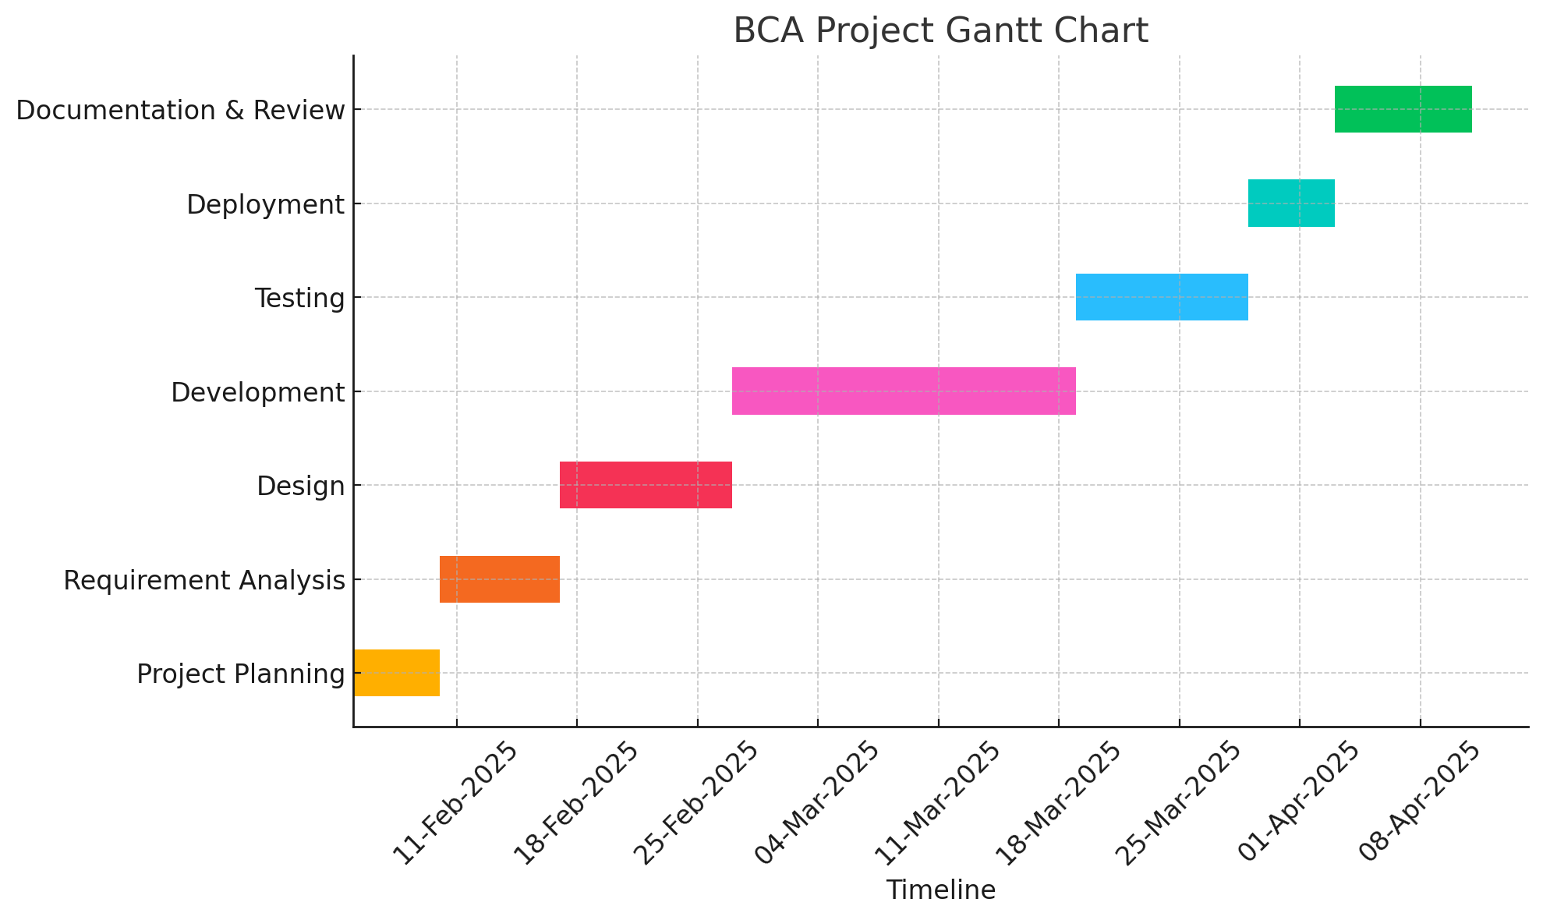
Timeline of the Project (Gantt Chart)

Slide 8
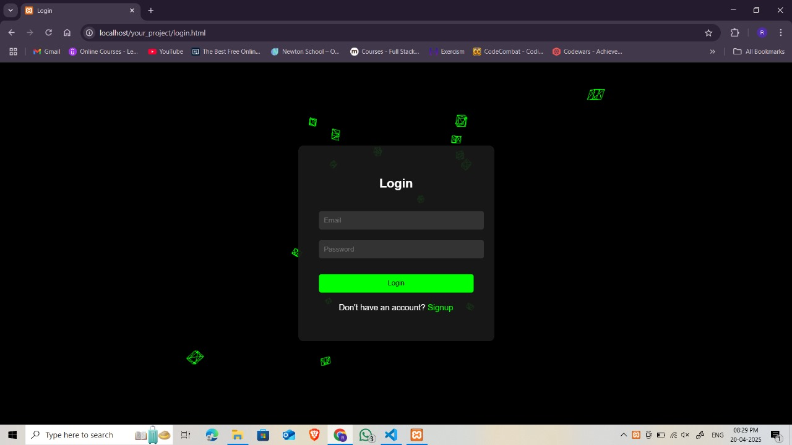
Progress Update

Slide 9
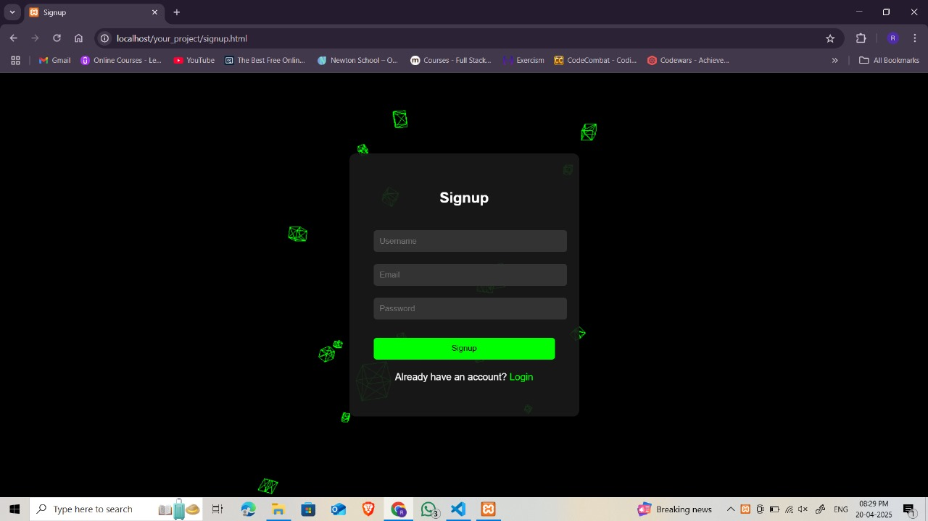
Progress Update(cont)

Slide 10
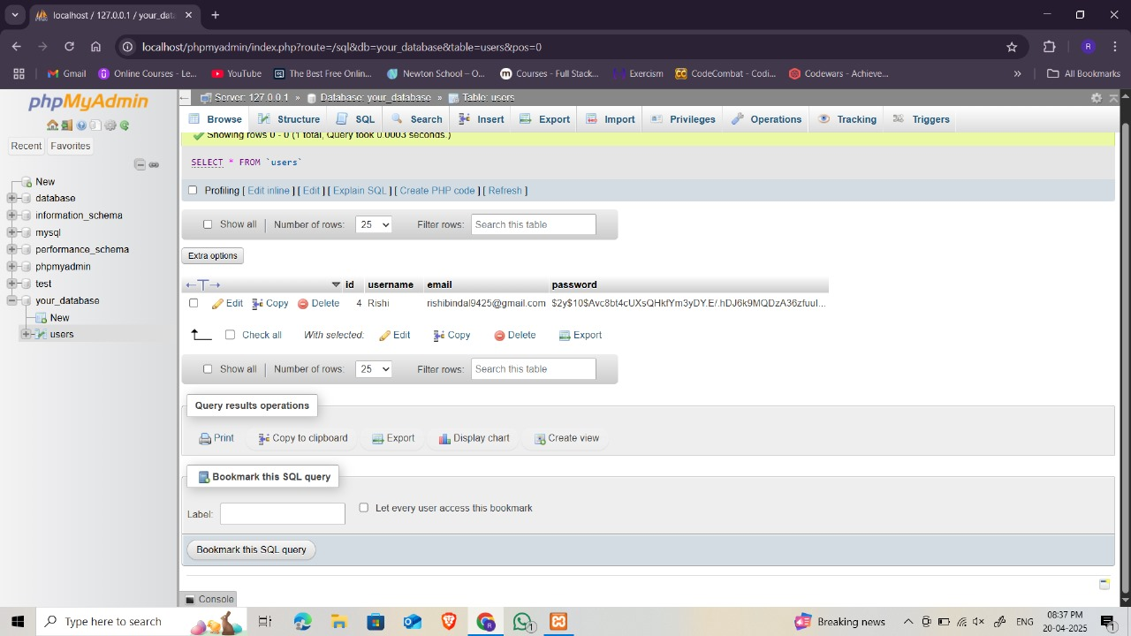
Progress Update (cont)

Slide 11
Team Member Contributions
Team Member | Contribution
Rishita Kumari | Frontend of the project
Ghan Shyam | Backend of the project
Keneilhounuo Sanchu | Data Base of the project
Aswin P V | Testing and Integration

Slide 12


