Slide 1
Multilingual NLP – Project Presentation
Cross-lingual transfer via fully fine-tuning and BitFit

Slide 2
Code Presentation - Datasets
Base training/validation datasets
  WikiAnn (en)
  Conll2003
Test datasets:
  WikiAnn/Conll2003
  Masakhaner → training/validation/test merged to one big test set
Preprocessing:
  SAME → B_x, B_x, ..
  IGNORE → B_x, -, ..
  INSIDE → B_x, I_x

Slide 3
Code Presentation - Datasets
Dataloaders
  Training → shuffling, simple one
  Validation → no shuffling, simple one
  Test → no shuffling, combined one (forced to use sequential)

Slide 4
Code Presentation - Model
Model:
  Xml-roberta-base w/o pooling layers
  Single dense layer (d → number of NER tags)
BitFit modification
  Set “requires_grad” respectively for each parameter
    Bias = True
    Else = False
  Only pass relevant parameters to optimizer
    → AdamW influences parameters too

Slide 5
Code Presentation - Run
Different configurations
  Preprocessing
    Same
    Inside
    Ignore
  Batch size
    16
    32
    64
  Base dataset
    WikiAnn (en)
    Conll2003

Slide 6
Code Presentation - Details
GPU is assumed to be available
Flag “save_dir”
  Set save directory of runs and checkpoints
  (1.1GB BitFit / 3.3GB Fully)
Uses .env
  “CACHE_DIR” to set directory of huggingface cache
Saving and reloading preprocessed datasets to/from disk
  Due to certain issues in hf caching mechanisms
36(-3) runs in total
  Plotted results via matplotlib + wandb api

Slide 7
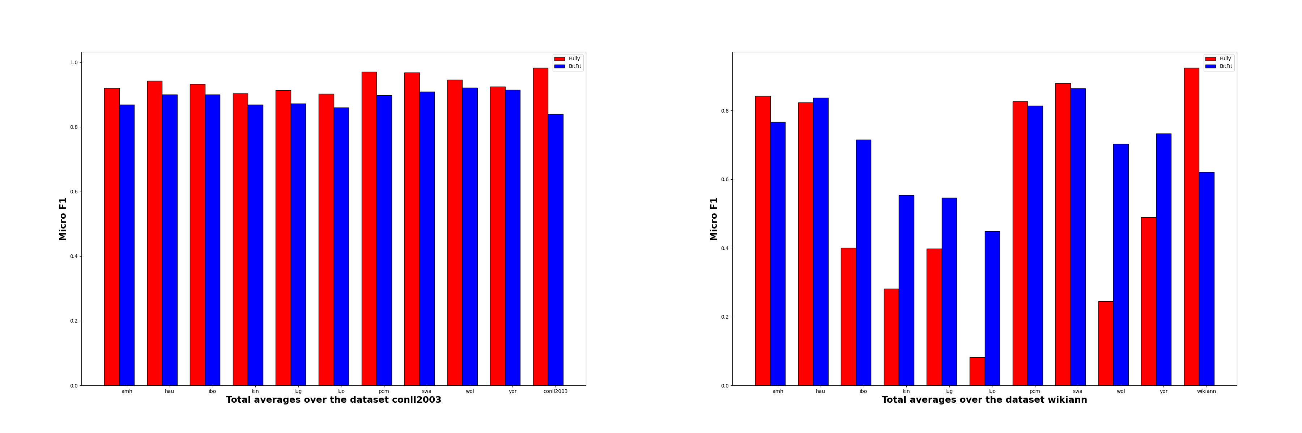
Code Presentation - Results
Datasets

Slide 8
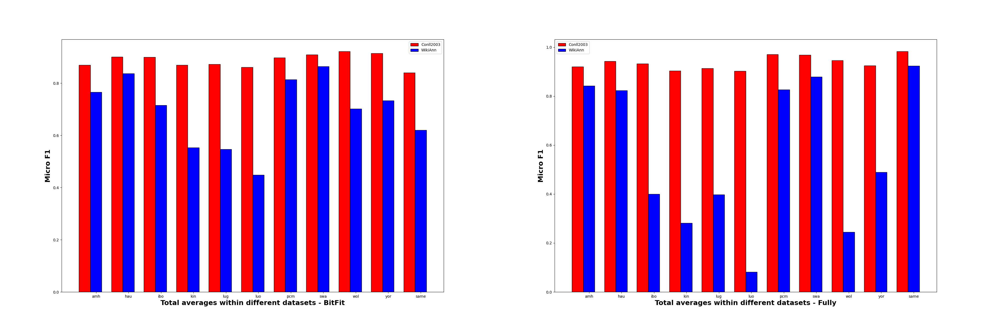
Code Presentation - Results
Datasets

Slide 9
Code Presentation - Results
Datasets
  Fully adapts better to base dataset
  Conll2003 > WikiAnn !!!
    Huge drop in performance
  Conll2003 → Fully, WikiAnn → BitFit

Slide 10
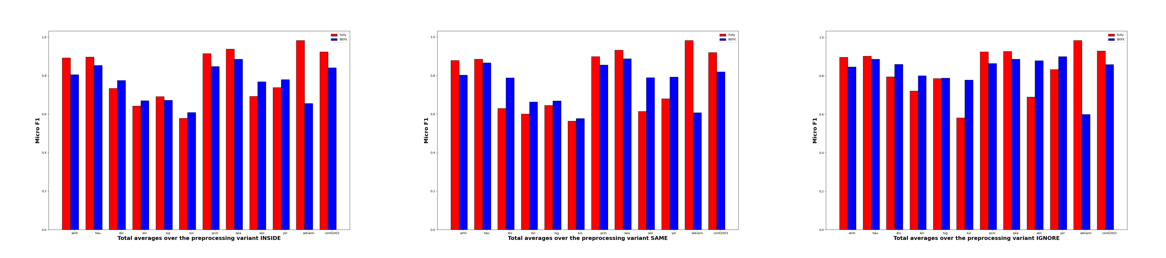
Code Presentation - Results
Preprocessing

Slide 11
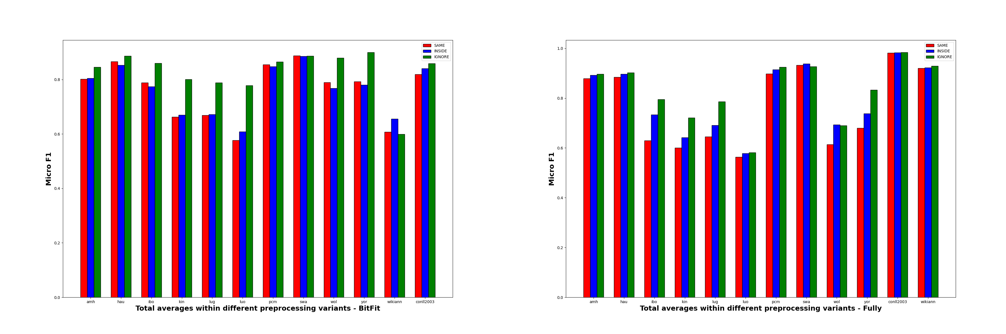
Code Presentation - Results
Preprocessing

Slide 12
Code Presentation - Results
Preprocessing:
  “Smaller” changes in performance
  Ignore >> Inside > Same
    Might be due to bias to non entities

Slide 13
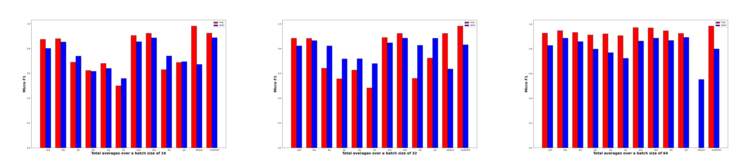
Code Presentation - Results
Batches

Slide 14
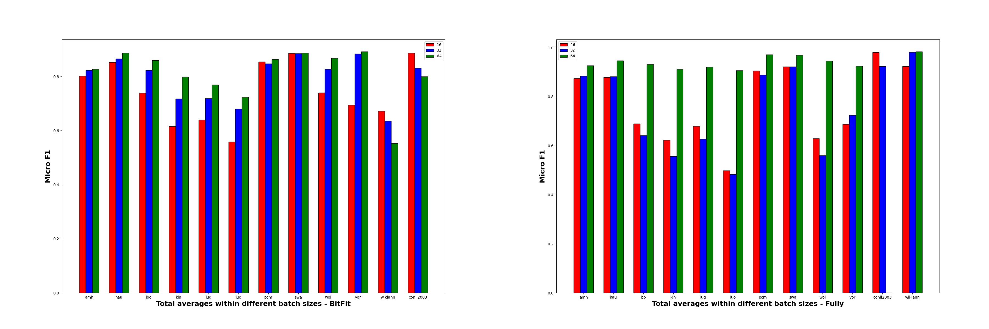
Code Presentation - Results
Batches

Slide 15
Code Presentation - Results
Batches
  64 for WikiAnn not available (16GB VRAM were not enough)
    Skewed plots
  BitFit:
    64 > 32 > 16
  Fully:
    Indications of 16 > 32 > 64

Slide 16
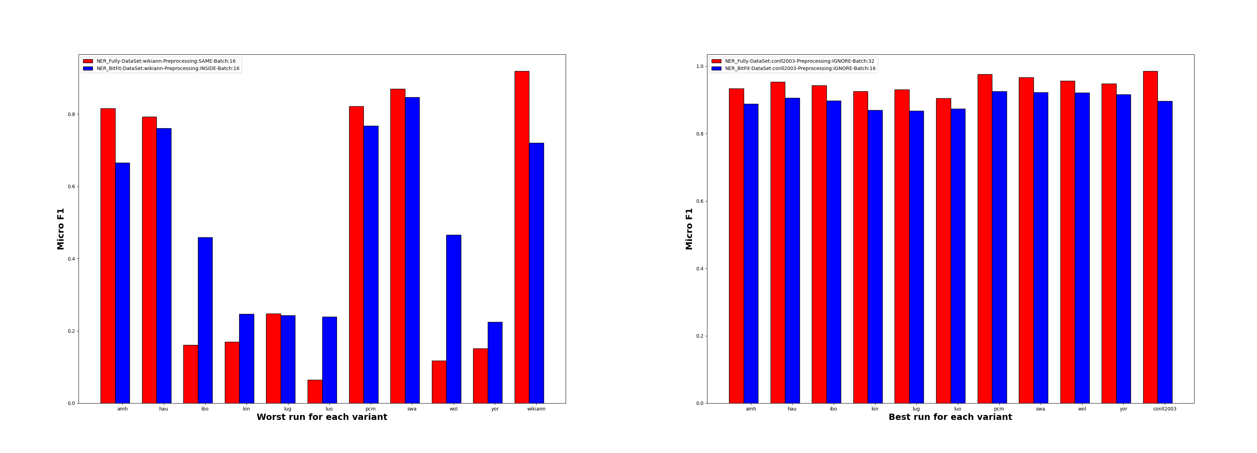
Code Presentation - Results
Best and Worst

Slide 17
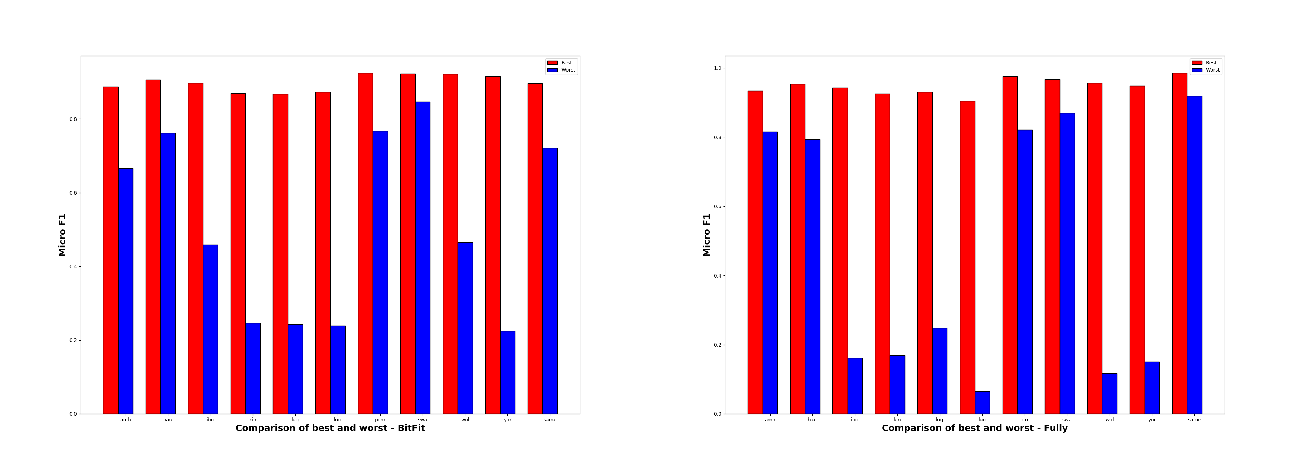
Code Presentation - Results
Best and Worst

Slide 18
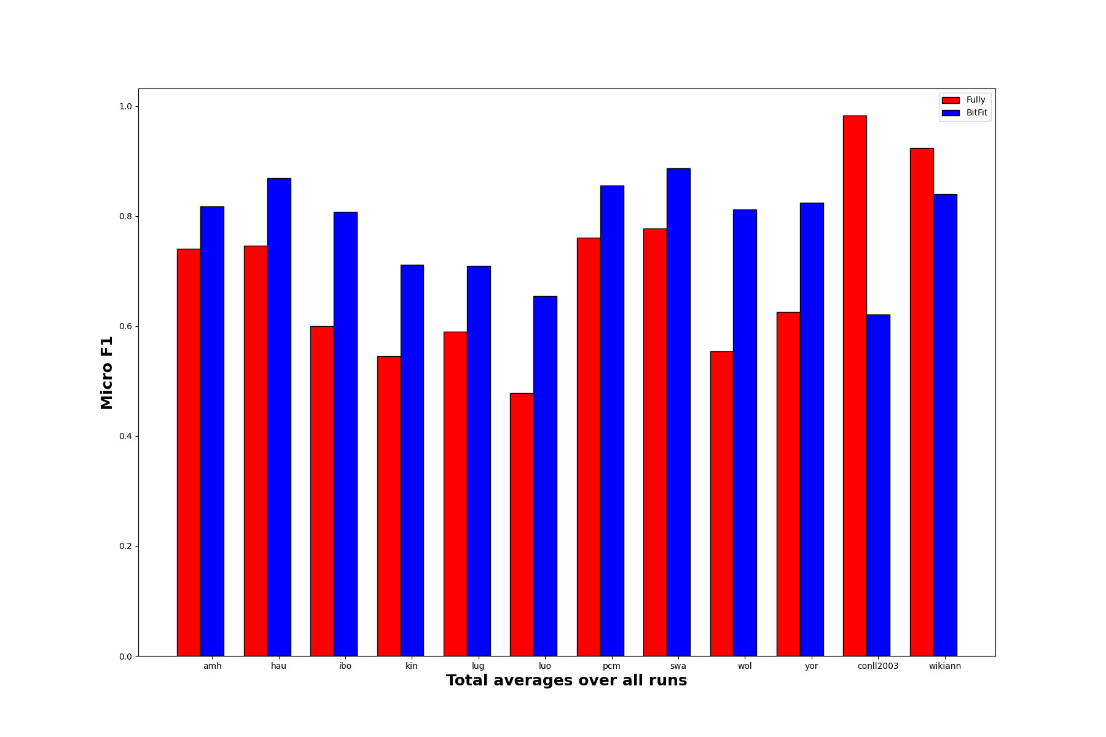
Code Presentation - Results
Average

Slide 19
Code Presentation - Results
Fully
  With right configuration is the best
    Conll2003, Ignore, 32
  But also the worst
    WikiAnn, Same, 16
  Also, higher discrepancy between worst and best
    Due to WikiAnn
BitFit
  Comparably good results
  More resistant to base dataset

Slide 20
Thanks for listening !!!
Quality matters!
and
BitFit is decent at worst!

