Slide 1


Data Visualization & Communication
2018 – Piza competition
Vasileios Ilias Drouzas

Slide 2
Static Visualizations
Comparison of Greece’s score vs the best country’s scores
Greece’s ranking in GLCM
Gender gap: Mean scores , Greece vs the rest participating countries
Top countries by Math score
Countries with great gender gap
Gender gap in Greece
Global gender gap: Mean scores by subject & gender
Overall student performance – Top 10
Qatar: Mean scores by subject & gender
Relationship between overall scores and GLCM scores

Slide 3
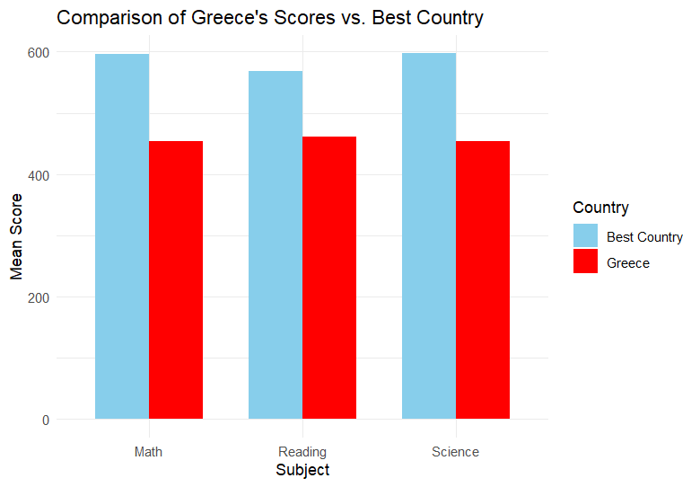
1. Comparison of Greece’s score vs the best country’s scores
In this barplot, we see what performance the Greek students achieve in all three subjects (Math, Reading, Science)
Also, we provide the scores that the students from the best country achieved (not necessarily the same country for each subject)
In all three occasions, Greek students underperformed in contrast to the top country (~110-140 points for each case)

Slide 4
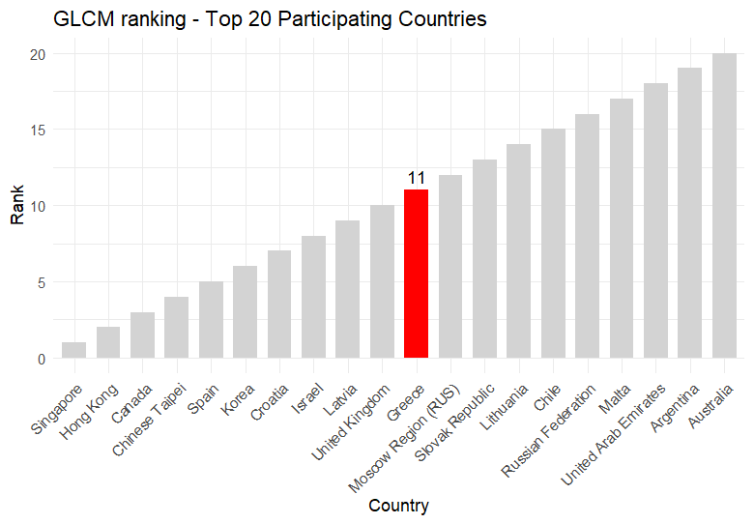
2. Greece’s ranking in GLCM
Here, we may check the top 20 countries as they are ranked in accordance to their overall global competency score (G L C M).
Greece scores 11th out of 80 participating countries and is highlighted in red color.

Slide 5
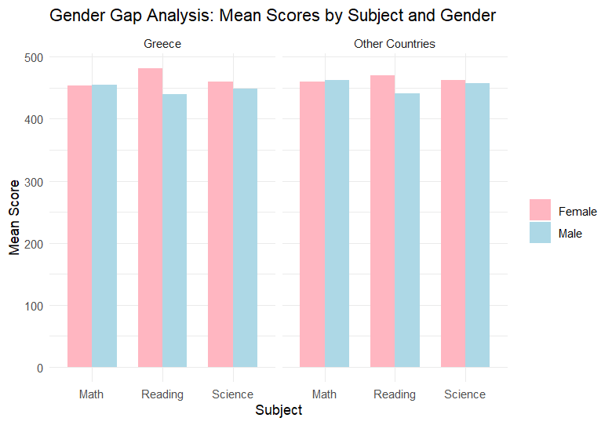
3. Gender gap: Mean scores , Greece vs the rest participating countries
After taking the mean values from all the countries, we notice that females achieve a higher performance in Reading & Science.
This is also the case in Greece!
Notice the difference in Reading, females outperform the males by a bigger margin, especially in Greece!
Males perform slightly better in Math than females, both in Greece and in the total of the participating countries.

Slide 6
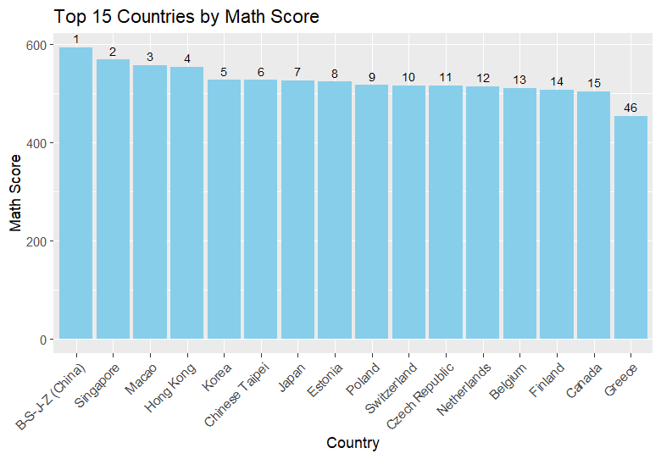
4. Top countries by Math score
Now, let’s take a look at the top 15 countries’ performance in Maths.
We will also include Greece in the diagram, to study its position.
China achieves the best scores (~600 points).
Greece is in the bottom half of the ranking, scoring 46^{th.}
As expected, due to Greece’s position (46th), the score gap to the leader China is significant (~140 points).

Slide 7
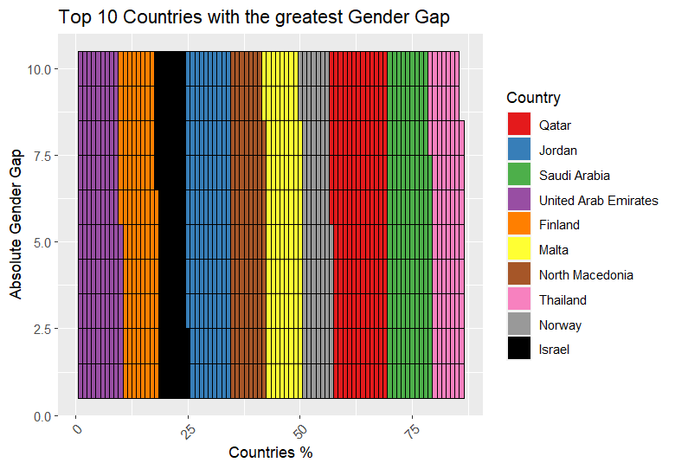
5. Countries with great gender gap (1/2)
Let’s take a look at the top 15 countries with the greatest ‘gender gap’
But what do we mean by ‘gender gap’ here?
First, we calculate the mean scores per country (for all the subjects)
Then, we filter by gender, so we can find the gender gap for each subject
Finally, we define the ‘absolute gender gap’ per country, as the sum of the gender gaps per subject.

Slide 8
5. Countries with great gender gap (2/2)
In our case, Qatar is the country with the greatest gender gap.
The countries are sorted in the legend by the gender gap, so Israel scores 10th in our case.
Notice that in this waffle plot, Qatar has significantly greater gender gap than Israel.

Slide 9
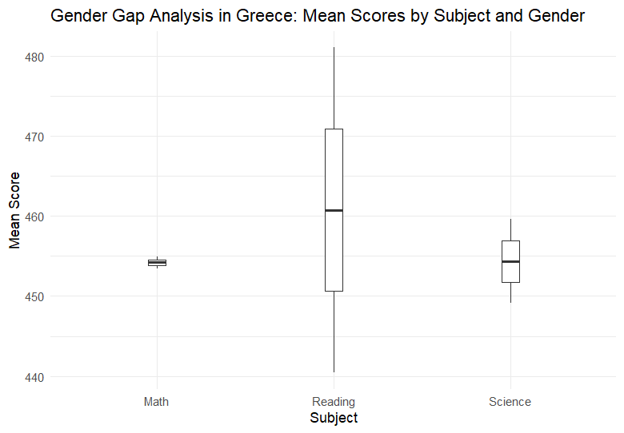
6. Gender gap in Greece
The violin plot provides a visual representation of the distribution of mean scores for each subject and gender in Greece.
The width of the violin indicates the density of data points at different score levels (the score of the females vs the score of the males).
We confirm again that there is significant deviation in the scores of Greek females and males in the Reading course. (~40 points)

Slide 10
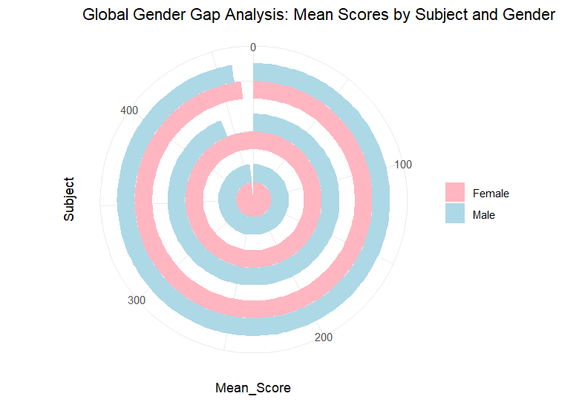
7. Global gender gap: Mean scores by subject & gender
This circular barplot provides a visual representation of the distribution of mean scores for each subject and gender globally.
The inner cycle represents Math, the middle represents Reading and the outer one represents the Science course.
Simirarly to Greece, females tend to perform better in the Reading course than males.
The scores in the rest two subjects are close, with females achieving slightly better scores in Science, while the performance in Math is similar.

Slide 11
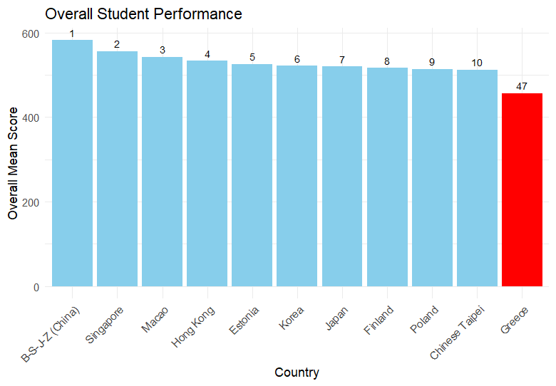
8. Overall student performance – Top 10
Now we will study the overall performance in all of the three subjects per country.
We find the overall performance for each country by summing the mean scores per subject and getting the average value.
Chinese students seem to excel in the three subjects. This is not a surprise, since we saw earlier that they are scoring first in the Maths course too.
Greek students achieve a moderate performance, scoring 47th in the total of 80 countries.

Slide 12
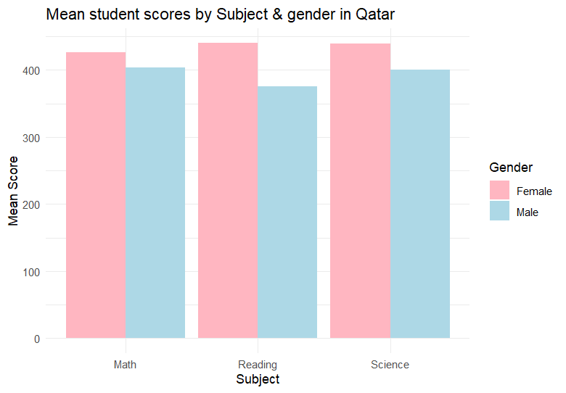
9. Qatar: Mean scores by subject & gender
Previously we noticed Qatar is the country with the greatest gender gap.
It is interesting to check now how much difference is noticed between the two genders’ performance.
The pattern that supports that females outperform males by far in the Reading course is applicable here too.
The margin is also significant for the Science course.
Finally, in Qatar, female students perform better in Maths (in contrast to the Greek reality)

Slide 13
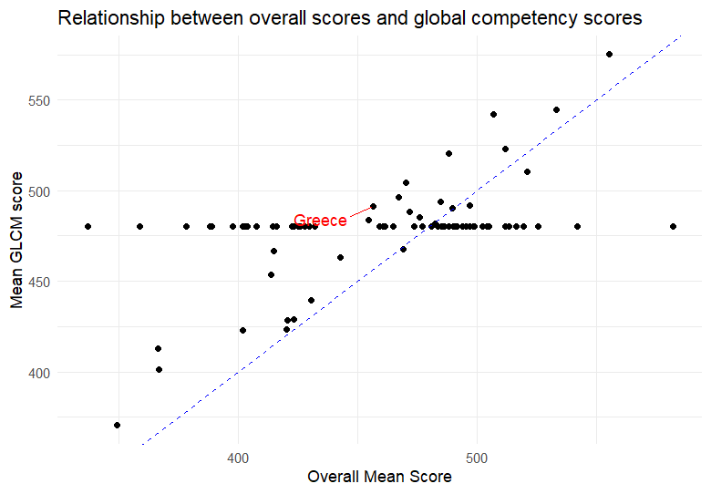
10. Relationship between overall scores and GLCM scores
Finally, another interesting aspect is to check whether the overall mean score in the three subjects & the GLCM score follow a linear trend.
Visualizaing via the following scatterplot, we conclude that these two are not linearly correlated; they do not follow the linear line y=x
In the diagram, we notice Greece has a higher GLCM score than its overall mean score in the three subjects.

Slide 14
Conclusions
Greek students score moderately in the three subjects (Math, Reading, Science)
Greek students score high in the overall global competency score
The gender gap is a phenomenon that is also noticed in Greece, with the greatest one highlighted in Qatar
Female students overall perform beter than male ones in Reading & Science course, while in Maths, males slightly outperform females (with Qatar being an exception)
The average score in the three courses does not correspond linearly to the overall global competency score

