Slide 1
AS.410.671 Final Project Haoyu Qi

Slide 2
Catalogue
1. Introduction
2. Outlier filter
3. Multiple Comparisons and Feature Selection
4. Clustering & Classification
5. Gene differential expression and discriminant genes
6. Conclusion

Slide 3

1. Introduction
Gene Array: GSE38941
GSE38941 is the Liver Regeneration Gene Signature in Hepatitis B virus (HBV)-Associated Acute Liver Failure Identified by Gene Expression Profiling
4 patients with HBV-associated acute liver failure (4-5 samples per liver, total 17 liver specimens) and 10 individual normal liver donors(27 total)
GSM952511 : GSM952520 Normal Liver
GSM952521 : GSM952537 HBV-associated ALF

Slide 4
1. Introduction
The liver has inherent regenerative capacity
The dramatic clinical course of acute liver failure (ALF) has posed major limitations to investigating the molecular mechanisms of liver regeneration.
The aim of the assay is to investigate the molecular mechanisms of liver regeneration in 4 patients who underwent liver transplantation for hepatitis B virus (HBV)-associated ALF.

Slide 5
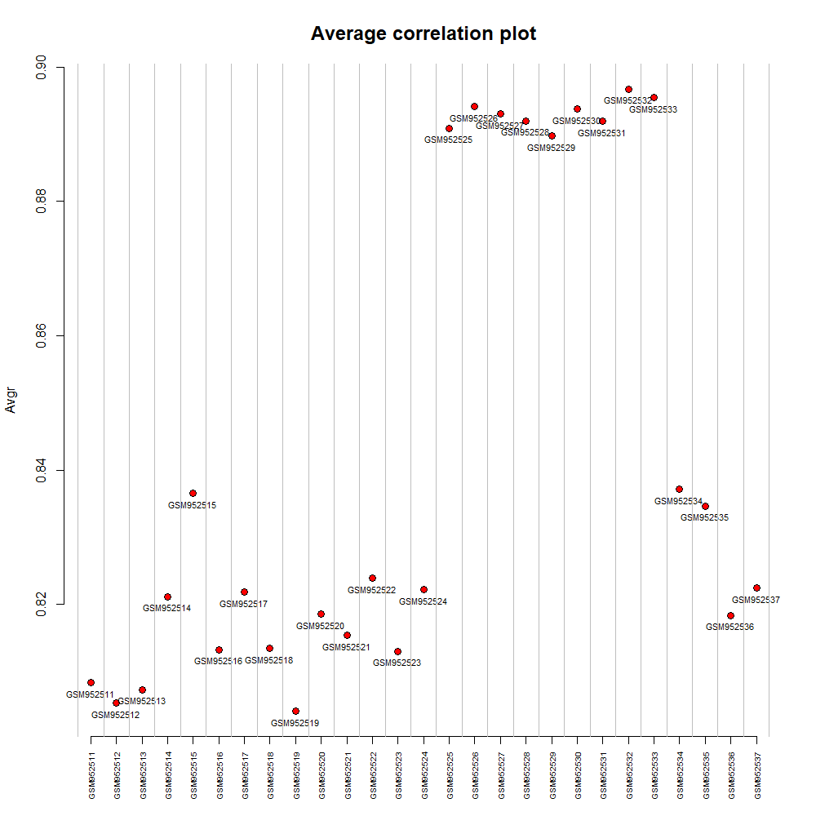
2. Outlier filter
The variation between the group seems more significate (0.92 is the most)
Little variation within the group
Result: No outlier
Normal
ALF
The lowest average correlation value is not enough to be outlier

Slide 6
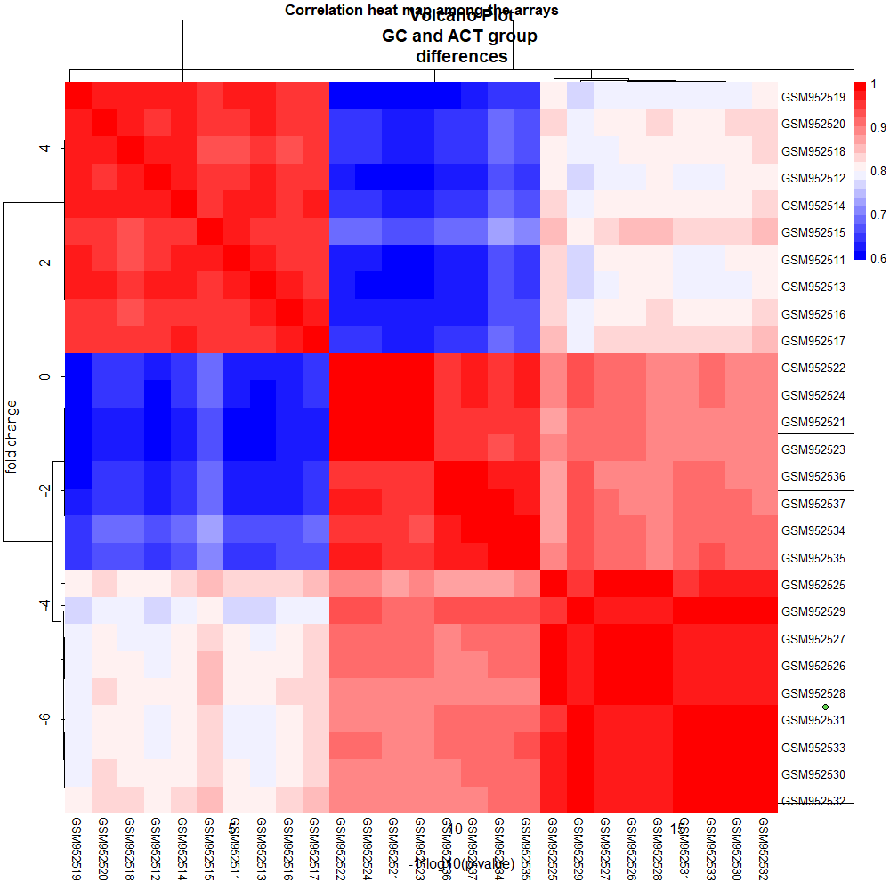
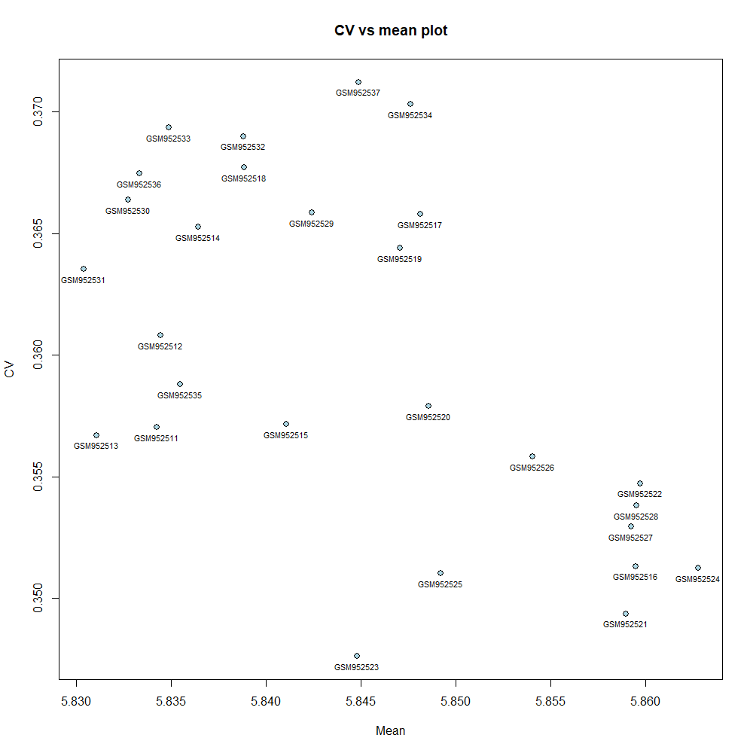
2. Outlier filter
Correlation heat map & CV vs mean plot verified the result
Normal
ALF

Slide 7
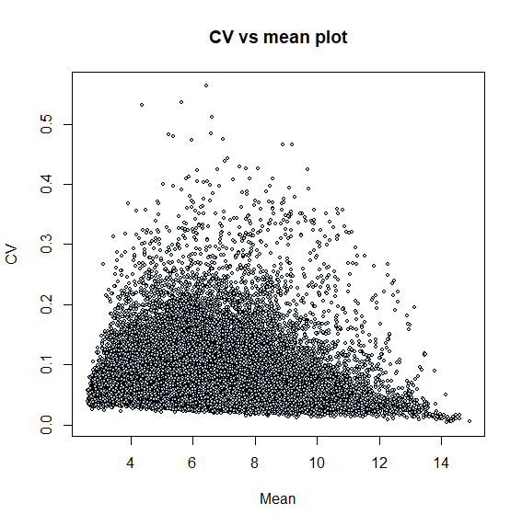
2. Outlier filter
The low Mean Value genes show very low CV, reflect that though these genes express not high, but can not be treated as the noise.

Slide 8
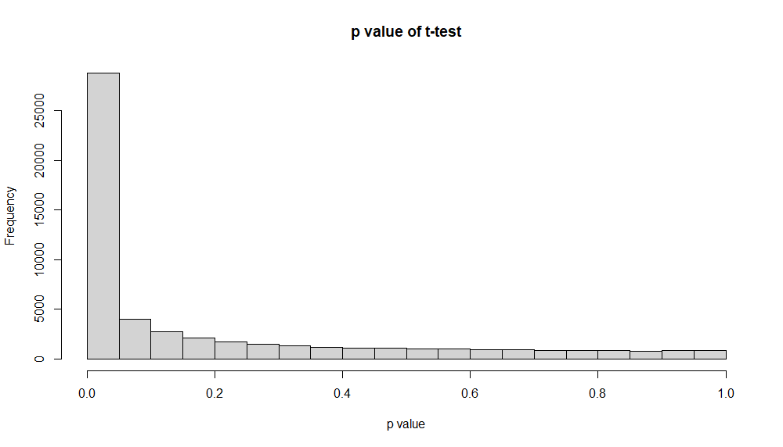
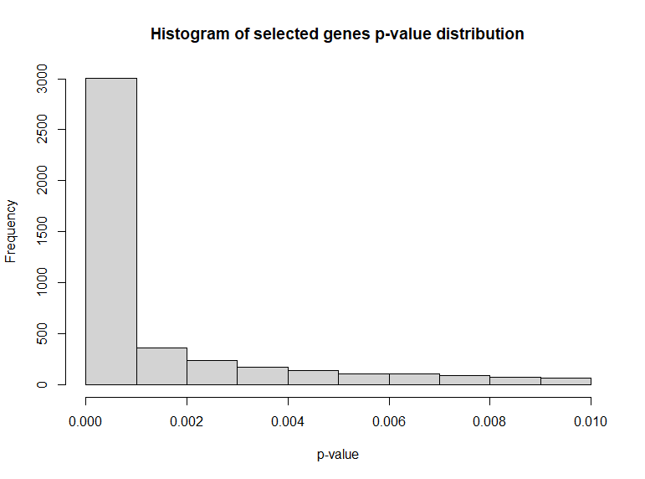
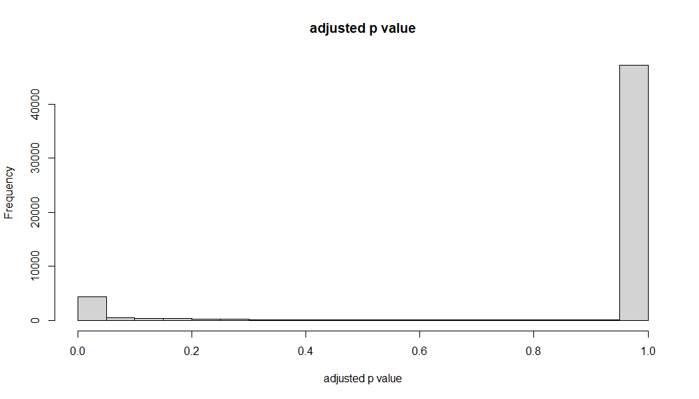

3. Multiple Comparisons and Feature Selection
Use p=0.01 as threshold, filtered 3198 genes out as the selected genes (5.84%)

Slide 9
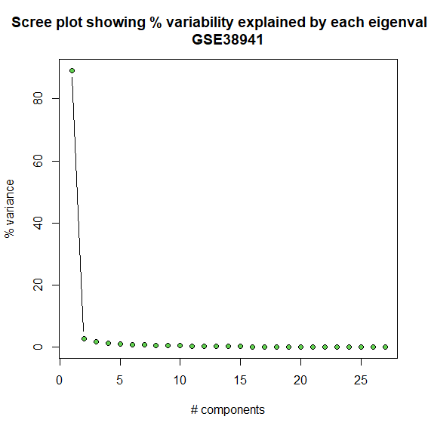
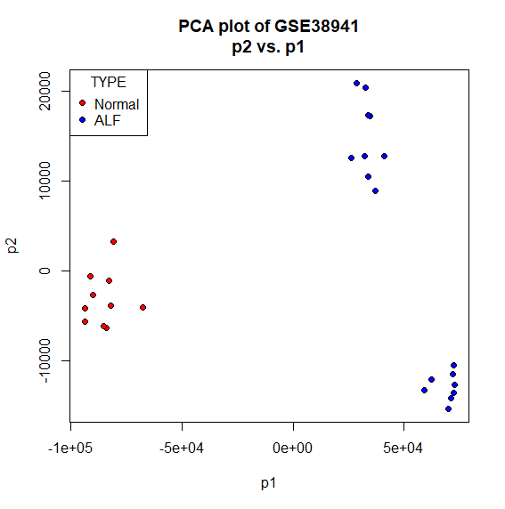
4. Clustering & Classification
First 2 components can explain nearly 90% percent of the variability (more than 80% for p1, near 5% for p2)

Slide 10
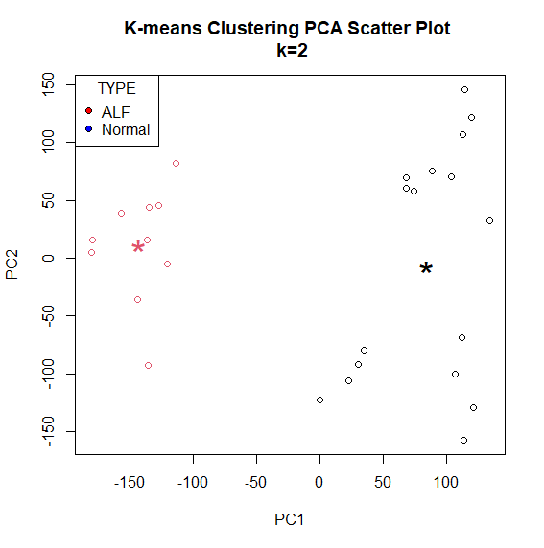
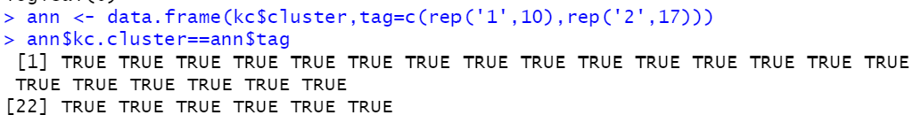
4. Clustering & Classification
The classification based on the prcomp function with the original dataset
The result shows the classification has NO difference with the class that the author provided

Slide 11
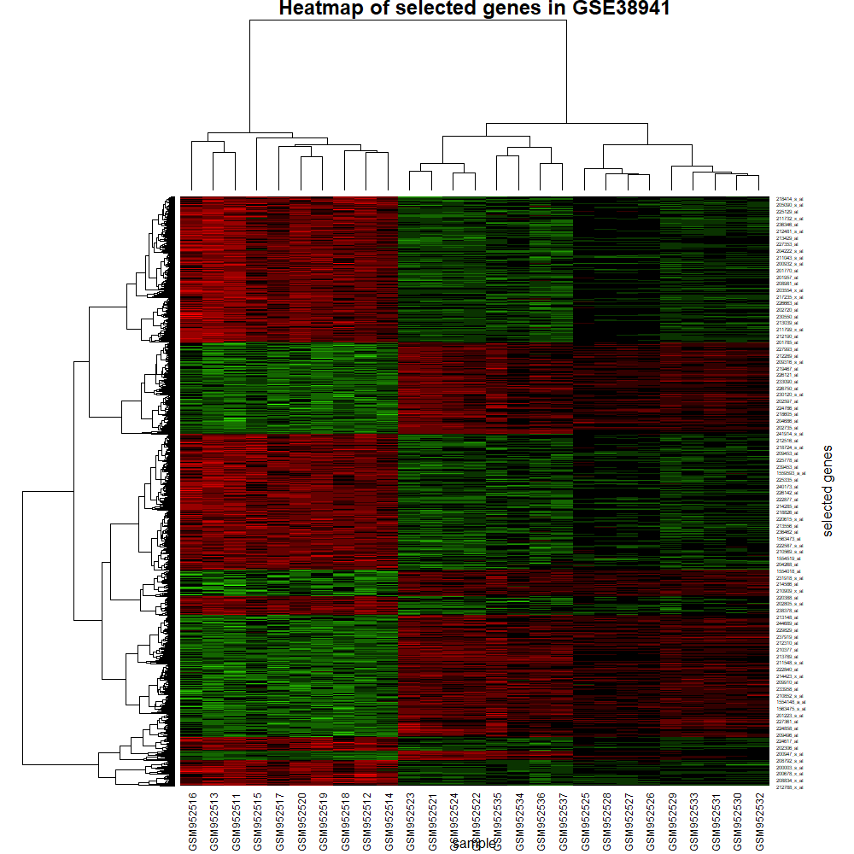
4. Clustering & Classification
Clustering for both sample and genes
(x: samples, y:genes)

Slide 12
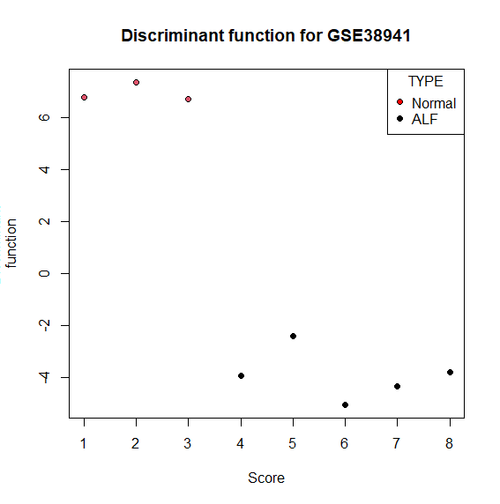
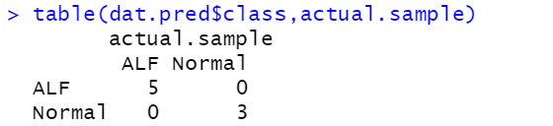
4. Clustering & Classification
The model based on Linear Discriminant Analysis (using 7 normal and 12 ALF as training set) shows good effect in predicting the test set(3 normal and 5 ALF samples)

Slide 13
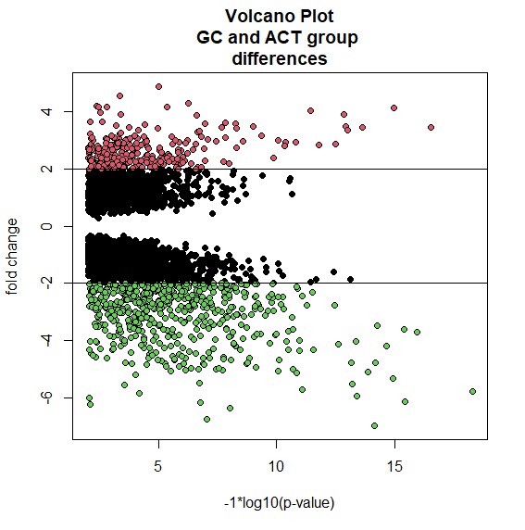
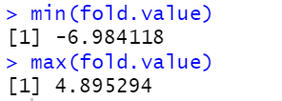
5. Gene differential expression and discriminant genes

Slide 14
5. Gene differential expression and discriminant genes
top 5 discriminant genes (Positive direction)
ID | Gene Name | GOTERM_BP_DIRECT | GOTERM_CC_DIRECT | GOTERM_MF_DIRECT | KEGG_PATHWAY
90265_at | ArfGAP with dual PH domains 1(ADAP1) | GO:0007166~cell surface receptor signaling pathway,etc. | GO:0005634~nucleus,etc. | GO:0005096~GTPase activator activity,etc.,
89977_at | acyl-CoA synthetase medium chain family member 5(ACSM5) | GO:0006633~fatty acid biosynthetic process etc. | GO:0005759~mitochondrial matrix, | GO:0004321~fatty-acyl-CoA synthase activity,etc. | hsa00650:Butanoate metabolism,hsa01100:Metabolic pathways,
64408_s_at | calmodulin like 4(CALML4) | GO:0050790~regulation of catalytic activity, |  | GO:0005509~calcium ion binding,etc. | hsa04014:Ras signaling pathway,hsa04015:Rap1 signaling pathway etc.
65630_at | transmembrane protein 80(TMEM80) | GO:1905515~non-motile cilium assembly, | GO:0016020~membrane,etc. | GO:0005515~protein binding,
78495_at | zinc finger protein 783(ZNF783) | GO:0006357~regulation of transcription from RNA polymerase II promoter, | GO:0005634~nucleus, | GO:0000978~RNA polymerase II core promoter proximal region sequence-specific DNA binding,etc. | hsa05168:Herpes simplex virus 1 infection,

Slide 15
5. Gene differential expression and discriminant genes
top 5 discriminant genes (Negative direction)
ID | Gene Name | GOTERM_BP_DIRECT | GOTERM_CC_DIRECT | GOTERM_MF_DIRECT | KEGG_PATHWAY
1405_i_at | C-C motif chemokine ligand 5(CCL5) | h_eosinophilsPathway:The Role of Eosinophils in the Chemokine Network of Allergy, | GO:0000165~MAPK cascade,GO:0002407~dendritic cell chemotaxisetc. | GO:0005576~extracellular region,GO:0005615~extracellular space, | IPR000827:CC chemokine, conserved site,IPR001811:Chemokine interleukin-8-like domain,
1552315_a_at | GTPase, IMAP family member 1(GIMAP1) |  |  | GO:0000139~Golgi membrane,GO:0005783~endoplasmic reticulum,etc. | IPR006703:AIG1,IPR027417:P-loop containing nucleoside triphosphate hydrolase,
1552316_a_at | GTPase, IMAP family member 1(GIMAP1) |  |  | GO:0000139~Golgi membrane,GO:0005783~endoplasmic reticulumetc. | IPR006703:AIG1,IPR027417:P-loop containing nucleoside triphosphate hydrolase,
1552343_s_at | phosphodiesterase 7A(PDE7A) |  | GO:0006198~cAMP catabolic process,GO:0007165~signal transduction,etc. | GO:0005829~cytosol, | IPR002073:3'5'-cyclic nucleotide phosphodiesterase, catalytic domain,IPR003607:HD/PDEase domain,IPR023088:3'5'-cyclic nucleotide phosphodiesterase etc.
1552307_a_at | tetratricopeptide repeat domain 39C(TTC39C) |  | GO:0032474~otolith morphogenesis,GO:0060271~cilium assembly |  | IPR011990:Tetratricopeptide-like helical,IPR019412:Outer membrane protein, IML2, mitochondrial/Tetratricopeptide repeat protein 39,

Slide 16
6. Conclusion
The dataset has very good quality that does not has any outliers or low expression genes as the noise of the further analysis.
Clustering analysis proof the consistency between the author provided tag and data inner coefficient variants. The group and samples from same patient are more likely to cluster together
Constructed a efficient model for the further prediction.
The top 5 identified overexpressed genes are involves in ATP and GTP synthesis, RNAase Ⅱ binding and lipid metabolism, potentially because the repair mechanism of damaged liver active the pathways associated with cell division.

Slide 17
6. Source Code-libraries
library(corrplot)
library(pheatmap)
library(ggplot2)
library(tidyverse)
library(pcaMethods)
library(edgeR)
library(fibroEset)
library(stats)
library(MASS)

Slide 18
6. Source Code
# data prepare
dat <- read.table(file=PATH,row.names = 1, header=T,comment.char = '!' )
dat <- 2^dat
dat.nor <- dat[,1:10]
dat.ALF <- dat[,11:27]
#outlier analysis
pearsonmatrix <- cor(dat,method = 'pearson',use = 'pairwise.complete.obs')
col <- colorRampPalette(c('blue','white','red'))(20)
p <- pheatmap(pearsonmatrix,col=col,clustering_distance_rows='correlation',clustering_distance_cols='correlation',border=F,
main = 'Correlation heat map among the arrays')
p
dat.mean <- apply(log2(dat),2,mean)
dat.sd <- sqrt(apply(log2(dat),2,var))
dat.cv <- dat.sd/dat.mean
plot(dat.mean,dat.cv,main="CV vs mean plot",xlab="Mean",ylab="CV",col='blue',cex=1.5,type="n")
points(dat.mean,dat.cv,bg="lightblue",col=1,pch=21,cex=1.1)
text(dat.mean,dat.cv,label=dimnames(dat)[[2]],pos=1,cex=0.7)
dat.avg <- apply(pearsonmatrix,1,mean)
plot(c(1,length(dat.avg)),range(dat.avg),type="n",xlab="",ylab="Avgr",main="Average correlation plot",cex.main=1.5,axes=F)
points(dat.avg,bg="red",col=1,pch=21,cex=1.2)
text(dat.avg,label=dimnames(dat)[[2]],pos=1,cex=0.7)
axis(1,at=c(1:length(dat.avg)),labels=dimnames(dat)[[2]],las=2,cex.lab=0.4,cex.axis=0.6)
axis(2)
abline(v=seq(0.5,62.5,1),col="grey")
dat.gene.mean <- apply(log2(dat),1,mean)
dat.gene.sd <- sqrt(apply(log2(dat),1,var))
dat.gene.cv <- dat.gene.sd/dat.gene.mean
plot(dat.gene.mean,dat.gene.cv,main="CV vs mean plot",xlab="Mean",ylab="CV",col='blue',cex=1.5,type="n")
points(dat.gene.mean,dat.gene.cv,bg="lightblue",col=1,pch=21,cex=0.5)

Slide 19
6. Source Code
# muti test
#we use t-test here
t.test.all.genes <- function(x,s1,s2) {
x1 <- x[s1]
x2 <- x[s2]
x1 <- as.numeric(x1)
x2 <- as.numeric(x2)
t.out <- t.test(x1,x2, alternative="two.sided",var.equal=T)
out <- as.numeric(t.out$p.value)
return(out)
}
t.pv <- apply(dat,1,t.test.all.genes,s1=c(1:10),s2=c(11:27))
pv
hist(t.pv,xlab ='p value of t-test' )
dat.p.adj <- p.adjust(p = t.pv,method = 'holm')
dat.p.adj
hist(dat.p.adj,xlab='adjusted p value')
length(dat.p.adj[dat.p.adj<0.01])
name <- as.vector(names(dat.p.adj[dat.p.adj<0.01]))
dat.selected <- dat[name,]
dat.selected.p <- dat.p.adj[dat.p.adj<0.01]
hist(dat.selected.p,main='Histogram of selected genes p-value distribution',xlab = 'p-value')

Slide 20
6. Source Code
#clustering and PCA
gene.pca <- prcomp(t(dat.selected),cor=F)
dat.selected.pca.var <- round(gene.pca$sdev ^2 / sum(gene.pca$sdev^2)*100,2 )
plot(c(1:length(dat.selected.pca.var)),dat.selected.pca.var,type="b",
xlab="# components",ylab="% variance",pch=21,col=1,bg=3,cex=1)
title("Scree plot showing % variability explained by each eigenvalue\nGSE38941")
gene.pca.loading <- gene.pca$x[,1:2]
plot(range(gene.pca.loading[,1]),range(gene.pca.loading[,2]),type="n",xlab='p1',ylab='p2',
main='PCA plot of GSE38941\np2 vs. p1')
points(gene.pca.loading[,1][as.vector(colnames(dat[1:10]))], gene.pca.loading[,2][as.vector(colnames(dat[1:10]))],
col=1,bg='red',pch=21,cex=1)
points(gene.pca.loading[,1][as.vector(colnames(dat[11:27]))], gene.pca.loading[,2][as.vector(colnames(dat[11:27]))],
col=1,bg='blue',pch=21,cex=1)
legend('topleft',title='TYPE',c('Normal','ALF'),pch = 21,col=1,pt.bg = c('red','blue’))
#classification from all
pca.dat<- prcomp(t(dat),center = T,scale. = T,cor=F)$x[,1:2]
kc <- kmeans(pca.dat, centers=2,iter.max = 20)
#used to test the difference between the classification and given tag
ann <- data.frame(kc$cluster,tag=c(rep('1',10),rep('2',17)))
ann$kc.cluster==ann$tag
#plot
plot(pca.dat, col = kc$cluster,cex=1,main='K-means Clustering PCA Scatter Plot \n k=2',lwd=1.5)
points(kc$centers,col=1:2,pch='*',cex=2.5)
legend('topleft',title='TYPE',c('ALF','Normal'),pch = 21,col=1,pt.bg = c('red','blue'))

Slide 21
6. Source Code
#train
ctr <- cbind(dat.selected[,1:7],dat.selected[,11:22])
ctr <- as.data.frame(t(cbind(dat.selected[,1:7],dat.selected[,11:22])))
cte <- cbind(dat.selected[,8:10],dat.selected[,23:27])
cte <- as.data.frame(t(cbind(dat.selected[,8:10],dat.selected[,23:27])))
train.set <- as.data.frame(cbind(c(rep('Normal',7),rep('ALF',12)),ctr))
test.set <- as.data.frame(cbind(c(rep('Normal',3),rep('ALF',5)),cte))
actual.sample <- test.set[,1]
test.set <- test.set[,-1]
dat.lda <- lda(train.set[,1]~.,train.set[,2:3199])
dat.pred <- predict(dat.lda,test.set)
table(dat.pred$class,actual.sample)
plot(dat.pred$x,bg=as.numeric(factor(actual.sample)),pch=21,col=1,ylab="Discriminant
function",axes=T,xlab="Score",main="Discriminant function for GSE38941")
legend('topright',title='TYPE',c('Normal','ALF'),pch = 21,col=1,pt.bg = c('red','black'))

Slide 22
6. Source Code
# Differential expression
normal.mean <- apply(log2(dat.selected[,1:10]),1,mean,na.rm=T)
ALF.mean <- apply(log2(dat.selected[,11:27]),1,mean,na.rm=T)
fold.value <- ALF.mean-normal.mean
fold.m <- data.frame(fold.value=fold.value,gene=row.names(dat.selected))
min(fold)
p.trans <- -1 * log10(dat.selected.p)
plot(range(p.trans),range(fold),type='n',xlab='-1*log10(p-value)',ylab='fold change',main='Volcano Plot\nGC and ACT group
differences')
points(p.trans,fold,col='black',pch=21,bg=1)
points(p.trans[(p.trans> -log10(.05)&fold>log2(4))],fold[(p.trans> -log10(.05)&fold>log2(4))],col=1,bg=2,pch=21)
points(p.trans[(p.trans> -log10(.05)&fold< -log2(4))],fold[(p.trans> -log10(.05)&fold< -log2(4))],col=1,bg=3,pch=21)
abline(v= -log10(.05))
abline(h= -log2(4))
abline(h=log2(4))
max.fold <- sort(fold.m[,2],decreasing = T)
min.fold <- sort(fold.m[,2],decreasing = F)
max.fold[1:5]
min.fold[1:5]

Slide 23
Thanks
Source code and gene information result are attached

