Slide 1
University Database Management
Ayushi Shrivastava (Fall 2018)
CSU, East Bay

Slide 2
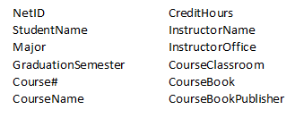
Attributes

Slide 3
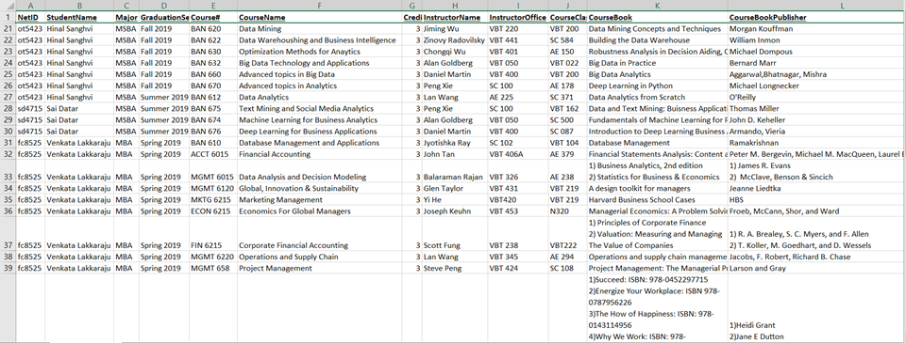
Raw Data Collected

Slide 4
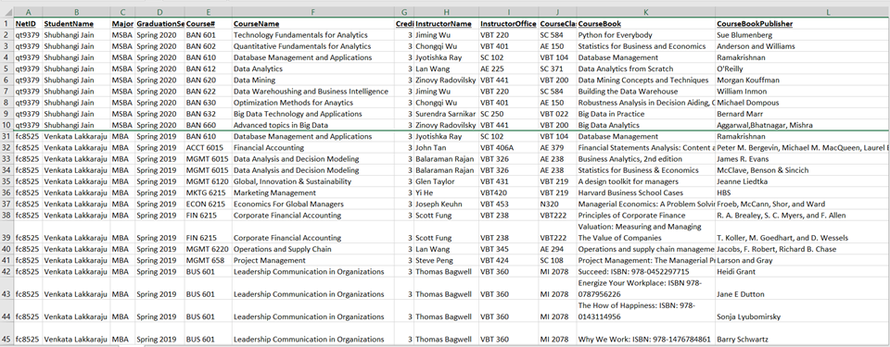
Converting it into 1NF
Table Name: SCHEDULE

Slide 5
Assumptions
Each course can have multiple books depending on the Instructor who is teaching the course
To distinguish same courses taught in different semesters, we added a surrogate key “Class Number” which will uniquely identify it
Same course can be offered at different times in the same semester depending on the timing taught by different instructors

Slide 6
Assumptions
Each course can be taught by different instructors
Each instructor can teach more than one course
Each course will have mandatorily one or many course book

Slide 7
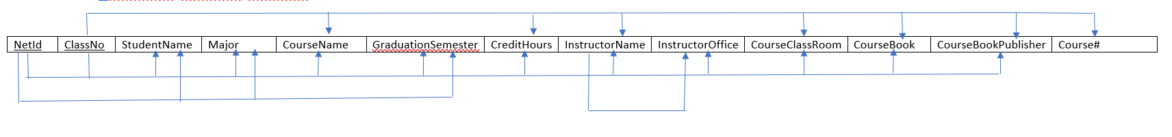
Functional Dependencies

Slide 8
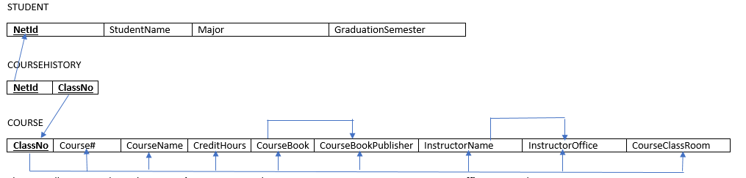
Functional Dependencies
2NF Removing Partial Dependencies

Slide 9
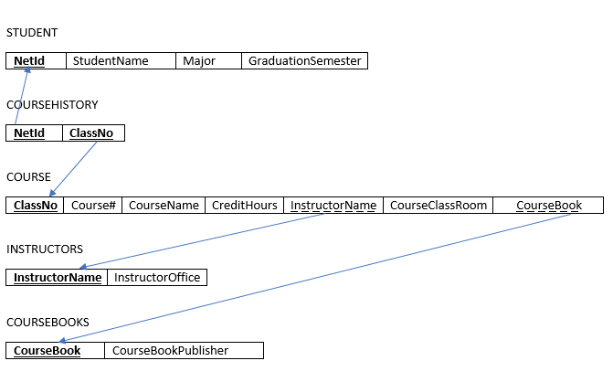
Functional Dependencies
3NF Removing Transitive Dependencies

Slide 10
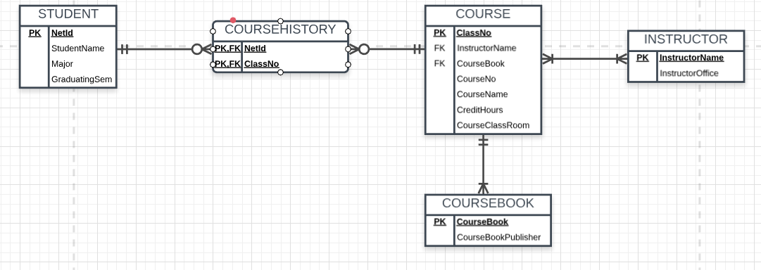
ER Diagram

Slide 11
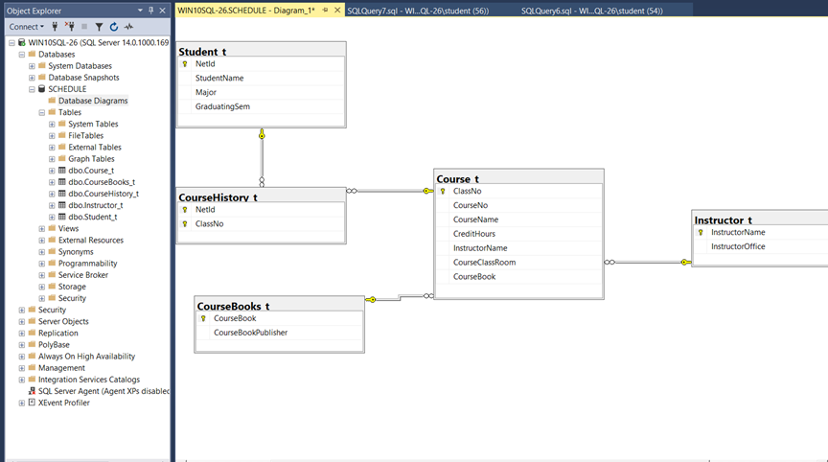
Database Diagram

Slide 12
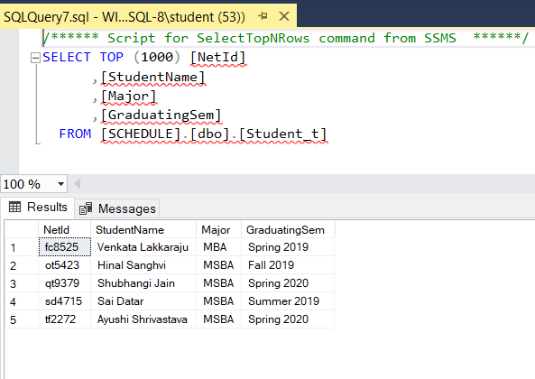
Student_t

Slide 13
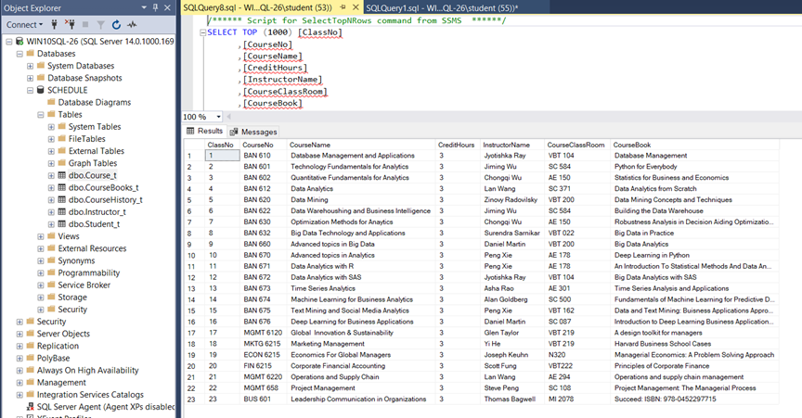
Course_t

Slide 14
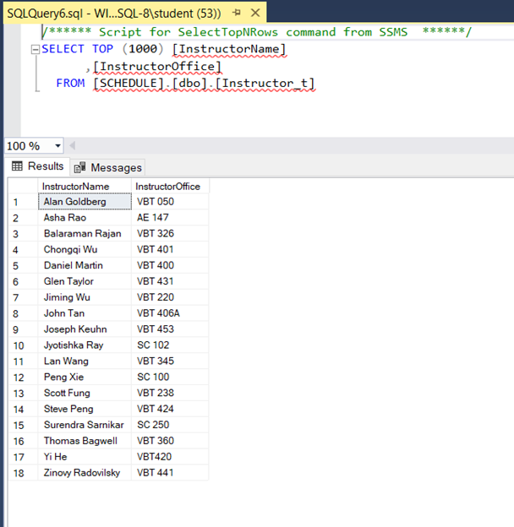
Instructor_t

Slide 15
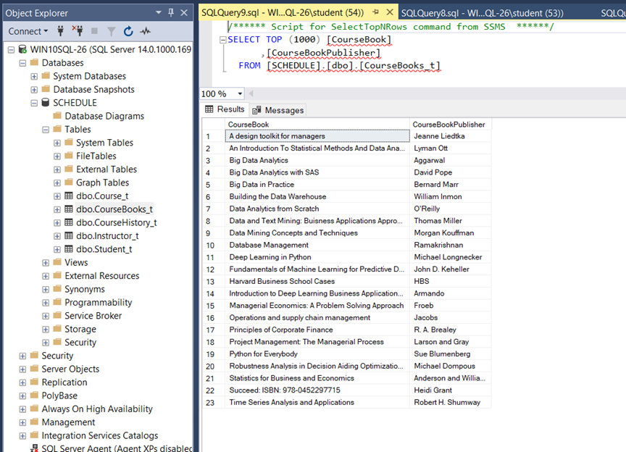
Coursebooks_t

Slide 16
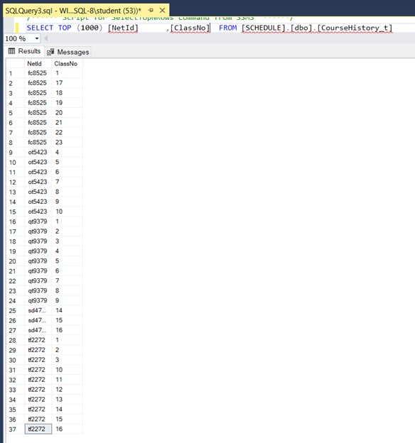
Coursehistory_t

Slide 17
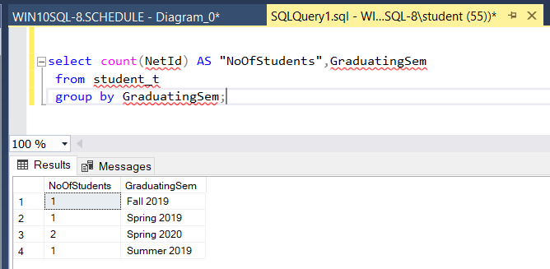
Query 1: Students Graduating in Same Semester

Slide 18
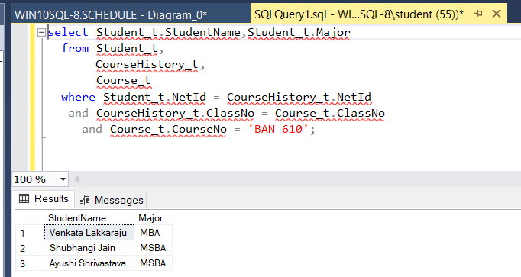
Query 2: StudentName and Major Who have taken BAN610

Slide 19
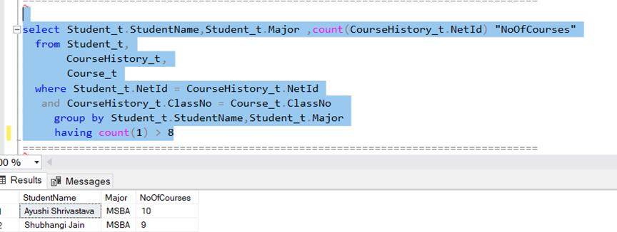
Query 3: NetId and StudentName who have taken more than 8 courses

Slide 20
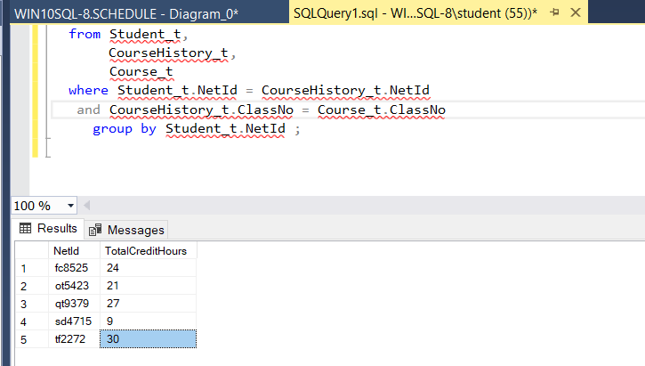
Query 4: NetId of Students and Total Credit Hours

Slide 21
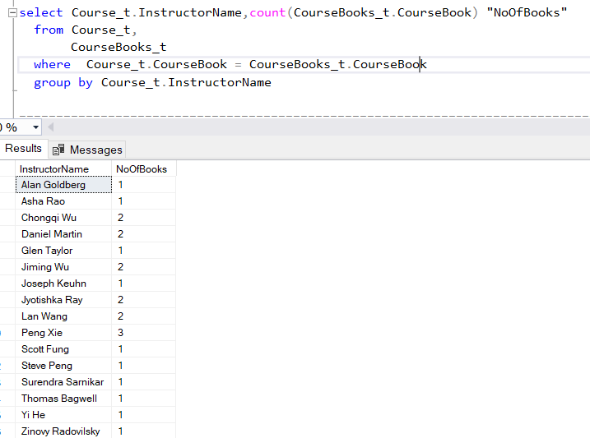
Query 5: InstructorNames and Number of Books assigned

