Slide 1
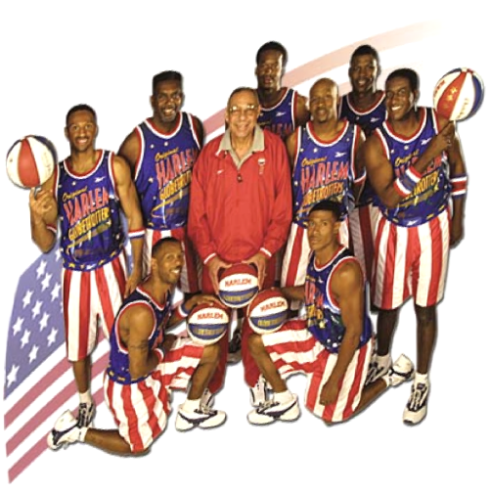
The web framework dream team
Johan Eltes
Johan.eltes@callistaenterprise.se
www.callistaenterprise.se

Slide 2
Agenda
Customer Case Background
Requirements
The reference architecture
The frameworks and their contributions
Lessons learned
The web framework dream team, Slide <number>
Copyright 2008, Callista Enterprise AB

Slide 3

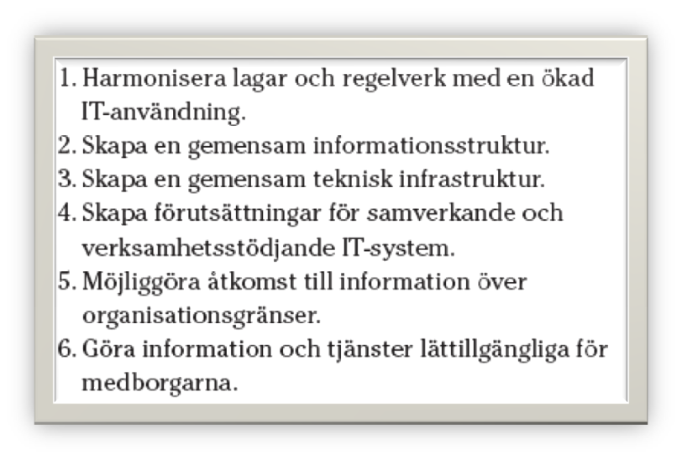



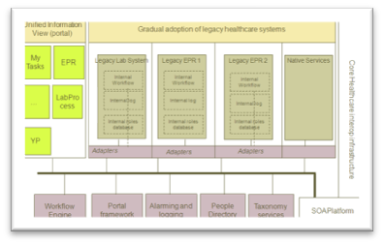
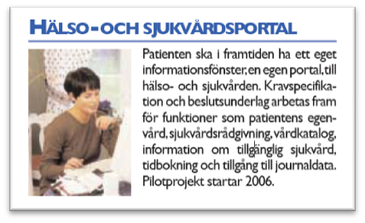
Strategic drivers behind reference architecture
National IT strategi for healthcare
Regional strategi
Regional projects
IT architecture
Portal framework
The web framework dream team, Slide <number>
Copyright 2008, Callista Enterprise AB
…

Slide 4
IT Architecture for VGRegion Healthcare
Unified Information View (portal)
Gradual adoption of legacy healthcare systems
New business process support (composite apps), utilizing service enabled back-ends
My Tasks
EPR
Legacy Lab System
Legacy EPR 1
Legacy EPR 2
Native Services
Internal Workflow
Internal Workflow
Internal Workflow
…
LabProcess
Internal log
Internal log
Internal log
Core Healthcare interop infrastructure
Internal roles database
Internal roles database
Internal roles database
YP
Adapters
Adapters
Adapters
Workflow Engine
Portal framework
Alarming and logging
People Directory
Taxonomy services
SOAPlatform

Slide 5
Layered View
Local development. Put together a development framework!
Composite Applications
Presentation
Workflow
Business Model
Composite Services
COTS and semi-COTS
Canonical (Enterprise) Services
SOA
Platform
Back-end enterprise resources

Slide 6

Requirement: “Use-Case-as-service”
Business Value
Usecase
Process Service
Data Service
The web framework dream team, Slide <number>
Copyright 2008, Callista Enterprise AB

Slide 7
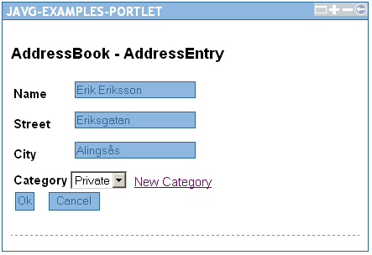
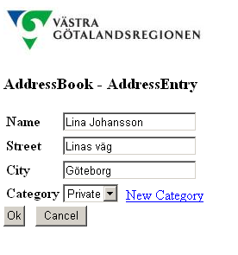
Requirement: Portability
Portlet
Web-app
Container portability (Java EE)
Portability across Web app and Portlet
The web framework dream team, Slide <number>
Copyright 2008, Callista Enterprise AB

Slide 8

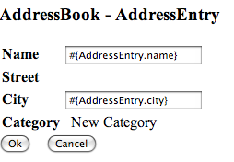
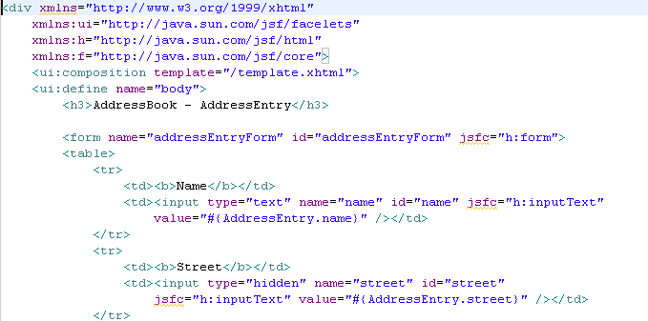

Requirement: Web designer friendly templating technology
Design in DreamWeaver
NetWeaver
Development in XML editor
The web framework dream team, Slide <number>
Copyright 2008, Callista Enterprise AB

Slide 9
Requirement: Support Verva web design requirements
Graceful degradation
  Always functional
  Usability proportional to browser capabilities
Example
  JavaScript disabled
The web framework dream team, Slide <number>
Copyright 2007, Callista Enterprise AB

Slide 10
Requirements: Agile Development environment
No IDE / Developer set-up lock-in
  Portable builds
  IDE settings / projects generated from build files (“build file is master”)
Reasonable hardware requirements
  Run well in VMWare on mid-range laptop
Broad, practical availability of tooling
  Consultant-friendly
Fast code-test-debug cycle
  Do not require deploy in WebSphere Portal for developer testing
  “Remove” inherent web programming issues / cost drivers
The web framework dream team, Slide <number>
Copyright 2008, Callista Enterprise AB

Slide 11
Major Challenge: Re-use at Use-Case-level
Business Value
Usecase
Process Service
Data Service
The web framework dream team, Slide <number>
Copyright 2008, Callista Enterprise AB

Slide 12
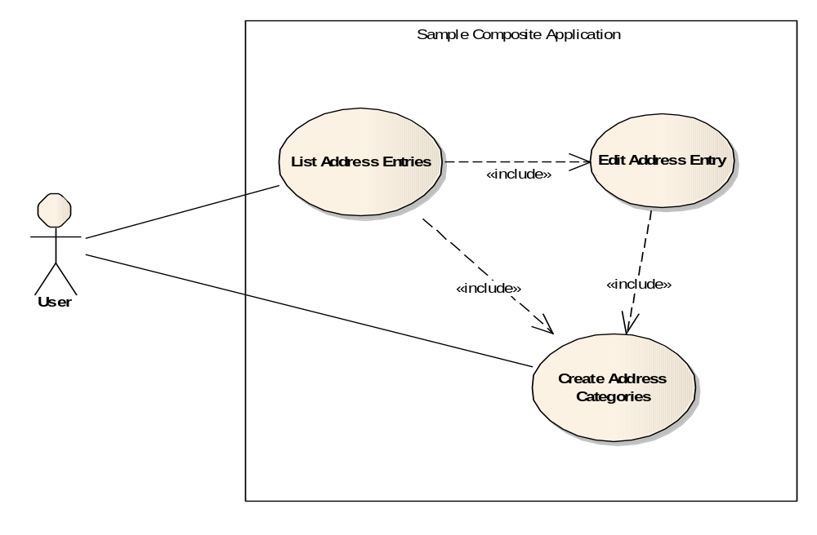
How will Use-cases become components?
Demo
The web framework dream team, Slide <number>
Copyright 2008, Callista Enterprise AB

Slide 13
Use-cases as Components
Composite Application
Semantically equivalent to calling modal dialog in Swing!
«webcomp»
:AddressList
1: editAddressEntry(long) :entryId of new Entry
«webcomp»
:Edit Address Entry
1.1: addNewCategory() :CategoryId
1.2: addNewCategory() :CategoryId
«webcomp»
:NewCategory
The web framework dream team, Slide <number>
Copyright 2008, Callista Enterprise AB

Slide 14
Web realization versus Rich Client
Think ”Modal sub dialogs”
Each dialog is tied to back-end logic
Use-case logic
Back-end services
The web framework dream team, Slide <number>
Copyright 2008, Callista Enterprise AB

Slide 15
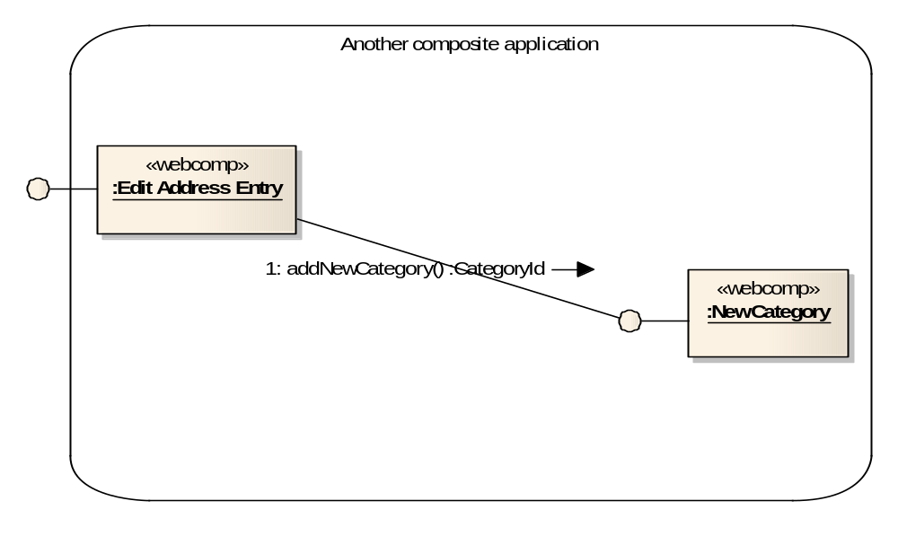
Re-use in another composite application
The web framework dream team, Slide <number>
Copyright 2008, Callista Enterprise AB

Slide 16
Adding portability…
WEB-INF artifacts are not portable - nor composable
  We can’t depend on JSPs
  A use-case web component will have to be a jar files that works on WEB-INF/lib whether portlet or webapp (formulera om)
Portlet
WebApp
«webcomp»
:Edit Address Entry
The web framework dream team, Slide <number>
Copyright 2008, Callista Enterprise AB

Slide 17
“Remove” inherent web programming issues
public class Game extends Element {
private static Random randomNumbers = new Random();
public void processElement() {
Template template = getHtmlTemplate("game");
int answer = 0, guesses = 0, guess = -1;
answer = randomNumbers.nextInt(101);
while (guess != answer) {
print(template);
pause();
template.clear();
guess = getParameterInt("guess", -1);
if (guess < 0 || guess > 100) {
template.setBlock("warning", "invalid");
continue;
}
guesses++;
if (answer < guess) template.setBlock("msg", "lower");
else if (answer > guess) template.setBlock("msg", "higher");
}
ContinuationContext.getActiveContext().removeContextTree();
template = getHtmlTemplate("success");
template.setValue("answer", answer);
template.setValue("guesses", guesses);
print(template);
}
}
0. Get a random number between 0 and 100
1. Show the guess-form
2. Repeat until successful guess:
2.1. The user enters a value and submits the form
2.2. Validate the guess. I error (not between 0 and 100), continue at 2.
2.3. Unless successful guess, show whether the guess was under or above the answer.
2.4. Display guess-form.
3.0 Show congratulations screen with number of guesses.
The web framework dream team, Slide <number>
Copyright 2008, Callista Enterprise AB

Slide 18
Reduce semantic gap: Flow of events
Continuations
  Code flow mirrors use-case flow
Supporting technologies
  Code in Java
    The RIFE framework
  Code in XML
    Spring WebFlow
The web framework dream team, Slide <number>
Copyright 2008, Callista Enterprise AB

Slide 19
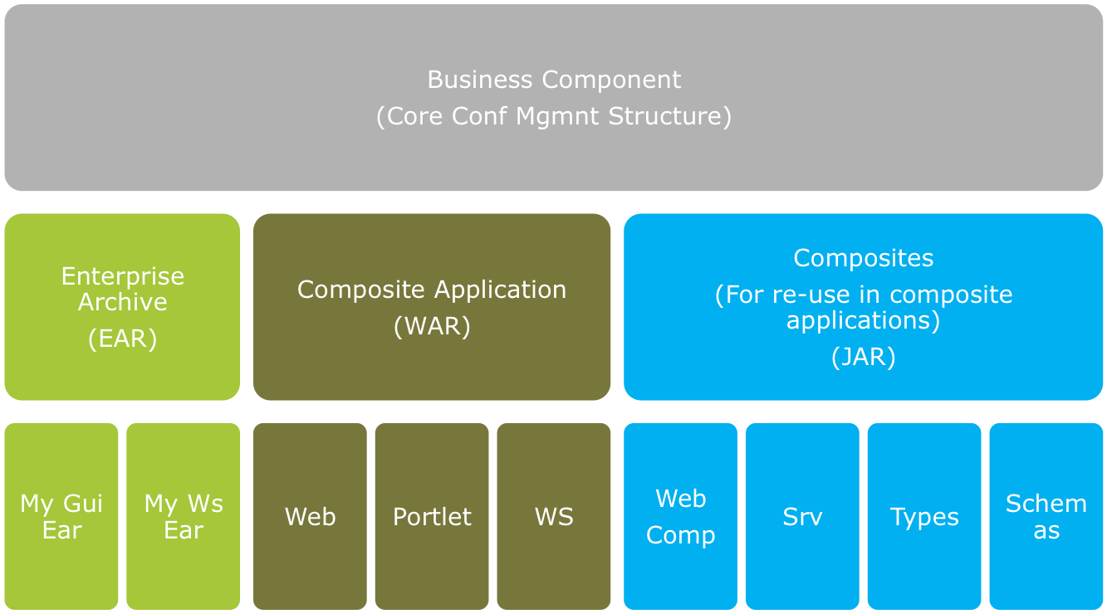
The resulting reference architecture
The web framework dream team, Slide <number>
Copyright 2008, Callista Enterprise AB

Slide 20
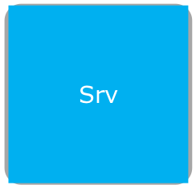
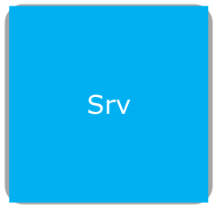
Dynamic view (runtime perspective)
Composite Application
Business Component 2
Business Component 1
<webcomp>
Address List
<webcomp>
Add Category
<webcomp>
Address Entry
The web framework dream team, Slide <number>
Copyright 2008, Callista Enterprise AB

Slide 21
Selected frameworks
Core requirements
  Complete workflow in composable archives (jar files)
  Empty web-inf (breaking the monolith web app)
  Continuations (remove semantic gap)
Spring WebFlow – Use-case logic
  Clean separation of workflow logic
  Powerful, expressive, simple, continuation-based
Facelets - Presentation
  None-intrusive to html
  Supports jar packaging!
  Made for JSF (unlike JSP)
JSF – Request processing
  Standard and does support jar-packaging
  “Hidden” by Spring WebFlow
The web framework dream team, Slide <number>
Copyright 2008, Callista Enterprise AB

Slide 22
Anatomy of a web use-case component
(web composite)
«webcomp»
:Category
Input / output parameters
Context for use-case component instance state
Use-case logic
Presentation
Back-end integration
The web framework dream team, Slide <number>
Copyright 2008, Callista Enterprise AB

Slide 23
Anatomy of a web use-case component
(web composite)
«webcomp»
:Category
Spring WebFlow: category-flow.xml
Input / output parameters
Context for use-case component instance state
Use-case logic
Presentation
Back-end integration
The web framework dream team, Slide <number>
Copyright 2008, Callista Enterprise AB

Slide 24
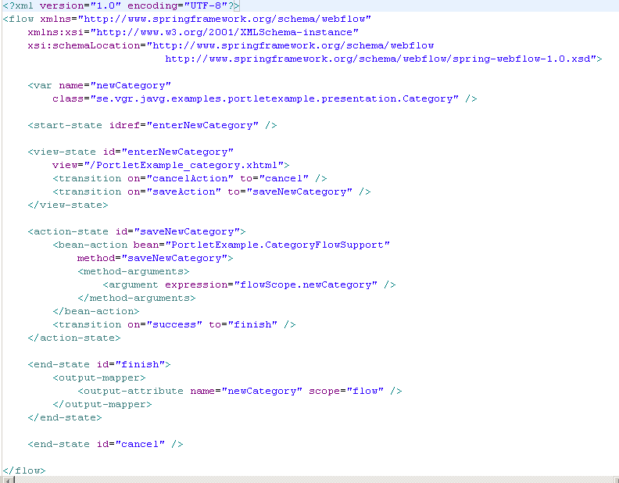
WebFlow – Sample – AddressEntryComposite
«action»
getNewOrExistingAddressEntity
start
«flow»
«view»
editAddressEntry
«action»
«flow»
assignNewCategory
cancel
«flow»
«flow»
ok
add category
«flow»
«action»
«subflow»
save
enterNewCategory
cancel
«flow»
Open ESB, Slide <number>
Copyright 2007, Callista Enterprise AB
exit

Slide 25
Anatomy of a web use-case component
(web composite)
«webcomp»
:Category
Facelets: Category.xhtml
Input / output parameters
Context for use-case component instance state
Use-case logic
Presentation
Back-end integration
The web framework dream team, Slide <number>
Copyright 2008, Callista Enterprise AB

Slide 26
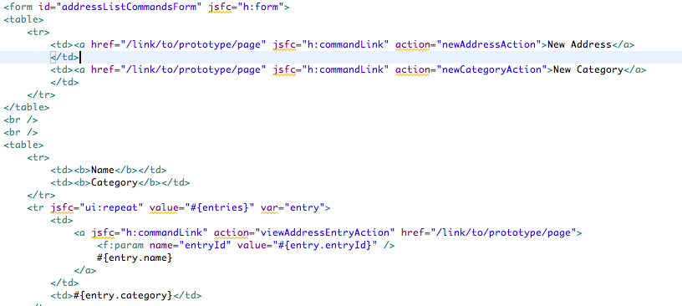
Facelets– Sample – Category Composite
None-intrusive to html
Supports jar packaging (loading of views from class-path)
Made for JSF (unlike JSP)
<h:commandLink action=“viewAddressEntryAction” ..>
The web framework dream team, Slide <number>
Copyright 2008, Callista Enterprise AB

Slide 27
Anatomy of a web use-case component
(web composite)
«webcomp»
:Category
Java: CategoryFlowSupport.java
Façade per use-case component.
Additional model beans
when required
Input / output parameters
Context for use-case component instance state
Use-case logic
Presentation
Back-end integration
The web framework dream team, Slide <number>
Copyright 2008, Callista Enterprise AB

Slide 28
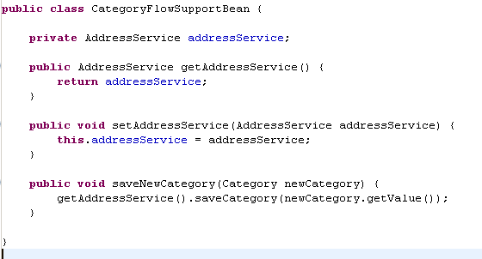
Use-case façade
The web framework dream team, Slide <number>
Copyright 2008, Callista Enterprise AB

Slide 29
But what about JSF?
Just for bootstrapping Spring Webflow
Generic faces-config in web-app
No footprint in web composites
<?xml version="1.0"?>
<!DOCTYPE faces-config PUBLIC
"-//Sun Microsystems, Inc.//DTD JavaServer Faces Config 1.0//EN"
"http://java.sun.com/dtd/web-facesconfig_1_0.dtd">
<faces-config>
<application>
<navigation-handler>
org.springframework.webflow.executor.jsf.FlowNavigationHandler
</navigation-handler>
<variable-resolver>
org.springframework.webflow.executor.jsf.DelegatingFlowVariableResolver
</variable-resolver>
<view-handler>com.sun.facelets.FaceletViewHandler</view-handler>
</application>
<lifecycle>
<phase-listener>
org.springframework.webflow.executor.jsf.FlowPhaseListener
</phase-listener>
</lifecycle>
</faces-config>JSF
The web framework dream team, Slide <number>
Copyright 2008, Callista Enterprise AB

Slide 30
Environments
Development
  Apache Tomcat with Apache Pluto
  Eclipse 3.3 (Europa) with WTP
Deployment
  WebSphere Application Server 6.1
  WebSphere Portal Server 6.0
Build system
    Maven 2 – manages the component architecture
    Generates Eclipse dependencies and project files
Web Framework Dream Team, Slide <number>
Copyright 2008, Callista Enterprise AB

Slide 31
Lessons learned
Webflow
  Revolution for html centric web applications
  The foundation for use-case componentization
  WebFlow validation framework tied into SpringMVC
    On the agenda for next version…
Facelets
  Momentum depends on Seam
  Servlet required for loading web resources (images etc) from jar files (web composites)
  Intuitive
Portability
  Native JSF implementations are not fully portable. We ended up bundling MyFaces rather than deploying to WebSphere JSF implementation (Sun RI)
The web framework dream team, Slide <number>
Copyright 2008, Callista Enterprise AB

Slide 32
Summary
Re-usable Use-case Components Delivered!
Business Value
Usecase
Process Service
Data Service
…by the dream team: Spring WebFlow, Facelets, JSF, a reference architecture and some glue
The web framework dream team, Slide <number>
Copyright 2008, Callista Enterprise AB

Slide 33

Time (?) for Questions!
The web framework dream team, Slide <number>
Copyright 2008, Callista Enterprise AB

