Slide 1
VastraCo
VastraCo
Cloud-Native E-Commerce Platform on AWS
Microservices · Kubernetes · GitOps · AI-Powered Shopping Assistant
AWS
Kubernetes
Terraform
GitHub Actions
ArgoCD
Helm
Final Project Evaluation | Production-Grade Cloud Architecture
Containerized · Kubernetes-Native · Zero Static Credentials · GitOps-Driven
1

Slide 2
VastraCo
What is VastraCo?
A production-grade fashion e-commerce platform with 5 microservices deployed on Amazon EKS.
Service | Language | Port | Purpose
Frontend | React + Vite | 80 | SPA UI served via nginx
User Service | Node.js | 3001 | Auth, JWT, user management
Product Service | Node.js | 3002 | Catalog, S3 product images
Order Service | Node.js | 3003 | Order lifecycle management
AI Service | Python FastAPI + LangGraph | 3004 | Groq-powered shopping assistant
All containerized · All deployed to Kubernetes · All secrets managed via AWS Secrets Manager
2

Slide 3
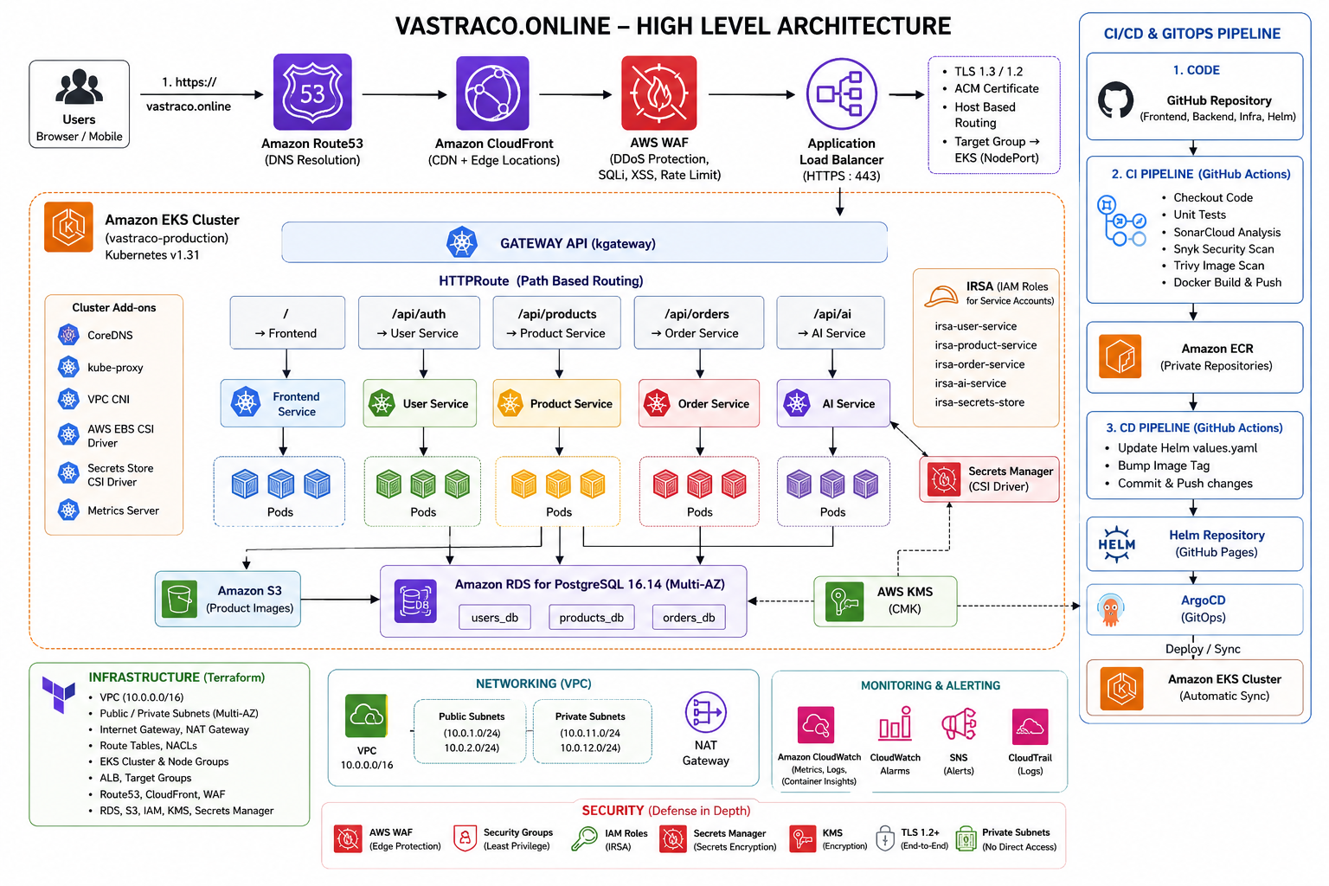

Slide 4
VastraCo
AWS Infrastructure — Terraform-Provisioned
Networking
Compute & Storage
Security & Observability
VPC 10.0.0.0/16
EKS 1.31 on t3.medium
KMS CMK (alias/vastraco-prod)
2 Public Subnets
desired=2, max=3
Secrets Manager (3 secrets)
2 Private App Subnets
ECR (5 repos, IMMUTABLE)
WAF (CloudFront scope)
2 Private DB Subnets
RDS PostgreSQL 16.14
ACM Certificate:
Internet Gateway
db.t3.micro
vastraco.online
Single NAT Gateway
S3 Product Images Bucket
*.vastraco.online
VPC Interface Endpoints:
CloudWatch Alarms
ECR · Secrets Mgr · SSM
CloudFront Distribution
SNS email alerts
S3 Gateway Endpoint
PriceClass_100
4

Slide 5
VastraCo
Infrastructure as Code — Terraform
bootstrap/
S3 state bucket: vastraco-terraform-state-63f1696f
DynamoDB lock table: vastraco-terraform-locks
vpc
kms
iam
alb
waf
cloudfront
eks
irsa
rds
secretsmanager
s3
route53
Remote S3 Backend with DynamoDB state locking · Two AWS providers: default (ap-south-1) + us-east-1 alias for WAF & ACM (required by CloudFront)
5

Slide 6
VastraCo
Defence in Depth — Zero Trust by Design
1
2
3
4
5
Edge
Network
Identity
Data
Code
WAF (OWASP rules, rate limiting) on CloudFront
ALB in public subnets, EKS nodes in private subnets
IRSA — no static AWS credentials in pods
KMS CMK encrypts RDS, Secrets Manager, S3, CloudWatch
Snyk: dependency CVE scanning on every CI run
TLS 1.3 minimum
RDS in isolated DB subnets (10.0.20-21.0/24)
4 IAM roles: user-svc, product-svc, order-svc, ai-svc
CSI Driver — secrets never in env files, ConfigMaps, or images
SonarCloud SAST: static analysis on every CI run
DDoS protection via CloudFront Shield Standard
SGs: RDS allows only EKS node SG on port 5432
Trust policy locked by namespace + service account name
EKS etcd Secrets encrypted with KMS
Trivy: filesystem + container image scan on every CI run
No public IPs on nodes or RDS
6

Slide 7
VastraCo
IRSA — IAM Roles for Service Accounts
OIDC Registration
STS AssumeRole
1
5
EKS publishes OIDC issuer URL → Terraform registers as IAM Identity Provider
CSI Driver reads token → calls sts:AssumeRoleWithWebIdentity → gets temp credentials (1hr TTL, auto-rotated)
IAM Role + Trust Policy
Secrets Fetch
2
6
sts:AssumeRoleWithWebIdentity only from system:serviceaccount:production:user-service-sa
CSI Driver calls Secrets Manager → fetches vastraco/db-creds and vastraco/jwt-secret → mounts as K8s Secret
Pod Starts
Pod Env Vars
3
7
Pod spec sets serviceAccountName: user-service-sa
Container reads from K8s Secret: USER_DB_HOST, USER_DB_PASSWORD, JWT_SECRET — zero static credentials
Webhook Injection
4
EKS Pod Identity Webhook injects AWS_ROLE_ARN + AWS_WEB_IDENTITY_TOKEN_FILE (24hr projected token)
Zero static credentials anywhere — temporary STS tokens rotated every 1 hour
7

Slide 8
VastraCo
Kubernetes — Production Namespace
5 Deployments (HPA min=2 max=5, CPU=70%)
HTTPRoute Rules
Path Prefix | Backend | Port
/api/auth | user-service | 3001
/api/orders | order-service | 3003
/api/categories | product-service | 3002
/api/products | product-service | 3002
/api/ai | ai-service | 3004
/ (catch-all) | frontend | 80
5 ReplicaSets → 10 Pods (2 replicas per service)
5 ClusterIP Services
1 Gateway: vastraco-gateway (kgateway / Envoy)
1 HTTPRoute: vastraco-routes
Gateway API (not Ingress)
kgateway — Envoy-based data plane
ServerSideApply=true for conflict resolution
8

Slide 9
VastraCo
Secrets Flow — CSI Driver + AWS Secrets Manager
AWS Secrets Manager
Key Principle
vastraco/db-creds
→ {host, username, password}
Secrets are never stored in Git, ConfigMaps, Docker images, or plain Kubernetes Secrets manually.
They flow exclusively from AWS Secrets Manager on pod startup, injected via CSI Driver using short-lived IRSA credentials.
vastraco/jwt-secret
→ {jwt_secret}
vastraco/app-secrets
→ {groq_api_key, groq_model}
via IRSA temp credentials
SecretProviderClass (jmesPath extraction)
CSI Driver mounts on pod start
Container Environment Variables (secretKeyRef)
K8s Secret (user-service-secret, product-service-secret, …)
USER_DB_HOST
USER_DB_PASSWORD
JWT_SECRET
GROQ_API_KEY
PRODUCT_DB_HOST
9

Slide 10
VastraCo
GitOps CI/CD — GitHub Actions + ArgoCD
Developer
pushes code
CI: detect-changes
(paths-filter)
Parallel Security Gates
SonarCloud · Snyk · Trivy FS
Docker Build
Trivy Image Scan
Push to ECR
Upload
build-metadata
artifact
Image tag format: 7-char git SHA e.g. 11fcd17
CD: yq update
values-production.yaml
git commit
→ vastraCo-helm
repo
ArgoCD detects
Helm repo change
→ kubectl apply
Smoke Tests
/health checks
Email notify
ArgoCD GitOps: Detects Helm repo change → Renders templates → kubectl apply → Rolling update → kubectl rollout status → Smoke tests → Email notification (success/failure)
10

Slide 11
VastraCo
ArgoCD — Git as Single Source of Truth
ArgoCD Applications
Sync Policy
vastraco-production
automated:
prune: true # removes resources deleted from Git
Chart: charts/vastraco-services
Revision: main
selfHeal: true # reverts manual kubectl changes
Values: values.yaml + values-production.yaml
syncOptions:
- CreateNamespace=true
vastraco-kgateway
- ServerSideApply=true
Path: kgateway/
retry:
Resources: Gateway + HTTPRoute
limit: 5
Namespace: production
backoff:
duration: 5s
Key Principle: Any drift between cluster state and Git is automatically corrected. Rollback = git revert. Full audit trail in Git history.
factor: 2
maxDuration: 3m
11

Slide 12
VastraCo
Helm — One Chart, Five Microservices
Chart Files
CD Image Tag Update
vastraco-services/
yq e '.services."user-service"
├── Chart.yaml (version: 0.1.0)
.image.tag = "11fcd17"' \
├── values.yaml (defaults: tag=latest)
-i values-production.yaml
├── values-production.yaml
│ (real tags, IRSA ARNs, resource limits)
# git commit → ArgoCD detects → sync
└── templates/
├── deployment.yaml ({{range}} all services)
Current Production Tags
├── service.yaml (ClusterIP per service)
├── configmap.yaml (non-secret env vars)
frontend:
06dd0d5
order-service:
11fcd17
├── secretproviderclass.yaml
user-service:
11fcd17
ai-service:
06dd0d5
├── serviceaccount.yaml (IRSA annotation)
└── hpa.yaml (min=2, max=5, CPU=70%)
product-service:
11fcd17
Single Helm chart with {{range .Values.services}} loops — one template, five deployments. ArgoCD applies on every values-production.yaml commit.
12

Slide 13
VastraCo
AI Shopping Assistant — Groq + LangGraph + FastAPI
User Query
/api/ai
FastAPI
ai-service:3004
LangGraph
Agent
Groq API
LLM Inference
Technical Implementation
LangGraph Agent Tools
Stack:
Python 3.12 + FastAPI + LangGraph
Tool: product_search
→ calls product-service:3002 (catalog queries)
Secrets:
Groq key from vastraco/app-secrets (Secrets Manager)
Tool: order_history
Auth:
IRSA → never hardcoded, never in image
→ calls order-service:3003 (order lookup)
Streamed SSE response back to frontend
Startup:
validate_groq_connectivity() → pod unhealthy if Groq unreachable
CORS:
vastraco.online, www.vastraco.online
Route:
/api/ai prefix, Gateway API route
13

Slide 14
VastraCo
Observability — CloudWatch · SNS · Structured Logging
CloudWatch Alarms → SNS → harshithasrinivask@gmail.com
Log Groups (all KMS-encrypted)
Alarm | Threshold | Period
EKS Node CPU High | > 80% | 2 × 5 min
RDS CPU High | > 80% | 2 × 5 min
ALB 5XX Errors | > 10 errors | 1 × 1 min
RDS Storage Low | < 2 GB | 1 × 5 min
/aws/eks/vastraco-production/cluster
Retention: 7 days
/vastraco/production/application
Retention: 14 days
/aws/rds/instance/.../postgresql
Retention: 7 days
EKS Control Plane Logs Enabled
api
audit
authenticator
controllerManager
scheduler
Structured JSON logging on all services · Alarm actions → SNS → Email · All metric data encrypted with KMS CMK
14

Slide 15
VastraCo
Key Design Decisions & Summary
Security First
GitOps Principle
Cloud-Native Architecture
▸ IRSA over IAM users (zero static credentials)
▸ Git is single source of truth
▸ Gateway API (kgateway) over legacy Ingress
▸ CSI Driver over K8s Secrets for injection
▸ ArgoCD self-heals cluster drift
▸ Multi-origin CloudFront (ALB + S3)
▸ KMS CMK encrypts everything at rest
▸ CD updates Helm values via yq — no imperative kubectl
▸ Terraform remote state with DynamoDB locking
▸ 4-layer: Edge → Network → Identity → Data
▸ Full audit trail in Git history
▸ HPA auto-scaling per service (min=2, max=5)
Technology Stack
AWS EKS
Terraform
Helm
ArgoCD
GitHub Actions
Groq
FastAPI
React
PostgreSQL
KMS
15

