Slide 1
Denoising Depth images using Rgb images
Vasu Eranki

Slide 2
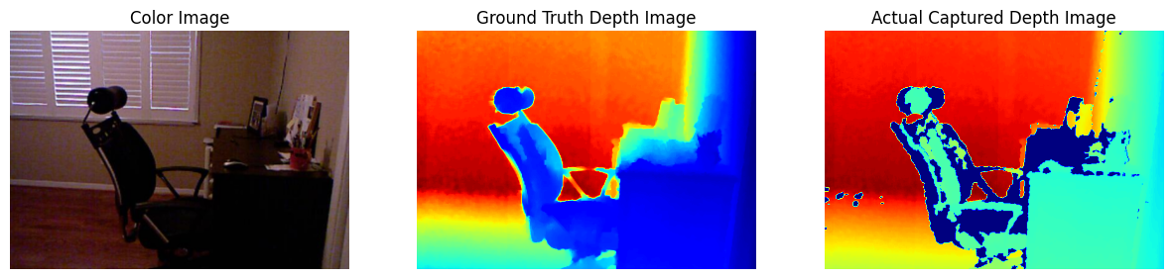
Motivation & Objectives
Practical Depth Images captured can be quite noisy and are usually not denoised which affects downstream tasks and datasets
Color and Scene information can be used since its less noisy than the Depth Image
Having denoised depth images closer to the ground truth can help improve the confidence levels of downstream tasks
The goal of this project is to leverage the information present inside the color image to help further denoise a depth image. (Without having access to pairs of clean-noisy depth images)

Slide 3
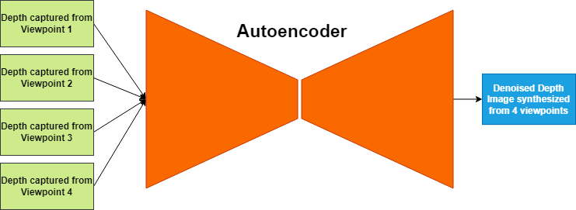
Technical Approach and novelty
Current State of the Art (SOTA) [1]
Images captured at slightly different angles have:
Similar information about the scene
Different amounts of noise present in it
Trained in a self-supervised manner
Proposed Approach
Train a denoiser which is given both RGB and Depth
Should use the scene information from RGB to denoise the Depth in a self-supervised manner
Limitations:
Requires 4 different depth images for training and there is no such dataset that is present

Slide 4
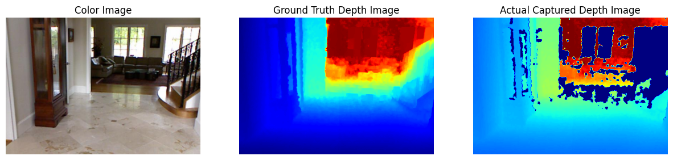
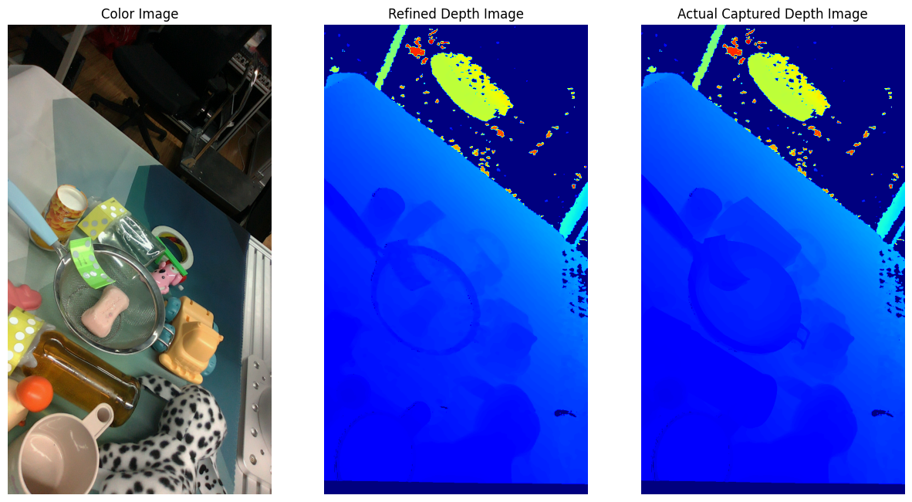
Methods
Dataset | Types of Images
NYU Depth Dataset [2] | Microsoft Kinect – Noisy and Clean
TransCG [3] | Intel L515 – Noisy and Refined Depth
CLUBS [4] | Intel D415 – Noisy
Hardware | Type
Intel RealSense L515 [5] | LiDAR based Depth Sensor

Slide 5
Evaluation and metrics
Typical Values Seen in Literature
Metrics | NYU Depth Dataset [2] | TransCG Dataset [3]
Mean Absolute Error (MAE) | ~5mm | ~12mm
RMSE (Root Mean Squared Error) | ~21mm | ~35mm
RMSE and MAE are the most common metrics used for evaluating denoising based models
A secondary goal of this project is to not make an overly complex system. A metric that helps this is the time taken to denoise a single depth frame.
Algorithm | Time to denoise a single frame
Bilateral Filter | 22ms
Anisotropic Diffusion | 0.64s
SOTA [1] | 16ms – On a T4 GPU

Slide 6
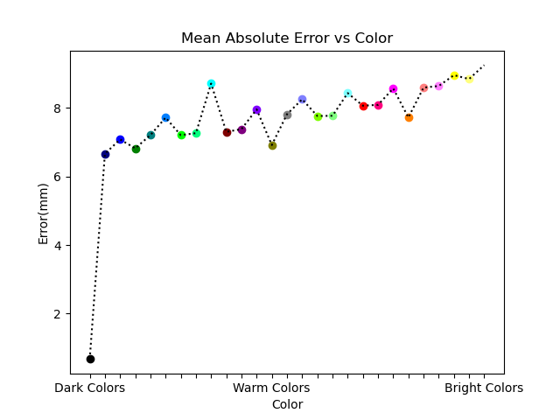
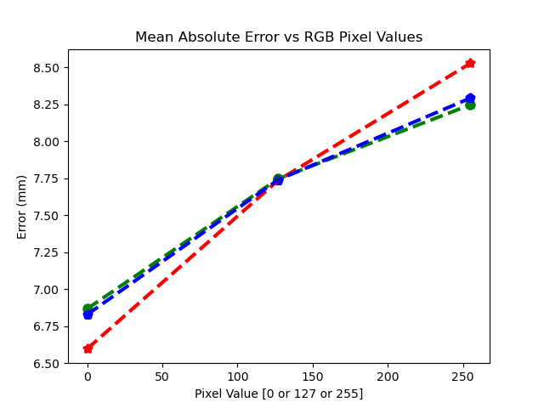
Current status
Simulated various colours through a monitor and captured the depth readings in a dark room:
Conclusions:
Colors with stronger intensities generate more noise (like white, yellow, orange)
The noise introduced by one channel is not independent of the others.

Slide 7
Current status and next steps
Setting Baseline Performance (Errors are in millimetre (mm))
 |  | NYU Depth Dataset[2] |  | TransCG Dataset [3]
 |  | MAE | RMSE | MAE | RMSE
Classical Computer Vision | Bilateral Filter | 16.41mm | 37.62mm | 41.03mm | 84.90mm
 | Anisotropic Diffusion based Filter | 44.34mm | 196.89mm | 49.24mm | 169.32mm
Data Driven Method | Current SOTA [1] | 8.58mm | 30.15mm | 11.02mm | 37.78mm
Next Steps
Develop a Noise model from the data collected
Apply it during training in one of two ways:
By augmenting our training data with a colour-informed noise function
Create a loss function that forces the model to leverage the colour information.

Slide 8
References
[1] Sterzentsenko, V., Saroglou, L., Chatzitofis, A., Thermos, S., Zioulis, N., Doumanoglou, A., Zarpalas, D. and Daras, P., 2019. Self-supervised deep depth denoising. In Proceedings of the IEEE/CVF International Conference on Computer Vision (pp. 1242-1251).
[2] Silberman, N., Hoiem, D., Kohli, P. and Fergus, R., 2012. Indoor segmentation and support inference from rgbd images. In Computer Vision–ECCV 2012: 12th European Conference on Computer Vision, Florence, Italy, October 7-13, 2012, Proceedings, Part V 12 (pp. 746-760). Springer Berlin Heidelberg.
[3] Fang, H., Fang, H.S., Xu, S. and Lu, C., 2022. Transcg: A large-scale real-world dataset for transparent object depth completion and a grasping baseline. IEEE Robotics and Automation Letters, 7(3), pp.7383-7390.
[4] Novkovic, T., Furrer, F., Panjek, M., Grinvald, M., Siegwart, R. and Nieto, J., 2019. CLUBS: An RGB-D dataset with cluttered box scenes containing household objects. The International Journal of Robotics Research, 38(14), pp.1538-1548
[5] https://www.intelrealsense.com/lidar-camera-l515/

