Slide 1
Preliminary results on relation between colour and noise

Slide 2
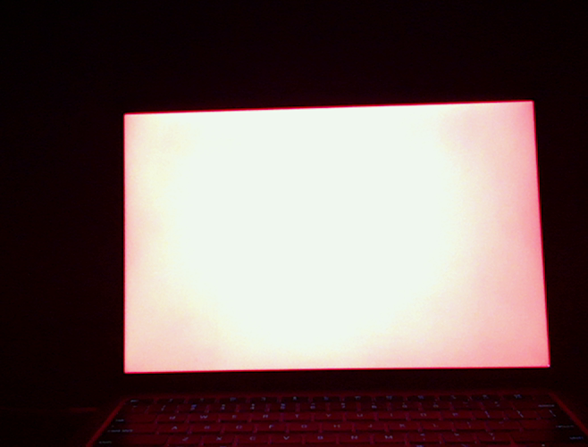
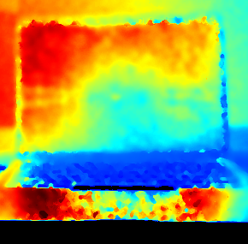
Experimental Methodology
The values of R,G,B were varied from 0 to 127 to 255 to give a total of 27 colour readings.
The depth and colour images were taken by flashing colours on a laptop screen.

Slide 3
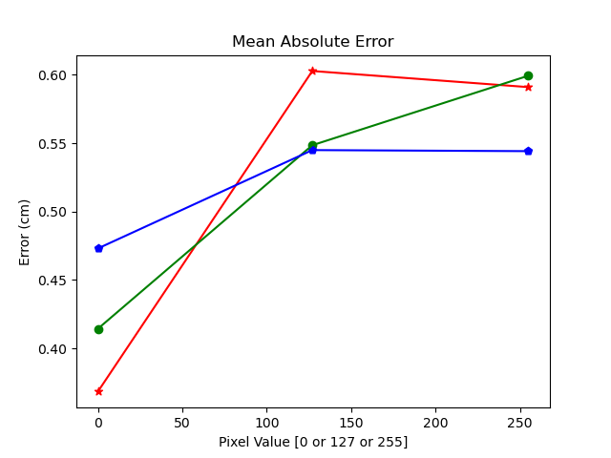
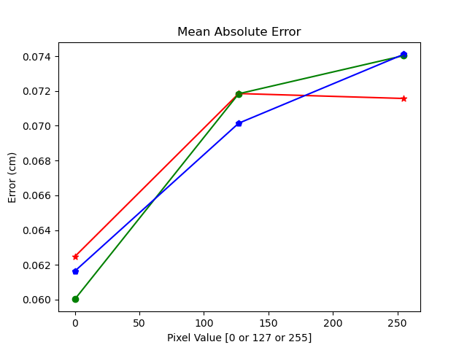
Relationship Between RGB and Noise
Experiment on November 12th
Experiment on November 13th

Slide 4
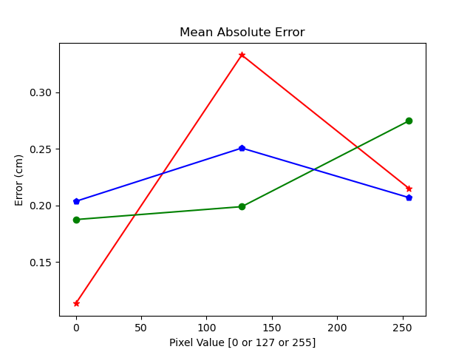
Relationship Between RGB and Noise (Continued)
Experiment on November 14th

Slide 5
Explanation for following results
The following results are just the plain results from the sensor upon which the errors were calculated. This plot was then subsequently processed to get the R/G/B plots that were shown earlier.

Slide 6
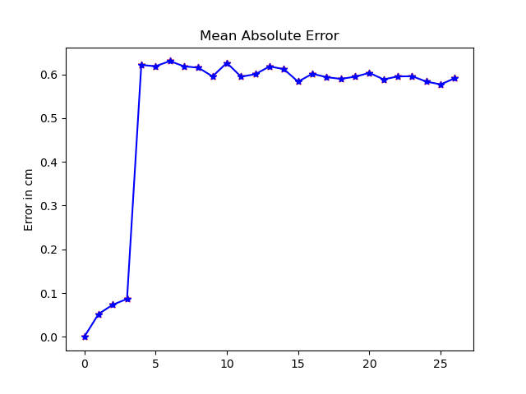
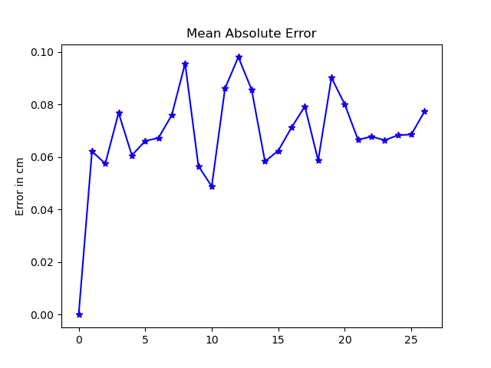
November 12th, Range of Errors when varying colors
November 13th, Range of Errors when varying colors

Slide 7
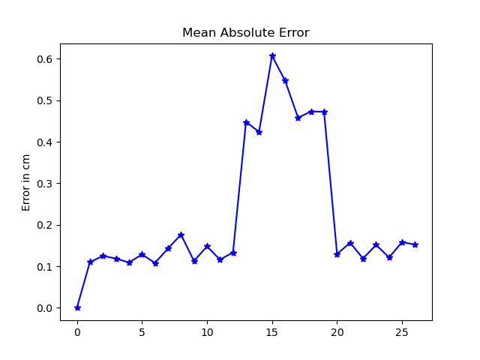
November 14th, Range of Errors when varying colors

