Slide 1
Personalized Stress Detection System
Predicting Stress Level for Better Health
Vasu Seelamneni

Slide 2
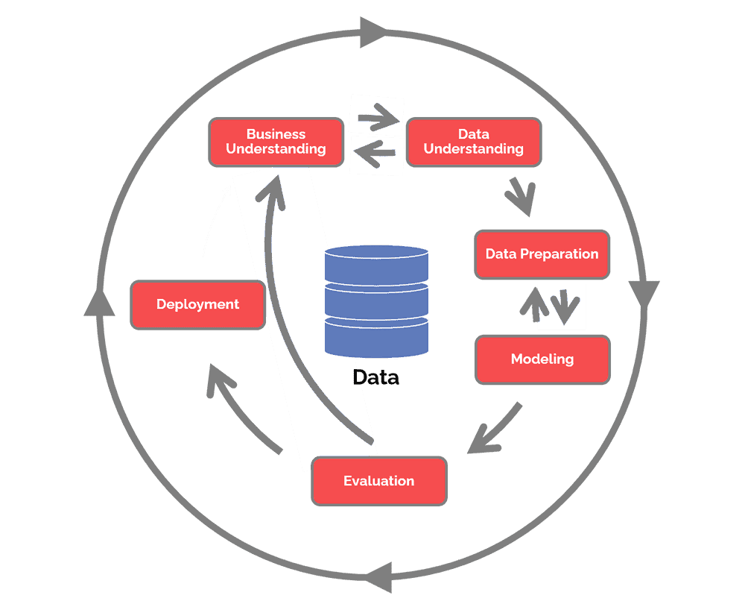
What had been done in the ML lifecycle of this project
Business understanding – What does the business need?
Data understanding – What data do we have / need? Is it clean?
Data preparation – How do we organize the data for modeling?
Modeling – What modeling techniques should we apply?
Evaluation – Which model best meets the business objectives?
Deployment – How do stakeholders access the results?

Slide 3
Background & Data Understanding
Introduction
Stress is a common issue in modern society and can have significant impacts on health and well-being. Being able to predict an individual's stress level could help in early detection and intervention, potentially preventing health issues and improving quality of life. Therefore, this project aims to predict the personalized stress detection based on various features. The dataset is downloaded from Kaggle and Google Dataset Search
Describe Data
The dataset has 13 columns, and with 559 entries in total. The data types for the dataset consists of object type, integer type, and float type in which 1 columns are float type, 7 column is integer type, and 5 columns are object type.
Data Dictionary
Person ID: An identifier for each individual.
Gender: The gender of the person (Male/Female).
Age: The age of the person in years.
Occupation: The occupation or profession of the person.
Sleep Duration (hours): The number of hours the person sleeps per day.
Quality of Sleep (scale: 1-10): A subjective rating of the quality of sleep, ranging from 1 to 10.
Physical Activity Level (minutes/day): The number of minutes the person engages in physical activity daily.
Stress Level (scale: 1-10): A subjective rating of the stress level experienced by the person, ranging from 1 to 10.
BMI Category: The BMI category of the person (e.g., Underweight, Normal, Overweight).
Blood Pressure (systolic/diastolic): The blood pressure measurement of the person, indicated as systolic pressure over diastolic pressure.
Heart Rate (bpm): The resting heart rate of the person in beats per minute.
Daily Steps: The number of steps the person takes per day.

Slide 4
Data Preparation
All the data columns are selected in predicting the outcome of the stress level. The missing values that exist in the dataset are handled in a proper and formal way to maximize the accuracy, precision and recall of the results.
Handle Missing Values
As we can observe that there are 375 null values for Sleep Disorder column in the dataset. The presence of "Nan" value indicates that the individual does not have sleep disorder. Therefore, we will replace it with the term "Nothing".
Also, we can observe that in the "BMI Category" column, the term "Normal" and "Normal Weight" have same meant. Hence, we replace the value with "Normal" for consistency.
Handle Data Transformation
Numerical Data | Categorical Data
The numerical data that present in the dataset are transformed by standardizing the values using StandardScaler in the sklearn.preprocessing library after the missing values have been handled. Stadardizing is required as the column values of the categorical data is within the range 0-4 while the column values of numerical data can be range to thousands. | The categorical data that present in the dataset are transformed to numerical representations (string to numeric) before handling the missing values by using the categorical function in the pandas library. It is required to transform the data because most of the machine learning algorithms can only process numerical values.

Slide 5
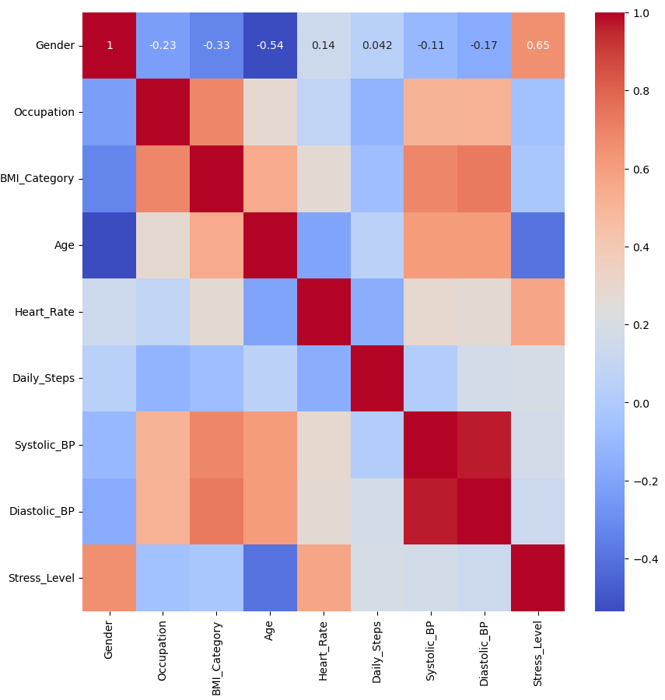
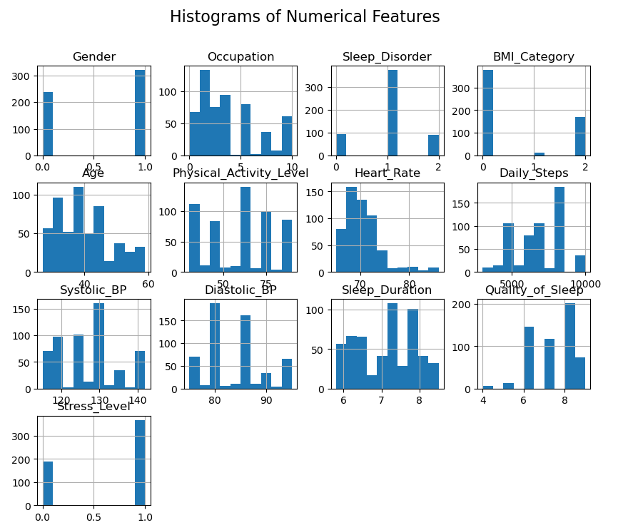
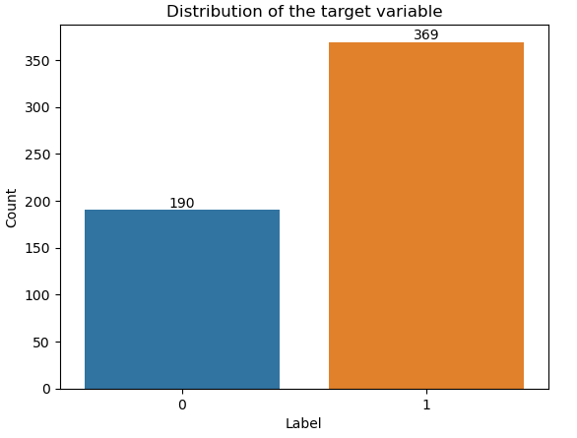
Data Visualization
Distribution of the target variable.
Histograms of all numerical features.
Heatmap to see the correlations between the features and the target variable.
Due to least correlation between the target variable and few features, dropped the columns that are not needed for the model training.

Slide 6
Algorithms Selected
There are total 6 supervised learning algorithms selected to model the dataset to find the best modelling technique to detect the stress level of an individual.
Random Forest Classifiers: An ensemble learning method that constructs multiple decision trees and outputs the mode of the classes predicted by individual trees.
K-nearest Neighbors (KNN): A type of instance-based learning that classifies a data point based on the classes of its nearest neighbors in the feature space.
Logistic Regression: A statistical model that uses a logistic function to model a binary dependent variable, used for classification problems.
Support Vector Classifier (SVC): A type of Support Vector Machine that finds the best boundary to divide data into classes, effective in high dimensional spaces.
Gaussian Naive Bayes: A variant of Naive Bayes that follows Gaussian normal distribution and supports continuous data, making it simple and fast for large datasets.
Decision Tree: A flowchart-like structure where each internal node represents a feature, each branch represents a decision rule, and each leaf node represents an outcome.

Slide 7
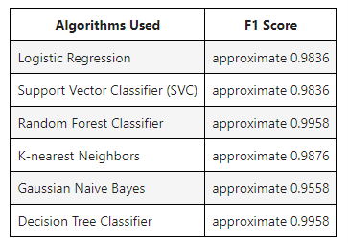
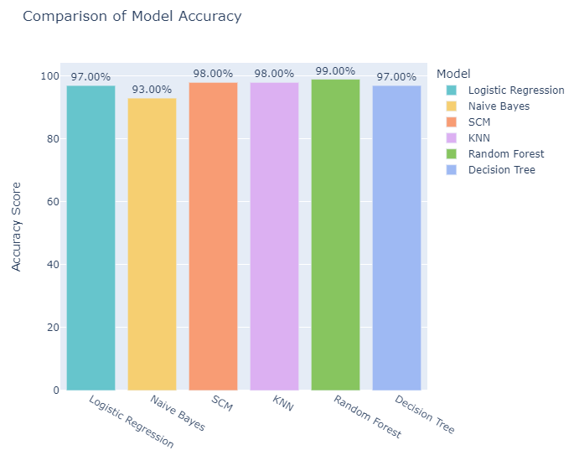
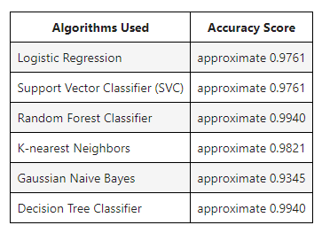
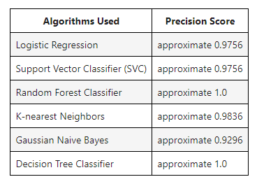
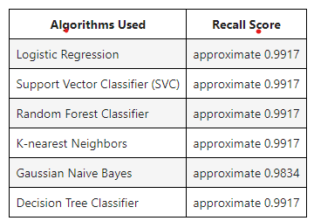
Model Evaluation

Slide 8
Conclusion
The primary goal of this system is to provide personalized insights into stress management. By accurately detecting stress levels, the system can help individuals understand their stress triggers and patterns. This understanding can be a powerful tool for managing stress and promoting healthier lifestyle choices.
Furthermore, the system can be used by healthcare professionals to monitor their patients' stress levels and provide more targeted and effective treatments. It can also be used by organizations to understand the stress levels of their employees and create a healthier and more productive work environment.

Slide 9
Thank you and Q & A

