Slide 1



LINUX

Slide 2

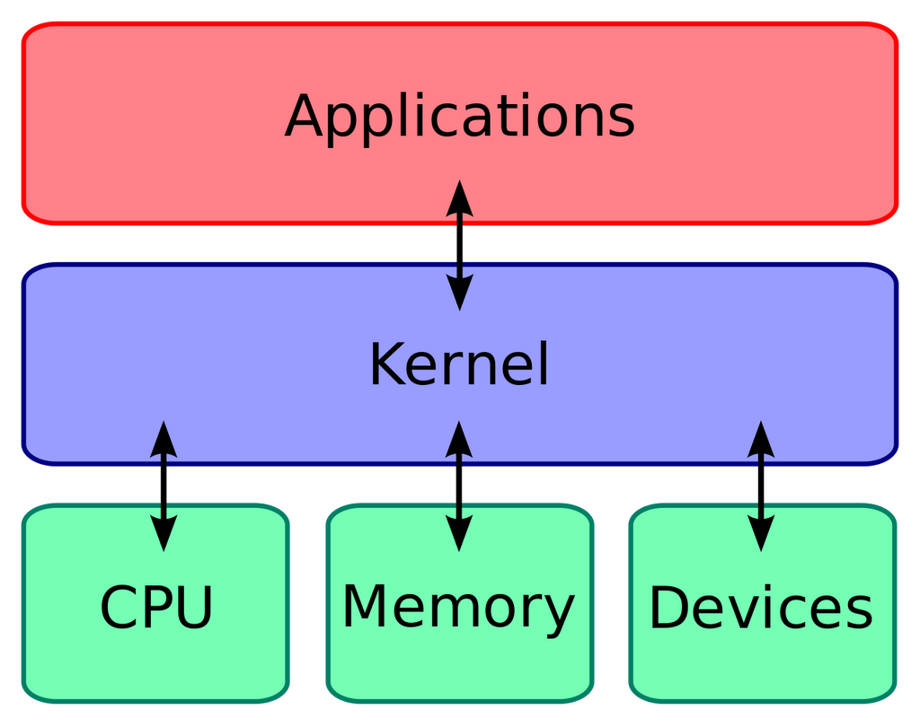
LINUX KERNEL
Memory Management
Process Management
Drivers
Processes

Slide 3

LINUX VERSIONS

Slide 4
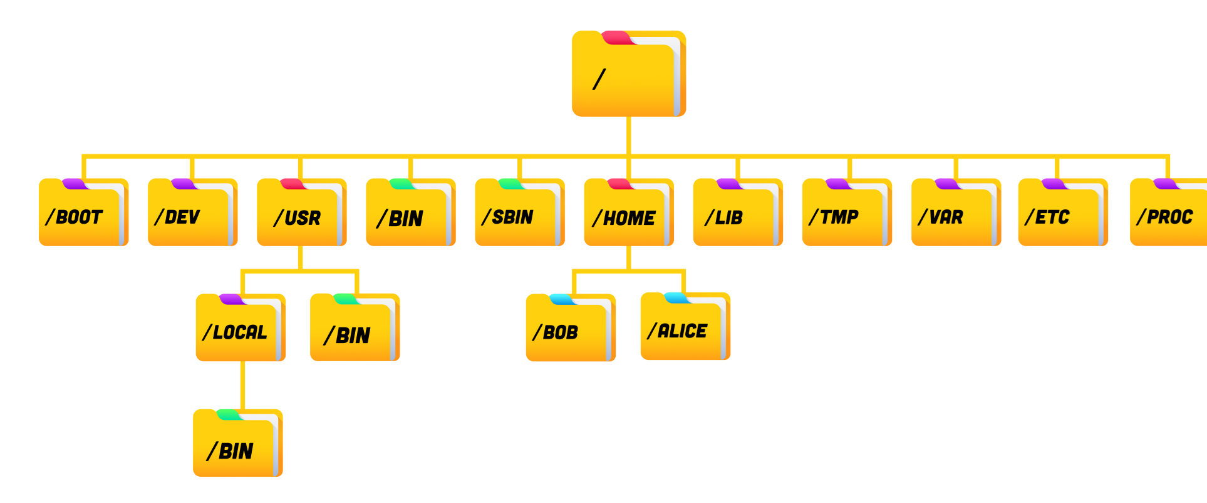
LINUX DIRECTORIES

Slide 5
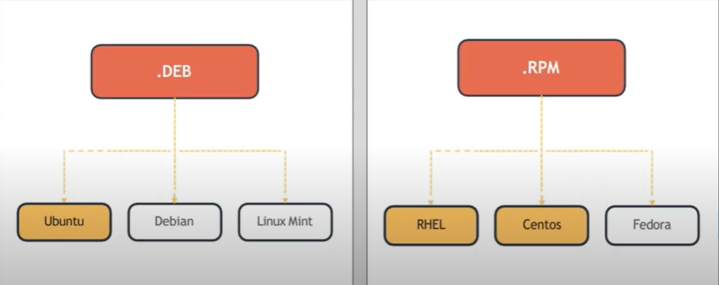
LINUX PACKAGES
Package Managers:
Package management is a method of installing, updating, removing, and keeping track of software updates from specific repositories (repos) in the Linux system

Slide 6
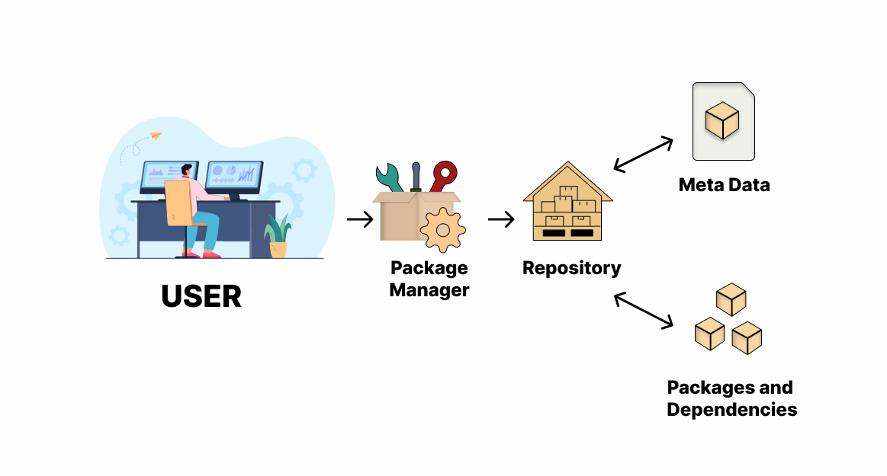
LINUX PACKAGES

Slide 7
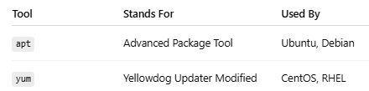
APT AND YUM
  HANDLES DEPENDENCIES AUTOMATICALLY
  EASIER TO SEARCH, INSTALL, UPGRADE
  SAFER: PACKAGE FROM VERIFIED REPOSITORIES
  MAINTAINS A LOCAL CACHE OF METADATA
  SUPPORTS INTERACTIVE OR AUTOMATED INSTALLS

