Slide 1
F I N I S H E R S
Team Members
Sugumar S
Vasu M
Sakthivelan G
Sivaram P V
Sujay V

Slide 2
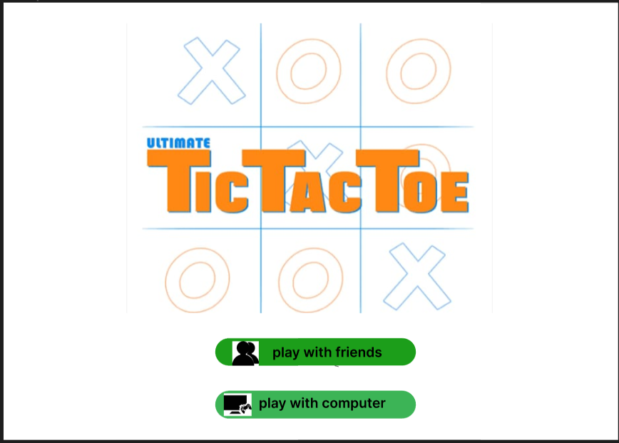

Slide 3
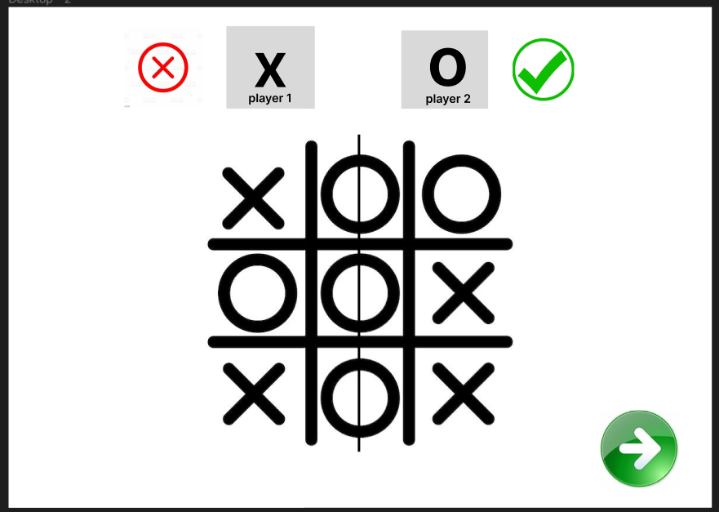

Slide 4
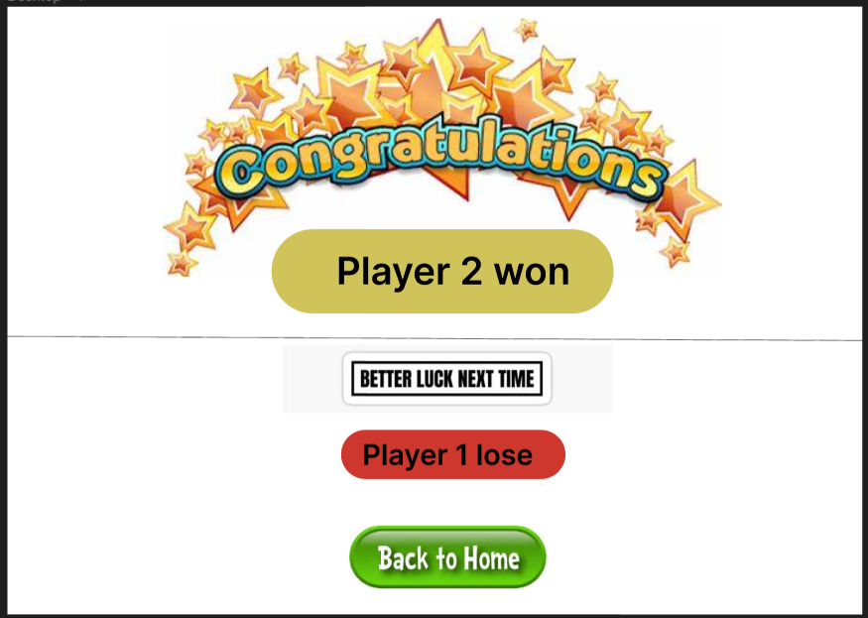

Slide 5
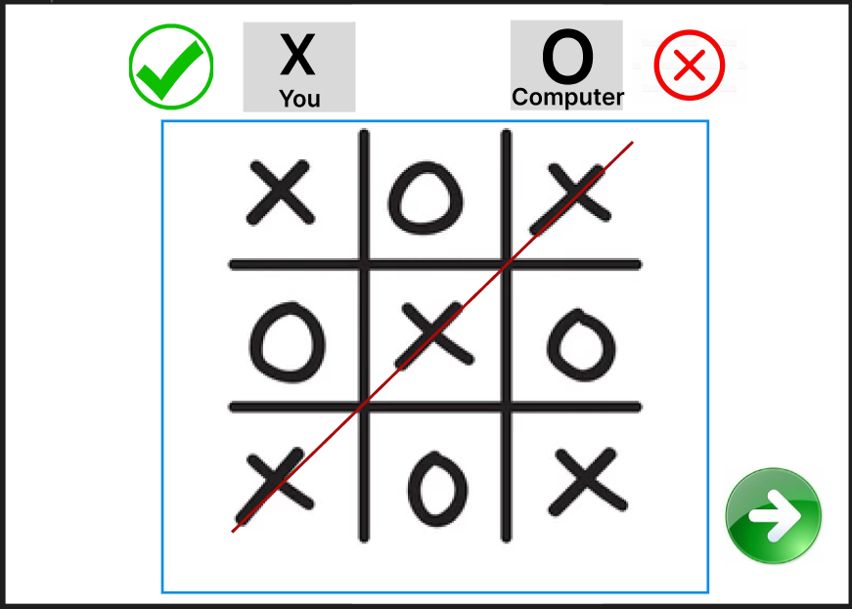

Slide 6
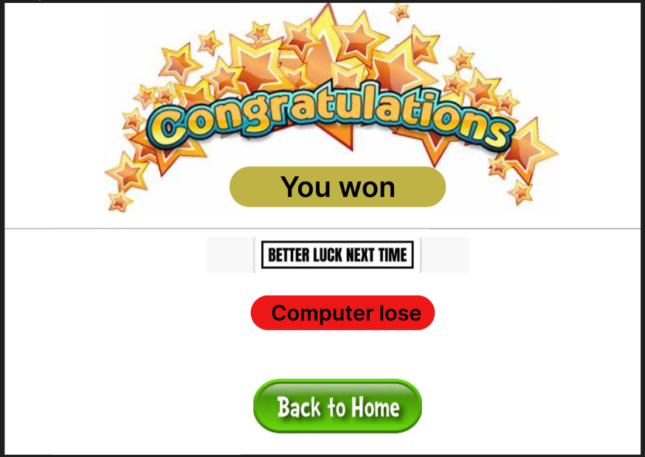

Slide 7
Links
Figma: https://www.figma.com/file/0QVPTAGhKfXDF91bwGaUA3/Untitled?node-id=0%3A1
Github: https://github.com/Vasu20041612/FINISHERS.git

Slide 8
Thank You

