Slide 1

Go Serverless with Firebase

Slide 2
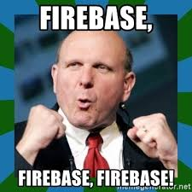

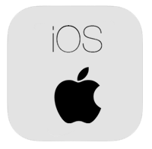

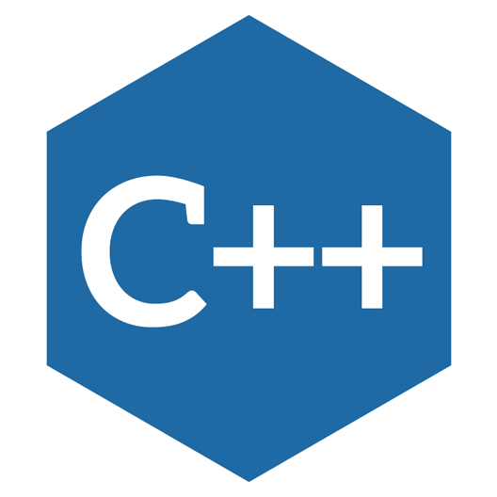

So What is Firebase
Firebase is Google’s unified platform that brings together powerful features for developers, including a mobile backend, analytics, and growth and monetization tools. Developers can choose just what they need and take advantage of the tight integration between the products they use. With solutions for each stage of development and growth, developers can develop with confidence knowing that they are using a comprehensive, scalable solution backed by Google.
Supports

Slide 3
“WHY” Firebase?

Slide 4
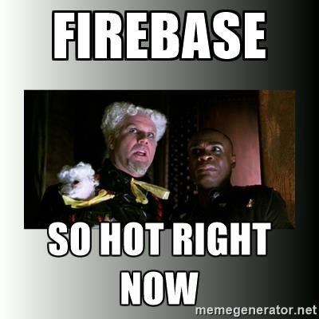
You don’t need to manage servers anymore.
You don’t need to write APIs anymore
Real-Time Database has its roots in real-time delivery of data structured using NOSQL conventions
Firebase allows you to develop the whole application on the front-end without any server-side code
Apps need to run from a central database and sync in real time between devices and browsers
Cloud messaging and notifications
Cloud Functions which allows you to write your custom code to execute business logic based on firebase triggers

Slide 5
Some Awesome Services from Firebase
For Growing Business
Analytics
Prediction
A/B Testing
Cloud Messaging and more
For Development
Real Time Database
Authentication
Cloud Storage
Hosting
Cloud Functions and more
ML-Kit (Introduced in Google I/O 2k18)
Text Recognition
Face Detection
Barcode Scanning
Image Labeling
Landmark Recognition
For Improving Quality
Crashlytics
Performance Monitoring
Test Lab

Slide 6
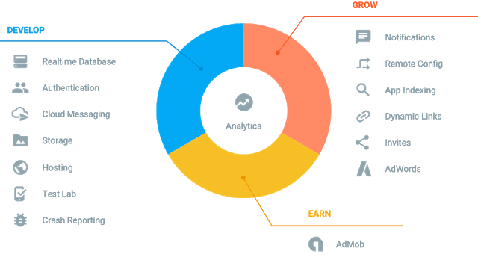
Yes, you can Earn Also!

Slide 7
Some Cool Projects built on top of it!
Shazam
Fabulous
Sky-scanner
Tune-in
kkBox
Glow
And the list goes on ….

Slide 8
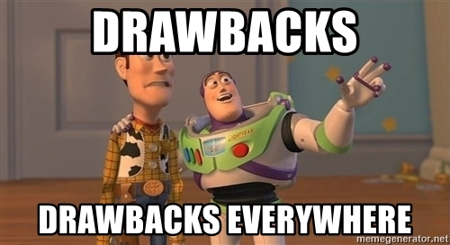
Does it have any “Drawbacks” ?

Slide 9
Of course, it has!
Firebase is also not ideal if your application requires continuous processing on server side (especially when data has to be analyzed before there is some display to your users real-time based on the result).
Firebase definitely doesn’t support transactions.
With Firebase, you are free to choose the pricing plan - but the one fitting for the real time applications is a “pay as you go” one.
It has a manual tree like data explorer but becomes complicated or difficult to traverse as dataset goes bigger.

Slide 10
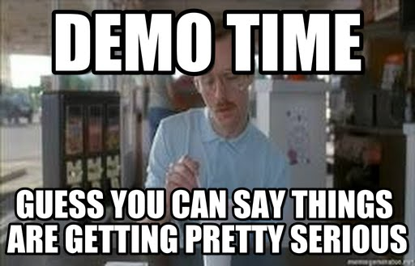
Let’s Move on to
Android Demo

Slide 11
Files : https://github.com/Vasu7052/GDG-Firebase-Talk
Thank you
Vasu Gupta
https://github.com/vasu7052 vasugupta7052@gmail.com
8447135901

