Slide 1
Assignment-2 Discussion (Question Answering)
NVS Abhishek 213050019
Gunjan Kumari 213050062
Vasudhan Varma 213050015
March 9,2022

Slide 2
Problem Statement (1/2)
Create a question answering system using a Recurrent Neural Network (RNN)
Dataset: SQUAD (https://rajpurkar.github.io/SQuAD-explorer/).
Consider only FACTOID type questions. Answers to such questions are single words and phrases. Thus, only WHO, WHAT, WHEN, WHERE questions are admitted and not WHY and HOW (pl do not quibble about 'what is the reason of' and 'what is the process of' which are equivalent to 'why' and 'how'!).
Create an encoder decoder network for the above task.

Slide 3
Problem Statement (2/2)
Extract factoid QA pairs from SQUAD.
Train with this data
QA system performance metrics: precision, recall and F-score.
Compare numbers with the state of the art. SQUAD is the standard benchmark for QA and umpteen number of papers report results on this data. A part of the assignment will be to tabulate these reported results along with their corresponding techniques.

Slide 4
Dataset Discussion

Slide 5
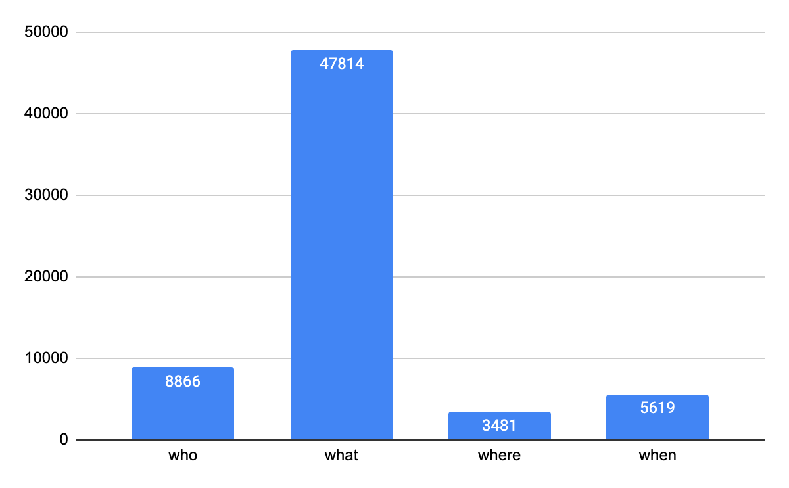
Details of Questions
Distribution of question: who, what, when, where

Slide 6
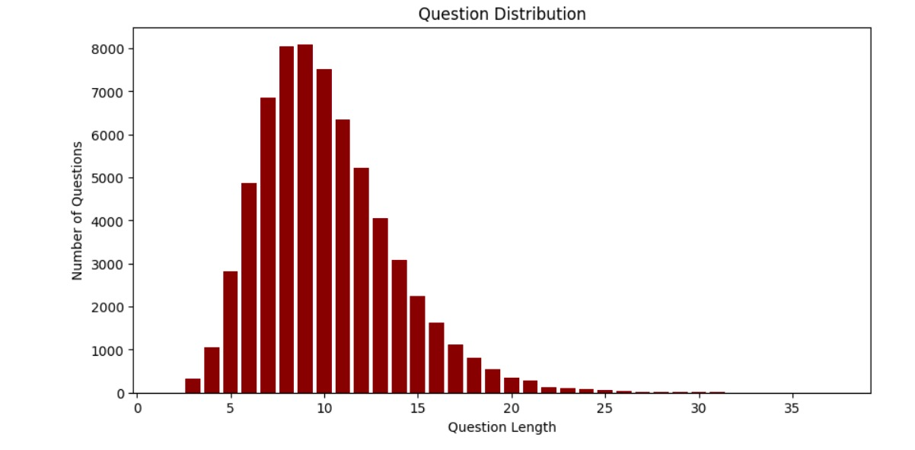
Details of Questions
Distribution on length of the question

Slide 7
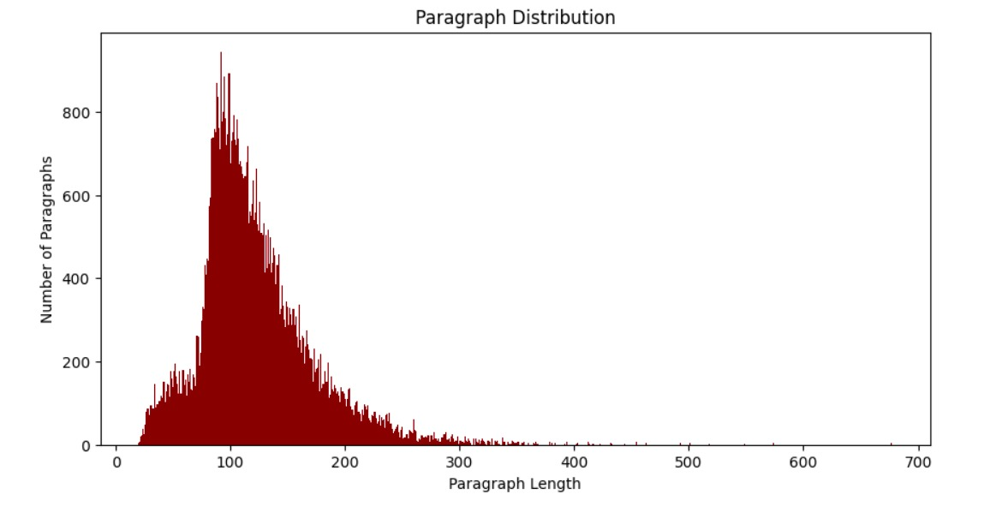
Details of Paragraphs
Distribution on length of the paragraphs

Slide 8
System implementation

Slide 9
Details of the RNN N/W
Layers:
Neurons/layer:
Embedding dimension: 50, 300
Attention: Bahdanau Attention
Different Hyper parameters:
Batch size - 1
Encoder:
Max sequence length observed-579
Hidden Layer size - 50
Attention result shape: (1,50)
Decoder output shape:
vocab size-9720

Slide 10
Training details (hyper-parameters)
How many epochs?
Embedding_50: 40 epochs
Embedding_300: 38 epochs
What is the learning rate?
0.001
Convergence criterion (at what error level do you stop)
Embedding50: 1.4411 loss
Embedding300: 1.74 loss

Slide 11
Various performance parameters: P, R, F-score, Accuracy
Embedding size: 50 | Precision | Recall | F1-score | Similarity Score
Who | 0.355 | 0.35 | 0.355 | 0.459
What | 0.268 | 0.268 | 0.267 | 0.412
When | 0.168 | 0.1685 | 0.168 | 0.361
Where | 0.269 | 0.269 | 0.269 | 0.40
Total | 0.263 | 0.2628 | 0.262 | 0.408

Slide 12
Various performance parameters: P, R, F-score, Accuracy
Embedding size: 300 | Precision | Recall | F1-score | Similarity Score
Who | 0.171 | 0.171 | 0.165 | 0.326
What | 0.237 | 0.237 | 0.237 | 0.396
When | 0.488 | 0.488 | 0.486 | 0.677
Where | 0.221 | 0.221 | 0.221 | 0.366
Total | 0.264 | 0.264 | 0.263 | 0.426

Slide 13
Error Analysis
Good cases
For embedding size 50 “who” questions have been answered properly and for embedding size 300 “when” questions have high accuracy.
Bad cases
For embedding size 50 “when” questions have been answered poorly and for embedding size 300 “who” questions have poor accuracy.

Slide 14
Comment slide (evaluation guideline- students to note)
You are being evaluated on:
Data gathering and preparation (10 marks)
RNN implementation (10)
Performance reporting (10)
Performance demonstration (10)
Error Analysis (10)

