Slide 1

Credit Card Fraud Detection

Slide 2

Contents
Business Objective – Problem Statement
Approaches
Solution Methodology (Proactive)
Measures
Solution Methodology (Reactive)
Improvements

Slide 3

Business Objective – Problem Statement
Recognizing fraudulent credit card transactions so that customers are not charged for items that they did not purchase.
Problem Statements
Cut down on Organizational Loss
Minimizing time and manpower used for fraud detection and prevention.
Identifying potential Fraudsters and Trustworthy customers.
Ensuring customers are only billed for their purchases.
Objectives
Notes:
This is a significant issue in the financial sector, and it requires a lot of time and manpower to detect and prevent frauds which can be utilized for other jobs. Here it not just involves to prevent customers from being charged for items they did not purchase but it also involves blocking such fraud transactions to minimize organization’s loss.
The problem is to identify and prevent fraudulent credit card transactions. This is a significant issue as it can lead to financial loss for both the customers and the credit card companies, and it can also damage the trust between them.

Slide 4



Approaches
This is Customer Level Solution
Here we are going to Identify the Customers who are more prone to be involved in fraudulent activities
Then the banks can take measures to prevent frauds
Proactive Approach (Customer Segmentation)
This is transaction Level Solution
Here we are building a Robust Machine Learning Model to prevent fraud on time as it is happening.
Thus reduce the loss for banks and fraud rate
Reactive Approach (Fraud Detection)
Notes:
Reactive Approach (Fraud Detection)
This approach is about identifying and flagging fraudulent transactions as they occur. It involves preprocessing the data, selecting the most relevant features, building a predictive model, and evaluating its performance. The goal is to accurately classify transactions as fraudulent or not. This is typically done using binary classification algorithms, and the performance of the model is evaluated using metrics like precision, recall and F1-score.
Proactive Approach (Customer Segmentation)
This approach is about proactively identifying customers who are likely to make fraudulent transactions. It involves creating new features that can help in identifying risky customers, using clustering algorithms to segment customers into different risk groups, and analyzing each cluster to understand its characteristics. The goal is to proactively identify high-risk customers and take preventive measures to mitigate the risk of fraud.

Slide 5
Solution Methodology Proactive Approach
This approach involves clustering techniques on the provided dataset to segment customers into different risk categories.
Solution Methodology
Technology Enablers
Realized Objectives
Data Preprocessing
K-means clustering algorithm
Libraries:
Pandas: Data Processing
Sklearn: Model Building
Matplotlib: Exploratory Data Analysis
Algorithms:
K-means
Hierarchical
Exploratory Data Analysis
Identifying potential Fraudsters and Trustworthy customers.
Feature Engineering
Model Building (Clustering)

Slide 6
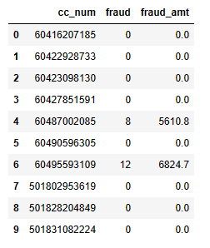
Proactive Approach
Data
Insights
cc_num => Credit Card Number

Slide 7

Proactive Approach
Measures
High Risk Customers:
Strict Monitoring
Limit Transactions
Two-Factor Authentication
Issuing new cards
Mid Risk Customers:
Periodic Monitoring
Customer Education
Low Risk Customers:
Regular Updates
Rewards
Notes:
High
Strict Monitoring: Implement real-time monitoring of transactions for these customers. Any suspicious activity should trigger an immediate alert.
Limit Transactions: Consider setting lower transaction limits for these customers to minimize potential losses.
Two-Factor Authentication: Enforce two-factor authentication for all transactions to add an extra layer of security.
Mid
Periodic Monitoring: Monitor these customers’ accounts periodically for any unusual activity.
Customer Education: Educate these customers about safe online transaction practices.
Low
Regular Updates: Keep these customers updated about any changes in security protocols.
Rewards: Consider rewarding these customers for maintaining secure transaction habits, which can encourage others to do the same.
it’s important to maintain a balance between security and customer experience. Overly strict measures might deter customers from using services.

Slide 8
Solution Methodology Reactive Approach
This approach is about identifying and flagging fraudulent transactions as they occur.
Solution Methodology
Technology Enablers
Realized Objectives
Data Preprocessing
xgboost
Libraries:
Pandas: Data Processing
Sklearn: Model Building
Matplotlib, Seaborn : Exploratory Data Analysis
xgboost: Model
datetime: to deal with dates and time features
Algorithms:
Logistic Regression
Random Forest
Decision Tree
xgboost
Cut down on Organizational Loss
Exploratory Data Analysis
Minimizing time and manpower used for fraud detection and prevention.
Feature Engineering:
Feature Selection, Encodings and Scaling
Model Building (Classification):
Model Selection and Evaluation
Ensuring customers are only billed for their purchases.
Notes:
Reactive Approach It involves preprocessing the data, selecting the most relevant features, building a predictive model, and evaluating its performance. The goal is to accurately classify transactions as fraudulent or not. This is typically done using binary classification algorithms, and the performance of the model is evaluated using metrics like precision, recall and F1-score.

Slide 9
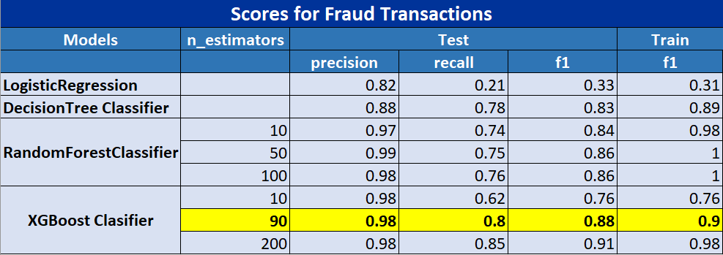
Reactive Approach
Model Selection
After selecting the features, we did hyper parameter tuning to find the best fit model.
Out of which we finalized XGBclassifier with 90 trees which is giving good f1 score without overfitting on train data

Slide 10
s
Impacts
Fraud Transactions
Before
0.45%
Fraud Transactions
After
0.1%
Fraud Transactions
Reduction of
80%
Fraud Amount
Before
$1,87,506 Fraud Transactions
After
$16,530 Fraud Transactions
Reduction of
91%
Notes:
Before 355 out of 77800 after 71

Slide 11
Thank You

