Slide 1



p_file
View in Power BI
Last data refresh:
7/20/2023 4:20:51 AM UTC
Downloaded at:
7/20/2023 4:35:54 AM UTC

Slide 2
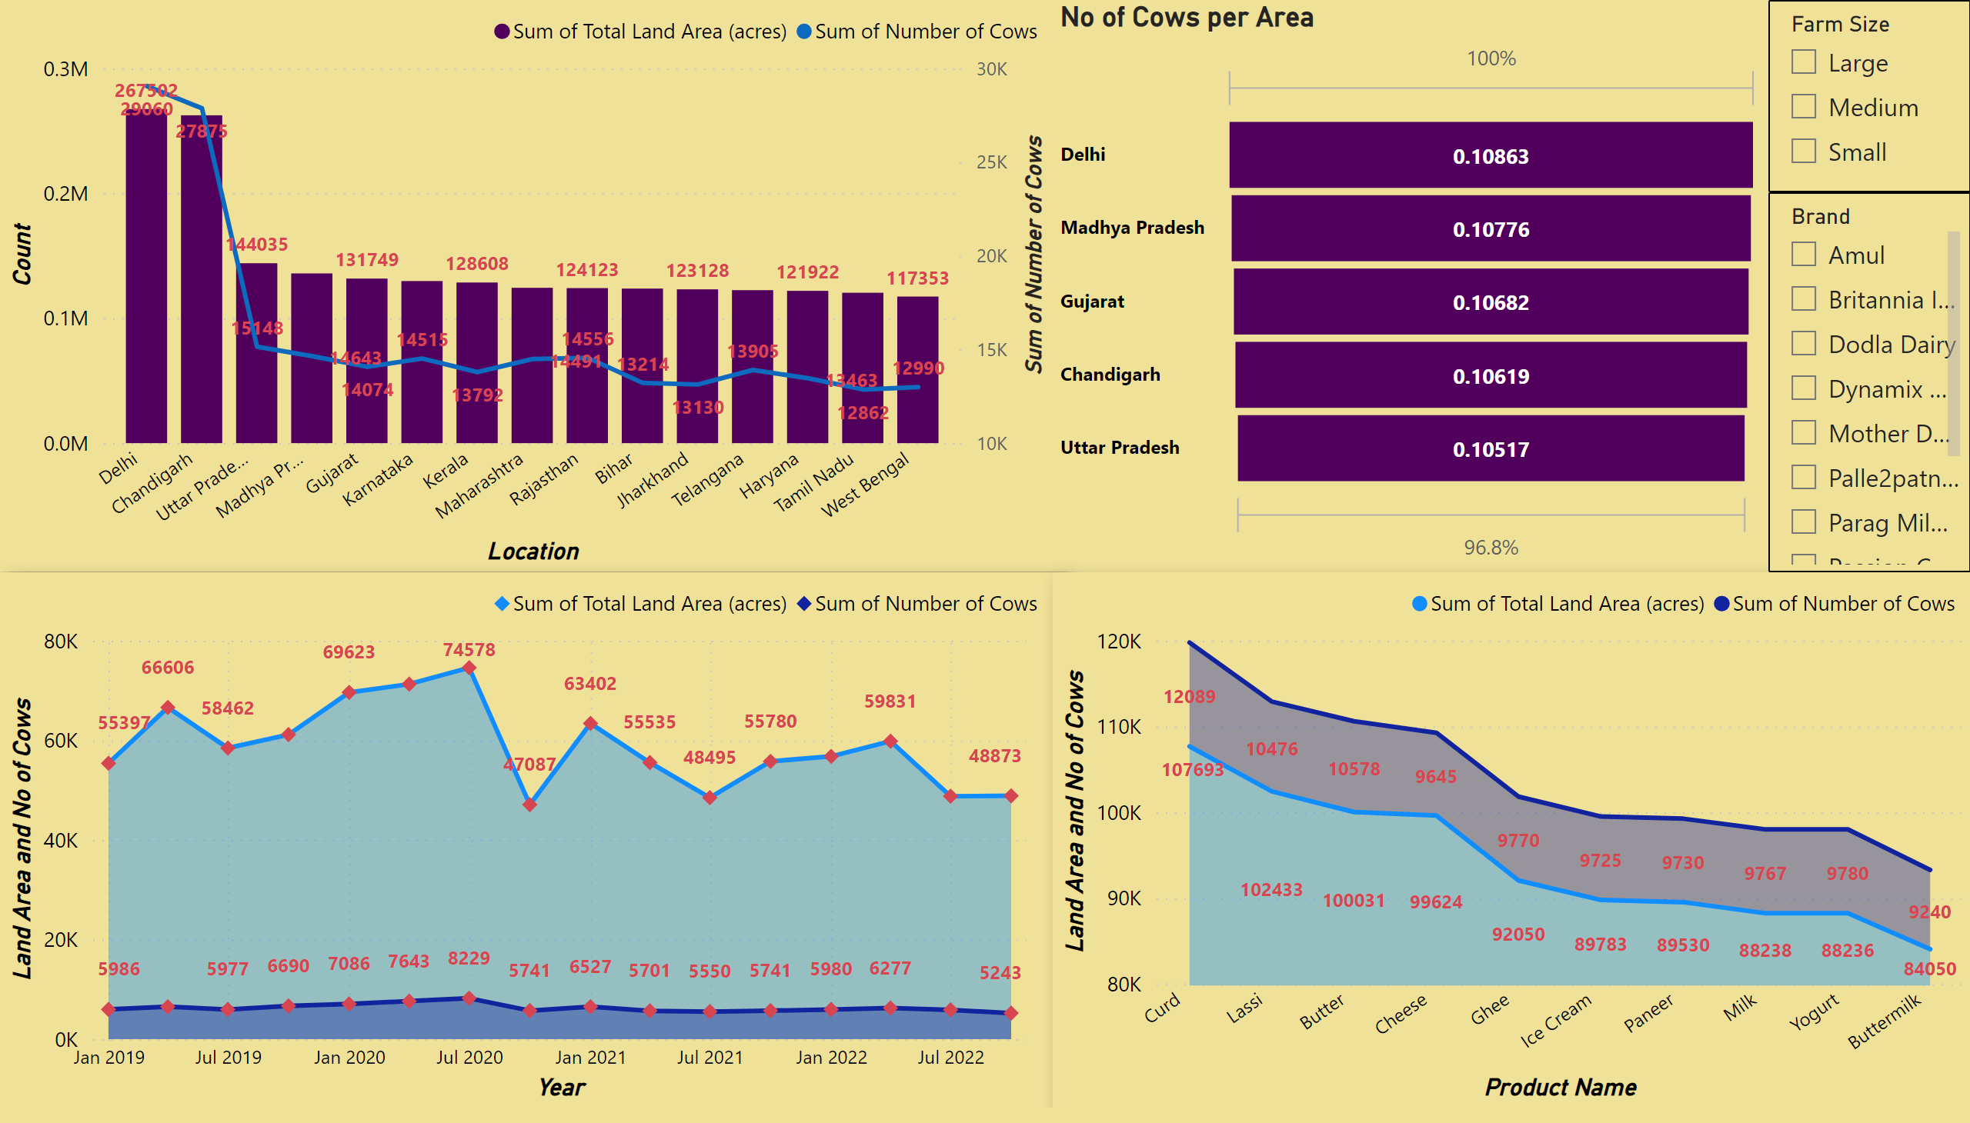
Area & Cows
Notes:
lineStackedColumnComboChart
No alt text provided
slicer
No alt text provided
No of Cows per Area
No alt text provided
Land Area VS Year
No alt text provided
stackedAreaChart
No alt text provided
slicer
No alt text provided

Slide 3
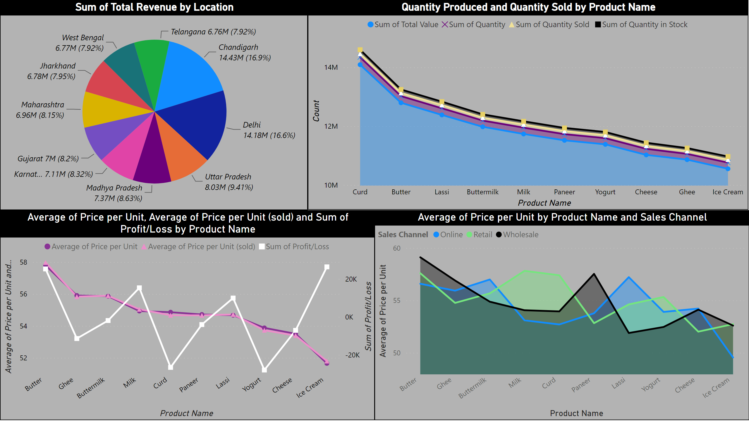
Revenue
Notes:
Sum of Total Revenue by Location
No alt text provided
lineChart
No alt text provided
Quantity Produced and Quantity Sold by Product Name
No alt text provided
areaChart
No alt text provided

Slide 4
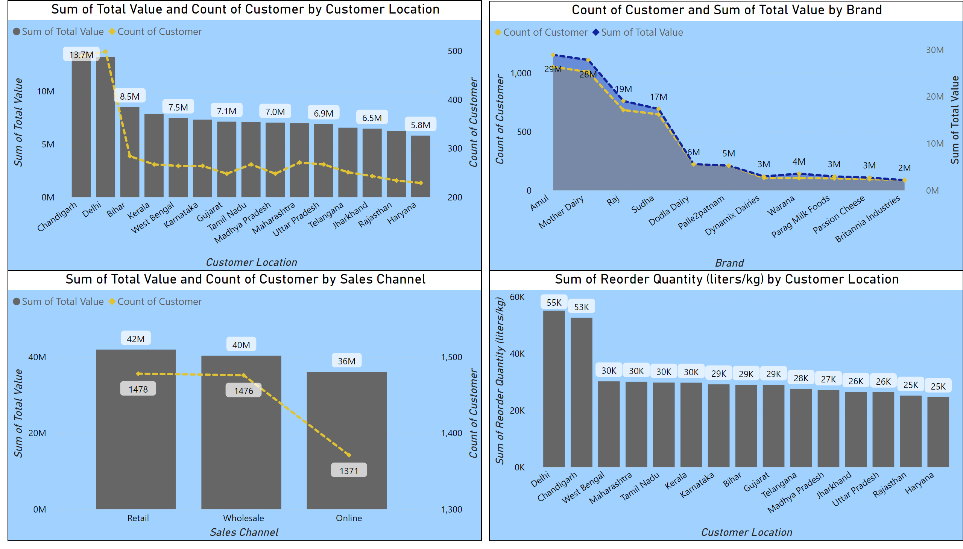
Customer
Notes:
lineStackedColumnComboChart
No alt text provided
areaChart
No alt text provided
lineStackedColumnComboChart
No alt text provided
lineStackedColumnComboChart
No alt text provided

Slide 5
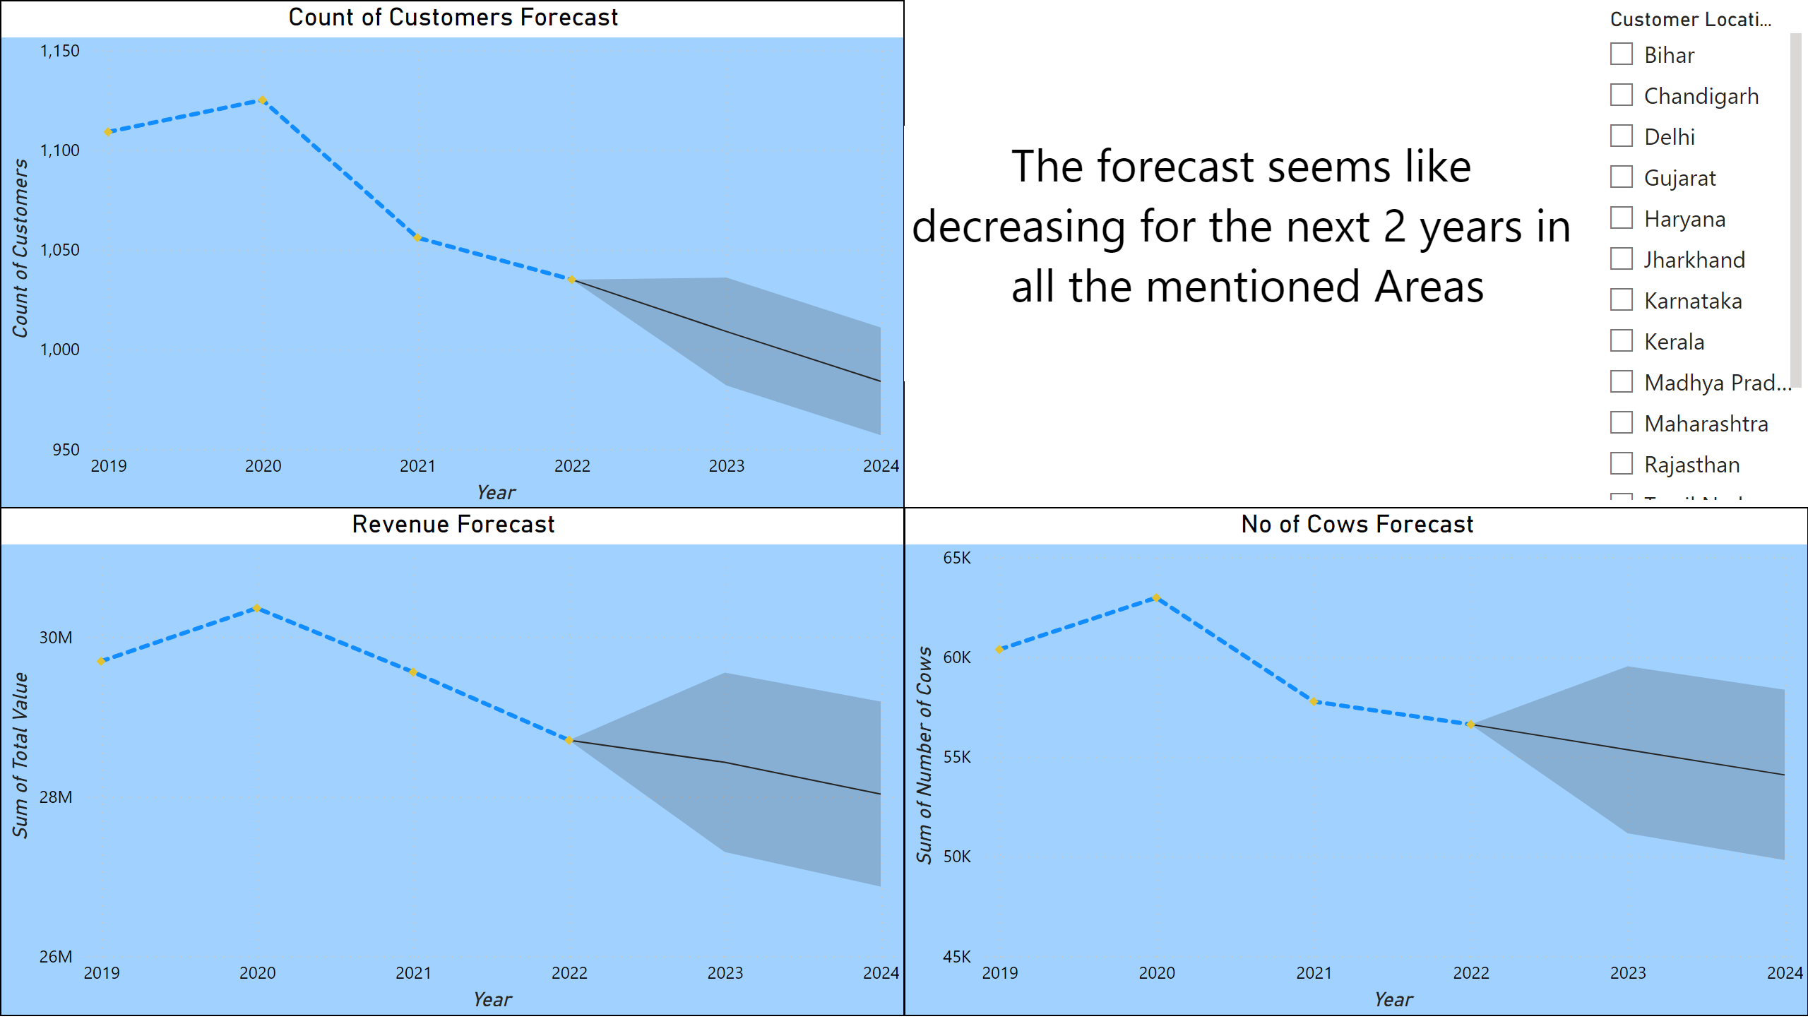
Forecast
Notes:
slicer
No alt text provided
Count of Customers Forecast
No alt text provided
Revenue Forecast
No alt text provided
No of Cows Forecast
No alt text provided
textbox
No alt text provided

Slide 6
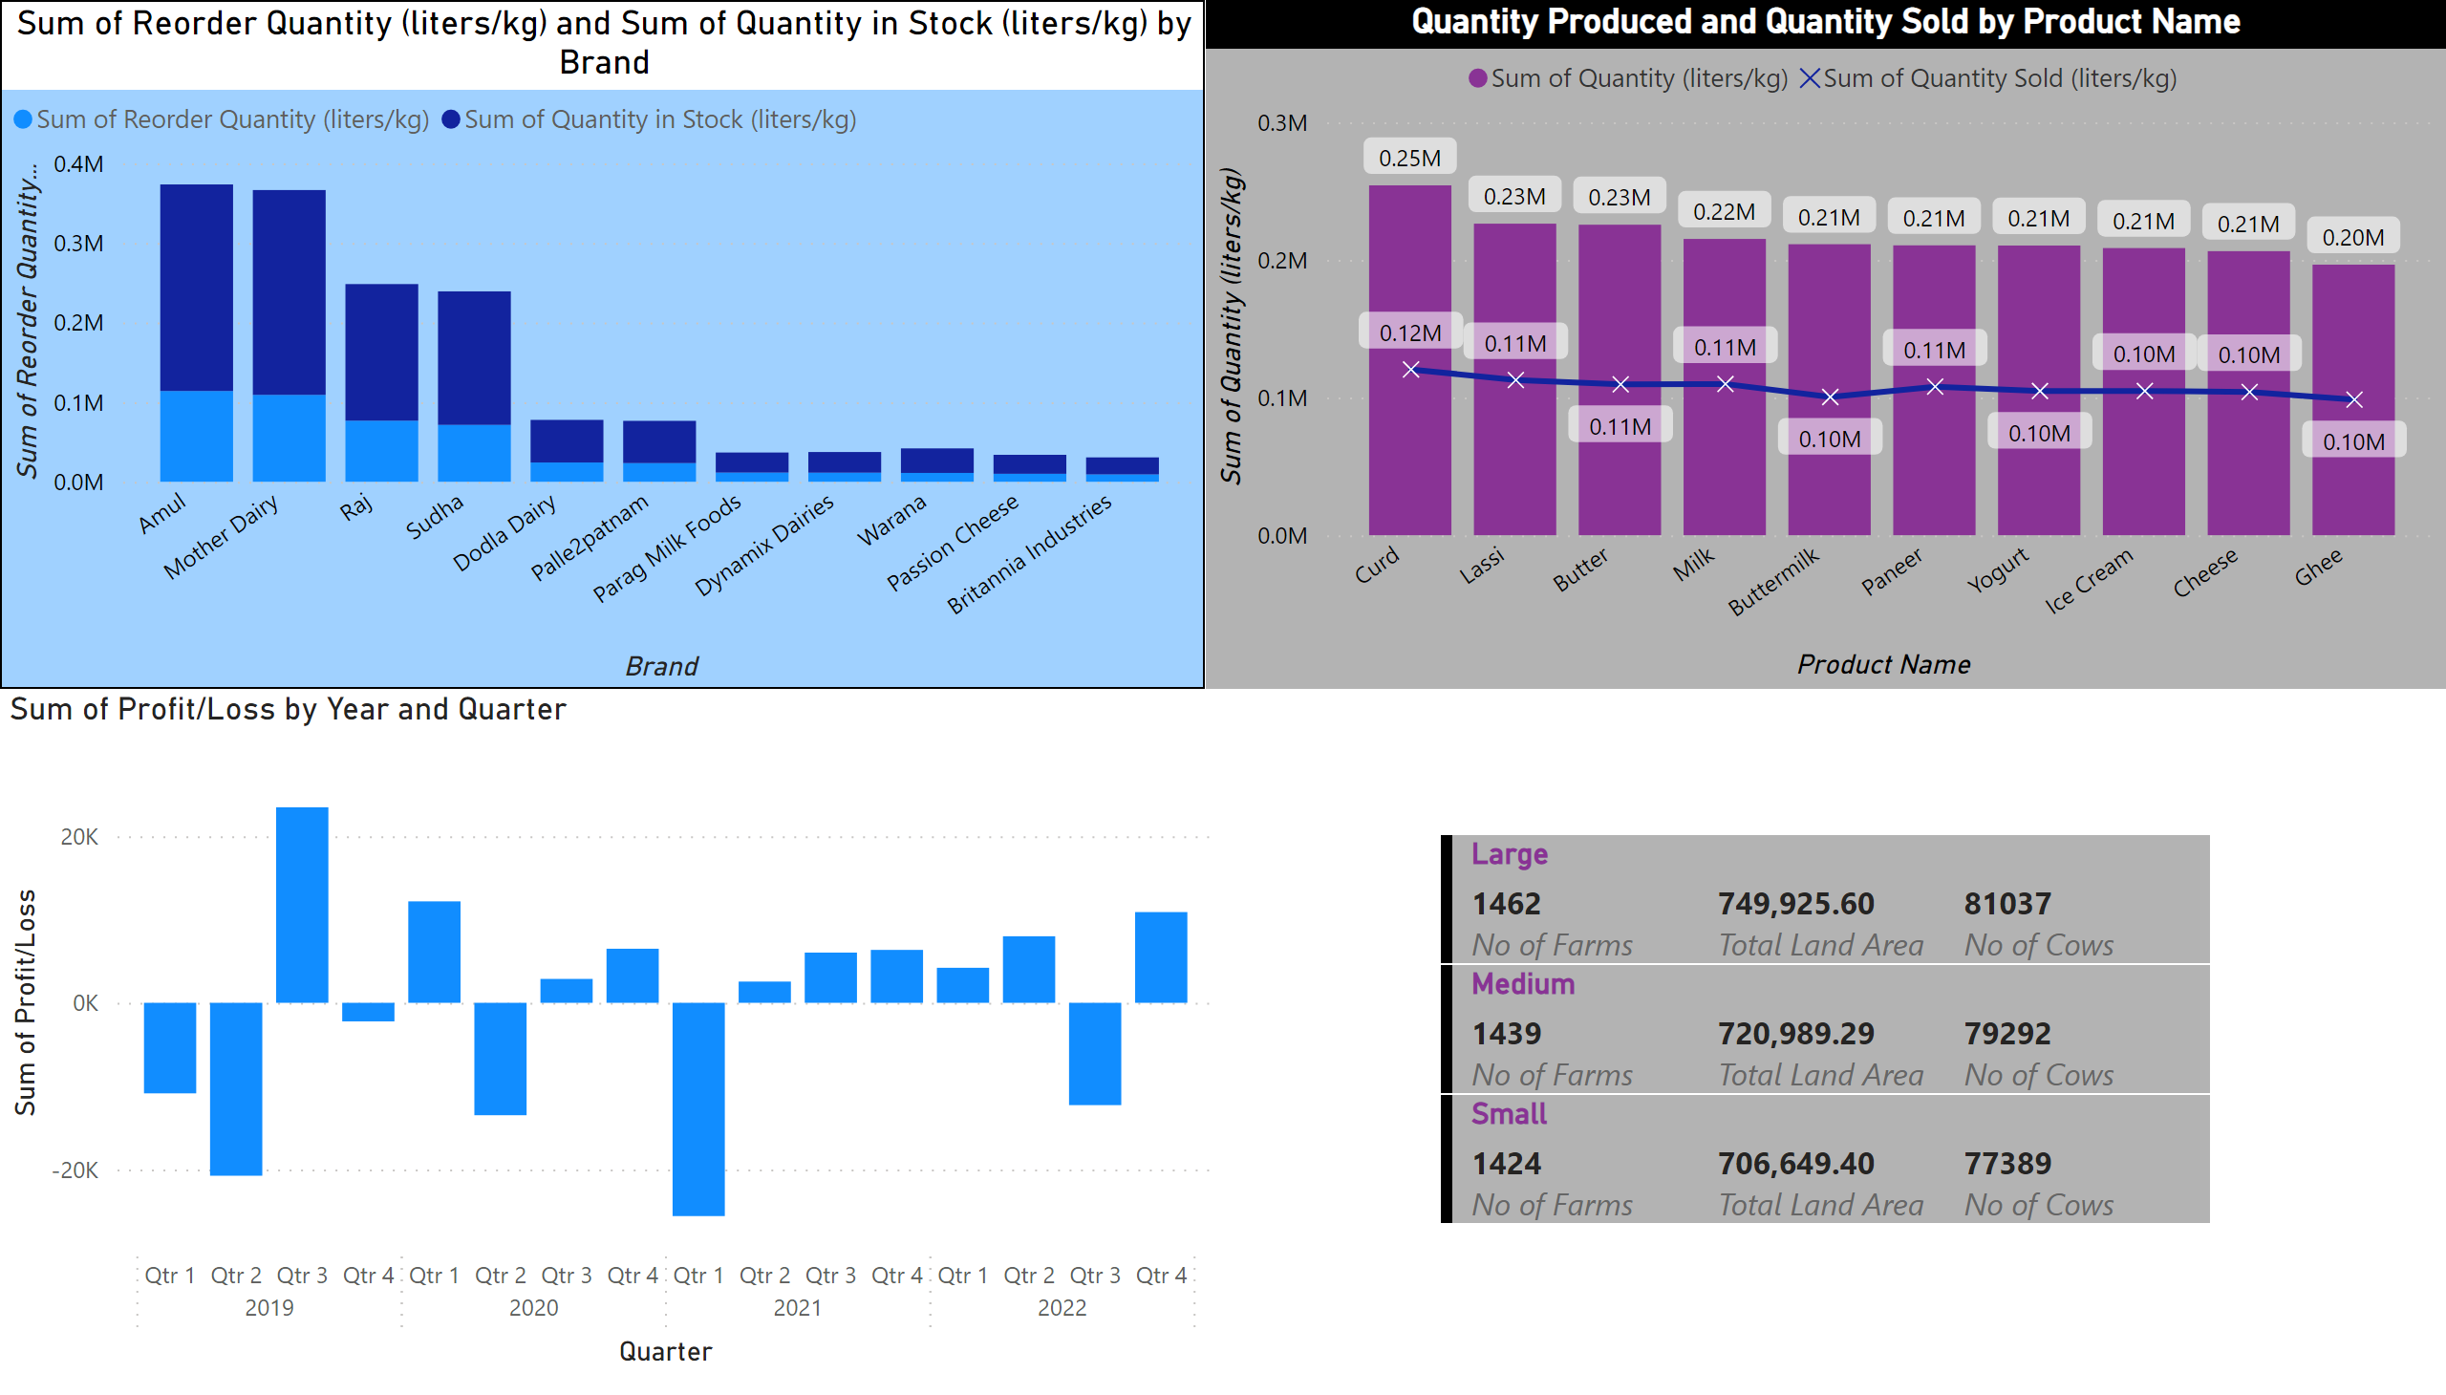
Miscellaneous 1
Notes:
multiRowCard
No alt text provided
clusteredColumnChart
No alt text provided
Quantity Produced and Quantity Sold by Product Name
No alt text provided
lineStackedColumnComboChart
No alt text provided

Slide 7
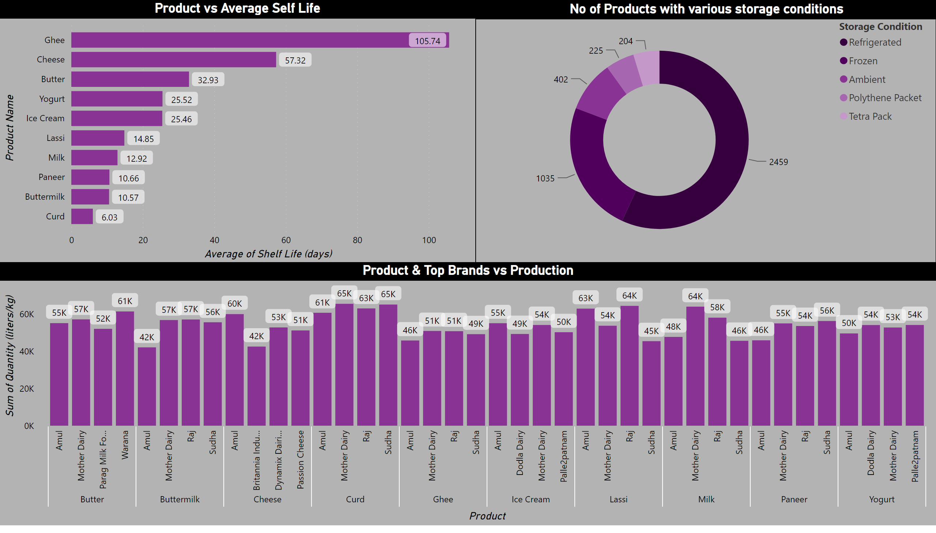
Miscellaneous 2
Notes:
Product vs Average Self Life
No alt text provided
No of Products with various storage conditions
No alt text provided
Product & Top Brands vs Production
No alt text provided

