Slide 1
project
File created on: 2/16/2023 2:12:46 PM

Slide 2
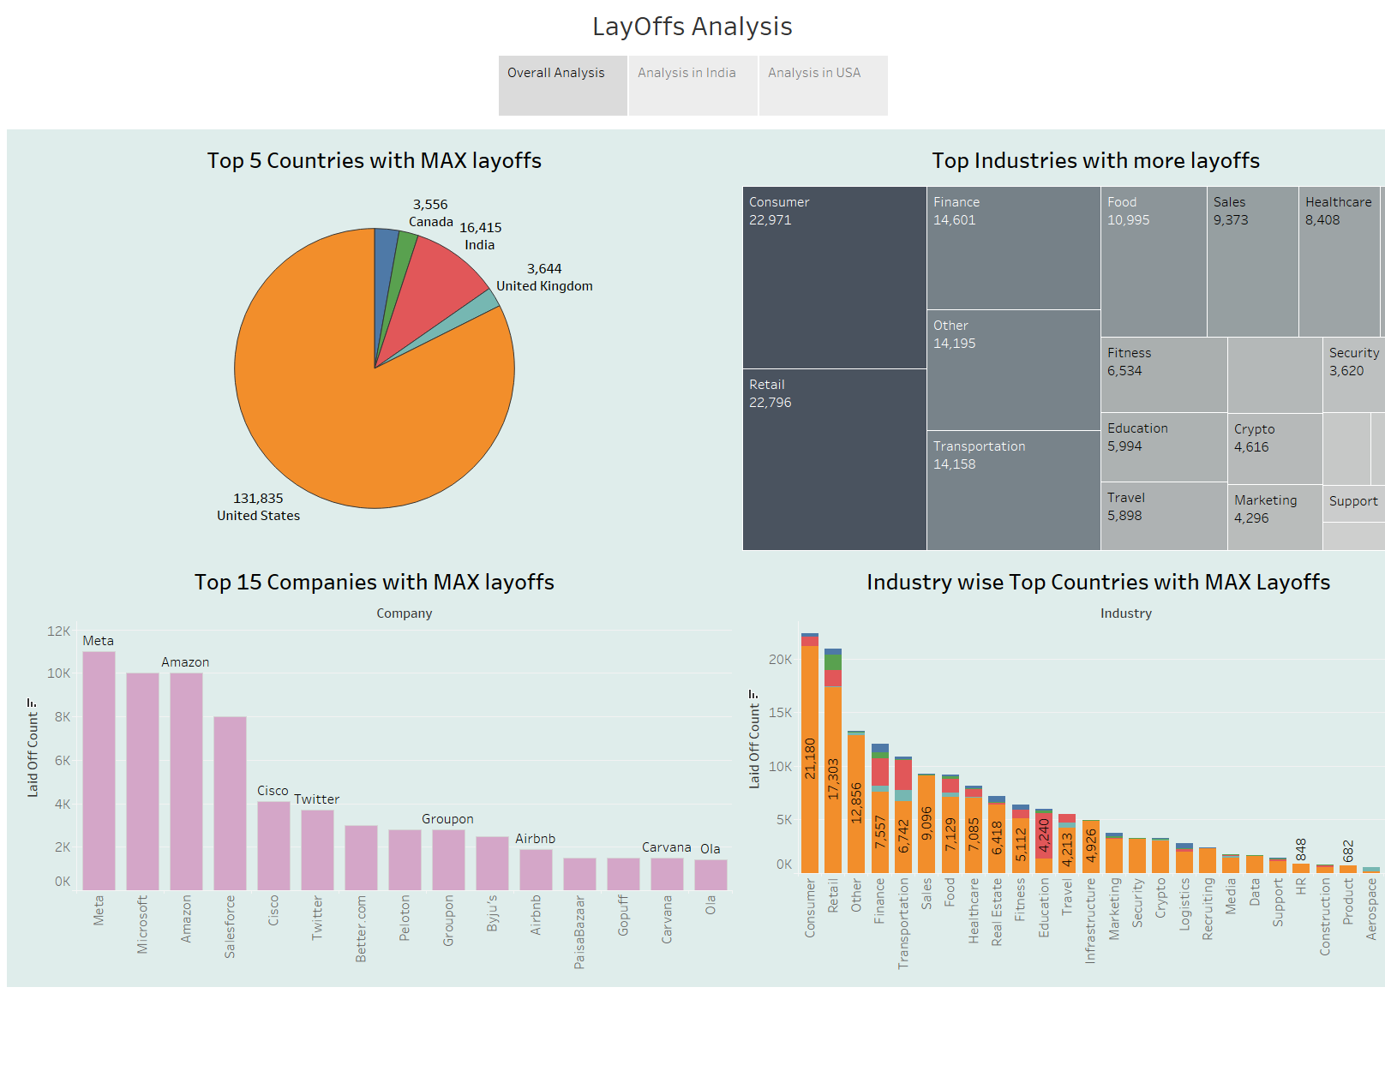

Slide 3
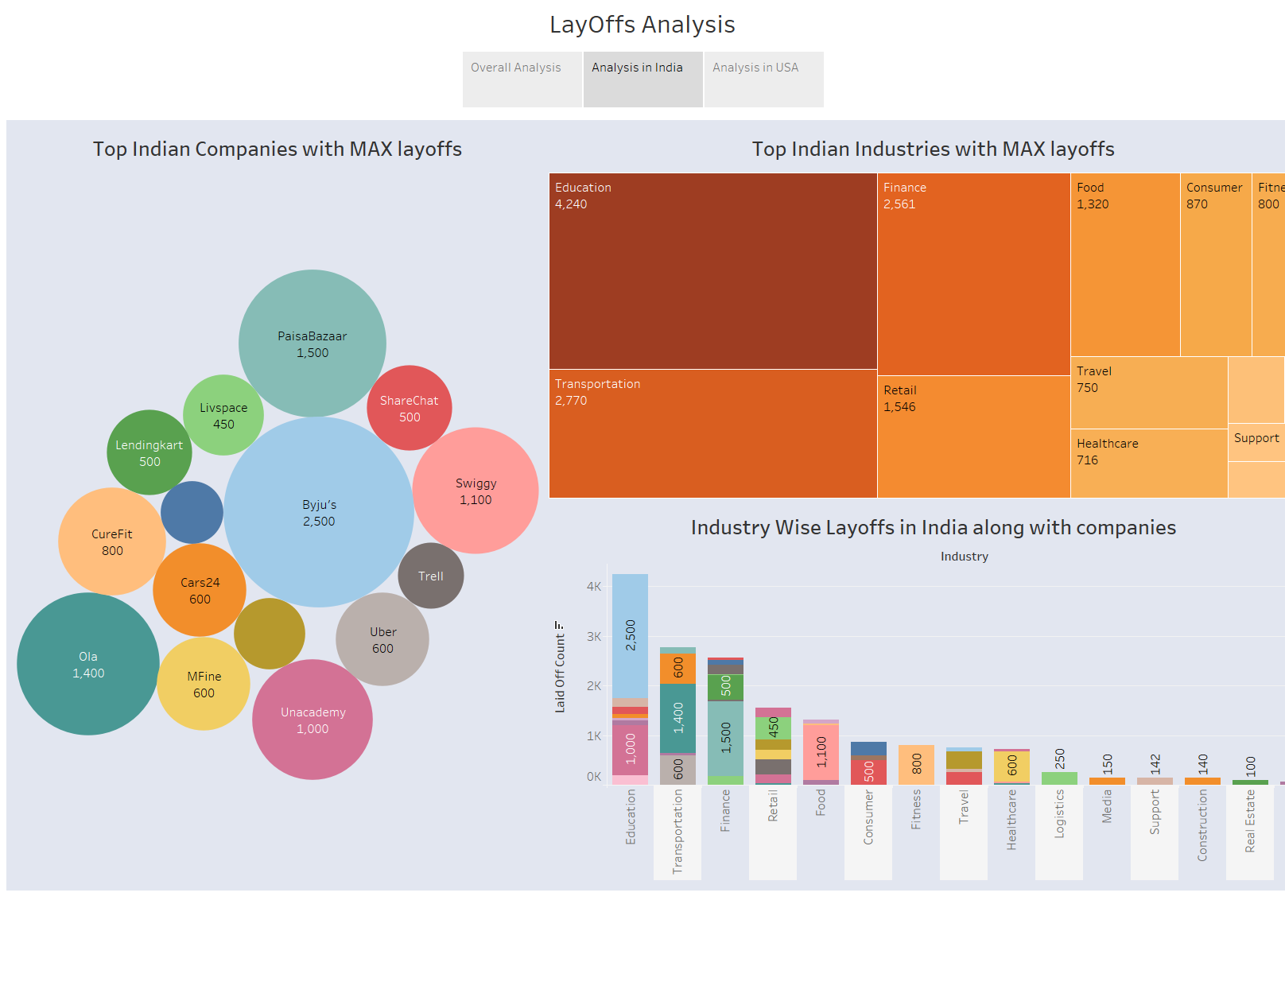

Slide 4
