Slide 1

MANTO
Janhavi Ghogare
Divyansh Kothari
Vasu Kashiv
Abya Singh

Slide 2
PART 1: Manto’s life and literary works in Bombay

Slide 3
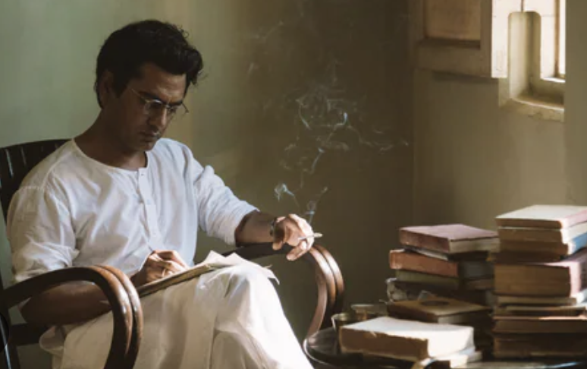
Work, belief, and literary artworks
Controversial figure of his time, known for his frank and unflinching portrayal of dark and taboo aspects of Indian.
‘Dus rupay ki note’ - optimistic and hopeful story revolving around a young female prostitute
‘Sau Watt ka Bulb’ - calls out the dark side of the society standing up for women who are forced into prostitution.

Slide 4
How should writing be?
Should truth be depicted so harshly that it fails the purpose of reaching an audience with the power it needs to?
Does a good writer write the truth or what the society needs as of that era….

Slide 5
PART 2

Slide 6
Partition -> Transition

Slide 7
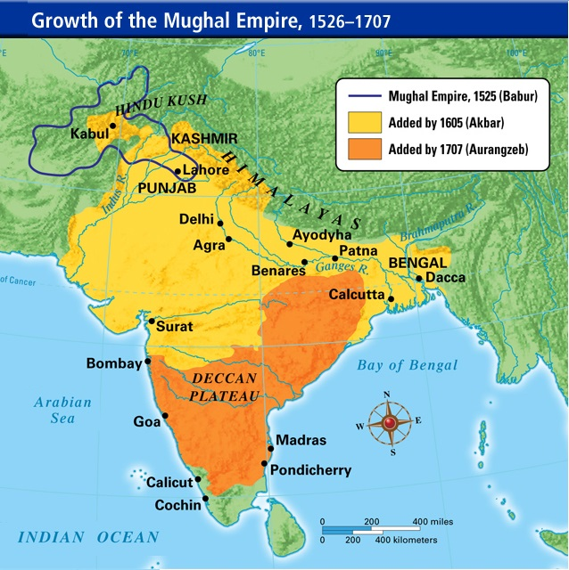
Mughal empire and delhi sultanate

Slide 8
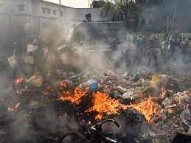
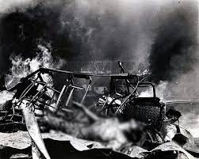
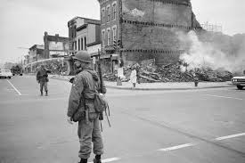
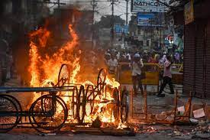
RIOTS

Slide 9
Transitions that Partition brought in Manto’s Life!

Slide 10
Some key points in his transition phase
Lost his well reputed position which he had built over the years
Lost his monetary compensations from a charge of over 2400 Rs per film to mere 20 Rs per column for a news paper while also losing his status
During his work in a relief camp he came across a case of case of women being tortured which became the basis of his next masterpiece ‘Khol-Do’ describing the plight and cruelty over women during partition and riots

Slide 11
PART 3: Manto’s Life in Lahore And Effects of Partition

Slide 12
Manto’s literature and Recognition
His fame and prominence fades away as he lands in Lahore.
Struggles to find settled work and publishers for his Literary works.
His brushes with the legal system and an increasingly unsupportive publishing industry tailspined him.
Faces legal charges on one of his most popular works “Thanda Ghosth” due to obscenity and profanity.
Yet he remained an unstoppable force of nature who relentlessly chased the truth no matter the obstacles.

Slide 13
Personal State of Mind
A despondent and nostalgic state of mind.
A constant yearning for his homeland-Bombay.
The striking change in his tone of writing is comparable with his impassive life and surrounding.
The devastating “Khol-Do”, controversial “Thanda Ghosth”, and classical “Toba Tek Singh”-all look at devastating repercussions of Partition.

Slide 14
State of Mind
He envisaged partition and freedom as visionless-describing his state as one of a bird with clipped wings.
Faces separation and disjunction from his family due to his ill-state of mind.
The inevitable friendship between him and Shyam Chadda continues even after separated states.

Slide 15
PART 4

Slide 16
Loss of emotional support along with financial hardships and severe addiction

Slide 17
HIS FINANCIAL CONDITION
Lost in the trial
Late payments
Reduced pay
Refused to accept money from his friend
Sick children
Alcohol and smoking addiction
Notes:
Terrified of jail, choses to pay instead. Believes he would die if asked to stay in jail for 3 months.

Slide 18
Unhealthy Addiction
His drinking habits turn from bad to worse after the trial
Retorts to alcohol and smoking to escape reality
‘It keeps me alive’
Notes:
Justifies his addiction

Slide 19
Toba tek singh
Writes his final story
The main character in his narrative seems to be helpless, and shattered due to partition
His situation can be compared to that of Manto who has lost everything and is on the verge of collapse
Notes:
Exchange of people of mental asylums and emphasis on a man who does’nt want to be part of ind or pak and dies in a no-man’s land. Tries hard to deny the fact that partition has actually taken place

Slide 20
THANK YOU!

