Slide 1

CASE STUDY
A data was provided that contains readings of power consumption for a total of 18 Air conditioners at some hotel in Gurgaon ,India. Minute to minute power reading of every unit was recorded for a total of 61 consecutive days starting from Time:- 12:00 AM , date:- 01st August 2019 to Time:- 11:59 PM, date:- 30th September 2019.
However, some of the readings were blank/not recorded because ACs might be switched off at that time or due to power cut. With the help of this given data , Answers of the following questions were to be given using Python Pandas library.
Identify patterns/trends in the data?
Which AC was used the most/least?
Relate this power data with the outside temperature of Gurgaon.
Using the power data, predict/forecast the power consumption?

Slide 2
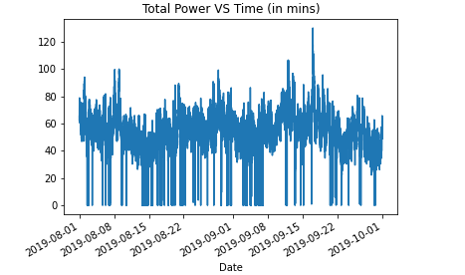
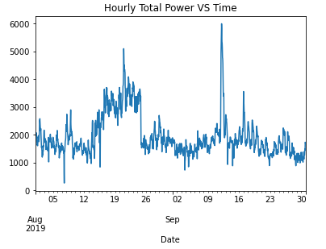
Identification of patterns/trends in the data
Fig.1.1 :- Total power VS Time(in mins)
Fig. 1.2 :- Hourly Total power VS Time
Due to no fix patterns or trend in the data, we have to deep dive into more granular level

Slide 3
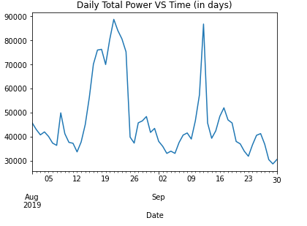
Identify patterns/trends in the data?
The dip in the power consumption in the last week of August could be seen due to lower environment temperature & higher rainfall in Gurgaon city during that time
Fig.1.3 :- Daily Total power VS Time(in days)
Which AC was used the most/least?
AC which has consumed most and least units of power in the given time frame would be the most and least used respectively.
AC 5 was used least (Power units consumed: 72323.28)
AC 18 was used most (Power units consumed: 336287.60)

Slide 4
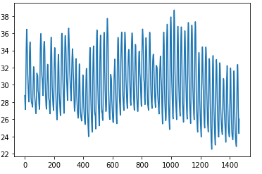
Comparison of temp data with time (hours)
There is general trend in decreasing temperature due to fall in the environment temperature at the end of Quarter 3
Fig.1.3 :- Temperature VS Time (Hrs.)
Please refer to the code attached in the mail for more details

