Slide 1
Google Play Store Case Study
Google Play Store wants to develop a feature that would enable them to boost visibility for the most promising apps. This analysis would require a preliminary understanding of the features that define a well-performing app. By using a dataset contains the data of over 10,000 apps insights are drawn to define the names of well performing apps.

Slide 2
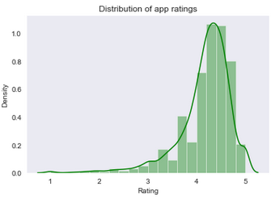
Identification of patterns/trends in the data
Most of the app ratings lie in the 4-5 range, If people dislike an app, they don’t generally wait to give it bad ratings; rather, they go ahead and remove it immediately. Therefore, the average ratings of the apps are pretty high

Slide 3
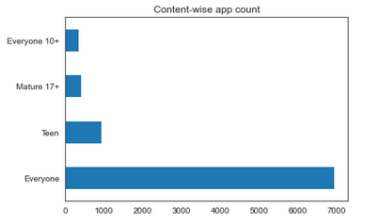
Identification of patterns/trends in the data
‘Everyone’ category has the highest number of apps followed by Teen and Mature 17+

Slide 4
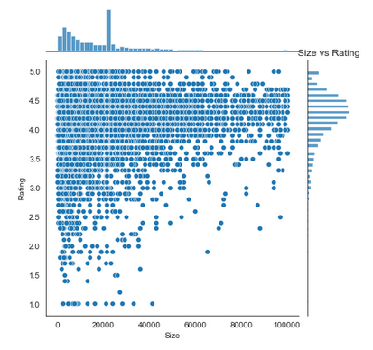
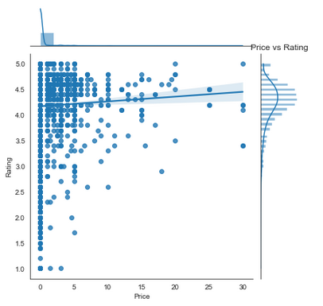
Identification of patterns/trends in the data
Rating shows a weaker trend with Size of the app whereas Rating tends to be more for the paid apps i.e. High price apps have more chances to score high rating

Slide 5
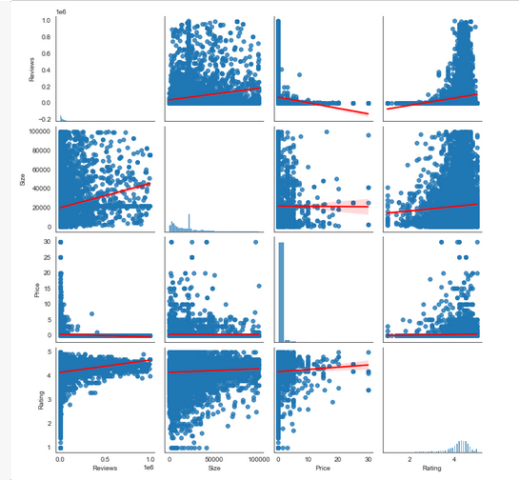
COMPARING ALL THE NUMERCIAL/FACTUAL DATA OF APPS
Reviews and Size: Directly related Reviews and Price : Inversely related
Reviews and Rating : Directly related
Rating and Size : Directly related Rating and Price : Directly related

Slide 6
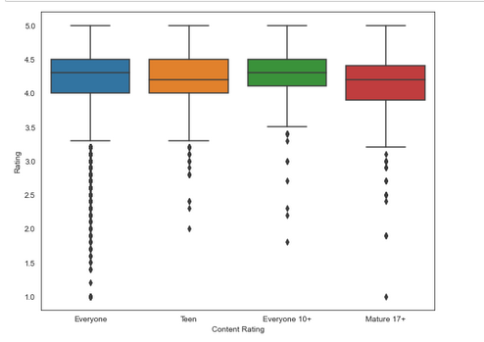
Comparison between content rating type
“Everyone” category has the highest number of ratings in the lower percentiles as compared to the other categories.

Slide 7
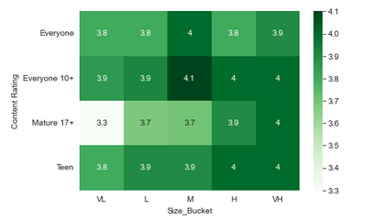
Comparison of content rating with SIZE of the app
1.Lighter apps which are focused on one task only those are better and the heavy apps which more utilities and features are also doing pretty well.
2."Everyone 10+" content rating shows more Rating for Medium sized apps and also, overall it is the doing well than other content ratings.

Slide 8
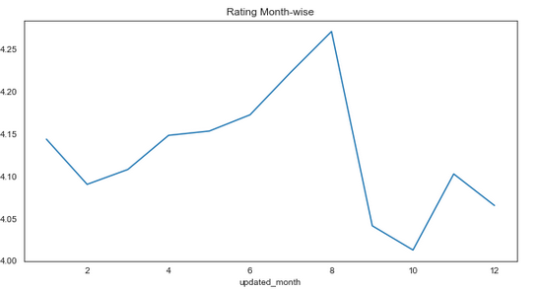
Checking trend of rating month wise
There is indeed some improvement in the ratings during the months of July-August, this is because most of the students who are studying have summer vacations within these months.

Slide 9
THANK YOU ☺

