Slide 1

SpinSense: Motor Speed Monitoring
Using Hall Effect Sensor and FPGA (EDGE Artix 7)
Presented by:
S. Mahammad Saleem - SSIT0035
C.V. Jaya Prakash - SSIT0041
P. Vasu - SSIT0042

Slide 2
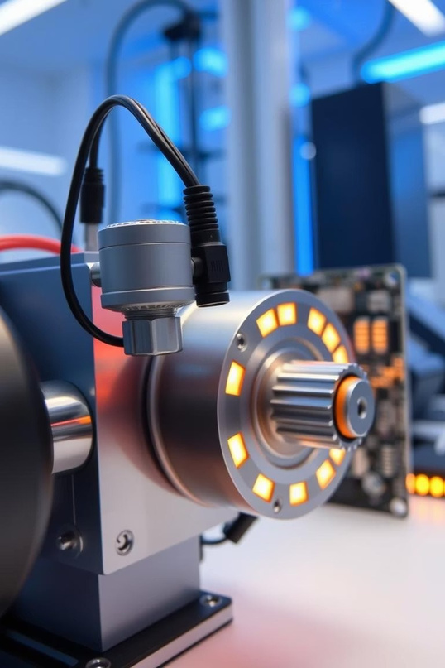
Introduction to SpinSense
What is SpinSense?
A real-time system that measures motor speed in RPM using a Hall effect sensor interfaced with an FPGA.
Why it Matters
Crucial for automation, diagnostics, and safety in systems controlled by motors, enabling precise monitoring and control.

Slide 3
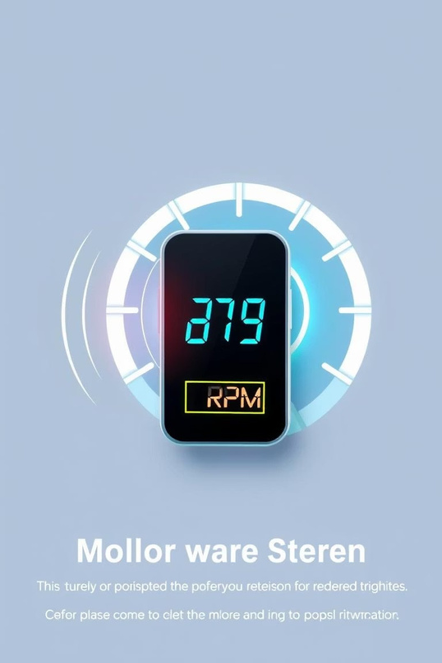
Project Objectives
RPM Monitoring
Continuously measure the rotational speed of a DC motor in real-time.
Alert System
Trigger a buzzer alert when the motor speed exceeds a predefined RPM threshold.
FPGA Integration
Leverage FPGA hardware logic to interface sensors and process speed measurements efficiently.

Slide 4
Key Components Used
FPGA Board
EDGE Artix 7 3 Serves as the processing unit to count pulses and calculate RPM.
Hall Effect Sensor
Detects magnetic field changes corresponding to motor shaft rotations.
DC Motor & Magnet
Motor with an attached magnet on the shaft for pulse triggering.
Buzzer
Acts as an alert actuator when RPM exceeds set thresholds.

Slide 5
Working Principle of SpinSense
Magnet Attachment
A magnet mounted on the rotating motor shaft creates a magnetic field for detection.
1
Battery
2
Pulse Detection
Hall effect sensor produces one pulse per shaft revolution based on magnetic changes.
DC
Motor
FPGA
EDGE
ARTIX-7
3
Pulse Counting
FPGA counts pulses within a time interval to calculate RPM accurately.
IN
GND
VCC
Magnet
Hall Effect Sensor
4
Buzzer Activation
When RPM surpasses a threshold, the FPGA triggers the buzzer to warn users.

Slide 6
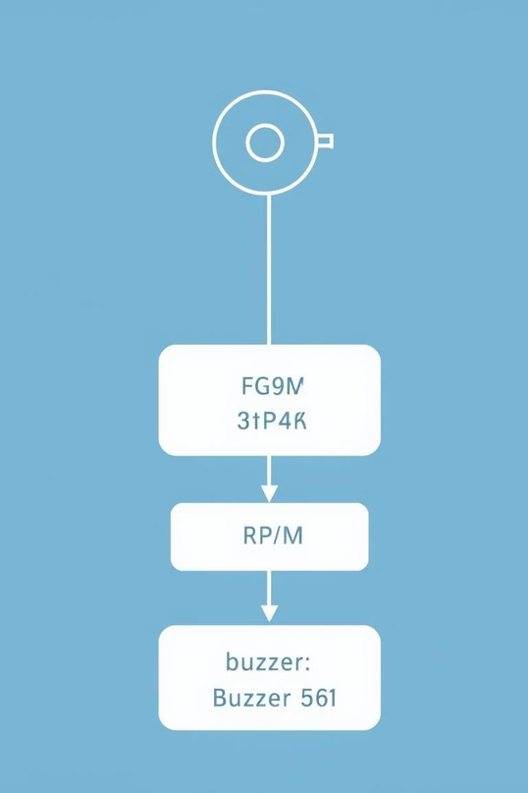
System Block Diagram
The diagram illustrates the straightforward flow from the motor's rotation through sensor detection to FPGA processing, culminating in buzzer alerts based on speed criteria.

Slide 7
FPGA Implementation Details
Pulse Counter Logic
Implemented in Verilog/VHDL to count pulses from the Hall sensor reliably.
1
Timer Logic
Generates one-second intervals for consistent RPM calculation.
2
Threshold Detection
Compares counted pulses against a limit to control buzzer activation.
3

Slide 8
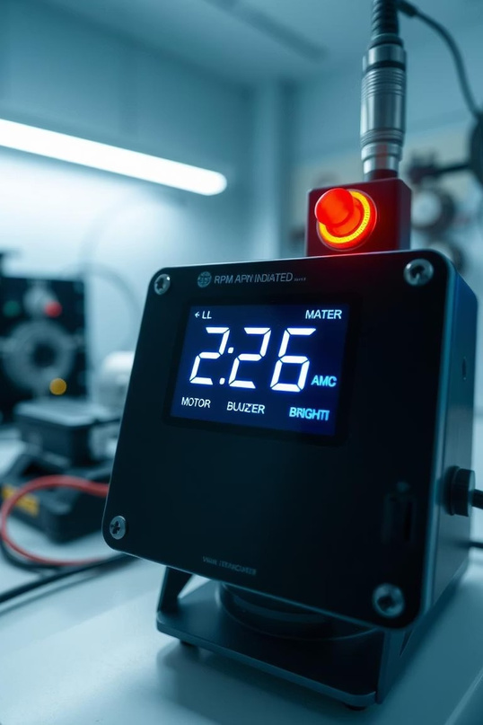
Output & Results
RPM Display
Optional visualization on 7- segment or LCD shows real-time motor speed.
Alert Mechanism
Buzzer activates immediately if motor speed exceeds safe operational limits.
Performance
Hardware logic provides accurate, fast motor speed monitoring essential for safety.

Slide 9
Applications of SpinSense
Industrial Automation
Ensures precise motor control and system diagnostics in manufacturing environments.
Robotics
Monitors motion speeds for safe and efficient robotic operations.
Smart Appliances
Integrates into home devices for optimized motor performance and alerts.
Electric Vehicles
Tracks motor speed for enhanced battery management and safety protocols.

Slide 10
Future Scope & Conclusion
Future Enhancements
Conclusion
SpinSense leverages FPGA hardware for efficient, fast, and reliable motor speed monitoring. It provides a scalable foundation for diverse embedded applications, enhancing industrial automation and safety.
Add Bluetooth/WiFi modules for IoT and remote monitoring.
Integrate LCD for live RPM display on device.
Develop closed-loop motor speed control using FPGA feedback.

Slide 11


