Slide 1

Ad_Hoc_Insights
Consumer Goods

Slide 2
Why?
How?
Objective
Data, Requests and Tools
1
2
3
What?
Behind the Scenes: Our Company's Tale

Slide 3
Why?
1
Atliq Hardware
2
Management Observation
A leading computer hardware manufacturer in India with a strong international presence.
Lack of sufficient insights needed for making quick, smart, and data-driven decisions.
3
Expansion Plan
4
SQL Challenge
To address this, they plan to expand their data analytics team by hiring junior data analysts.
Tony Sharma, the Data Analytics Director, plans to conduct an SQL challenge to assess candidates' technical and soft skills.

Slide 4
What?
Behind the Scenes: Atliq Company's Tale
Product Divisions
N & S
P & A
PC
Wifi Extenders
Processors
Personal Desktops
USB Flash Drives
Motherboards
Gaming Laptops
Keyboards
Product Segments
Storage
Peripherals
Notebooks
Desktop
Product Categories
Batteries
Graphic Cards
Business Laptops
Mouse
USB Flash Drives
Processors
Motherboards

Slide 5
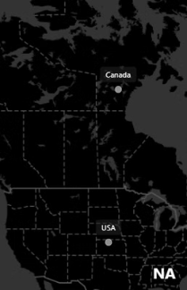
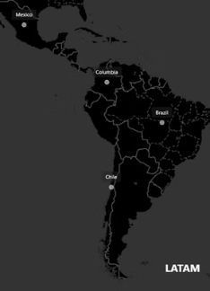
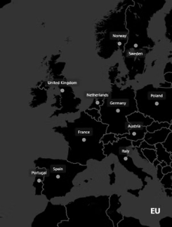
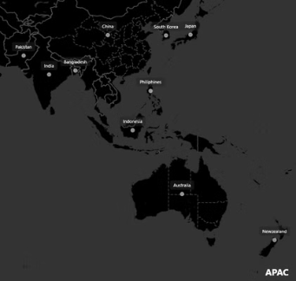
ATLIQ : Global Market Presence
Fiscal Year Timeline
FY 2023
1
September 2022 - August 2023
2
FY 2024
September 2023 - August 2024

Slide 6
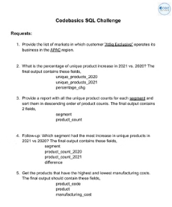
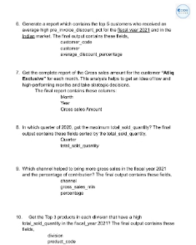
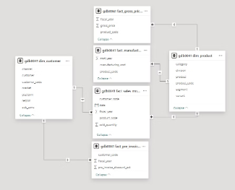

How?
Data, Requests and Tools

Slide 7
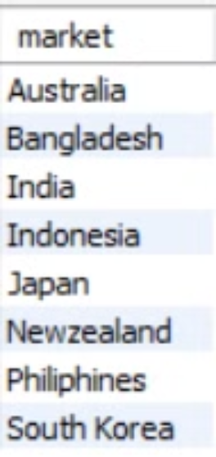
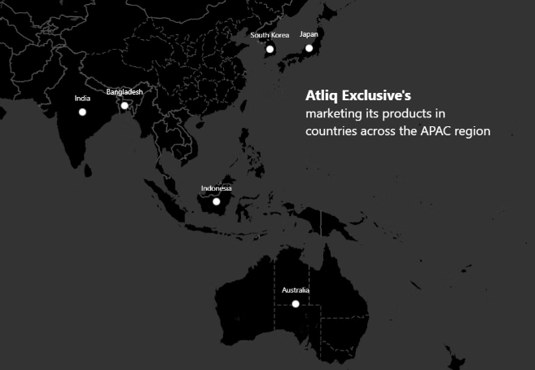
1. Provide the list of markets in which customer "Atliq Exclusive" operates its business in the APAC region.
SQL
Power BI

Slide 8
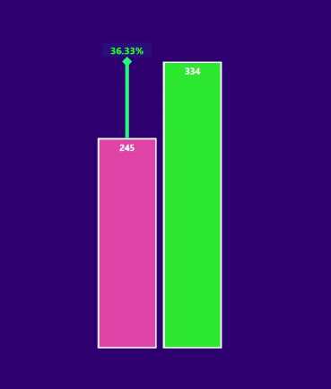

2. What is the percentage of unique product increase in 2021 vs. 2020?
SQL
Power BI
Insights
Unique Products 2021
Both demand and production have increased.
Vs
Unique Product 2020

Slide 9
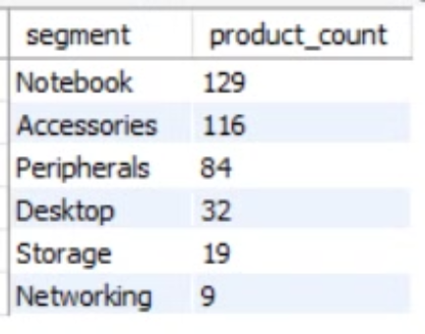
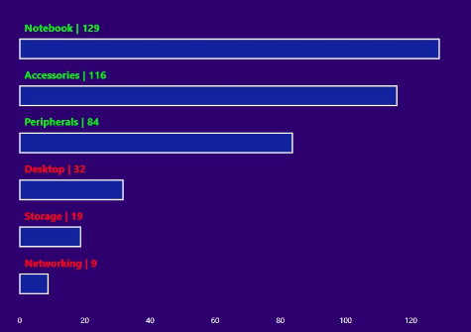
3. Provide a report with all the unique product counts for each segment and sort them in descending order of product counts.
SQL
Power BI
Insights
The manufacturing of notebooks, accessories, and peripherals is growing significantly more than desktops, storage, and networking.
Notebooks, accessories, and peripherals make up 83% of all manufactured products.

Slide 10
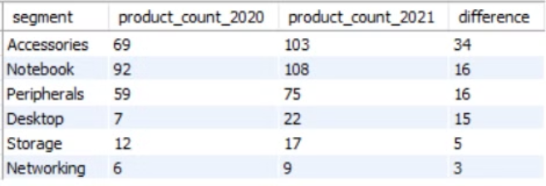
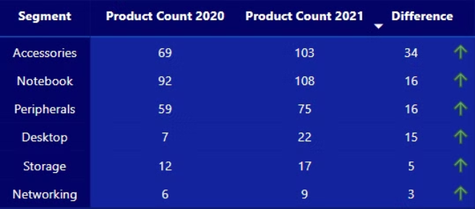
4. Which segment had the most increase in unique products in 2021 vs 2020?
SQL
Power BI
Unique product difference per segments from 2020 to 2021
Insights
Accessories had the biggest production increase.
Storage and networking are growing slower in production than other segments.

Slide 11
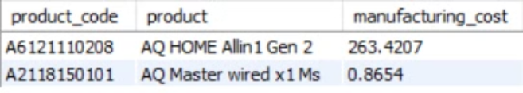
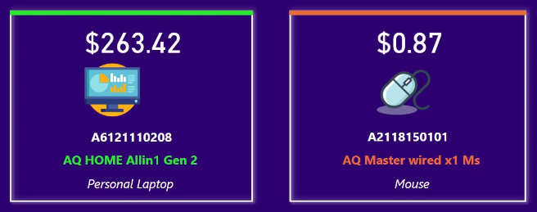
5. Get the products that have the highest and lowest manufacturing costs.
SQL
Power BI
Insights
The Mouse AQ Master wired x1 Ms (Standard1) has the lowest manufacturing cost.
The Personal Desktop AQ Home Allin1 Gen2 (Plus 3) has the highest manufacturing cost.

Slide 12
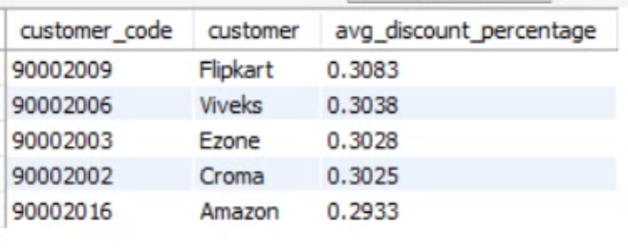
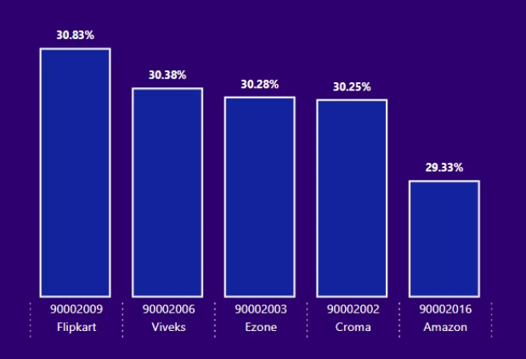
6. Generate a report which contains the top 5 customers who received an average high pre_invoice_discount_pct for the fiscal year 2021 and in the Indian market.
SQL
Power BI
Insights
Flipkart received the highest average pre-invoice discount.
Amazon received the lowest average pre-invoice discount.
Top 5 Indian customers with the highest average discount percentage in FY 2021.

Slide 13
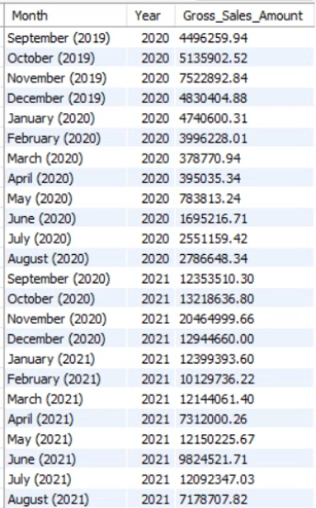
7. Get the complete report of the Gross sales amount for the customer “Atliq Exclusive” for each month . This analysis helps to get an idea of low and high-performing months and take strategic decisions.
SQL
Insights
The lowest gross sales total for both fiscal years occurred in March 2020 ($0.38M).
The highest gross sales total for both fiscal years was in November 2020 ($20.46M).
73.8% of the total gross sales figure is in FY 2021.

Slide 14
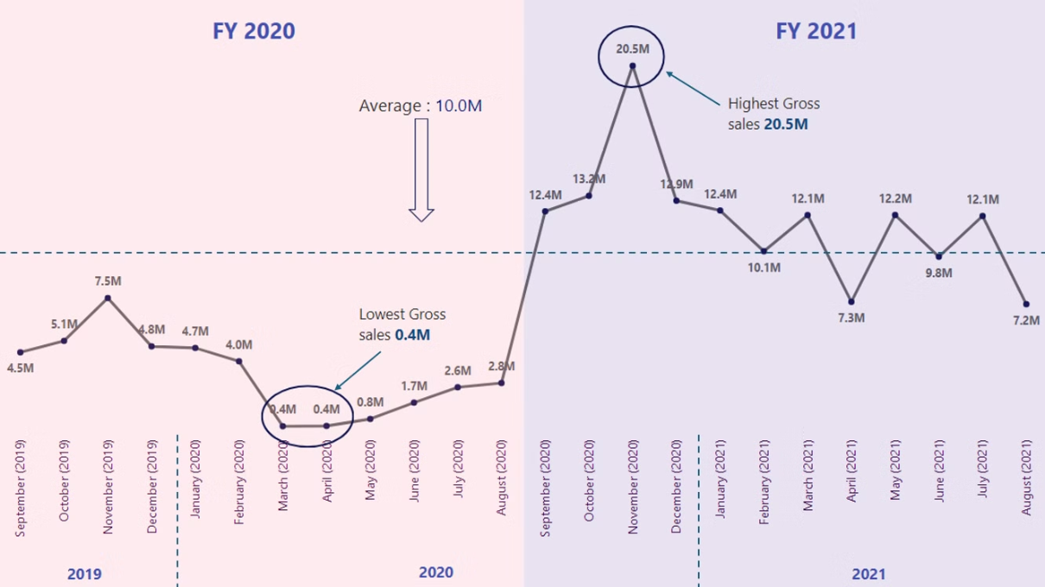
Power BI

Slide 15
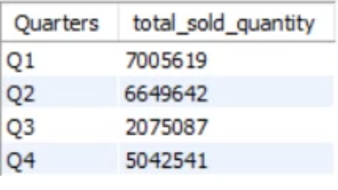
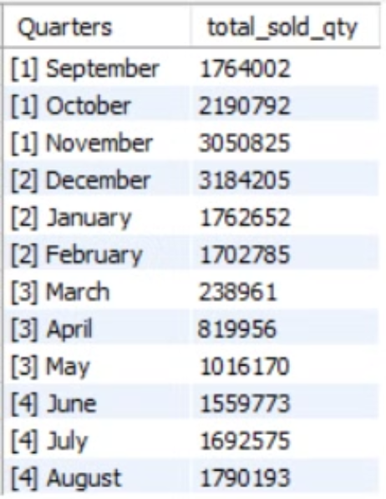
8. In which quarter of 2020, got the maximum total_sold_quantity?
SQL
Insights
Quarterly Sales:
Quarter 1 of FY2020 had the highest units sold.
Quarter 3 had the lowest units sold.
Monthly Sales:
December had the highest sales.
March had the lowest sales.
Sales Distribution:
Quarter 1 contributed about 34% of the total sales for FY2020.

Slide 16
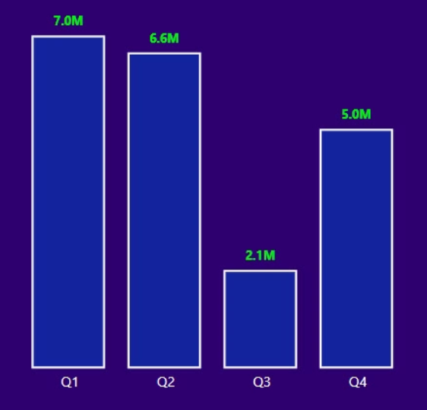
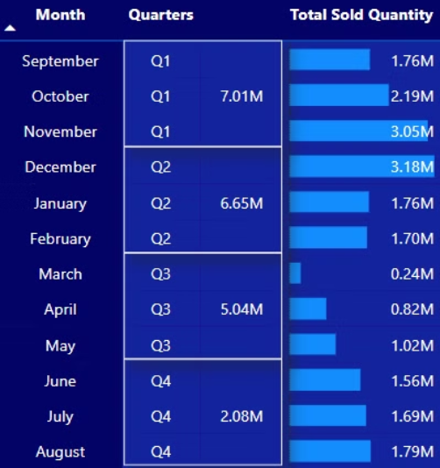
Power BI

Slide 17
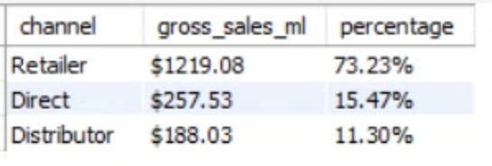
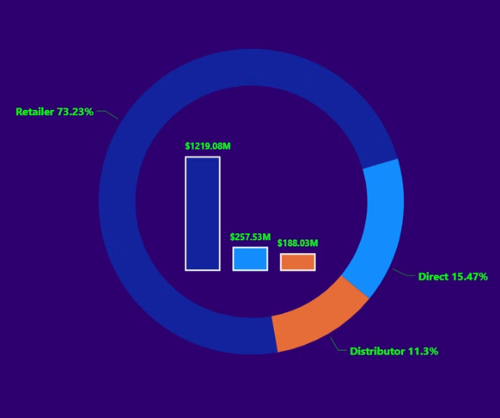
9. Which channel helped to bring more gross sales in the fiscal year 2021 and the percentage of contribution?
SQL
Power BI
Insights
Channel : "Retailer" helped bring maximum sales to the company with 73.22% as the contribution percentage
Channel : "Distribution" makes the least contribution at a percentage of 11.31%

Slide 18
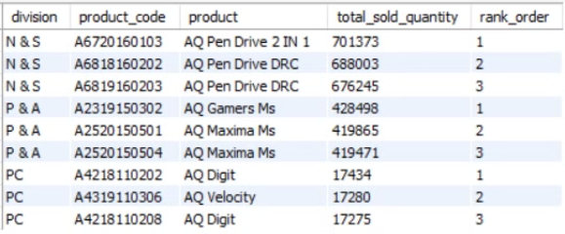
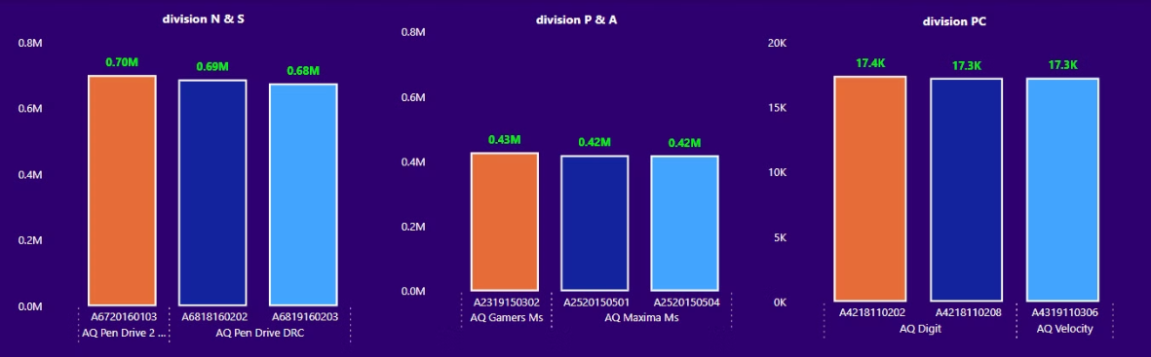
10. Get the Top 3 products in each division that have a high total_sold_quantity in the fiscal_year 2021?
SQL
Insights
Each division has a product variant that appears twice in its top three products list.
Power BI

Slide 19
Thank you!

