Slide 1

DR. BABASAHEB AMBEDKAR TECHNOLOGICAL
UNIVERSITY , LONERE
Department of Computer Engineering
Presented by,
Vasudha Venkat Patil
(2130331245055)
T.Y. Computer
Guided by,
Prof.Arvind Kiwelekar sir

Slide 2

Welcome to Employee Management System

Slide 3

Contents
1.Introduction
2.Key Features
3.Comparison
4.Working of EMS
5.Project Design

Slide 4

Introduction
Welcome to the Employee Management System (EMS) presentation. Our EMS is a comprehensive software solution designed to streamline and optimize the management of employee information within an organization.
This centralized platform focuses on three core functionalities: adding new employees, updating existing employee data, and deleting employee records
A key aspect of the EMS is its hierarchical access control, which restricts the ability to add, update, or delete employee information to designated heads or administrators.

Slide 5
Key Features
1.Employee Registration:
Enables the addition of new employees to the system.
2.Update Employee Information:
Allows authorized personnel to modify existing employee data.
3.Delete Employee Records:
Facilitates the removal of employee information when necessary.
4.Database Connectivity:
Uses MySQL Connector/J 8.0.28 for efficient and reliable database connectivity
5.Advanced Date and Time Handling:
Integrates JCalendar-tz-1.3.3-4 for sophisticated date and time functionalities.

Slide 6
Comparison
Advantages EMS
Disadvantages EMS
Efficiency and Productivity:
- Streamlines administrative processes related to employee data management, such as registration, updates, and deletions
Data Accuracy and Integrity:
- Ensures that employee information is accurately recorded and maintained in a centralized database.
Dependency on Technology:
- Organizations become reliant on the EMS for managing employee data, which can pose risks if the system experiences technical issues or downtime.
Data Security Risks:
- Storing sensitive employee information in a centralized database increases the risk of data breaches or cyberattacks.

Slide 7
Working of EMS
The Employee Management System (EMS) functions by integrating various modules to effectively manage employee-related tasks within an organization. Here’s an overview of how it typically works:
User Authentication: The EMS typically begins with user authentication, where authorized personnel log in using their credentials.
2. Employee Data Entry: Once logged in, HR personnel can add new employees to the system by entering their details such as name, contact information, designation, salary, etc.
3. Data Retrieval and Viewing:
The EMS allows users to view employee information stored in the database. They can search for specific employees based on various criteria like employee ID, name, department, etc.
4. Data Update and Management:
HR administrators can update employee information as needed.
5. Data Deletion:
In case an employee leaves the organization or their information becomes obsolete, HR personnel can delete the corresponding records from the system.

Slide 8
Libraries
1 .Frontend ( Librari):
jcalendar-tz-1.3.3-4:
The ”jcalendar-tz-1.3.3-4” library is a version of the JCalendar library, specifically designed to handle time zone functionality within Java applications.
2 .Backend ( Libraries):
mysql-connector-java-8.0.28:
mysql-connector-java-8.0.28 is an essential library for Java developers working with MySQL databases. It provides a robust and efficient way to connect Java applications to MySQL, supporting a wide range of database operations and ensuring secure, high-performance communication.
ResultSet2xml :
ResultSet2xml is a powerful approach for converting SQL query results into XML format, providing a structured and portable way to handle data.

Slide 9

Project Design
1 Main Page :
This the first page which user observe after running the project

Slide 10
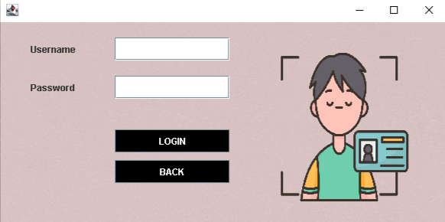
Project Design
2 Login Pages:
In Login Page only HR can login by using username and Password

Slide 11
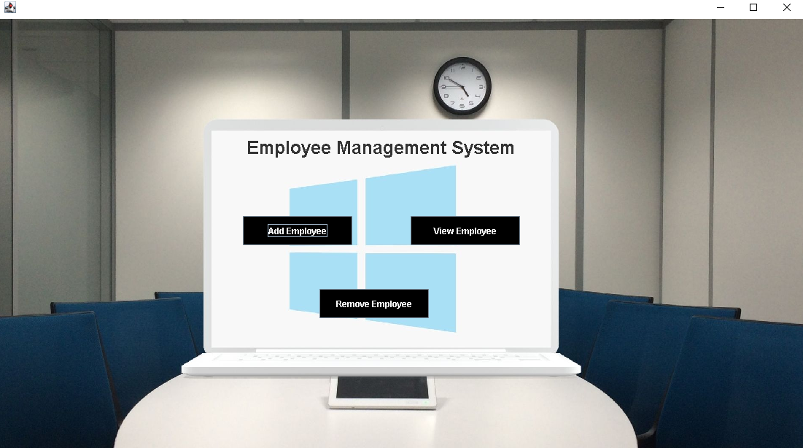
Project Design
3 Home Pages:
In Home Page to add , view and delete buttons.

Slide 12
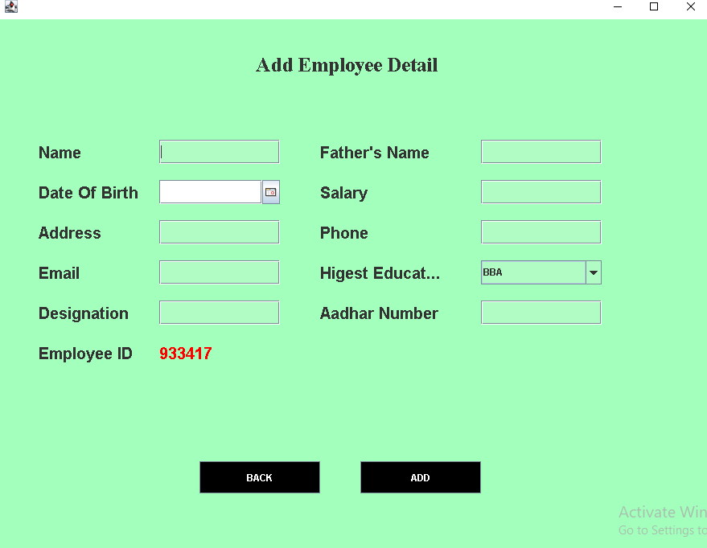
Project Design
4 AddEmployee Pages:
In AddEmployeePage to insert values like name , id, bdate,address etc. in database

Slide 13
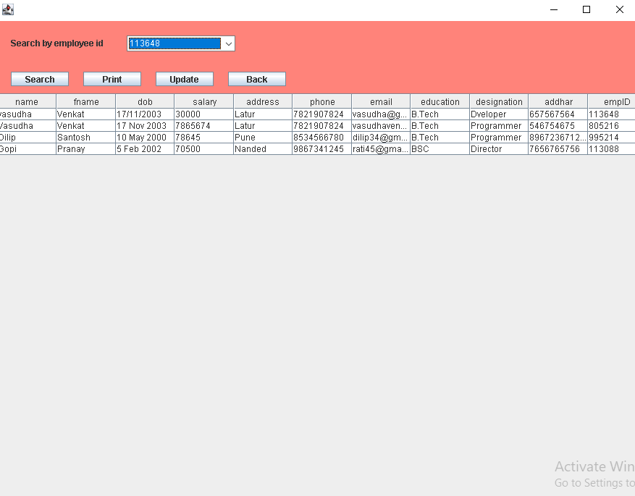
Project Design
5 ViewEmployee Pages:
In View Page to show the number of employee and thier details.

Slide 14
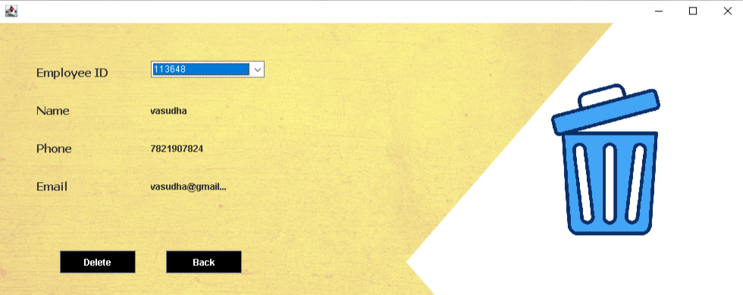
Project Design
6 RemoveEmployee Pages:
In Delete Page to show the ID number of employee and thier details for delete .

Slide 15
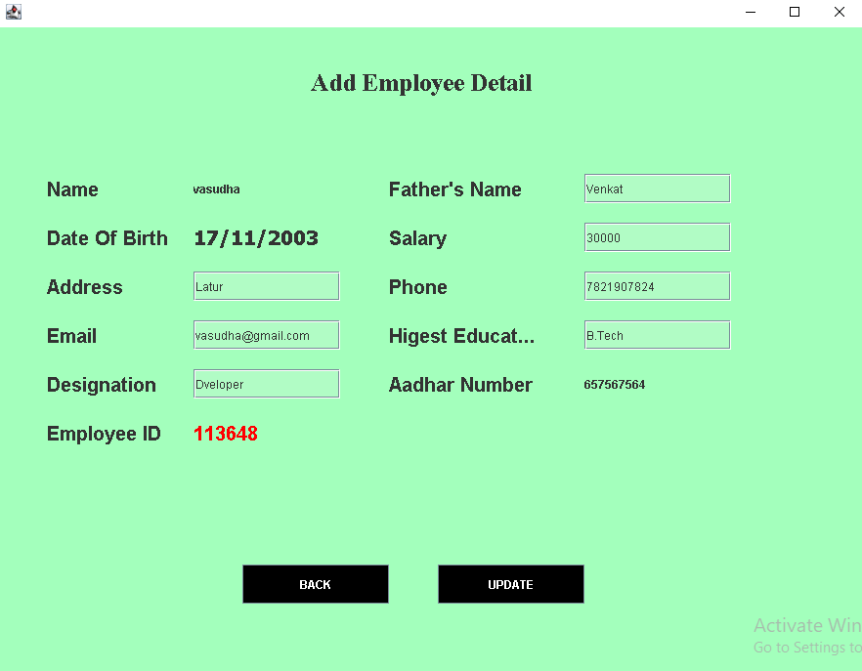
Project Design
7 ViewEmployee Update Pages:
In ViewEmployee Update Page to show the employee and thier details to update.

Slide 16
Conclusion
The Employee Management System (EMS) is a pivotal tool for organizations, offering streamlined human resource management capabilities. With its user-friendly interface and robust backend architecture, it facilitates efficient handling of employee data.
Through features like data storage, retrieval, and manipulation, the EMS ensures the integrity of employee records. Built using Java and SQL, it guarantees scalability and reliability, supported by essential libraries such as mysql-connector-java.
Despite its advantages in enhancing organizational efficiency, challenges like security risks and scalability concerns must be addressed. Nevertheless, with regular updates and maintenance, the EMS remains a cornerstone for optimizing HR processes and fostering a productive work environment

Slide 17

Thank You

