Slide 1
Fundamentals of Accelerated data science with rapids

Slide 2
Course goals
Learn the core tools to use RAPIDS for everyday data science
Understand RAPIDS’ scalability from workstation and cluster to cloud and HPC
Build the foundations for you to learn RAPIDS capabilities now and in the future

Slide 3

Fundamentals

Slide 4

Traditional model
APP B
Read data
APP B
APP A
GPU data
APP B
Copy & convert
CPU
Copy & convert
GPU
GPU data
APP A
Copy & convert
APP A
Load data

Slide 5
RAPIDS model
APP B
Read data
APP B
APP A
GPU data
CPU
Few or no copies to CPU
GPU w/ RAPIDS
GPU data
APP A
Load data

Slide 6

RAPIDS Platform
Dask
cuDF
Data Prep/Handling
cuML
Machine Learning
cuGraph
Graph Analytics
DL Frameworks
Deep Learning
cuXfilter
Visualization
GPU Memory

Slide 7
Data science toolsets
 | CPU | GPU/RAPIDS
Data handling | pandas | cuDF
Machine learning | scikit-learn | cuML
Graph analytics | NetworkX | cuGraph
 | CPU | GPU/RAPIDS
Viz | Bokeh/ Datashader | cuXfilter
Geospatial | GeoPandas/ SciPy | cuSpatial
Signals | SciPy.signal | cuSignal
Cyber | cyberpandas | CLX

Slide 8


Requirements
Linux OS (Ubuntu 16.04, 18.04 or CentOS 7)
NVIDIA Pascal™ GPU architecture or better
CUDA 9.2/10.0/10.1.2, drivers, etc. (see rapids.ai)
Open source/flexible mindset
Using v0.12 today
v0.13 soon
v1.0 not imminent

Slide 9








Source code on GitHub
Containers on NGC & Docker Hub
Conda packages
https://github.com/rapidsai
https://ngc.nvidia.com
https://anaconda.org/rapidsai
rapids.ai
In the cloud
On-premises

Slide 10
Exercise data
Fused and simulated from several sources
Population data
Simulated from UK Census data on England and Wales, both from details (age, sex, given name, county) and aggregate statistics (geographic coordinates, employment)
Road network data
Nodes (endpoints/junctions) and edges of the entire road network of Great Britain
Epidemic data
Detailed hospital/clinic data from the UK National Health Service
Spread modeled on academic research on Ebolavirus risk factors

Slide 11
Section 1 01 - 04

Slide 12
RAPIDS Platform
Dask
cuDF
Data Prep/Handling
cuML
Machine Learning
cuGraph
Graph Analytics
DL Frameworks
Deep Learning
cuXfilter
Visualization
GPU Memory

Slide 13
cudf Dataframes
Pandas model: observations/records (rows) of features (columns)
Each feature/column has a single datatype
Simple, flexible interface to complex, performant datastructure
Special emphasis on columnar structure

Slide 14
RAPIDS Platform
Dask
cuDF
Data Prep/Handling
cuML
Machine Learning
cuGraph
Graph Analytics
DL Frameworks
Deep Learning
cuXfilter
Visualization
GPU Memory

Slide 15
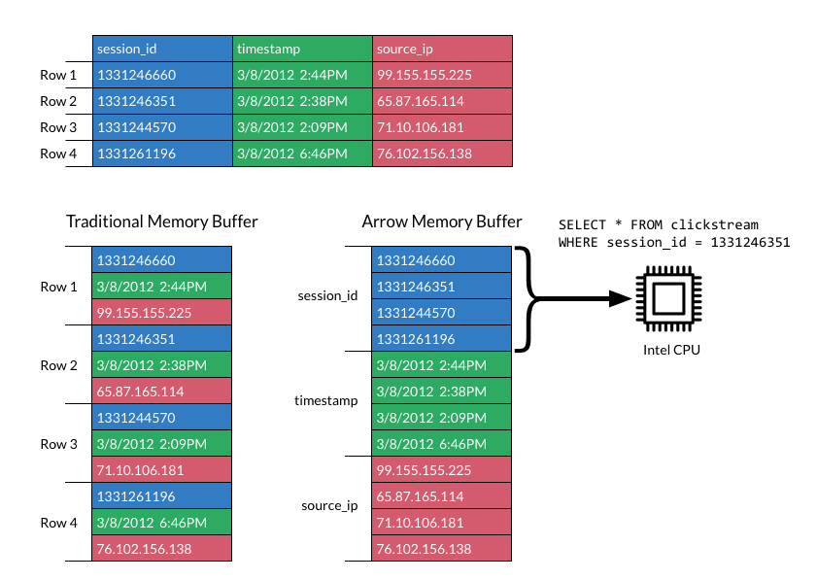

Apache Arrow
Columnar layout leverages GPU strengths
Emphasis on zero-copy and shallow-copy operations minimizes a core bottleneck
Consistency with CPU version simplifies development and conversion
gdf[‘session_id’]

Slide 16





APACHE ARROW
One format for interoperability and efficiency
cuDF
cuML
cuGraph
cuDNN

Slide 17

Interoperability beyond dataframes
DLPack and __cuda_array_interface__
Deep Learning
Array Compute

Slide 18
Interoperating with cupy
CuPy:cuDF :: numpy:pandas
Not as fast as an optimized CUDA kernel, but very efficient for coding
Important to keep track of data type requirements (e.g. contiguity)

Slide 19
Try notebooks 01 – 04 now
docs.rapids.ai/api

Slide 20
Section 1 05

Slide 21
Coordinate systems
We will be using data that was provided in both ellipsoidal and grid coordinate formats
Grid coordinates make distance calculations more convenient within a specific area
Fusing geospatial datasets like this requires complex coordinate conversions—a perfect job for GPU acceleration!

Slide 22
Try notebook 05 now
docs.rapids.ai/api

Slide 23
Section 1 06

Slide 24
RAPIDS Platform
Dask
cuDF
Data Prep/Handling
cuML
Machine Learning
cuGraph
Graph Analytics
DL Frameworks
Deep Learning
cuXfilter
Visualization
GPU Memory

Slide 25
cugraph
node
Follows NetworkX convention for graph object
Key differences to take advantage of GPU power
Exercises
Now: steps to build a graph with from_cudf_edgelist
Later: traversing the graph with single-source shortest path
Not shown today: analyzing a graph for centralities, communities, link prediction…
0
1
2
2
1
2
edge
2
3

Slide 26
Building a graph
With from_cudf_edgelist
Need compact range of int32 identifiers for the nodes
Will examine the factorize method to produce identifiers from arbitrary series
Undirected graph: graph with edges in both directions
One source column, one destination column, one edge weight column

Slide 27
Try notebook 06 now
docs.rapids.ai/api

Slide 28
Section 1 07 - 08

Slide 29
RAPIDS Platform
Dask
cuDF
Data Prep/Handling
cuML
Machine Learning
cuGraph
Graph Analytics
DL Frameworks
Deep Learning
cuXfilter
Visualization
GPU Memory

Slide 30
Distributed Dataframes
Scaling seamlessly
Partition 0
Partition 1
Partition 2
Partition 3
Partition 4
DataFrame (pandas or cuDF)
Dask DataFrame
(same type)

Slide 31
Working with partitions
No intrinsic row ordering, so no .iloc row selection, and index is essential
Key methods operate on whole dataframe partitions
Remember distinction between multi-GPU algorithms and multi-node/multi-GPU algorithms
Rebalance across workers when necessary

Slide 32
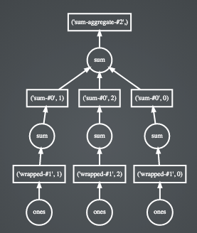
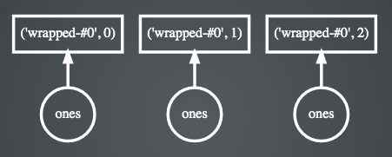
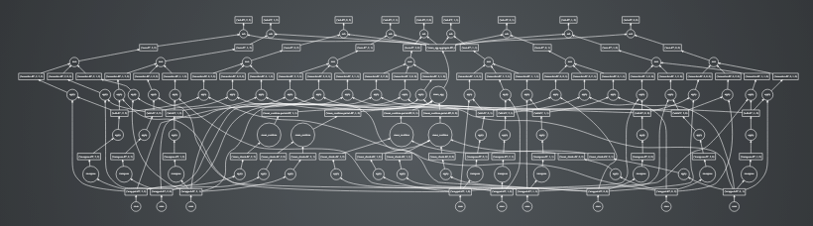
Task Scheduler
Enabling efficient compute
Compound operations
Simple operations
Complex DAG task chains
Notes:
Dask parallelizes PyData natively.
Dask.distributed is a centrally managed, distributed, dynamic task scheduler. The central dask-scheduler process coordinates the actions of several dask-worker processes spread across multiple machines and the concurrent requests of several clients.
The scheduler is asynchronous and event driven, simultaneously responding to requests for computation from multiple clients and tracking the progress of multiple workers. The event-driven and asynchronous nature makes it flexible to concurrently handle a variety of workloads coming from multiple users at the same time while also handling a fluid worker population with failures and additions. Workers communicate amongst each other for bulk data transfer over TCP.
Internally the scheduler tracks all work as a constantly changing directed acyclic graph of tasks. A task is a Python function operating on Python objects, which can be the results of other tasks. This graph of tasks grows as users submit more computations, fills out as workers complete tasks, and shrinks as users leave or become disinterested in previous results.

Slide 33
Working with the scheduler
Let Dask help you overcome your storage I/O barriers
Limit .compute (stay in Dask) until necessary
For exploratory and experimental data science, don’t be afraid to .persist
Remember that everything in a graph will be rerun without .persist/.compute— including random generation

Slide 34
Try notebooks 07 - 08 now
docs.rapids.ai/api

Slide 35
Section 2 01 - 07

Slide 36
RAPIDS Platform
Dask
cuDF
Data Prep/Handling
cuML
Machine Learning
cuGraph
Graph Analytics
DL Frameworks
Deep Learning
cuXfilter
Visualization
GPU Memory

Slide 37
cuxfilter
(coo-cross-filter)
Efficient GPU-backed in-browser visualization engine
Built on a host of pyViz ecosystem tools
Bokeh and Datashader charts
Multiple charts with cross-filtering widgets

Slide 38
RAPIDS Platform
Dask
cuDF
Data Prep/Handling
cuML
Machine Learning
cuGraph
Graph Analytics
DL Frameworks
Deep Learning
cuXfilter
Visualization
GPU Memory

Slide 39
cuML
Follows scikit-learn convention of model objects with .fit and .predict/.transform
Rapidly-growing subset of algorithms, driven by use cases
In today’s workshop
K-means (single- and multi-GPU)
DBSCAN
Logistic regression
K-nearest neighbors
XGBoost

Slide 40
K-means
Partitions data by iteratively moving cluster centers and reassigning datapoints based on which center is closest to the point
Requires a known (or well-estimated) number of clusters
Fast, simple, easy to understand
Has an efficient multi-node, multi-GPU implementation

Slide 41
DBSCAN
Uses spatial density to cluster—finds cluster points within at most epsilon distance of another point in the cluster
Can identify outliers—not every point is “reachable” from a cluster core
Does not require prior knowledge of the number of clusters, but does require an estimate for epsilon
Can identify clusters of unusual shapes

Slide 42
K-nearest neighbors
Enables rapid discovery of nearby, existing points to a new observation
Algorithm fits a data structure for future use
Foundation of other algorithms that require knowing which points are nearby a given point

Slide 43
Logistic regression
Regression with binary dependent variables
Uses the logistic function to map (-inf, +inf) domain scores to (0, 1) range
No simple coefficient formulas, as with ordinary least squares (OLS) linear regression
Assumes independence of features

Slide 44
Try notebooks 01 - 07 now
docs.rapids.ai/api

Slide 45
Section 2 08

Slide 46
XGBoost
Popular and powerful general-purpose classification and regression algorithm for structured data—can identify and use complex patterns
Gradient-boosted decision trees—optimizing against an objective function while controlling tree complexity with regularization
snake
No
Fur > 0
Yes
Size < 20cm
Yes
mouse
No
cat

Slide 47
Try notebook 08 now
docs.rapids.ai/api

Slide 48
Section 2 09

Slide 49
Single-source shortest path
Input: Graph (w/o negative-weight cycles), node_id
Output: dataframe with Vertex, Distance, Predecessor columns
0
Vertex | Distance | Predecessor
0 | 0 | -1
1 | 2 | 0
2 | 1 | 0
3 | 3 | 2
1
2
cg.sssp(G, 0)
2
1
2
2
3

Slide 50
Try notebook 09 now
docs.rapids.ai/api

Slide 51
Section 3 CAPSTONE EXERCISEs

Slide 52
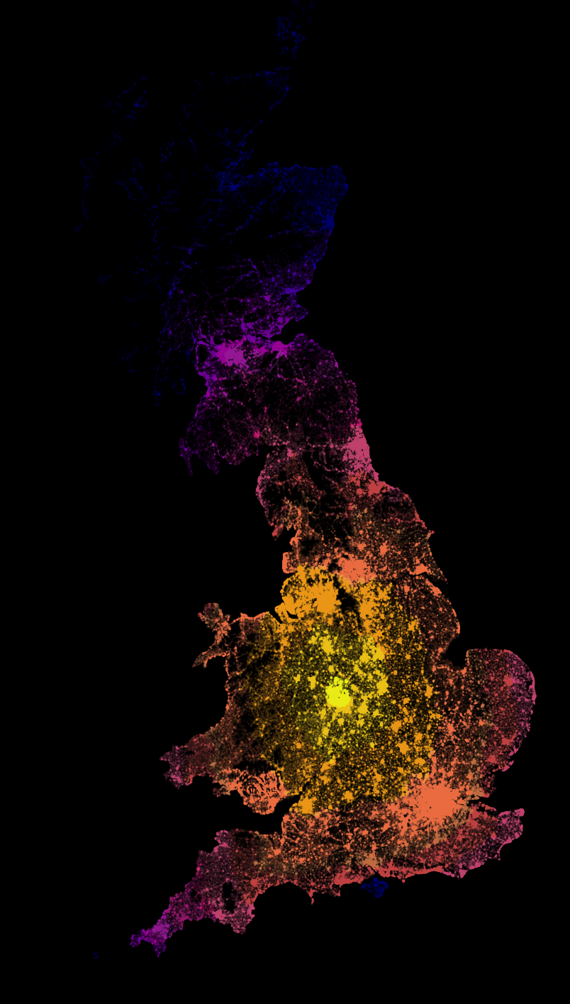
Biodefense
Simulation/exercise
Multiple weeks of a virulent epidemic
Performing analytics for national health authorities
Different tasks each week as the virus spreads
Note: simulation was created in summer 2019 and modeled on medical research on Ebolavirus

Slide 53
Week 1: Containment
Known infected: 18,000
A virus has been spreading through the UK population for an unknown amount of time, and symptomatic individuals have started showing up in hospitals by the thousands.
We need to get a handle on this—work with your team to see if you can identify any geographic areas of greatest concern. Maybe we can still contain the virus to specific regions.
Key goal: Find dense geographic clusters of infected people
Optional goals:
Calculate measures of geographic spread for each cluster
Compare the density of infected vs uninfected people in each cluster region

Slide 54
Week 2: response logistics
Known infected: 71,000
Efforts at containment have been unsuccessful, and known infections are over triple last week’s count.
We are shifting to prioritize efficient mitigation—and that starts with logistics. Work with your team to identify likely capacity requirements for each medical facility.
Key goal: Find the nearest hospital or clinic to each infected person so we can estimate capacity needs
Optional goals:
For each hospital, calculate the number of individuals who are nearest to that hospital
Prepare road directions for ambulances coming from a hospital to a given set of coordinates

Slide 55
Week 3: crisis management
Estimated infected: 294,000
Infections have reached about 1 in every 200 people, but there is still time to bend the infection curve.
We are trying to prioritize scarce resources and need to know who is most at risk. Work with your team to analyze demographic and employment data so we can target interventions most effectively.
Key goal: Identify factors associated with higher rates of infection
Optional goals:
Complete a regression or decision tree analysis of the data to understand the magnitude of different factors’ relative impact on risk

Slide 56
Conclusion

Slide 57
What you learned today
(a lot)
You learned why RAPIDS is being built and how it fits in the data science ecosystem
You learned how to use GPUs for everyday and advanced data science tasks
You learned the tricks to get next-level performance from common algorithms
You solved real-world problems with real-world data
What will you do next?

