Slide 1
9177: Detecting Illicit Massage Businesses by Leveraging Graph Machine Learning
Vasuki Garg¹
Osman Y. Özaltın¹, Maria E. Mayorga¹, Sherrie Bosisto²
¹North Carolina State University
²Global Emancipation Network
August 21st, 2025

Slide 2

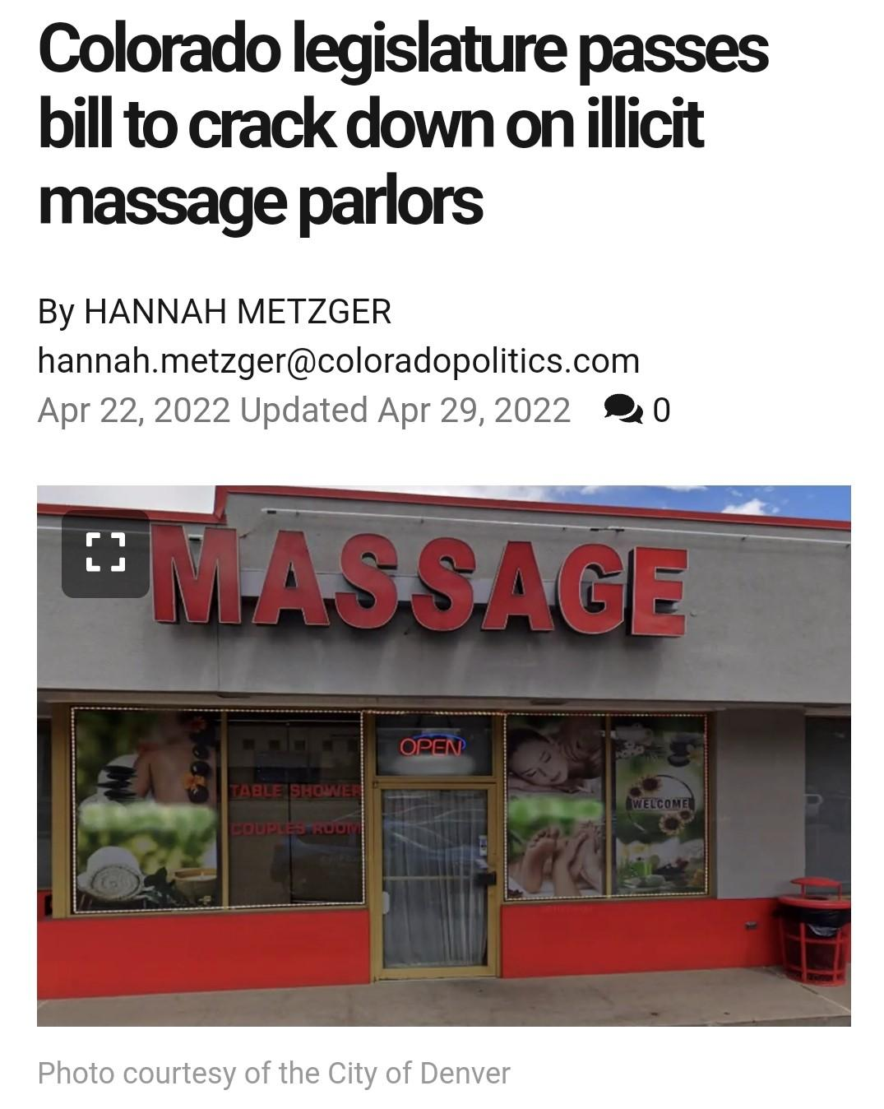
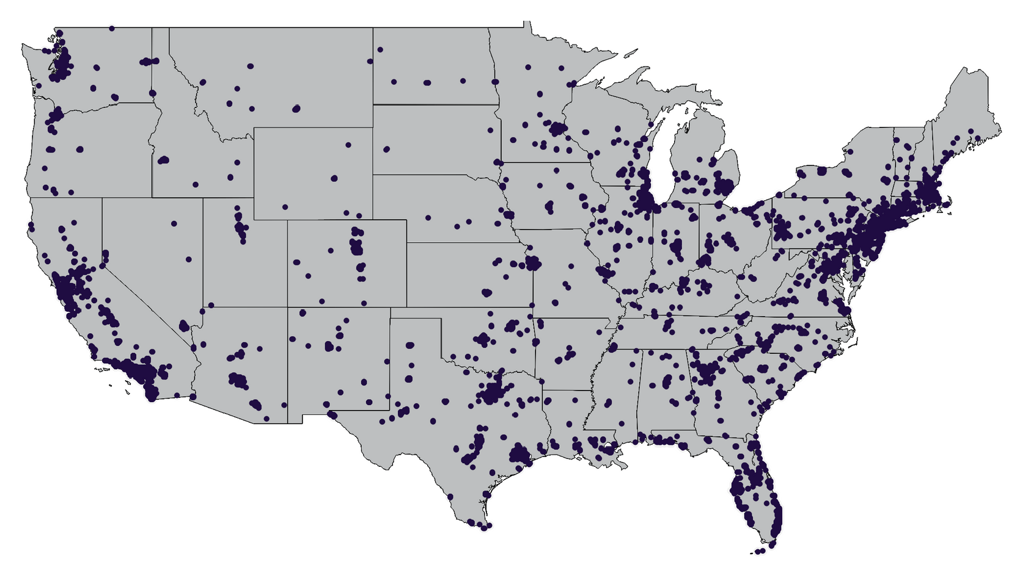
Background
Human trafficking:
The use of force, fraud, or coercion to exploit people for commercial sex acts or labor services against their will (US Dept. of State, 2025)
Illicit Massage Businesses (IMBs):
Businesses that pose as legitimate massage establishments but provide commercial sex. IMBs engage in a hybrid form of trafficking: sex and labor
Estimated 15,000 IMBs across the US (The Network, 2024)

Slide 3
Arc of the Work
Problem: Human trafficking investigators face two critical challenges:
Identifying IMBs, as they operate covertly
Processing the sheer volume of digital data from open sources such as online business reviews
High labeling effort and class imbalance arise
Automated Classification of Online Customer Reviews, MSOM 2023
Identifying high risk IMBs
Multi-source data integration
Risk scores, decision trees
Extracting signals from unstructured review text
Lexicon, Embedding
NLP for automation
Improving label efficiency with fewer annotations
Reinforcement learning-based active learning policy
Interpretable models for IMB Detection, IISE 2022
Active Learning for Detecting Human Trafficking, OR 2025
Need for large-scale, scalable automation of text data

Slide 4
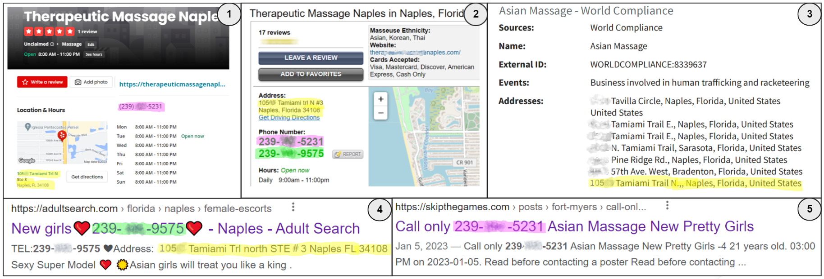
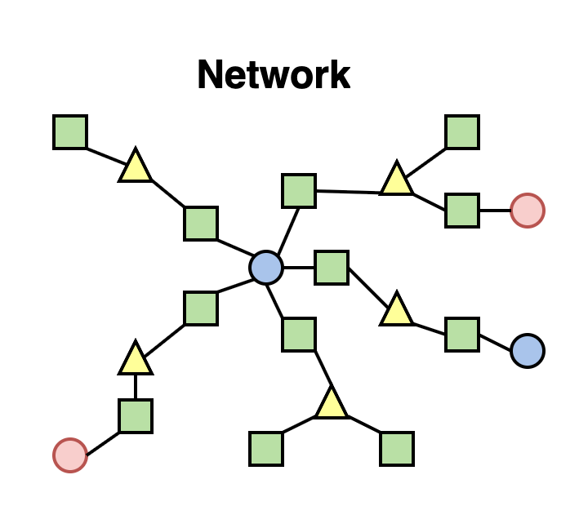
How to improve IMB detection?
Figure illustrates cross-platform linkage of businesses through shared identifiers
Solution: Network Based Detection
Instead of treating each business as an isolated entity, leveraging a heterogeneous network by linking and analyzing businesses, reviews, and reviewers to:
Classify businesses (illicit vs non-illicit)
Prioritize the investigation of the most suspicious massage businesses

Slide 5

Practical Impact
Model Applicability:
Generalizes to any business-review network with:
Features for businesses, reviews, and reviewers
Linkage metadata (e.g., bizId, reviewerId) for graph construction
with any #hops/layers (depth) and the #neighbors (breadth)
Metric selection is context-driven:
Precision (resource efficiency)
Recall (maximizes illicit business detection)
Broader Impact:
Acts as a decision support framework for prioritizing investigations
Informs:
Policy-making & resource allocation
Regulatory reforms and labor protections
Advocacy for transparency in vulnerable industries

Slide 6

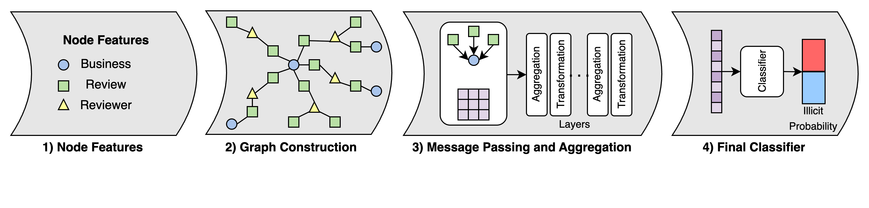
Methodology – Relational Graph Convolutional Network (RGCN)

Slide 7
Methodology – Relational Graph Convolutional Network (RGCN)
Heterogeneous Graph/Network Construction: (V, E, R)
V: set of nodes (businesses, reviews, and reviewers)
E: set of edges (business – review, and review – reviewer)
R: set of relations (has review {for business – review}, and written by {for review – reviewer})
Message Passing and Aggregation in RGCNs: a three-step process
Message Passing: propagates information over a node’s receptive field, preserving relation semantics.
Aggregation: gathers messages from neighbors, grouped by relation type.
Representation Update: combines node features and aggregated messages, followed by non-linear activation
Final Classifier: final business node embeddings from the RGCN are passed through a logistic regression classifier
Linear transformation followed by sigmoid activation
Classification threshold set to 0.5

Slide 8



Labeling “Li, R., Tobey, M., Mayorga, M., Caltagirone, S., & Ӧzaltın, O. Detecting Human Trafficking: Automated classification of online customer reviews of massage businesses. MSOM, 2023.”
A labeling procedure for the businesses (in previous work) was developed using the data sources and the criteria mentioned below for Washington D.C., Georgia, Florida, and Texas.
Multi-source data used:
Review sites: Yelp.com and RubMaps.ch (e.g., average rating, business name, phone number, etc.)
GIS (e.g., distance to truck stops), Census (e.g., housing and demographic information), and landcover type
Massage Businesses’ license records
Labeling criteria:
Using features from RubMaps information (review count, last review date, specific lexicon) and license disciplinary data (status = surrendered, suspended, revoked)
Outcome: Labeling method for massage businesses

Slide 9

Data sources:
Node Features:
Business: categorical to binary feature generation, univariate logistic regression for feature selection
Yelp, GIS, Census, landcover type
Rubmaps and license records (for labeling only)
Review:
Review Text Embeddings (Doc2Vec followed by PCA)
Sentiment Analysis Scores (RoBERTa)
Reviewer:
Gender (gender guesser)
With a focus on Colorado, Florida, and Texas in this study:
Business Type | CO | FL | TX
Total | 1926 | 4774 | 4699
Label = 1 (illicit) | 85 | 157 | 246
Label = 0 | 1841 | 4617 | 4453
Imbalance ratio | 0.046 | 0.034 | 0.055
Note: These imbalance ratio are for the labelled businesses after sampling using strategies, such as location intersection, illicit phrase search, BERT- LR predicted reviews.
Business Data

Slide 10

Experimental Setup
Undersampled Business Type | CO | FL | TX
Total | 425 | 785 | 1230
Label = 1 (illicit) | 85 | 157 | 246
Label = 0 | 340 | 628 | 984
Imbalance ratio | 0.25 | 0.25 | 0.25
Class Imbalance: Undersampling with 4x non-illicit than illicit
Loss Function: Negative Log-likelihood (NLL)
Performance Metrics: AUC (ROC Curve), Recall, and F1-Score
Hyperparameter Optimization: Epochs, Dropout, #Layers, #Neighbors
Train and Validation Setup: 10-fold stratified CV on undersampled data
Hyperparameter | Value
#Layers | 5
Batch Size | 128
Hidden Dimensions | 64
Dropout | 0.5
Epochs | 100
Early Stopping criteria | 20
#Neighbors | 5
Batch Normalization | True
Self-loop | True

Slide 11
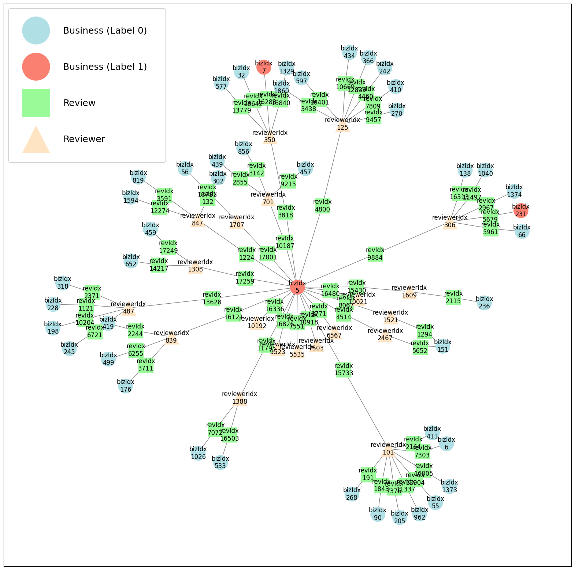
4 Hop Subgraph Heterogeneous Network
Node/Edge Type | CO | FL | TX
Total Nodes | 13610 | 23704 | 36562
Business | 425 | 785 | 1230
Review | 7662 | 13584 | 21824
Reviewer | 5523 | 9335 | 13508
Total Edges | 15324 | 27168 | 43648
Business - Review | 7662 | 13584 | 21824
Review - Reviewer | 7662 | 13584 | 21824
Key Takeaway:
CO produces the sparsest network

Slide 12

Numerical Results
State | Model | Recall | F1-Score | AUC
CO | Logistic Reg. | 0.2941 | 0.4348 | 0.8279
 | Logistic Reg. (bal) | 0.5294 | 0.5 | 0.8209
 | Random Forest | 0.2353 | 0.3478 | 0.8183
 | RGCN_LR | 0.4706 | 0.5333 | 0.7889
FL | Logistic Reg. | 0.8065 | 0.8621 | 0.9119
 | Logistic Reg. (bal) | 0.8065 | 0.8333 | 0.9112
 | Random Forest | 0.8387 | 0.8814 | 0.9192
 | RGCN_LR | 0.8065 | 0.8475 | 0.9099
TX | Logistic Reg. | 0.7755 | 0.8352 | 0.986
 | Logistic Reg. (bal) | 0.898 | 0.8544 | 0.9853
 | Random Forest | 0.7143 | 0.8235 | 0.9743
 | RGCN_LR | 0.7755 | 0.8261 | 0.9826
Takeaways:
RGCN_LR shows an improvement of 0.18 in Recall and 0.10 in F1-Score compared to logistic regression for the CO dataset (highlighting its ability to leverage network-informed learning in scarce data)
RGCN_LR also maintains competitive AUC values across all other states.

Slide 13

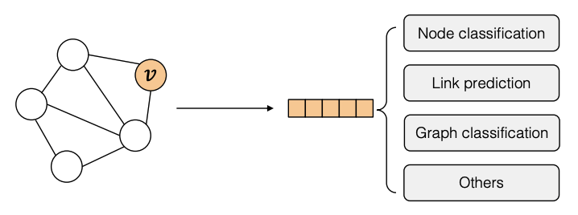
Conclusion
Conducted a feasibility study to detect illicit massage businesses (IMBs) using a Relational Graph Convolutional Network (RGCN) on business-review data
Achieved competitive performance, especially strong on the smallest dataset, highlighting value of network-informed learning
Future work
Marginal gains from review/reviewer nodes suggest the need for denser network connectivity
Incorporating license and financial records
Architectural extensions:
Adding multi-node-type classification
Cross-business link prediction

Slide 14
This work was supported by the Criminal Investigations Network Analysis Center (CINA) and our collaborators at the Global Emancipation Network (GEN) Thank you! Vasuki Garg - vgarg5@ncsu.edu
FOR MORE DETAILS: The synthetic dataset and the code are available on GitHub:
https://github.com/Vasuki-Garg/rgcn-imb-detection

