Slide 1
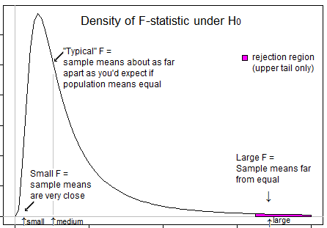
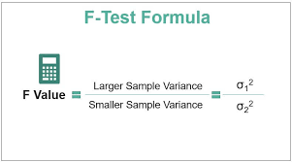
UIT2502 – Data Analytics & Visualization
Analysis of Variance - F-test

Slide 2
Introduction
An F-statistic is the ratio of two variances.
Variances measure the dispersal of the data points around the mean.
Higher variances occur when the individual data points tend to fall further from the mean.

Slide 3
Introduction
F-Test in statistics is a hypothesis-testing procedure that considers two variances from two samples.
The F-Test is used when the difference between two variances needs to be significantly assessed,
When determining whether or not two samples can be taken as representative of the normal population with the same variance.
Helps to determine the overall significance of the regression

Slide 4
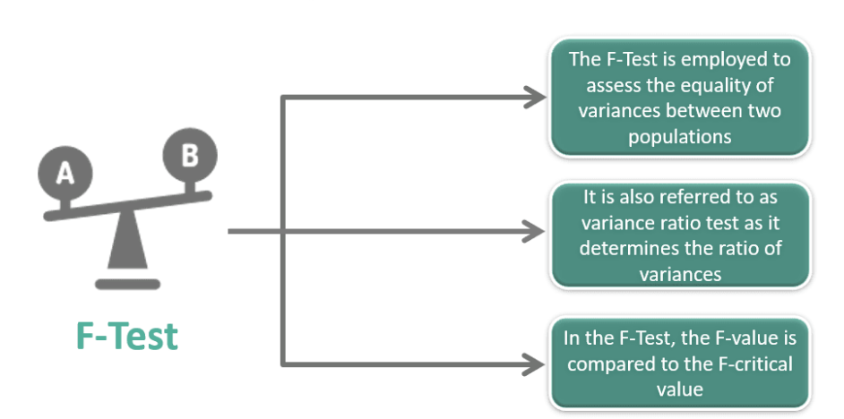
Introduction
F-Test - Definition, Statistics, Calculation, Interpretation, Example (wallstreetmojo.com)

Slide 5
Introduction
F-Test is utilized to determine whether two populations’ variances are equal.
It is used to examine the hypothesis that a population’s mean values are normally distributed.
It is also utilized to determine whether a suggested regression model accurately predicts the data.

Slide 6
Assumptions of F-Test
Normality: the populations must have a normal distribution.
Independent and random selection of sample items: the selection of the samples’ components should be independent and random.
More than unity: The variance ratio must be one or larger than one; it cannot be less than one. When dividing variance estimates, smaller estimates divide the larger estimates of variances.

Slide 7
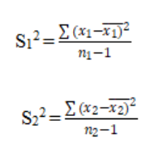
Assumptions of F-Test
The additive property states that the total of different variance components will equal the total variance, i.e., the total variance is the sum of the variance between samples and the variance within samples (one-way ANOVA).

Slide 8
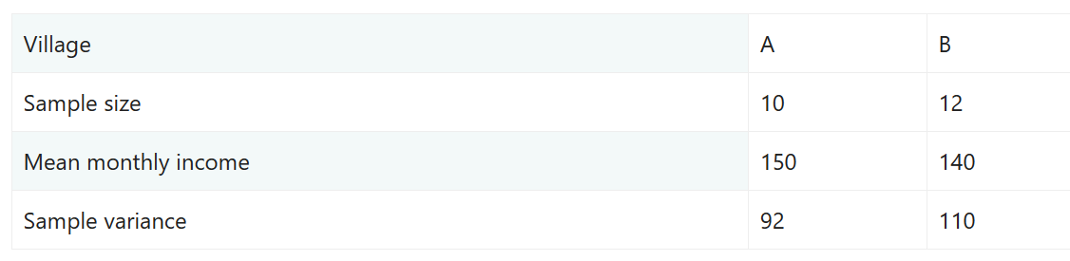
Example
Testing the equality of sample variances with a significance level of 5%

Slide 9
Example
Testing the equality of sample variances with a significance level of 5%
H0: Var1 = Var2
Var of sample 1 = 10.22
Var of sample 2 = 10
F score = 1.022
Critical value of v1 = 9
Critical value of v2 = 11
F-table value @ 0.05 is 2.90
Inference:
F’s computed value (1.022) is less than its table value obtained from the F table (2.90). Null hypothesis is true and that the variance of the two samples is equal.

Slide 10
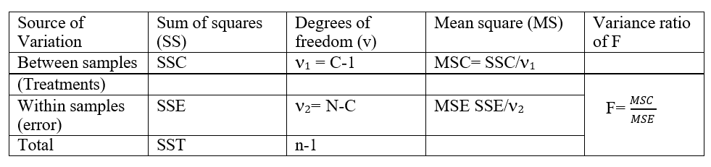
ANOVA Table
SSC= Sum of squares between samples (Columns)
SST= Total sum of the squares of Variations.
SSE= Sum of squares within the samples.
MSC= Mean sum of squats between samples
MSE= Mean sum of squares within samples

Slide 11
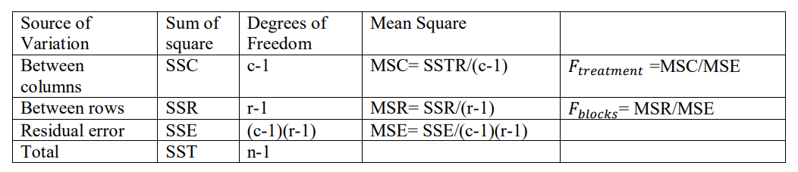
ANOVA for Two-way classification
𝐹𝑡𝑟𝑒𝑎𝑡𝑚𝑒𝑛𝑡 = MSC/MSE; MSC > MSE or MSE/MSC; MSE > MSC
𝐹𝑏𝑙𝑜𝑐𝑘𝑠 = MSR/MSE; MSR > MSE or MSE/MSR; MSE>MSR

Slide 12
ANOVA for Two-way classification
Total variation consists of three parts:
variation between columns, SSC;
variation between rows, SSR; and
(iii) actual variation due to random error, SSE.
That is,
SST=SSC+(SSR+SSE).
The degrees of freedom associated with SST are cr-1, where c and r are the number of columns
and rows, respectively.
Degrees of freedom between columns= c-1
Degrees of freedom between rows= r-1
Degrees of freedom for residual error=(c-1)(r-1)

Slide 13
Books
TEXTBOOKS:
David Cielen, Arno D. B. Meysman, and Mohamed Ali, “Introducing Data Science”, Manning Publications, 2016. (first two chapters for Unit I).
Robert S. Witte and John S. Witte, “Statistics”, Eleventh Edition, Wiley Publications, 2017.
Jake VanderPlas, “Python Data Science Handbook”, O’Reilly, 2016.
REFERENCES:
Allen B. Downey, “Think Stats: Exploratory Data Analysis in Python”, Green Tea Press, 2014.

