Slide 1


NAGAR YUWAK SHIKSHAN SANSTHA’S
YESHWANTRAO CHAVAN OF ENGINEERING
(An Autonomous Institute Affiliated to RTMNU)
Hingna Road, Wanadongri, Nagpur- 441110
ACCREDITED WITH NAAC A++ GRADE
SUBJECT: OOPS (JAVA)
MINIPROJECT
TOPIC:- WEATHER FORECAST APP
S.No. | Name | Roll No.
01 | ADITI ANAND NALDURGKAR | 02
02 | VAIBHAVI AMOL KUMBHALKAR | 23
03 | VASUNDHARA GANESH SHIVANKAR | 26

Slide 2

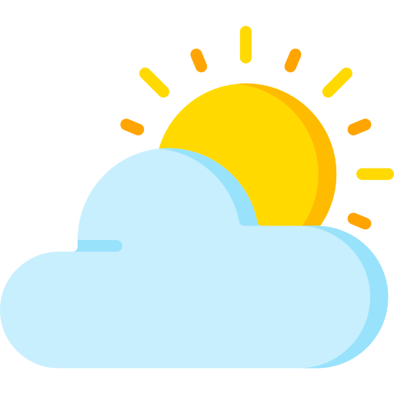
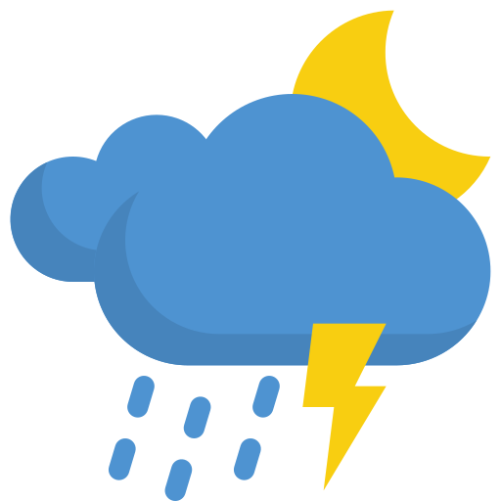
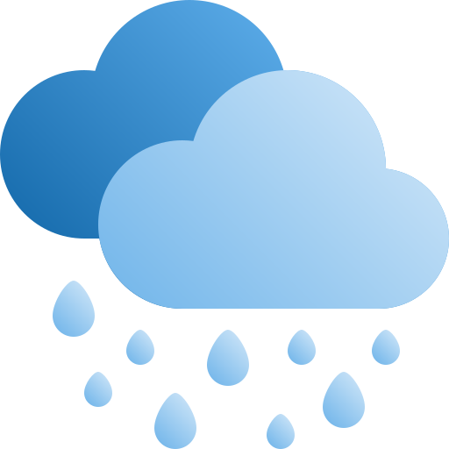
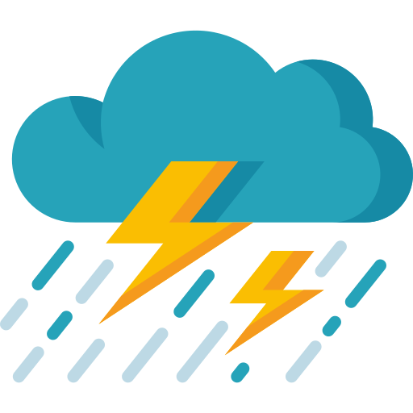
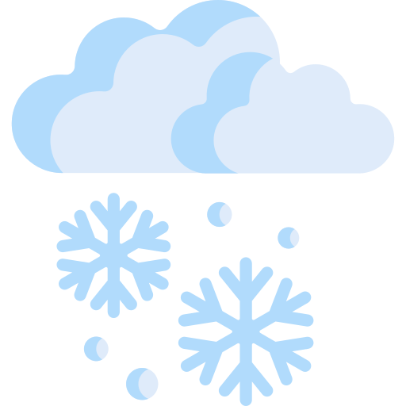
WEATHER FORECAST APP
Predicting Tomorrow: Exploring Weather Dynamics with Java

Slide 3
INTRODUCTION
The Weather App is a Java-based application that provides users with real-time weather information for a specified location. It fetches weather data from an external API and displays it in a graphical user interface (GUI). Users can enter a location, and the app retrieves and presents weather details, including temperature, weather condition, humidity, and wind speed. This outlines the project's architecture, technologies used, and the functionality of each class within the application. The Weather App represents a sophisticated integration of Java technologies, designed to empower users with accurate and up-to-date weather insights effortlessly. Leveraging a robust backend system, the application seamlessly fetches real-time weather data from an external API, ensuring reliability and precision in forecasting. Through an intuitive graphical user interface (GUI), users can easily input their desired location and promptly retrieve comprehensive weather details.
,u

Slide 4

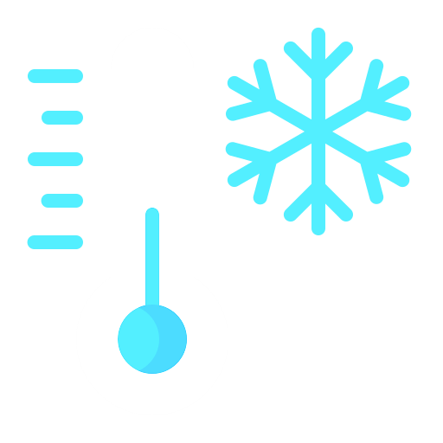
INPUT CODE (JAVA)
import java.applet.Applet;import java.awt.*;
import java.awt.event.*;
import java.io.*;import java.net.*;
import org.json.*;
public class WeatherApplet extends Applet implements ItemListener {
private Label cityLabel, forecastLabel, temperatureLabel, humidityLabel, windLabel;
private Choice cityChoice; private String selectedCity = "New York";
private JSONObject weatherData;
public void init() {
setLayout(new GridLayout(5, 2));
cityLabel = new Label("Select City:");
cityChoice = new Choice();
cityChoice.add("New York");
cityChoice.add("London");
cityChoice.add("Paris");

Slide 5
INPUT CODE (JAVA)
cityChoice.addItemListener(this);
forecastLabel = new Label("Weather Forecast:");
temperatureLabel = new Label("Temperature: ");
humidityLabel = new Label("Humidity: ");
windLabel = new Label("Wind Speed: ");
add(cityLabel);
add(cityChoice);
add(forecastLabel);
add(new Label());
add(temperatureLabel);
add(new Label());
add(humidityLabel);
add(new Label());
add(windLabel);
add(new Label());
fetchData();}
public void itemStateChanged(ItemEvent e) {
selectedCity = cityChoice.getSelectedItem();
fetchData()}
private void fetchData() {
try {
URL url = new URL("https://api.openweathermap.org/data/2.5/weather?q=" + selectedCity + "&appid=0ce7f1231c90c74080af7d7ee97a3d2d&units=metric");
HttpURLConnection conn = (HttpURLConnection) url.openConnection();
conn.setRequestMethod("GET");
conn.connect();
int responseCode = conn.getResponseCode();
if (responseCode == HttpURLConnection.HTTP_OK) {
BufferedReader in = new BufferedReader(new

Slide 6
INPUT CODE (JAVA)
InputStreamReader(conn.getInputStream()));
String inputLine;
StringBuilder response = new StringBuilder();
while ((inputLine = in.readLine()) != null) {
response.append(inputLine); }
in.close();
weatherData = new JSONObject(response.toString());
updateUI(); }
else {
System.out.println("Error fetching weather data. Response Code: " + responseCode);} }
catch (Exception e) {
e.printStackTrace(); } }
private void updateUI() {
if (weatherData != null) {
JSONObject main =
weatherData.getJSONObject("main");
JSONObject wind = weatherData.getJSONObject("wind");
String forecast = weatherData.getJSONArray("weather").getJSONObject(0).getString("main");
String temperature= main.getString("temp") + " °C";
String humidity= main.getString("humidity") + "%";
String windSpeed = wind.getString("speed") + " m/s";
forecastLabel.setText("Weather Forecast: " + forecast); temperatureLabel.setText("Temperature: " + temperature); humidityLabel.setText("Humidity: " + humidity);
windLabel.setText("Wind Speed: " + windSpeed);
} }}

Slide 7

INPUT CODE (HTML)
<!DOCTYPE html>
<html lang="en">
<head>
<meta charset="UTF-8">
<meta name="viewport" content="width=device-width, initial-scale=1.0">
<title>Weather Forecast Applet</title>
<style>
body {
font-family: Arial, sans-serif;
margin: 0;
padding: 20px;
background-color: #f7f7f7; }
.container {
max-width: 600px;
margin: 0 auto;
background-color: #fff;
padding: 20px;
border-radius: 8px;
box-shadow: 0 0 10px rgba(0, 0, 0, 0.1); }
h1 {
text-align: center; }
applet {
display: block;
margin: 0 auto; }
</style></head><body>
<div class="container">
<h1>Weather Forecast</h1>
<applet code="WeatherApplet.class" width="400" height="200">
Your browser does not support Java applets.
</applet>
<p>Java applets are deprecated and may not work in modern browsers. You might need to enable Java support or use an older browser.</p>
</div>
</body>
</html>

Slide 8
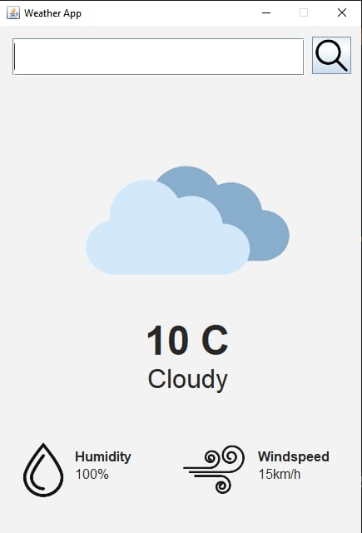
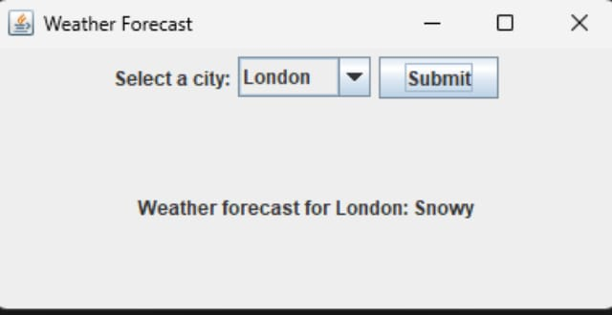
OUTPUT
USING APPLET
Russia
USING JFRAME
Temperature
Weather

Slide 9
CONCLUSION
In this project, we have successfully developed a weather forecasting app that provides users with real-time weather information for various cities around the world. The app utilizes the OpenWeatherMap API to fetch current weather data, including temperature, humidity, wind speed, and weather conditions. The user-friendly interface allows users to select their desired city and view the current weather forecast.
The app's features include:
A user-friendly interface with a dropdown menu to select cities.
Real-time weather data fetched from the OpenWeatherMap API.
Display of current temperature, humidity, wind speed, and weather conditions.
Ability to update the weather forecast for a selected city.
The development of this app has demonstrated the power of Java and its associated libraries in building a functional and user-friendly application. The use of the OpenWeatherMap API has enabled us to provide accurate and up-to-date weather information to users.
Overall, this weather forecasting app is a useful tool for anyone looking to stay informed about the weather in their area or in other cities around the world.

Slide 10

THANK
YOU!

