Slide 1
Amazon Product Data Visualization
This analysis explores Amazon product data, covering categories, pricing, discounts, ratings, and customer engagement.
The objective is to identify meaningful patterns and derive actionable insights through data visualization.

Slide 2
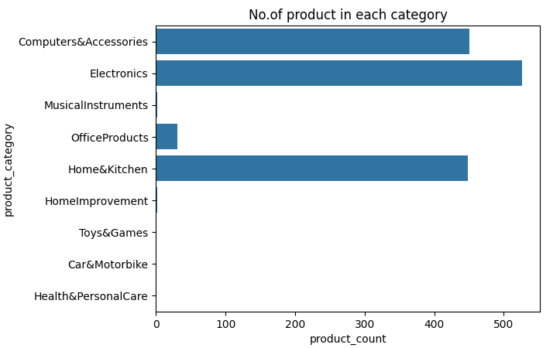
Product Category Distribution
Key Insights:
Electronics has the highest product representation, followed by Computers & Accessories and Home & Kitchen.
These three categories holds majority of products.

Slide 3
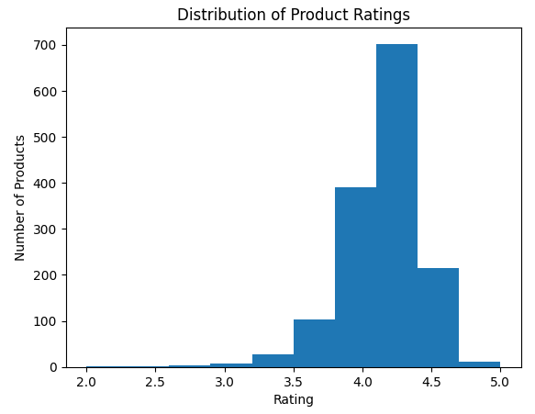
Product Rating Distribution
Key Insights:
Product ratings are predominantly concentrated between 4.0 and 4.5, indicating generally strong customer ratings across the product offerings.

Slide 4
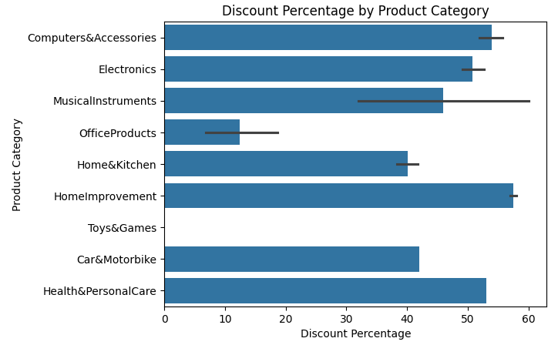
Discount Percentage by Product Category
Key Insights:
Home Improvement products show the highest discount percentage, while Office Products have the lowest.

Slide 5
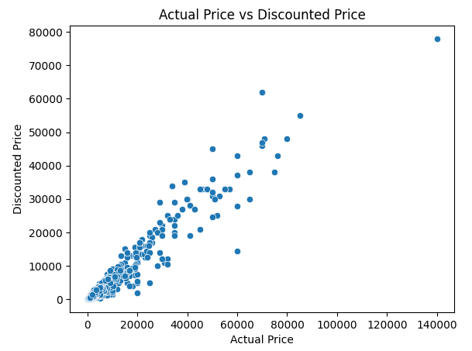
Actual Price vs Discounted Price
Key Insight:
Actual price and discounted price show a strong positive relationship, with higher-priced products generally has higher discounted prices.

Slide 6
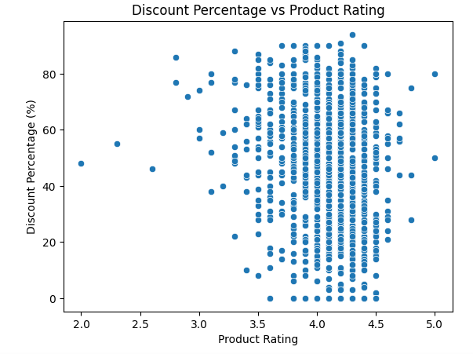
Discount Percentage vs Product Rating
Key Insight:
Product ratings show no clear relationship with discount percentage, suggesting that higher discounts do not necessarily correspond to higher customer ratings.

Slide 7
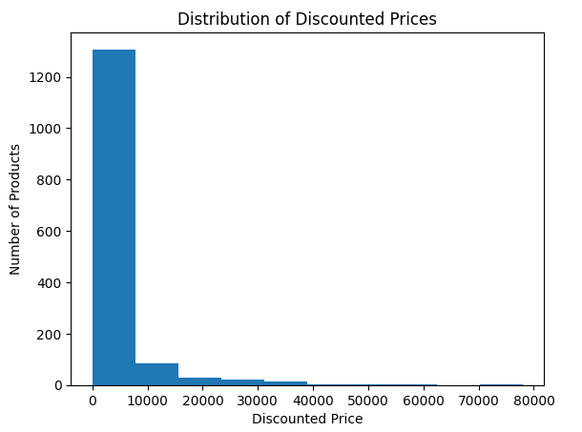
Distribution of Discounted Prices
Key Insight:
Most products are concentrated in the lower discounted-price range, while relatively few products are positioned at higher price points.

Slide 8
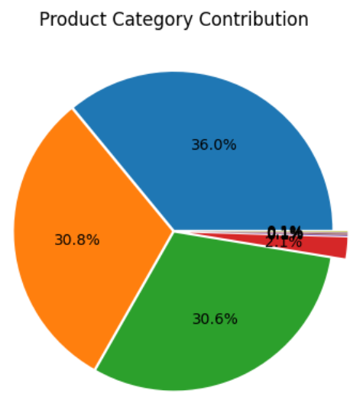
Product Category Contribution
Key Insights:
Electronics, Computers & Accessories , Home & Kitchen category holds most of the products and very few products are from other categories.

Slide 9
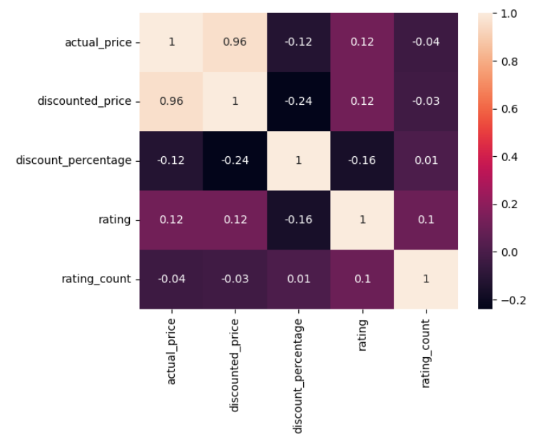
Relationships Across Product Metrics
Key Insights:
Actual price and discounted price show a very strong positive relationship, indicating that higher-priced products generally have higher discounted prices.
Discount percentage does not appear to have a strong relationship with product ratings.

