Slide 1


SMART INDIA HACKATHON 2024
TITLE PAGE
Problem Statement ID –SIH1630
PS Title- Mentor Connect
Theme- Smart Education
PS Category- Software
Team ID - 9
Team Name – ByteForce

Slide 2
WISEGUIDE
ByteForce
IDEA/SOLUTON:
To develop an mentoring platform that bridges the gap between mentors and mentees
This platform contains features like automated scheduling, integrated video communication using API’s like Calendly, Zoom etc.
The platform will include a feedback review system, resource sharing, and dynamic matching of mentees and mentors.
Problem Solution:
Dynamic matching of mentors and mentees
Automated scheduling and video communication and chat integration
Feedback system and resource sharing
Unique Value Propositions (UVP) :
AI-driven dynamic matching system ensures mentees are paired with suitable mentors
Calendar booking system that simplifies scheduling.
Gamification boosts engagement by rewarding mentees and mentors making the process interactive

Slide 3
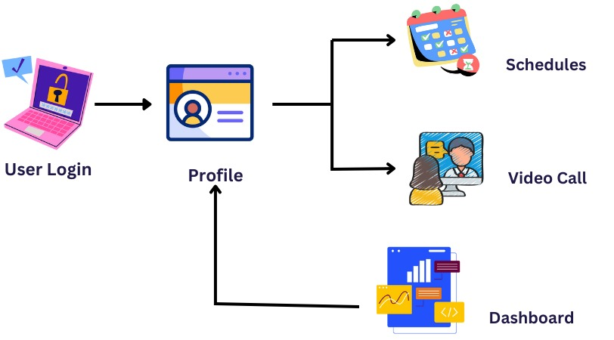

TECHNICAL APPROACH
ByteForce
Algorithm Development:
Python to develop the machine learning algorithm for Mentor Mentee Matching
Video and Text Communication:
Using APIs Socket.io, Agora.io, Zoom API, Jitsi Meet.
Cloud services:
AWS – hosting our application and scaling MongoDB – storing user data, mentor profiles, and matching information.

Slide 4
FEASIBILITY AND VIABILITY
ByteForce
EXISTING SYSTEMS:
MentorCruise
GrowthMentor
Clarity.fm
ADPList
PRSA Mentor Connect
Advantages:
Technical feasibility: It is feasible using APIs for video calls, calendars, and AI-based matching, though AI may require more development time
Scheduling, meetups, and skill-based matching enhance efficiency by automating mentor-mentee connections, making the process personalized.
Potential Challenges:
Ease of Use: Creating an intuitive and user-friendly interface can be difficult.
Adoption Rates: Encouraging both mentors and mentees to adopt and regularly use the platform might require significant effort.
Strategies to overcome:
User Testing: Conduct usability testing with target users to identify pain points.
Engagement Strategies: Use marketing, incentives, and community-building.

Slide 5
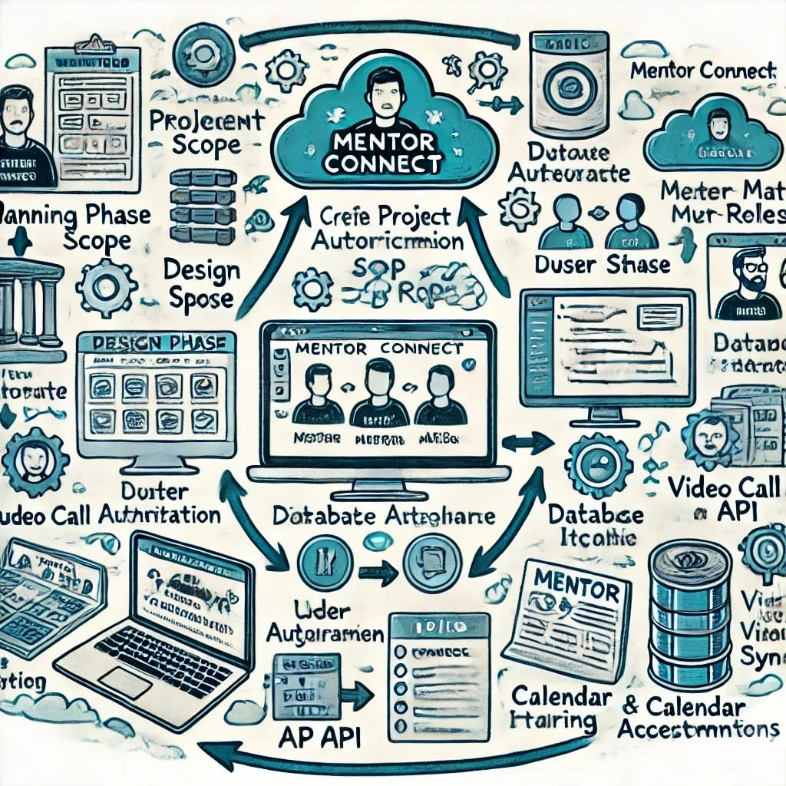
IMPACT AND BENEFITS
ByteForce
Enhanced Learning:
Personalized guidance
Feedback and support
Career Guidance:
Industry trends
Job opportunities.
Insights into career paths
Networking Opportunities:
Connect with professionals
Expanding their networks
Time Commitment:
Students and mentors need to invest time
Challenging for busy individuals.

Slide 6
RESEARCH AND REFERENCES
ByteForce
Reference Books:
https://archive.org/details/mentorsguidefaci0000zach/page/n9/mode/2up?view=theater
Reference Links:
https://www.togetherplatform.com/
https://api.zoom.us/v2/
Chronus : Offers customizable mentoring software that facilitates matching based on participant goals and preferences.

