Slide 1
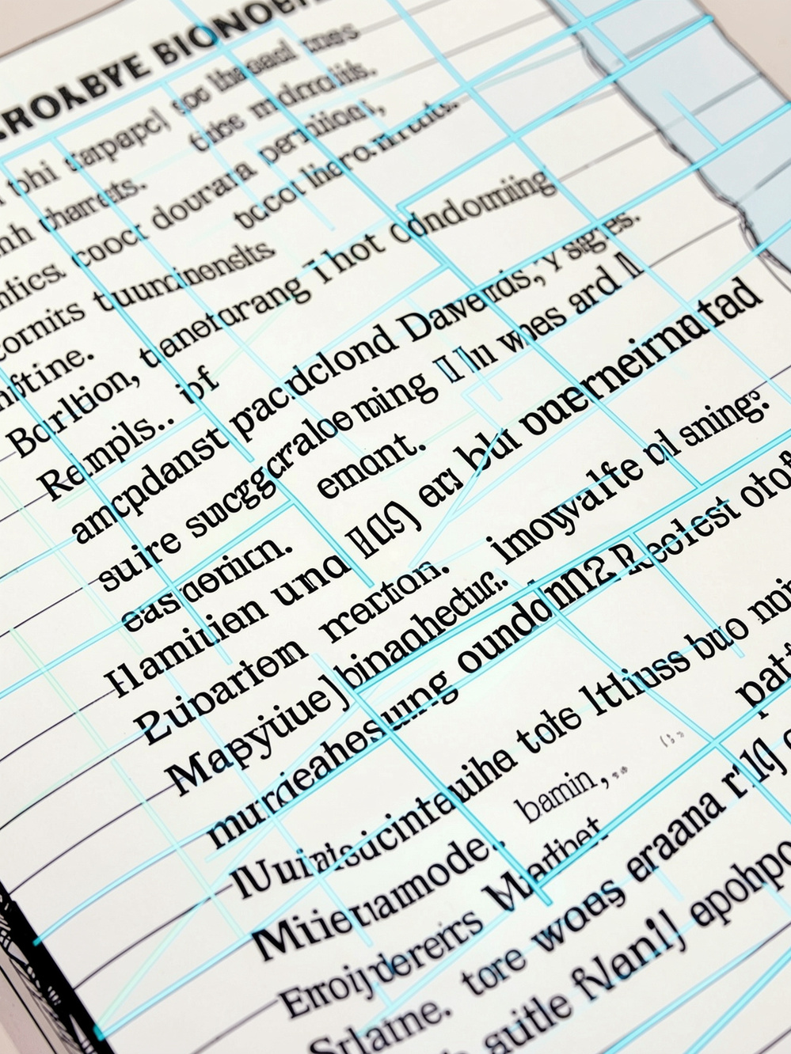
Optical Character Recognition (OCR)
A technical project presentation on automated text extraction from images and documents
Guided by: Leang Vakhim · Presented by: Ry Vorovath
Notes:
1

Slide 2
Table of Contents
01 | System Overview
02 | Technical Stack
03 | Model Architecture
04 | Data Processing Pipeline
05 | Demo & Testing
06 | Challenges & Future Improvements
Notes:
2

Slide 3
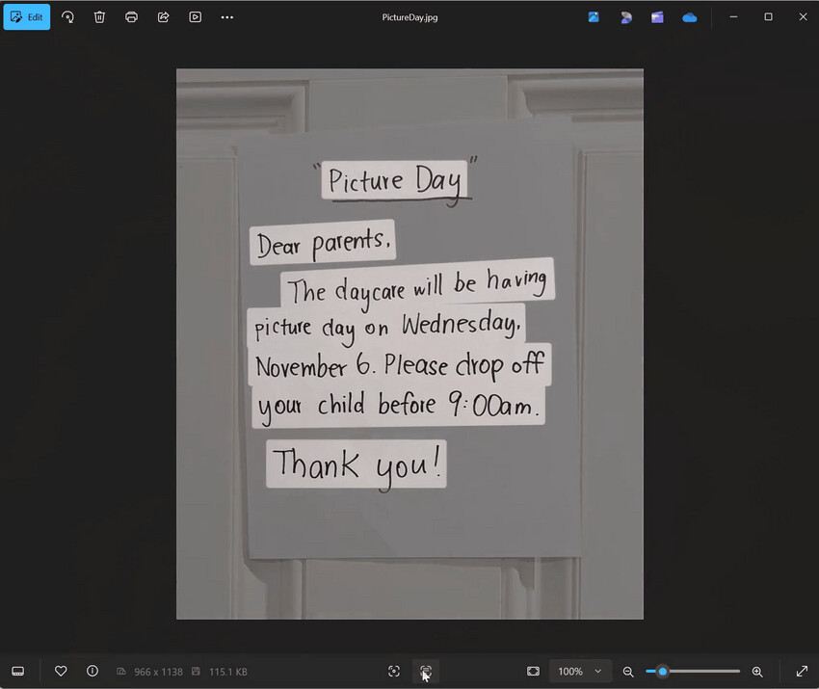

System Overview
This project builds an end-to-end OCR recognizer that automatically detects and extracts text from images, scanned documents, and natural scenes. The system transforms unstructured visual data into machine-readable, searchable text — enabling downstream applications such as document digitization, data entry automation, and accessibility tools.
Input
Process
Images, PDFs, and scanned documents
Preprocessing → Detection → Recognition
Output
Structured, searchable text data
Notes:
2

Slide 4
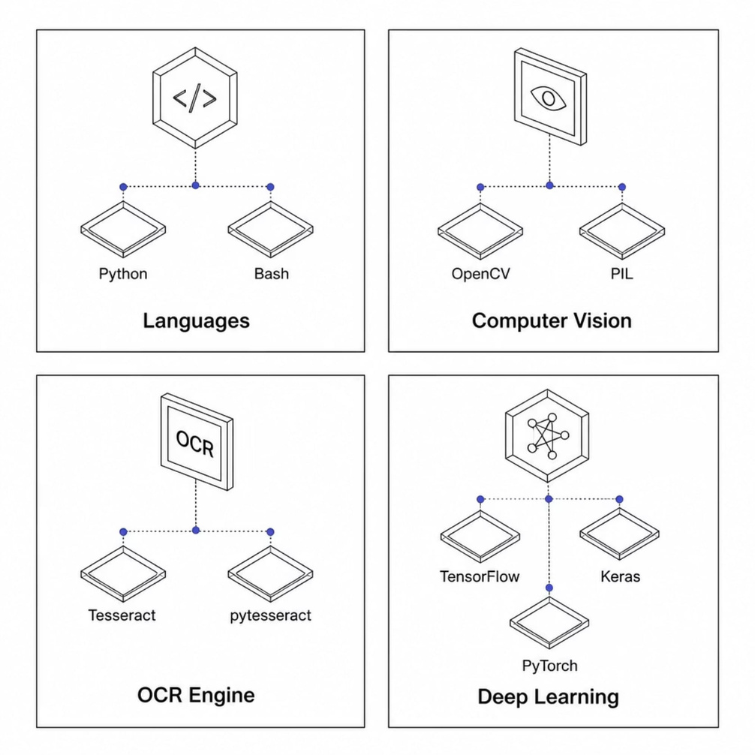
Technical Stack
The project leverages a modern, open-source toolchain optimized for image processing and deep learning.
Core Libraries
Python — primary development language
OpenCV — image preprocessing, deskewing, and decoding
EasyOCR — OCR engine (combines detection + recognition, not Tesseract)
PyTorch — deep learning backend that runs the EasyOCR models
FastAPI — backend API framework serving the /process-ocr/ endpoint
NumPy — image array handling between OpenCV and EasyOCR
Notes:
3

Slide 5

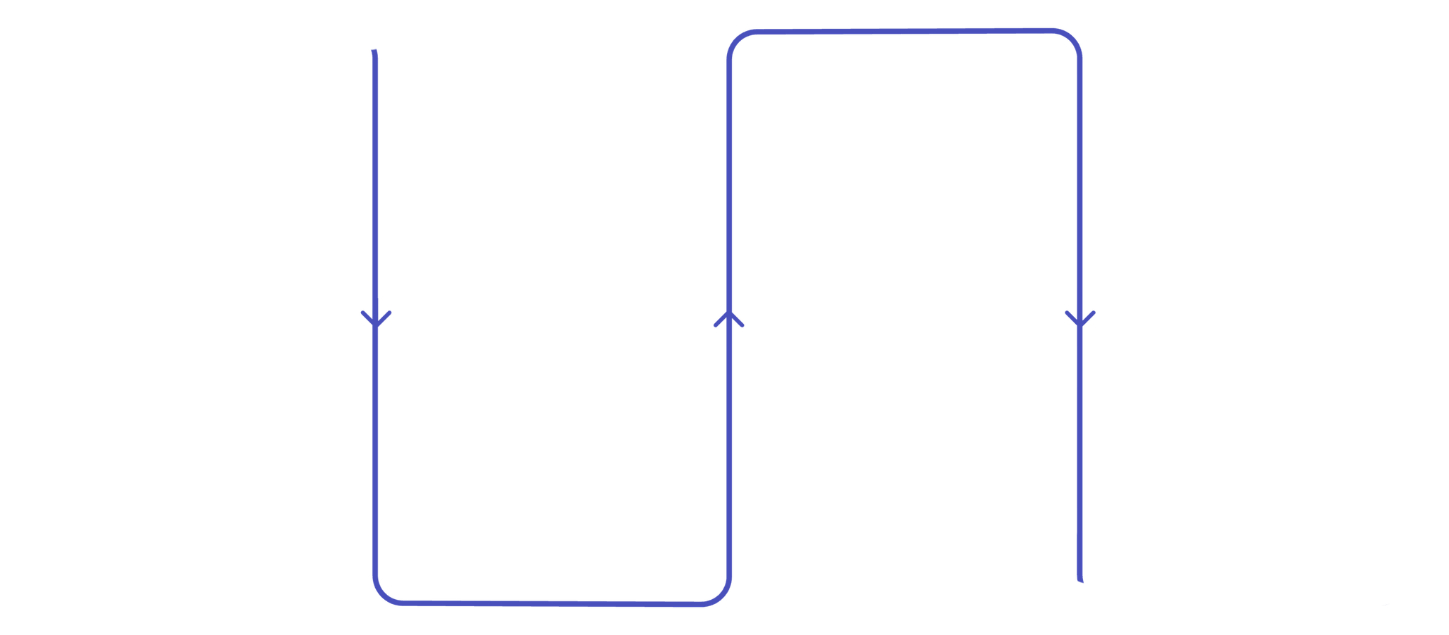
Model Architecture
The OCR system follows a two-stage approach: text detection to locate text regions, followed by text recognition to decode characters within those regions.
Text Recognition
CRNN with CTC loss decodes text
Text Detection
EAST or CRAFT to locate regions
The recognition module uses a Convolutional Recurrent Neural Network (CRNN) with Connectionist Temporal Classification (CTC) loss, enabling accurate recognition without explicit character segmentation.
Notes:
4

Slide 6
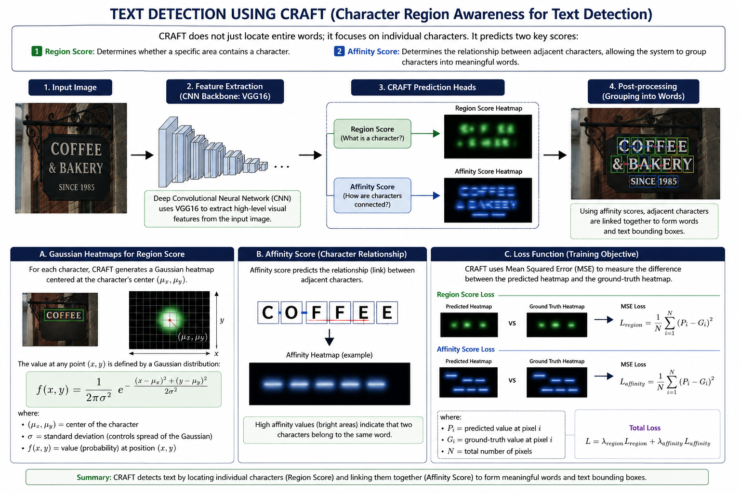
Notes:
4

Slide 7
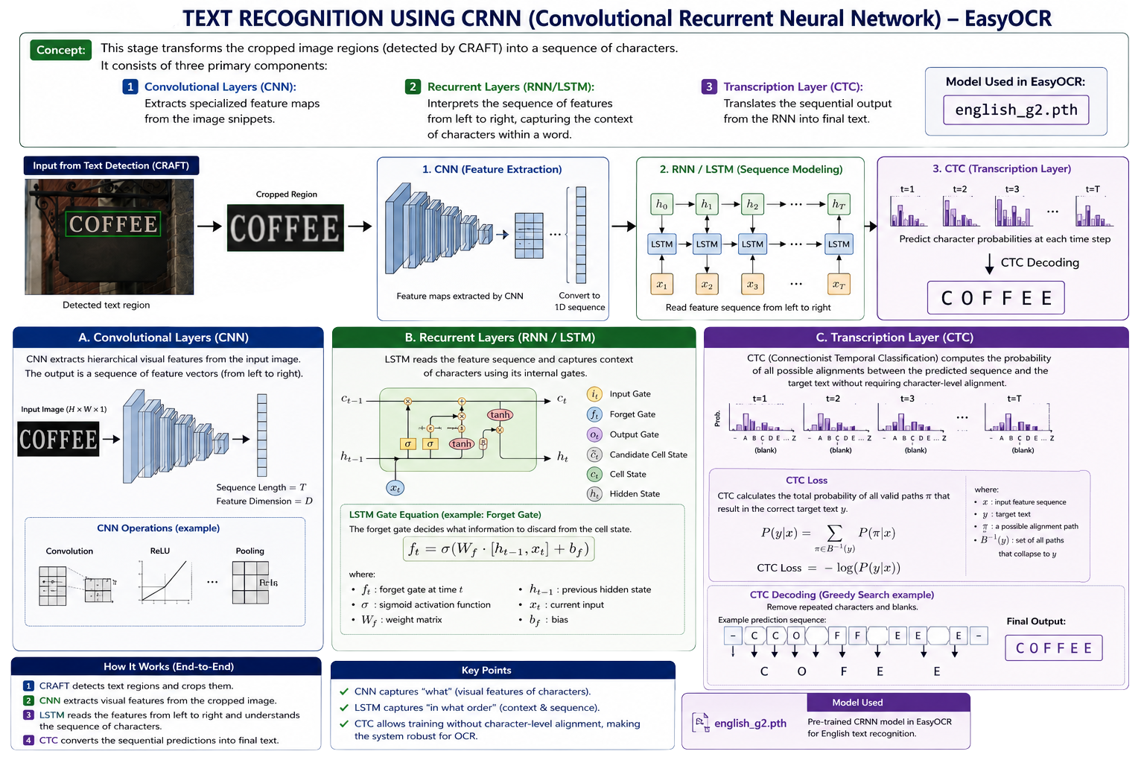
Notes:
4

Slide 8

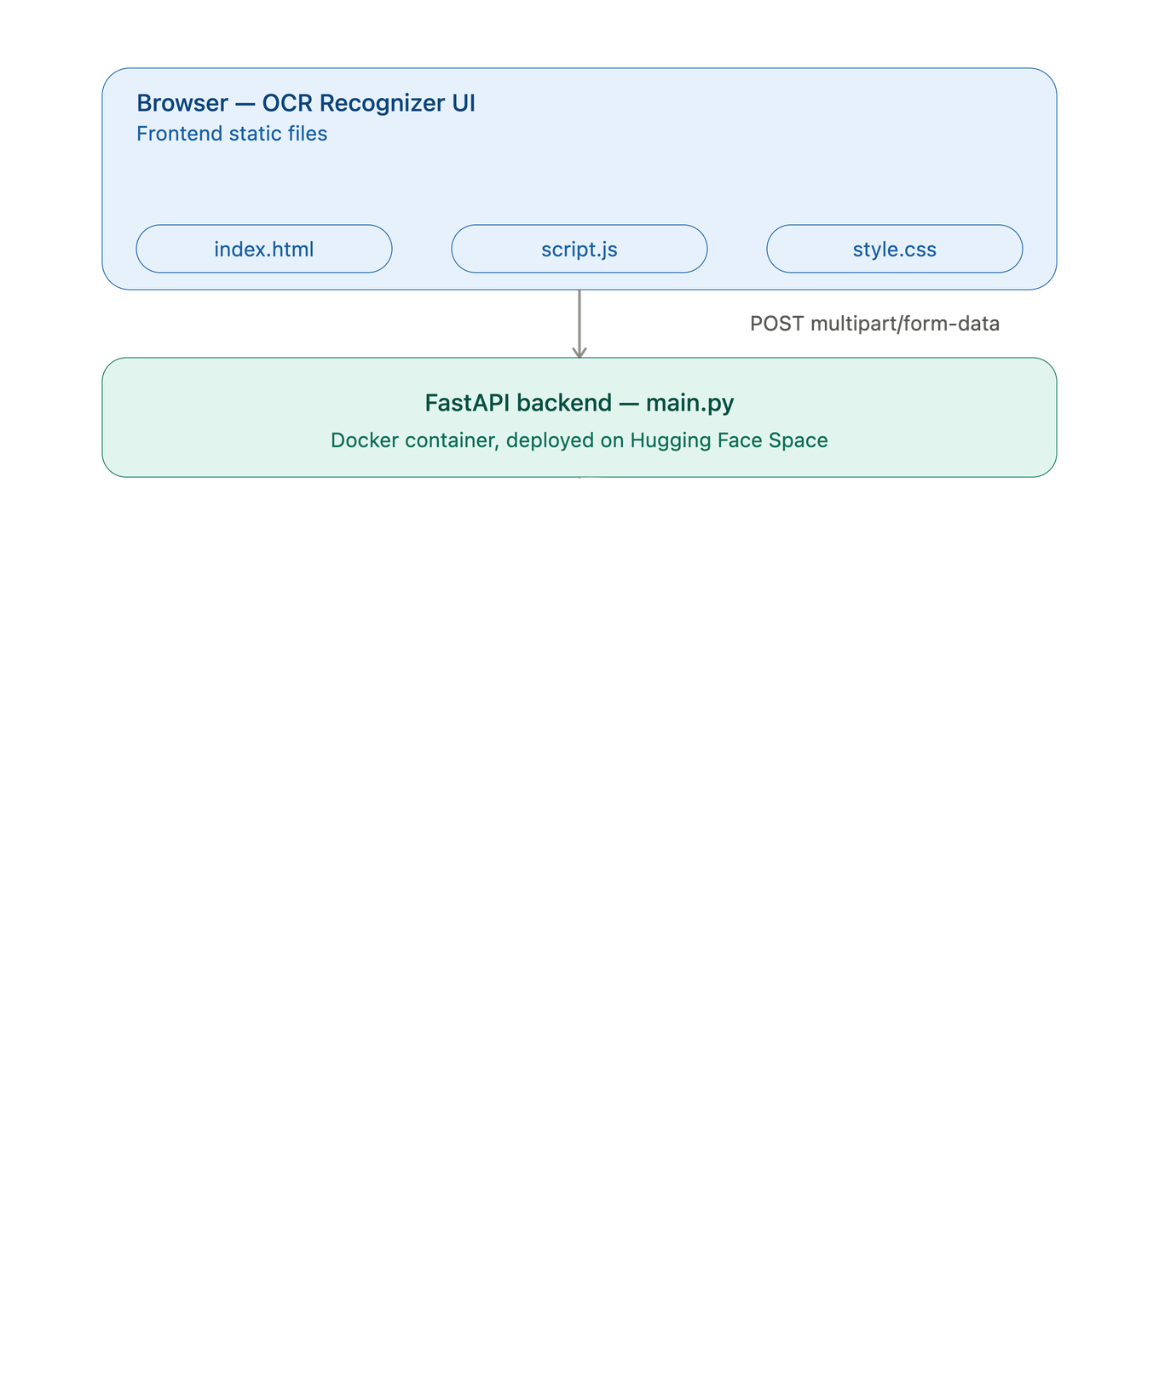
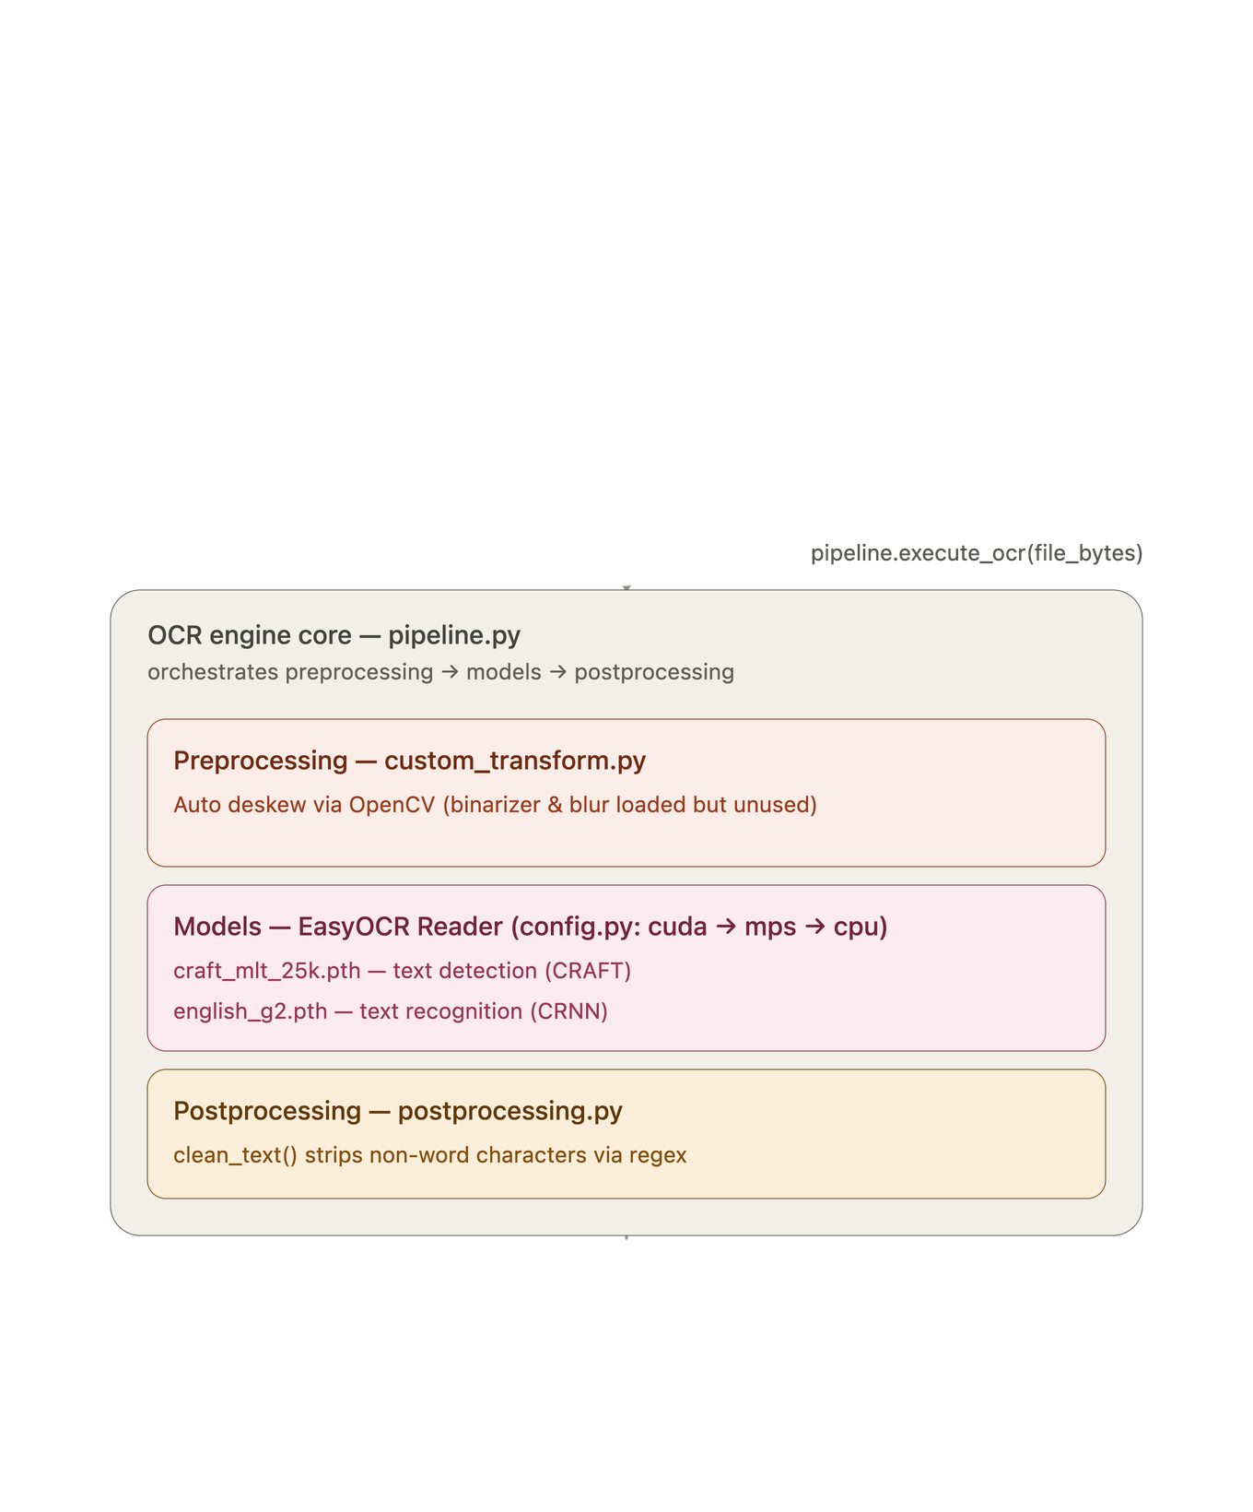

Data Processing Pipeline
Notes:
5

Slide 9
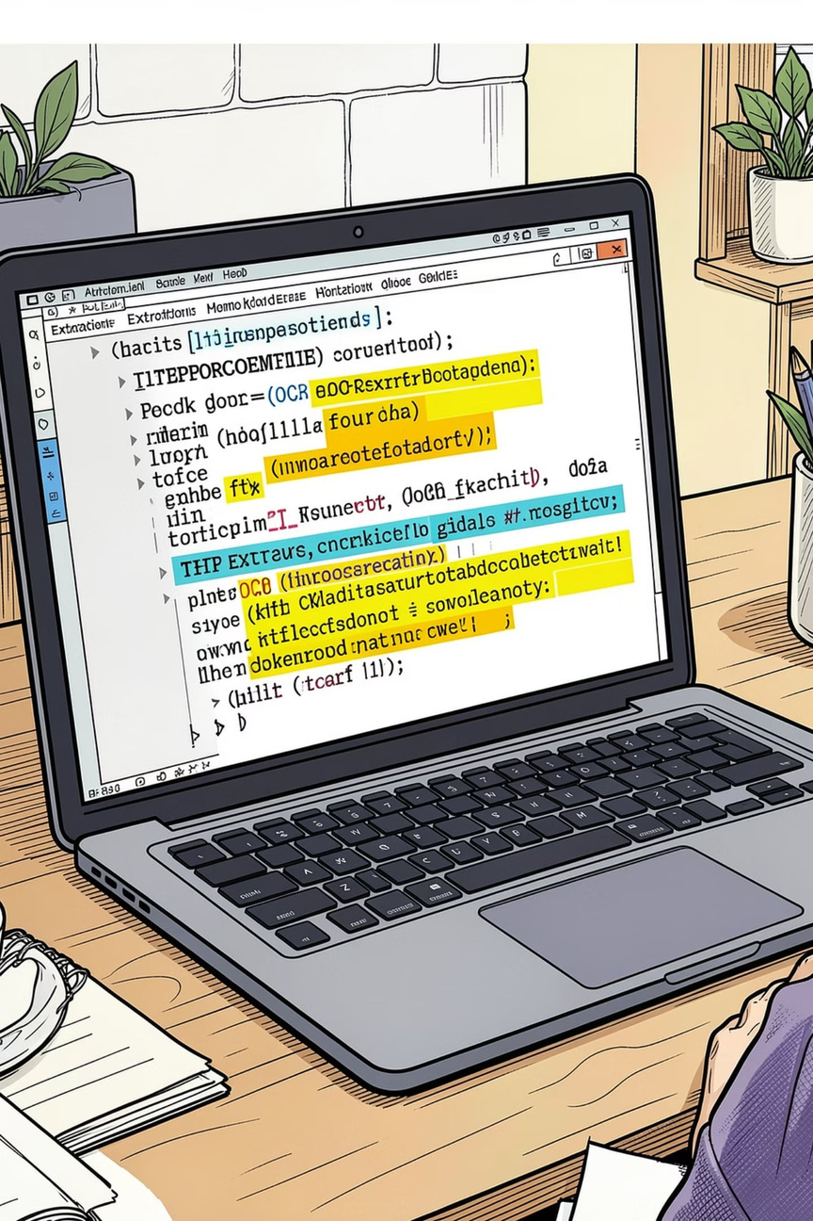
Demo
The live demonstration showcases the OCR system processing real-world inputs — from clean scanned documents to complex natural scene images with varied fonts, lighting, and orientations.
📄 Link of the web
🌐 QR-Code for Testing
https://vath7677.github.io/web_ocr/
⚡ Inference Speed
Real-time processing on standard hardware with batch support for throughput
Notes:
6

Slide 10

Challenges & Future Improvements
Current Challenges
Roadmap
Low-quality images — blur, glare, and low resolution reduce accuracy
Complex scripts — non-Latin alphabets and mixed-language text require specialized training
Handwritten text — high variability in stroke and style limits recognition
Curved or distorted text — standard detectors struggle with non-horizontal layouts
Integrate transformer-based models (e.g., TrOCR) for improved context awareness
Expand language support to Khmer, Chinese, and France scripts
Deploy as a REST API or web service for broader accessibility
Add layout analysis to preserve document structure and formatting
Notes:
7

Slide 11
Thank you !!

