Slide 1


Slide 2
hyperparameters
Hyperparameters are knobs that we can turn to get a ML algorithm to behave differently.
Examples are the “k” in kNN, or the maximum depth (number of sequential splits) or minimum size of a leaf node in a decision tree.
It is very common to vary hyperparameters as part of model optimization, because usually we can control complexity via hyperparameters and move along the bias vs variance relationship.

Slide 3
Optimizing hyperparameters
Should we vary hyperparameters all together or one at a time?
All together is probably formally correct because if they are correlated, I can’t trust the results of varying one at a time; on the other hand, to build intuition and limit optimization time, one at a time may be useful
2) Do you see any problem with using the test scores from the cross validation to pick the hyperparameters?
It is ok to do this to pick optimal hyperparameters, but the test scores we obtain are still optimistic.

Slide 4
Optimizing hyperparameters
The most common procedure to optimize hyperparameters is a cross-validated Grid Search of the hyperparameter space.
Like with any parameter space search, the grid method can be inefficient, or too time-consuming. Alternatives are varying parameters one at a time (ignores correlations), Random Search (often good enough), Bayesian parameter search (yay!).
As a reminder, we do this to pick optimal hyperparameters, but the test scores we obtain are still optimistic (there is leakage of information between the optimization and the test scores).
The correct procedure involves a 3-tiered structure: train/validation/test. If we do this in a cross-validated way, it becomes nested cross validation.

Slide 5
Application: particle identification IN LHC event simulations (physics beyond the standard model)
All the possible proton - proton collision products…

Slide 6
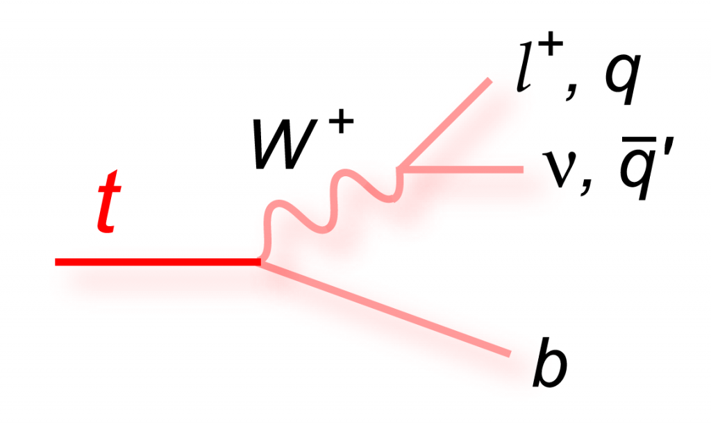
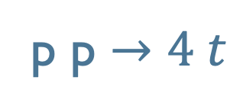
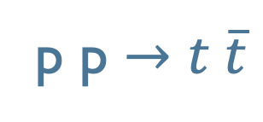
We focus on a subset with two channels 😅
p p $→t \overline{t}$
p p $→4 t$
Problem: the top quarks are not observed directly,
because they decay in a W boson and a bottom quark,
and the W boson decays in leptons/quarks (jets),
and neutrinos (unobserved).

Slide 7
Data set description
10, 000 events
For each event, we have the list of particles produced in the event + missing energy/momentum (carried by neutrinos)
For each particle, known features include the type
and the 4-momentum
The label is ttbar/ 4top

