Slide 1


Slide 2
THE POWER OF ENSEMBLING:
BAGGING AND
BOOSTING METHODS

Slide 3
ENSEMBLING
The main idea of ensembling is to combine base estimators (usually, weak learners) to obtain a more powerful (e.g. accurate, or robust) estimator.
Very often, the base estimator is a Decision Tree (or stump, which is a 1-split tree).
The name “bagging” comes from Bootstrap AGGregating. Boosting is just boosting, no acronym.
Bagging methods like Random Forests, Extremely Random Trees work by building full base estimators (trees) in parallel and then averaging the predictions.
Boosting methods (like AdaBoost or XGBoost) work sequentially: a weak learner (sometimes a small tree, or stump) is created and used to make predictions, then the next step focuses on getting the problematic examples right and this procedure is applied iteratively.
The common wisdom is that bagging is used to reduce variance, boosting to reduce bias. But I really think that this depends on the base learner and the ensemble method.

Slide 4
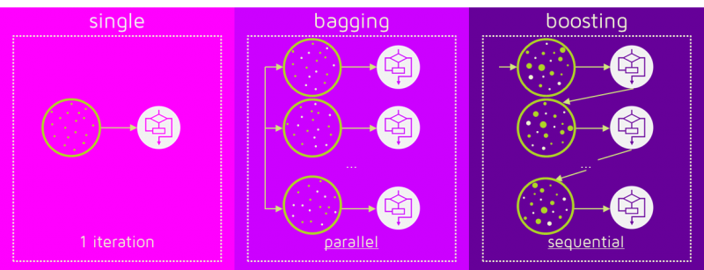
BAgging vs boosting
Bagging: learners are independent of each other.
Boosting: new learner is adjusted on the basis of previous steps.
Figure credit:
https://quantdare.com/what-is-the-difference-between-bagging-and-boosting/
(reproduced with permission)

Slide 5
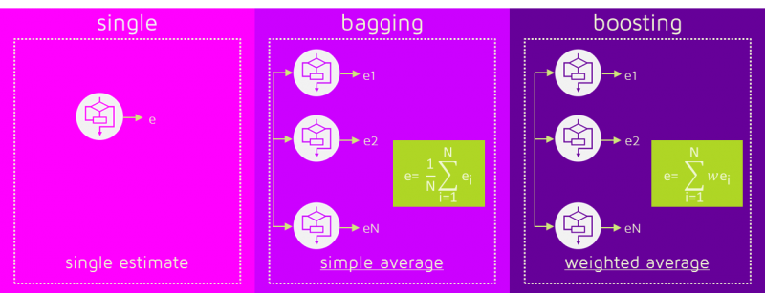
BAgging vs boosting
In Bagging algorithms, all models have equal weight.
In Boosting algorithms, the weight of different learners (weak models, e.g. stumps or shallow trees)
in the final classification depends on their performance.
Figure credit:
https://quantdare.com/what-is-the-difference-between-bagging-and-boosting/
(reproduced with permission)

Slide 6
DECISION TREES RECAP
☺
☹
INTERPRETABLE
FAST
ACCURATE (LOW BIAS)
USUALLY HIGH VARIANCE!
WHY?
It is VERY EASY to overfit (keep splitting more than necessary),
which makes for poor generalization.

Slide 7
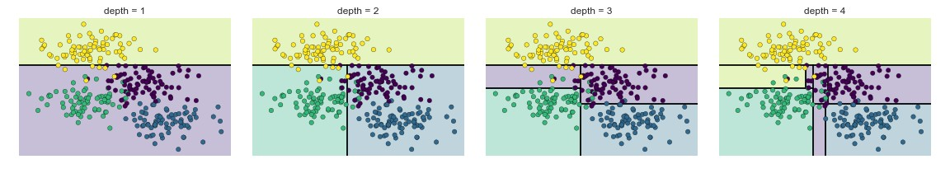
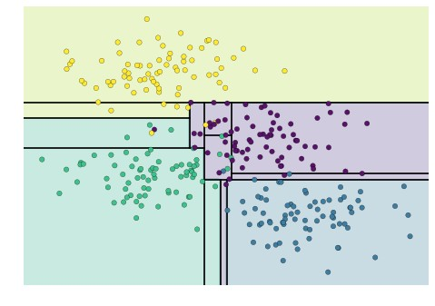
example
Figure credit: Jake Vanderplas (https://jakevdp.github.io/PythonDataScienceHandbook/06.00-figure-code.html#Decision-Tree-Levels)
depth = 5
Traditional approach: “prune” trees
(get rid of small leaves)
Notes:
Note: The notebooks are publicly available

Slide 8
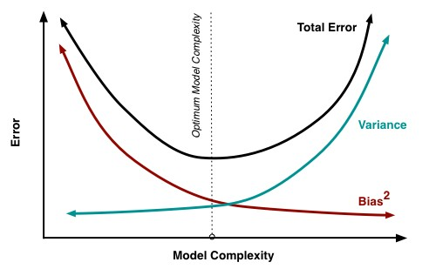
HOW CAN WE IMPROVE?
CONSIDER BIAS/VARIANCE DECOMPOSITION
For the mean squared error loss, the bias-variance decomposition of the expected generalization error at X = x is
MSE(x) =
noise(x)+bias²(x)+var(x)
P
Remember that this plot is not necessarily correct, but the idea of exploring
a different combination of bias-vs-variance error budget holds.
Idea: If we are willing to take a hit in bias, we can reduce variance by combining RANDOMIZED trees,
and still have an improved model (= lower test scores).
Figure from Fortman-Roe 2012

Slide 9
THEOREM: WE CAN further decompose the VARIANCE AS follows.
MSE(x) = noise(x) + bias²(x) + var(x)
and
noise(x) = Err (𝒚(x)),
bias²(x) = 𝐄[𝒚(x) − y(x)]²
var(x) = ρ(x) σ ²(x) + ^{𝟏 -𝝆(𝒙)} σ ² (x)
where σ is the variance of a single tree, M is the number of trees, and ρ(x) is the Pearson correlation coefficient between the predictions of two randomized trees built on the same learning set.
𝑴
Slide adapted from Gilles Louppe; see arXiv:1407.7502 for derivation

Slide 10
notes on bias and variance for a set of randomized trees (FOREST)
Bias: Identical to the bias of a single randomized tree.
Variance: var (x) = ρ(x) σ ²(x) + ^{𝟏 -𝝆(𝒙)} σ² (x)
M
As M → ∞, var (x) → ρ(x) σ²(x)
Stronger randomization, ρ(x) → 0, var(x) → 0
Weaker randomization, ρ(x) → 1, var(x) → σ² (x)
Bias-variance trade-off take-home point: Randomization increases bias but makes it possible to reduce the variance of the corresponding ensemble model. The crux of the problem is to find the right trade-off (reducing variance does not guarantee higher test scores!)
Slide adapted from Gilles Louppe; see arXiv:1407.7502 for derivation

Slide 11
how do we build randomized trees?
Bootstrap samples (with replacement)
}Random Forests
build different learning sets using bootstrap
Random selection of K ≤ p split variables
choose best split not among all features, but among some random ones
Random selection of the threshold
} Extra
Random
Trees
threshold value for split is chosen at random
These become hyper parameters of the model, as we will see in the coding part.

Slide 12
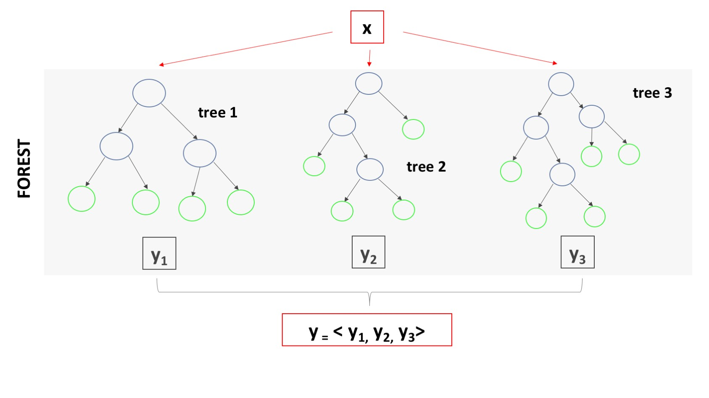
HOW TO COMBINE TREES?
The final prediction (class, or number) is the
average of all predictions
(for a regression problem),
or the majority vote
(for a classification problem)

Slide 13
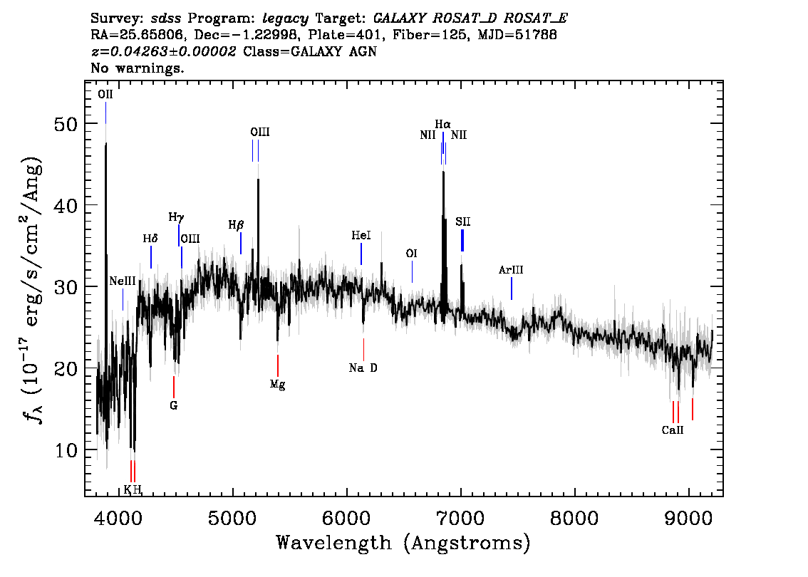
APPLICATION:
PHOTOMETRIC REDSHIFTS
A spectrum is a high-resolution chart of brightness vs wavelength.
For galaxies that are further away, the spectrum
is stretched
(all the wavelengths are longer).
Spectra contains spikes and dips, which corresponds to known transition in basic atoms (e.g., H, O).
If I can identify the emission lines I see (from the structure – one is not enough!), I can calculate the amount of stretch, which is 1 + z
(a Doppler effect, essentially!)
Example spectrum from the SDSS survey

Slide 14
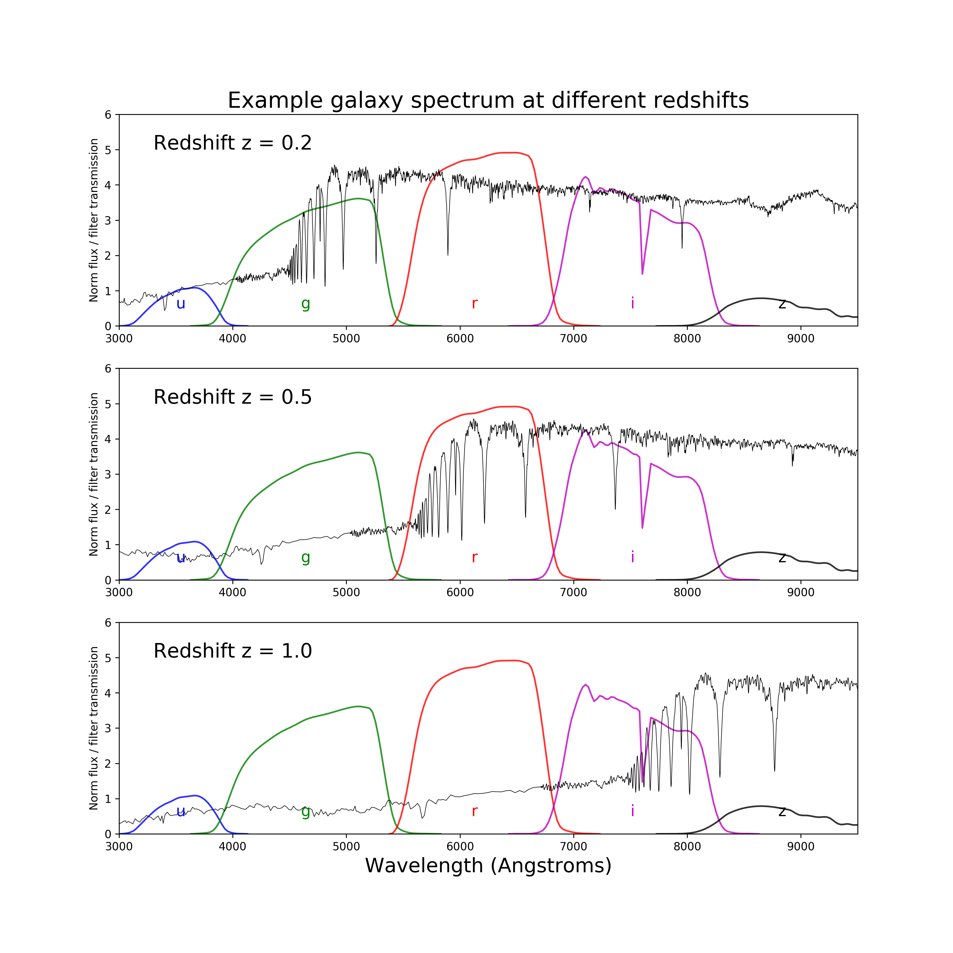
IT IS MUCH MORE CHALLENGING TO DO THE SAME THING THROUGH A DILUTED MAP (PHOTOMETRY)
In this case, we only have the average brightness over a wide range of wavelengths, called filters or bands (1000s of Angstroms).
Much more challenging/less accurate, but a lot cheaper to obtain!
Photo-z can be derived for billions of galaxies.
Spectroscopic redshifts (derived from line identification) can be used as a learning set for photometric redshifts.

Slide 15
Ensembling FTW: BOOSTING METHODS

Slide 16
Boosted ensemble methods (Gradient Boosted Trees, AdaBoost, XGB, LIGHTGBM…)
Tree-based boosting methods are the most common.
They work sequentially: a small tree (sometimes called a stump) is created and used to make predictions, then the next step focuses on getting the problematic examples right and this procedure is applied iteratively. They are multi-stage estimators.
There are two main schools of thought:
1. Update weights of each example (AdaBoost)
2. Update loss function (GBTs & friends)
Also, the ensembling can combine different stage-estimators with non-uniform weights.

Slide 17
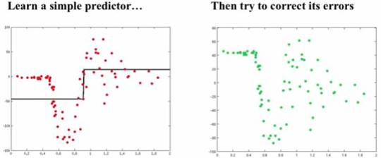
Gradient Boosted Trees
Simple idea:
1. Start with a weak learner (e.g. 1-split tree) and fit a model F to data y: F₁(x) = y
2. Calculate residuals (i.e., where model is failing) F₁(x) – y and make model h(x) that fits the residuals
3. Update model: F₂(x) = F₁(x) + h(x)
4. Repeat from 1, until convergence
Example credit: Alexander Ilher

Slide 18
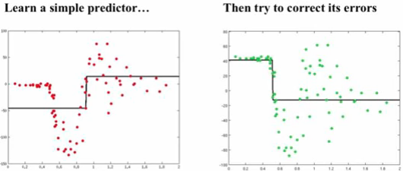
Gradient Boosted Trees
Simple idea:
1. Start with a weak learner (e.g. 1-split tree) and fit a model F to data y: F₁(x) = y
2. Calculate residuals (i.e., where model is failing) F₁(x) – y and make model h(x) that fits the residuals
3. Update model: F₂(x) = F₁(x) + h(x)
4. Repeat from 1, until convergence
Example credit: Alexander Ilher

Slide 19
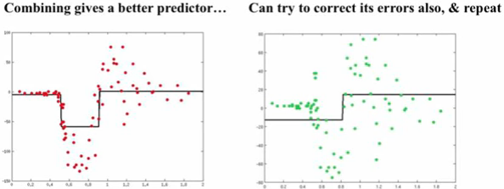
Gradient Boosted Trees
Simple idea:
1. Start with a weak learner (e.g. 1-split tree) and fit a model F to data y: F₁(x) = y
2. Calculate residuals (i.e., where model is failing) F₁(x) – y and make model h(x) that fits the residuals
3. Update model: F₂(x) = F₁(x) + h(x)
4. Repeat from 1, until convergence
Example credit: Alexander Ilher

Slide 20
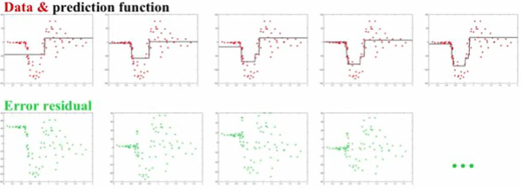
Gradient Boosted Trees
Simple idea:
1. Start with a weak learner (e.g. 1-split tree) and fit a model F to data y: F₁(x) = y
2. Calculate residuals (i.e., where model is failing) F₁(x) – y and make model h(x) that fits the residuals
3. Update model: F₂(x) = F₁(x) + h(x)
4. Repeat from 1, until convergence
Example credit: Alexander Ilher

Slide 21
Let’s put the “Gradient” in GBM
The general idea of “Gradient Descent” is that the most efficient way to minimize a function is to move in the direction of the loss function’s negative gradient.
If we want to minimize the loss function, we can fit a model iteratively to its negative gradient components.
In fact, fitting the residuals works because the residuals are the derivative of the mean square error function.

Slide 22
Let’s put the “Gradient” in GBM
Modified idea to work with any differentiable loss function L:
Initialize F to median of y
Calculate pseudo-residuals = - dL/dF
Fit model to pseudo - residuals, h(x)
Make new model: F₂(x) = F₁(x) + α* h(x) (α = learning rate)
Repeat from 2, until convergence
The learning rate is a parameter of boosted models (shrinkage).
Small α values require larger # of iterations but often gives better predictions
α can be chosen on a step-by-step basis and becomes the weight of each predictor in the final ensemble.

Slide 23
Issues with GBT: very easy to overfit → regularization is needed!
Regularization can be applied in various ways:
Shrinkage: We can choose a small value (< 1) for the coefficient η, also known in sklearn as learning rate, which regulates the contribution of each new correction to the current model. A GBT model with smaller values of η will take longer to achieve the same accuracy; there is a trade-off between the number of iterations and the learning rate.
Subsampling: We might select a random fraction of the data (with or without replacement) in order to fit each step. The smaller the fraction, the stronger the regularization.
Random feature selection: We might use only a random subset of features at each step. This randomization technique is “borrowed” from bagging algorithms such as Random Forests, where it is similarly used to reduce the variance of the single estimator.

Slide 24
What can you use Bagging/Boosting methods for?
Both classification and regression problems!
You can also always turn a classification problem into a regression problem by predicting a probability that on object belongs to a certain class
They are an all-purpose, generally fast and accurate sets of algorithms
For tabular data (where you don’t need to learn a representation, i.e., you are satisfied with your original feature space), often the best method out there (see this thread)

