Slide 1


Slide 2
Regularization for linear models

Slide 3
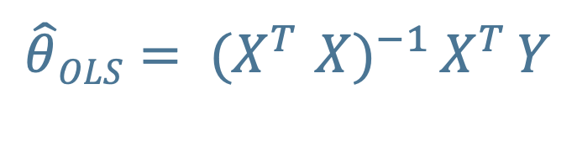
linear models with MSE loss (i.e., ordinary least squares solution) can be solved using the normal equation or some flavor of Gradient Descent.
$\hat{θ}OLS= {(X}^{T}$ ${X)}^{−1 }X^{T }Y$
Here X is the feature matrix, with N (number of objects) rows and m (number of features) columns, to which we have added a “mock” (= 1) feature to write the solution in matrix-multiplication form.
As a reminder, complexity for the normal equation is dominated
by the matrix inversion and scales linearly with # of examples,
but O(m^{2.5-3}) with # of features.
Our main reasons to choose Gradient Descent would be
1. Speed, (for feature-rich data sets) or 2. Using a different loss function.

Slide 4
If the algorithm is overfitting (often this comes from having highly correlated features), it might be helpful to use a regularized solution.
One nice bonus of linear models is that we can understand a bit more
of the mathematics behind regularization.

Slide 5
The bias-variance decomposition
Geman 1992 (very famous result)
For the MSE, the test error of a model
(which we use as a proxy for generalization error) can be written as
MSE = bias² + variance + noise
b ⁼ E(y – f(x)) (y = truth; f(x) = prediction)
var = E(f(x) – E(f(x))²)
bias = shift of mean prediction
variance = range of variation of each prediction around the true value
noise = irreducible and model independent

Slide 6
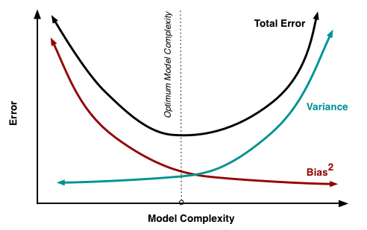
The bias-variance decomposition
MSE = bias² + variance + noise
A lot of optimization techniques in ML are based on
the concept of “trade-off”: we can obtain a lower
test error by shifting around the bias/variance balance,
which is often interpreted in terms of model complexity.
Figure from
Fortmann-Roe
2012

Slide 7
The bias-variance decomposition: consequences for linear models
For linear models, for some weak conditions
(if the errors in the linear regression model are uncorrelated, have equal variances and expectation value of zero),
Gauss-Markov theorem tells us:
1) The normal equation solution (OLS) is unbiased (bias = 0!)
2) The normal equation solution is the optimal unbiased estimator
(i.e., it has the lowest variance among the unbiased estimators)
Does this make it the estimator with the lowest test error?
Nope, and that’s why regularization might be worth it.

Slide 8
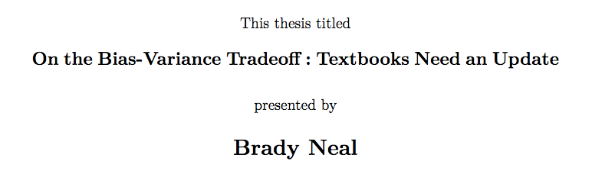
Actually, the concept of bias-variance trade-off
(not decomposition) might be in trouble.
https://arxiv.org/pdf/1912.08286.pdf
Main conclusion: the tradeoff
(namely, the common wisdom that variance
increases with model complexity)
does not seem to be true for neural networks
when the number of parameters increases.

Slide 9
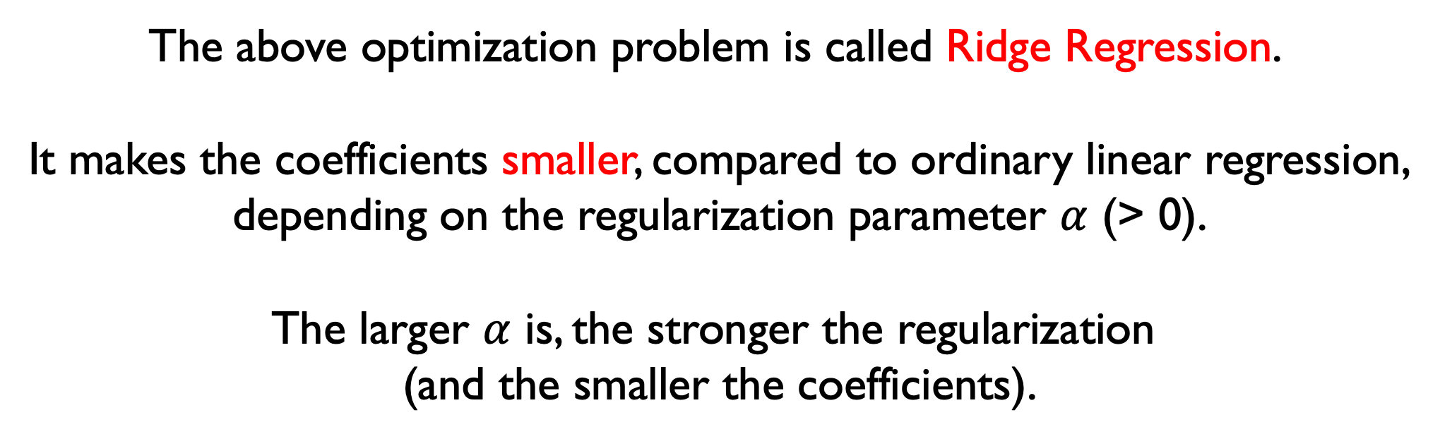
Ok, now back to regularization for linear models.
Will a regularized model be more or less biased than OLS?
More. We are adding bias but hoping to reduce variance
(which is ok even according to Gauss-Markov theorem).
Main idea:
minimize
modified loss function
$$\underset{θ}{argmin}{ \left[\left(X ∙θ −y\right)2+ α \sum_{i=1}^{m}{θ_{i}^{2}}\right]}$$
The above optimization problem is called Ridge Regression.
It makes the coefficients smaller, compared to ordinary linear regression,
depending on the regularization parameter $α$ (> 0).
The larger $α$ is, the stronger the regularization
(and the smaller the coefficients).

Slide 10
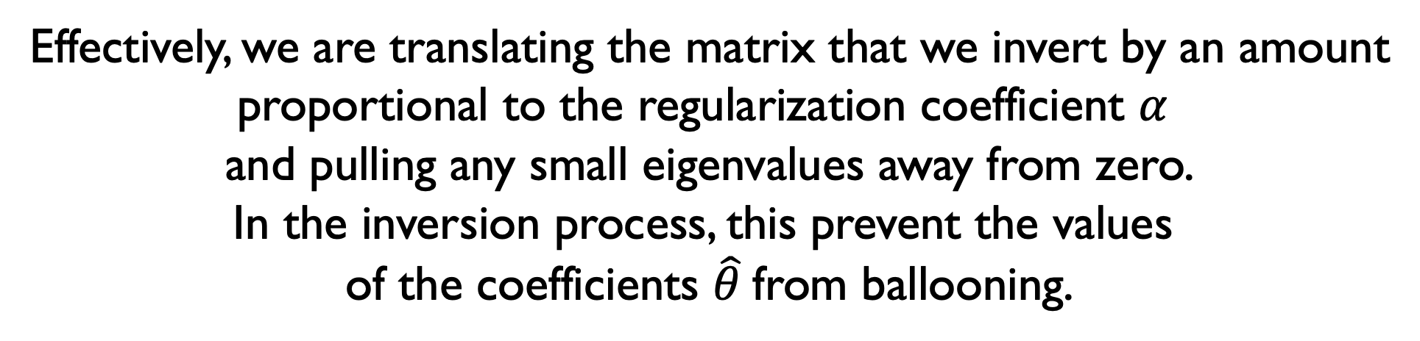
Ridge Regression still has an analytic solution!
$$\underset{θ}{argmin}{ \left[\left(X ∙θ −y\right)2+ α\sum_{i=1}^{m}{θ_{i}^{2}}\right]}$$
has solution
$\hat{θ}RIDGE= {(X}^{T}$ ${X+α I)}^{−1 }X^{T }Y$
Effectively, we are translating the matrix that we invert by an amount
proportional to the regularization coefficient $α$
and pulling any small eigenvalues away from zero.
In the inversion process, this prevent the values
of the coefficients $\hat{θ}$from ballooning.

Slide 11
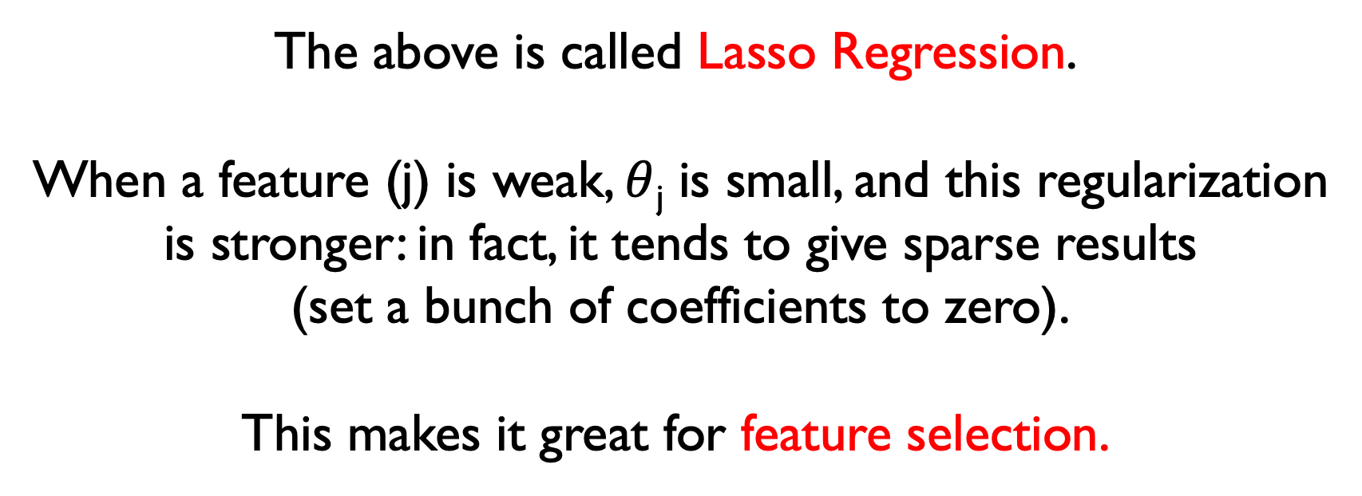
Another form of regularization for linear models
minimize
modified loss function
$$\underset{θ}{argmin}{ \left[\left(X ∙θ −y\right)2+ α\sum_{i=1}^{m}{\left|θi\right|}\right]}$$
The above is called Lasso Regression.
When a feature (j) is weak, $θ$_{j} is small, and this regularization
is stronger: in fact, it tends to give sparse results
(set a bunch of coefficients to zero).
This makes it great for feature selection.

Slide 12
Generalization of linear models

Slide 13
One nice thing about linear models is that they
are simple, efficient, and interpretable.
They can also extrapolate outside the training domain
(compare e.g. with Decision Trees)
It’s nice to be able to re-use the machinery!
We can look at two modifications:
LOGISTIC regression
and POLYNOMIAL regression

Slide 14
Logistic Regression
There are many case studies for which the range of the dependent variable is finite.
The linear models can’t reproduce this behavior.
In Logistic Regression (and many generalized linear models),
we apply a transformation to the dependent variable before applying the linear model.

Slide 15
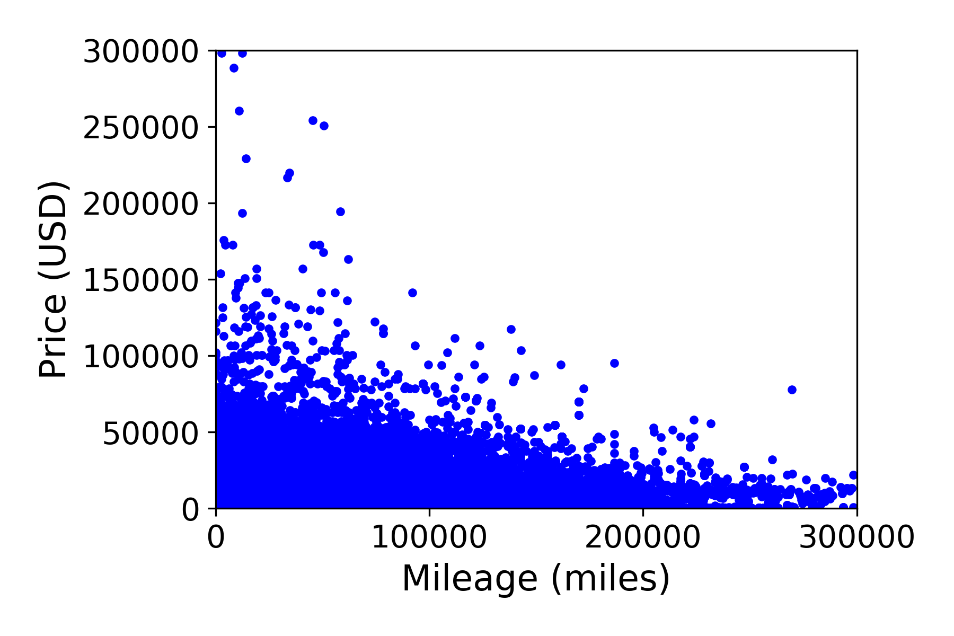
Simple example: USED Cars value
Data available from Kaggle

Slide 16
FIT with a linear model
B₀ = 23,102
B₁ = -0.07
How much is a car with 100,000 miles worth?
$16.074
How much is a car with 400,000 miles worth?
-$5,011

Slide 17
FIT with a modified linear model
Logging our prices, we can refit our model
(i.e. log(Y) = B₀ + B₁ * X) Y = e ^{B0 + B1 * X}
B₀ = 9.4
B₁ = - 4.53 x 10⁻⁶
How much is a car with 100,000 miles worth?
$7,743
How much is a car with 400,000 miles worth?
$1,988

Slide 18
Logistic Regression
A common application, binary logistic regression, is usually meant to solve a classification-like problem where we want to go beyond the 0/1 output.
For example: voting data.
In this case, a type of regression analysis where the dependent variable is class-like: coded 0 (did not happen) or 1 (did happen)
But maybe we want to model the probability (actually, the odds ratio) that someone will vote, using these data.

Slide 19
Logistic Regression
The "logit" model solves these problems: we can model the relationship between the log of the odds ratio and the independent variable with a linear model ln[p/(1-p)] = β₀ + β₁X (2D model; otherwise, X ∙ β)
p is the probability that the event Y occurs, p(Y=1)
[range=0 to 1]
p/(1-p) is the "odds ratio"
[range=0 to ∞]
ln[p/(1-p)]: log odds ratio, or "logit” (logistic unit)
[range=-∞ to +∞]

Slide 20
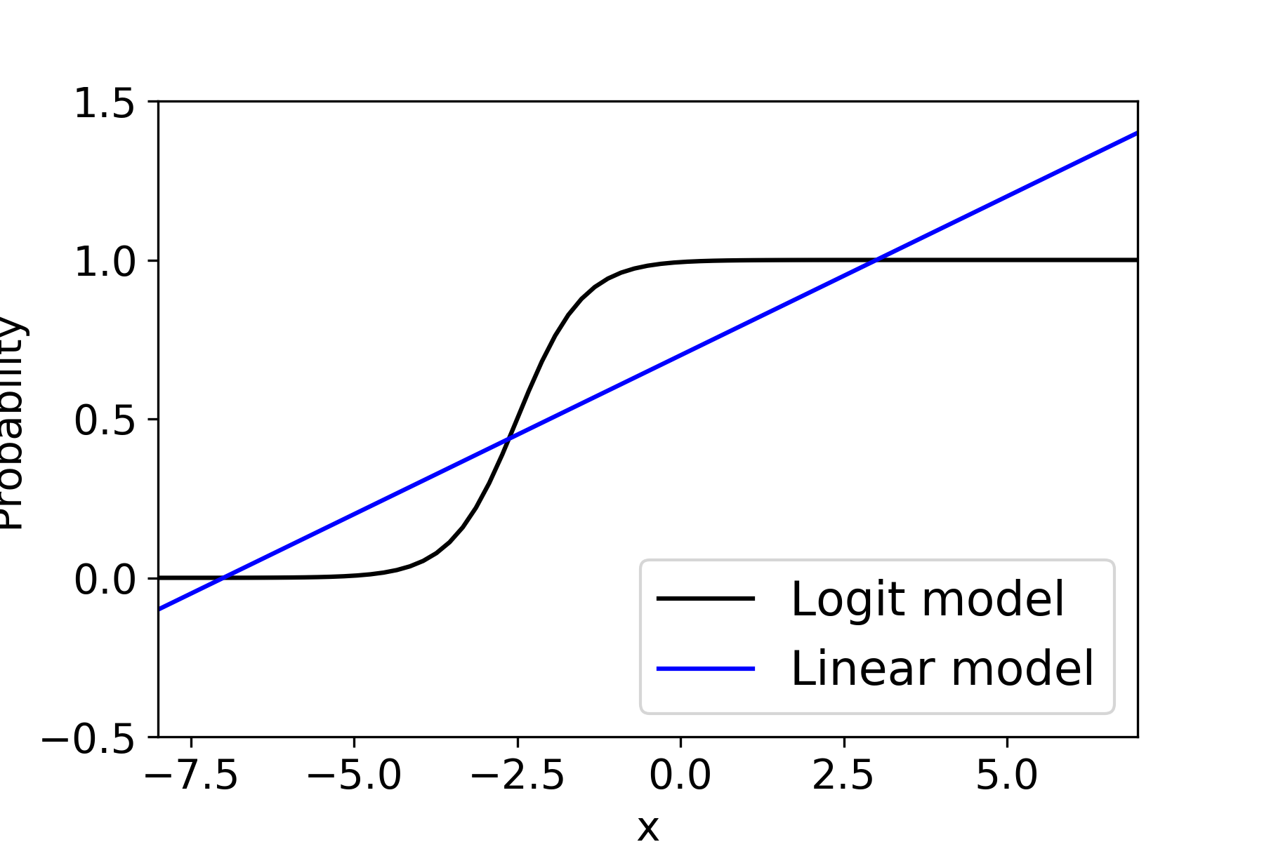
Logistic Regression
In many cases, it is beneficial to keep the range
of the outcome variable limited to (0,1) or any other range.

Slide 21
Of course, not all models where the output is a probability
can be successfully modeled by logistic regression.
There is a strong modeling assumption
(the log odds can be modeled using a linear model).
However, these functions are important because
are examples of SIGMOIDS (s-shaped functions!)
Those are common as activation functions/elements for neural networks.

Slide 22


Polynomial Regression as a linear model
y
y
Is the one
on the right
a
linear model?
x
x
$$y= β0+β1 x$$
$$y= β0+β1 x+ β2 x2$$
Yes! A linear model is linear in the coefficients, not the features.
If we are willing to build those features, we can re-utilize the machinery
of linear model in a much wider range of cases.
This can be inspiring for feature engineering + regularization!
Visualization inspired by: https://medium.com/analytics-vidhya/understanding-polynomial-regression-5ac25b970e18

Slide 23
References/further reading
This book (Elements of Statistical Learning) is really good/classic,
free, and it has the derivation of MSE decomposition:
https://web.stanford.edu/~hastie/ElemStatLearn/
Geman et al’s seminal paper:
http://www.dam.brown.edu/people/geman/Homepage/Essays%20and%20ideas%20about%20neurobiology/bias-variance.pdf
Link to Brady Neal’s thesis work:
https://www.bradyneal.com/bias-variance-tradeoff-textbooks-update
Hogg and Villar’s recent work on linear models with many parameters:
https://arxiv.org/pdf/2101.07256.pdf

