Slide 1


Slide 2
Metrics: Optimizing vs viewing
Important:
There is a big difference between choosing the optimal metric (e.g., precision vs accuracy) when comparing models (for example, when we choose between kNN or DT or when we select parameters) and choosing the metric that is optimized when building models.
For example, in a decision tree, would choosing accuracy or recall change the optimal splits of a given training set?
Why or why not?
Many algorithms, especially in sklearn, have a hard coded loss function.

Slide 3
Diagnosing and Improving Machine Learning algorithms

Slide 4
Diagnosing a ML algorithm
BIAS
VARIANCE
Algorithm
can’t capture
complexity
of rule
connecting
input and output
Algorithm
is excessively
tailored
to training set
and generalizes
poorly
UNDERFITTING
OVERFITTING

Slide 5
BIAS vs variance
Linear model
Degree 2 polynomial
High-degree polynomial
y
y
y
x
x
x
Not enough complexity:
high bias/underfit
Good trade-off
between complexity
and performance
Excessive complexity:
high variance/overfit
Slide inspired by Andrew Ng

Slide 6
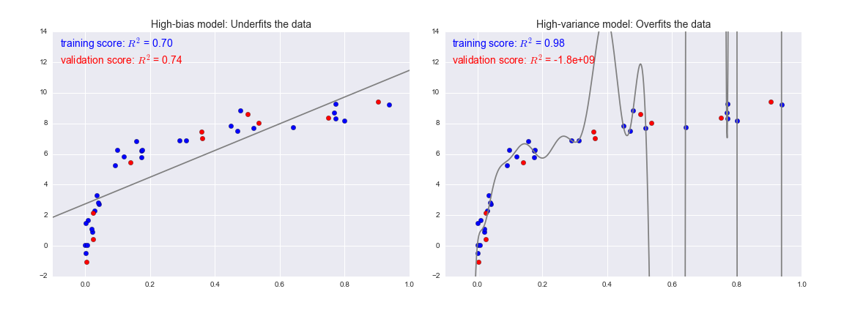
How can we diagnose high variance vs high bias?
Figure credit: Jake VanderPlas
High bias: test and train error are
similar but high
High variance: there is a gap between test and train error because algorithm does not generalize well

Slide 7
Improving high bias
Try using different features.
Try engineering new features.
Try a more complex algorithm/change parameters.
Improving high variance
Try reducing the number of features.
Try a less complex algorithm/change parameters/
Add regularization.
Also: Check if you need more training data.
Also: take all this with a huge grain of salt.
Not mutually exclusive, really meant as diagnostics.

Slide 8
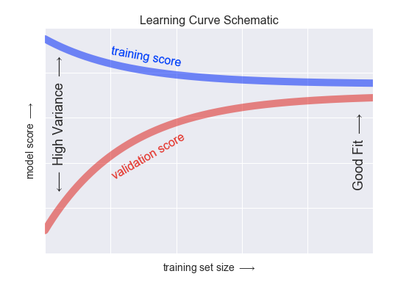

Useful diagnostic tool: learning curves
plot performance of algorithm for train and test set
as a function of size of training set
curve is flat = more
data doesn’t help
scores still changing:
more training data please
test score
Figure credit:
Jake VanderPlas

Slide 9
Note: which algorithm is the best? A) High bias low variance B) High variance low bias C) Lowest gap between train/test scores D) Highest test scores

Slide 10
Note: which algorithm is the best? A) High bias low variance B) High variance low bias C) Lowest gap between train/test scores D) Highest test scores

Slide 11
Summary: how to build a ML model
Choose a class of model (aka a machine learning algorithm) by importing the appropriate estimator class from Scikit-Learn.
Choose model hyperparameters by instantiating this class with desired values. Alternatively: optimize hyperparameters (later).
Arrange data into a feature matrix and target vector, if necessary.
Split the learning set into training/test using k fold cross validation.
Build the model to your data by calling the ``fit()`` method.
Apply the model to new data: predict labels for unknown data using the ``predict()`` method.
Estimate the performance (averaged over the k folds) by using one of the metrics in the "metrics" method of the model instance (accuracy, precision, recall … or custom).
Figure out what is not working out: Check training vs test score, learning curves, diagnose high variance vs high bias and decide how to move forward.

Slide 12
