Slide 1
CHAPTER 8-9: TREE & HEAP STRUCTURES
COSC 221 (Computer Science B)

Slide 2
Contents
Motivation
Binary Trees
Tree Traversal
Heap
Hash Table
Applications

Slide 3
Objective
Understand non-linear data structures including tree, heap and hash table.
Implement & perform basic operations for:
Binary trees: left(), right().
Tree traversal: preorder, postorder, breadth-first, inorder traversal.
Heap: insertion, deletion, peek, heapify_up(), heapify_down(), size...
Hash: hash function, get item, set item…

Slide 4
Motivation

Slide 5
Motivation
Stacks, queues, and linked lists are linear data structures, which means they organize elements sequentially (with previous & next pointers). However, sometimes we require more complex, non-linear data structures.
Linear data structures are not suitable for organizing hierarchical and complex relationships found in organizational charts and file systems.
They are not efficient in searching, insertion, and deletion operations. Hence, we need non-linear data structures such as trees, heaps, and hash tables.
Non-linear data structures can reduce the complexity of certain operations to constant time complexity (O(1)) and, at most, O(n).

Slide 6
Trees and Binary Trees

Slide 7
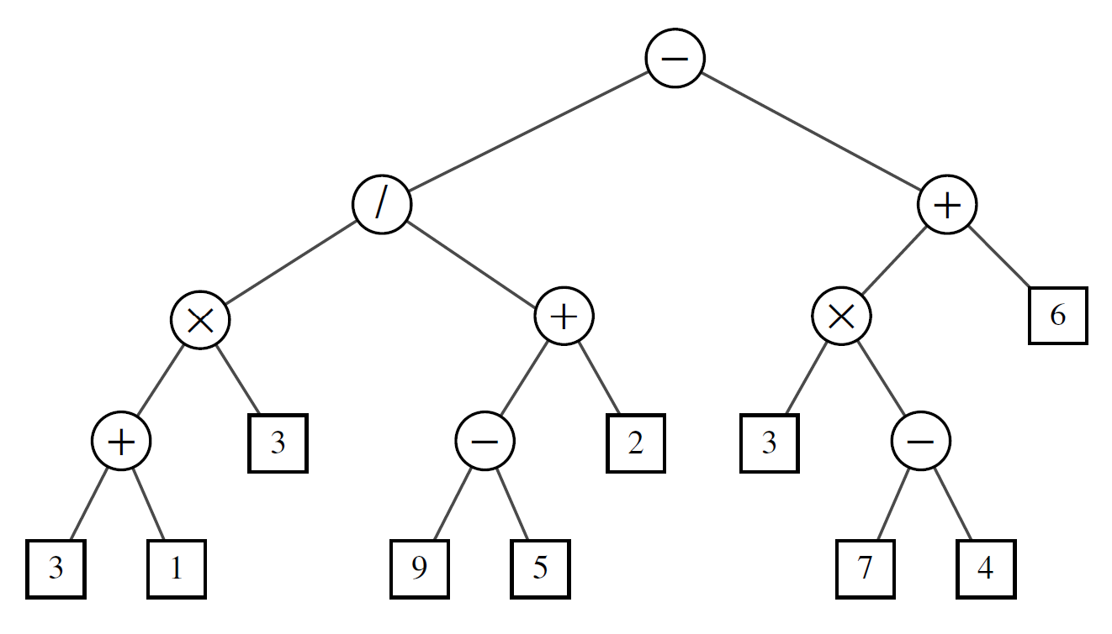
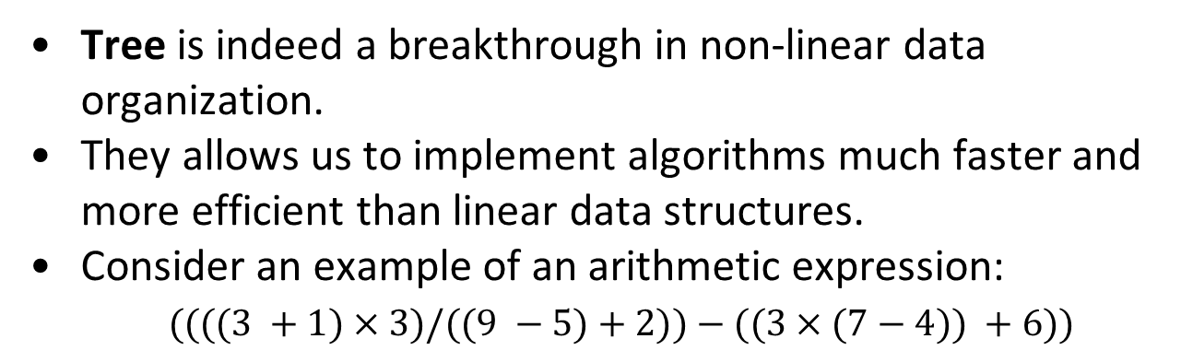
Trees and Binary Trees
Tree is indeed a breakthrough in non-linear data organization.
They allow us to implement algorithms much faster and more efficiently than linear data structures.
Consider an example of an arithmetic expression:
$((((3 +1)×3)/((9 −5)+2))−((3×(7−4)) +6))$

Slide 8
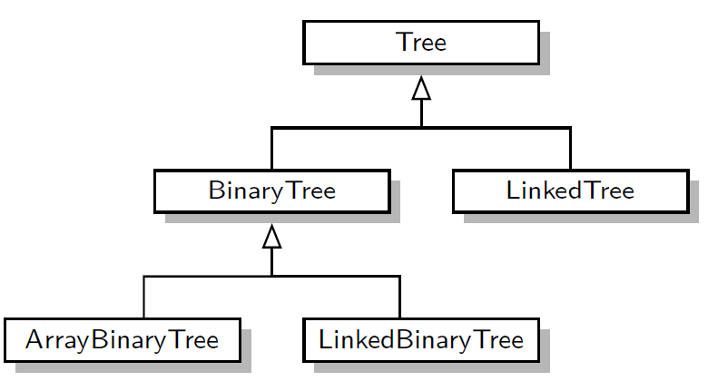
Trees and Binary Trees
Definition: A tree T is a collection of nodes where each node is connected to other nodes in a parent-child relationship. The main points are:
  If the tree is not empty, it has one special node called the root.
  Every node, except the root, has one unique parent and can have multiple child nodes.
In an ordered tree, the children of each node have a specific order.
There are different types of trees for various purposes, but in this chapter, we focus on binary trees

Slide 9
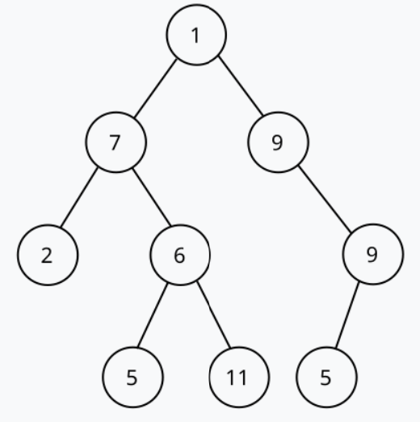
Trees and Binary Trees
Definition: A binary tree is a tree where each node has at most two children (left and right).
Recursion Definition: A binary tree T is either empty or consists of:
A node r, called root node of T, that stores an element.
A binary tree (possibly empty), called the left subtree of T.
A binary tree (possibly empty), called the right subtree of T.

Slide 10
Trees and Binary Trees
Task:
Write a class Node with 3 members: left, right and value for storing left and right child node and the value of each node.
Write another class BinaryTree with one member: root.

Slide 11
Trees and Binary Trees
Task:
Solution:
Write a class Node with 3 members: left, right and value for storing left and right child node and the value of each node.
Write another class BinaryTree with one member: root.
class Node:
def __init__(self, key):
self.left = None
self.right = None
self.value = key
class BinaryTree:
def __init__(self):
self.root = None

Slide 12
Tree Traversal

Slide 13
Tree Traversal
Now that we know how to create binary trees, we will learn how to explore the tree or known as Tree Traversal.
We will traverse trees using 4 different approaches:
  For general trees: preorder, postorder and breadth-first.
  For binary trees: inorder traversal.
Note: Traversal means "visiting" every node in a specific order

Slide 14
Tree Traversal
Now that we know how to create binary trees, we will learn how to explore the tree or known as Tree Traversal.
We will traverse trees using 4 different approaches:
Preorder Traversal:
  For general trees: preorder, postorder and breadth-first.
  For binary trees: inorder traversal.
First, traverse the root.
Then, traverse subtrees rooted at its children, recursively.

Slide 15
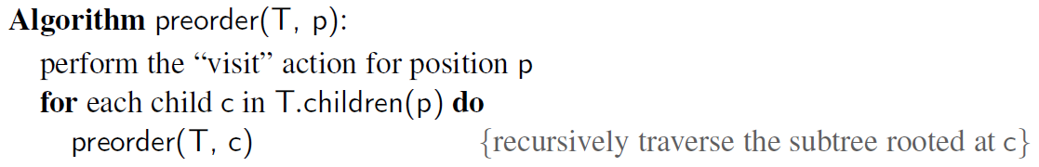
Tree Traversal
Now that we know how to create binary trees, we will learn how to explore the tree or known as Tree Traversal.
We will traverse trees using 4 different approaches:
Preorder Traversal:
Pseudo-code for preorder traversal:
  For general trees: preorder, postorder and breadth-first.
  For binary trees: inorder traversal.
First, traverse the root.
Then, traverse subtrees rooted at its children, recursively.

Slide 16
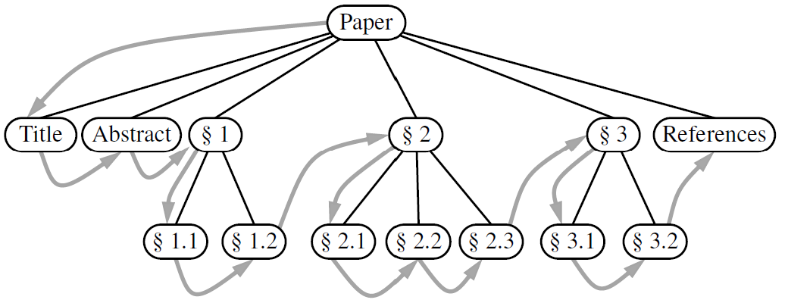
Tree Traversal
Pseudo-code for preorder traversal:
# Preorder Traversal: Root -> Left Subtree -> Right Subtree
def preorder_traversal(self, node, result):
if node:
result.append(node.value) # 1. Visit Root
self.preorder_traversal(node.left, result) # 2. Traverse Left
self.preorder_traversal(node.right, result) # 3. Traverse Right

Slide 17
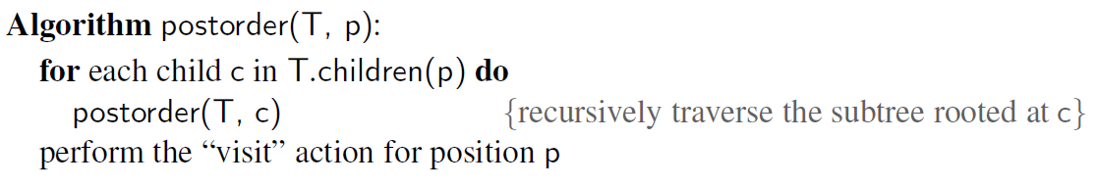
Tree Traversal
Postorder Traversal: Opposite to preorder traversal.
Pseudo-code for postorder traversal:
First, it recursively traverses the subtrees rooted at the
children of the root.
Then, traverse the root.

Slide 18
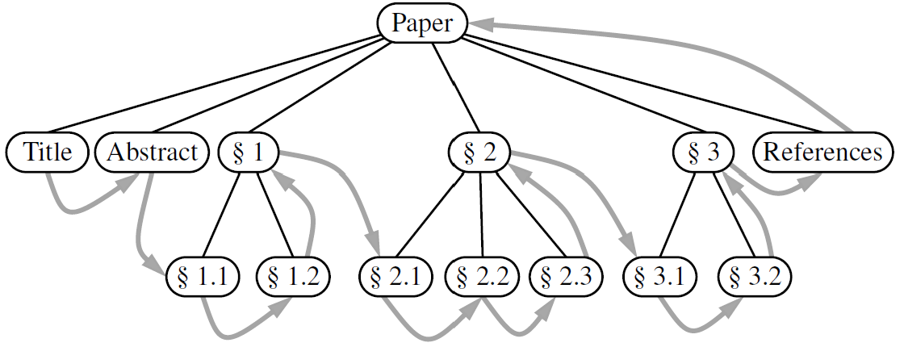
Tree Traversal
Pseudo-code for postorder traversal:
# Postorder Traversal: Left Subtree -> Right Subtree -> Root
def postorder_traversal(self, node, result):
if node:
self.postorder_traversal(node.left, result) # 1. Traverse Left
self.postorder_traversal(node.right, result) # 2. Traverse Right
result.append(node.value) # 3. Visit Root

Slide 19
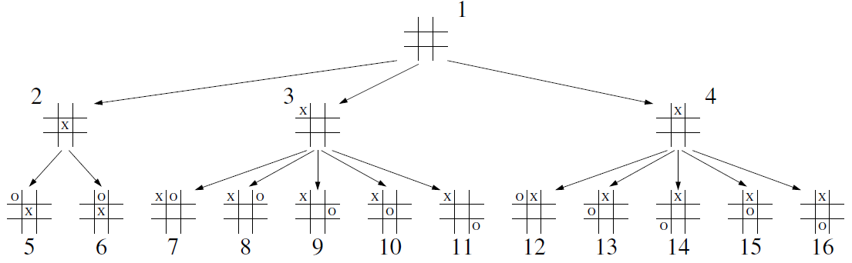
Tree Traversal
Breadth-First Traversal: another common approach for visiting nodes of a tree is visiting all positions at each depth.
Below is an example of a partial game tree for Tic-Tac-Toe.

Slide 20
Tree Traversal
Breadth-First Traversal: another common approach for visiting nodes of a tree is visiting all positions at each depth.
Below is an example of a partial game tree for Tic-Tac-Toe.
The pseudo-code for this algorithm is given below:
# Breadth-First (Level-Order) Traversal using a Queue (FIFO)
def breadth_first_traversal(self, result):
if self.root is None:
return
queue = [self.root]
while queue:
node = queue.pop(0) # 1. Dequeue front node
result.append(node.value) # 2. Visit node
if node.left: queue.append(node.left) # 3. Enqueue Left child
if node.right: queue.append(node.right) # 4. Enqueue Right child

Slide 21
Tree Traversal
Task1: add a method insert() to the BinaryTree class that allows to insert nodes to a tree. Try to grow a tree using values from the list [10, 5, 20, 3, 7, 15, 25]. Can you draw its tree representation?

Slide 22
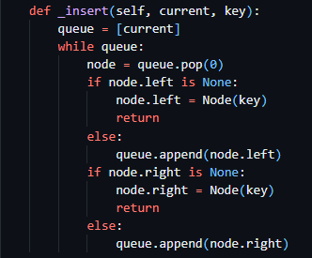
Tree Traversal
Task1: add a method insert() to the BinaryTree class that allows to insert nodes to a tree. Try to grow a tree using values from the list [10, 5, 20, 3, 7, 15, 25]. Can you draw its tree representation?
10
5
20
3
7
15
25

Slide 23
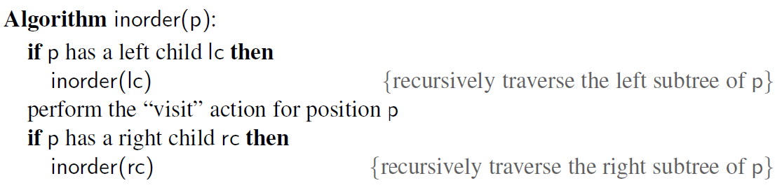
Tree Traversal
Inorder Traversal: This is another common traversal approach for binary trees.
It visits the left subtree first.
Then, it visits the root node.
Finally, it visits the right subtree.
Pseudo-code for inorder traversal:
Inorder traversal always gives sorted order in a Binary Search Tree (BST).
Note: Inorder traversal always gives sorted order in a Binary Search Tree (BST).

Slide 24
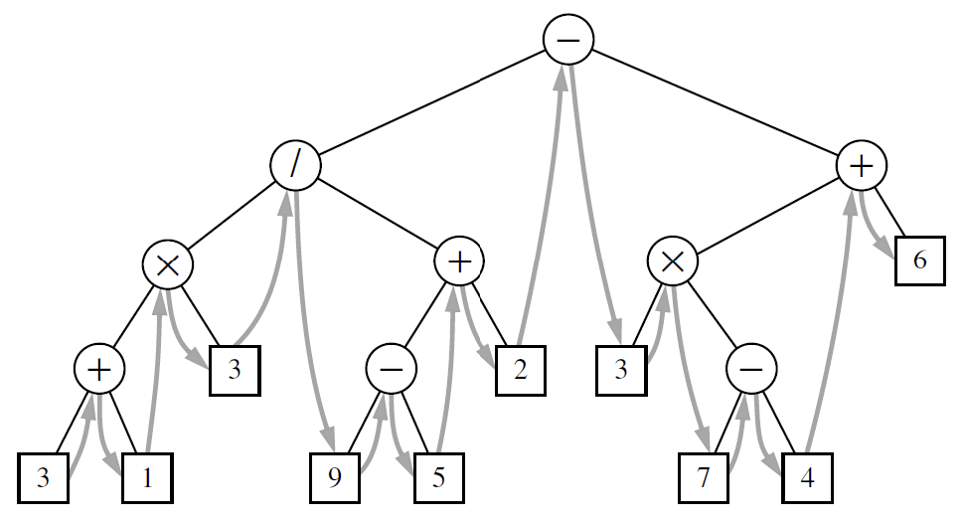
Tree Traversal
Pseudo-code for inorder traversal:
# Inorder Traversal: Left Subtree -> Root -> Right Subtree
def inorder_traversal(self, node, result):
if node:
self.inorder_traversal(node.left, result) # 1. Traverse Left
result.append(node.value) # 2. Visit Root
self.inorder_traversal(node.right, result) # 3. Traverse Right

Slide 25
Tree Traversal
Task2: add to our class the following methods:
  preorder_traversal(self, node, result)
  postorder_traversal(self, node, result)
  inorder_traversal(self, node, result)
  breadth_first_traversal(self, result),
This figure illustrates preorder
traversal on the tree.
Solution as demo!
where each traverses the tree built in Task1 using the corresponding traversal method and append each node value to result = [].
10
5
20
3
7
15
25

Slide 26
Tree Traversal
Review the Traversal Methods
Preorder (Root → Left → Right)
  Visit root first, then left subtree, then right subtree.
Inorder (Left → Root → Right)
  Visit left subtree first, then root, then right subtree.
Postorder (Left → Right → Root)
  Visit left subtree first, then right subtree, then root.
Breadth-First (Level Order)
  Visit nodes level by level from top to bottom.

Slide 27
Heap

Slide 28
Heap
  A Heap is a binary tree with two additional conditions:
  Heap-order Property:
              In a Min-Heap, every parent node has a value less than or equal to the values of its child nodes. This means the smallest element is always at the top (root).
                In a Max-Heap, every parent node has a value greater than or equal to its child nodes. This means the largest element is always at the top (root).

Slide 29
Heap
  Complete Binary Tree Property: A heap T, must be a complete binary tree, meaning all levels are fully filled except possibly for the last level, which is filled from left to right.
  Heap data structure is efficient in insertion, deletion and finding max or min.

Slide 30
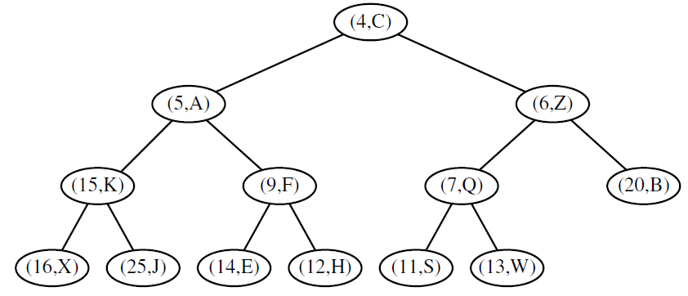
Heap
This is an example of a binary tree that stores pairs of
(key, value) at each node. Is it a heap?

Slide 31
Heap
This is an example of a binary tree that stores pairs of
(key, value) at each node. Is it a heap?
Yes, because it satisfies both heap properties.
Such a heap represents priority queue (keys often represent priorities).

Slide 32
Heap
Heap methods (Min-Heap):
    extract_min(): return and remove the min (root).
    get_min(): return min value without removing it.
    is_empty(): check if the heap is empty.
  Insert(): insert element to the heap.
  _heapify_up(): for maintaining heap properties after adding an element.
  _heapify_down(): for maintaining heap
  properties after removing an element.

Slide 33
Heap
_heapify_up(): maintains heap property after insertion.
    Starts with the newly inserted element.
    Compares the element with its parent.
    If the element is smaller (in a min-heap) or larger (in a max-heap) than its parent, they are swapped.
    This process continues until the heap property is restored or the element reaches the root.

Slide 34
Heap
_heapify_up(): maintains heap property after insertion.
Consider an example: adding (2, T) to heap.

Slide 35
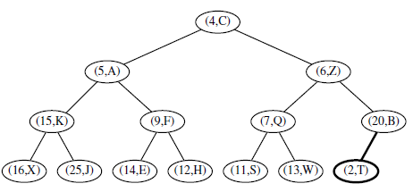
Heap
_heapify_up(): maintains heap property after insertion.
Consider an example: adding (2, T) to heap.

Slide 36
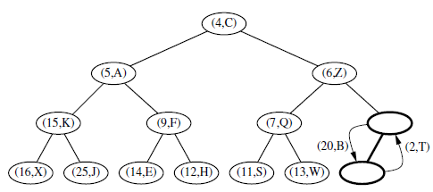
Heap
_heapify_up(): maintains heap property after insertion.
Consider an example: adding (2, T) to heap.

Slide 37
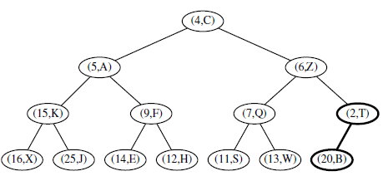
Heap
_heapify_up(): maintains heap property after insertion.
Consider an example: adding (2, T) to heap.

Slide 38
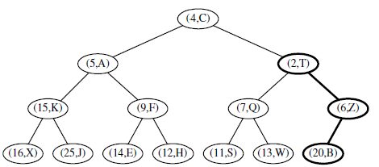
Heap
_heapify_up(): maintains heap property after insertion.
Consider an example: adding (2, T) to heap.

Slide 39
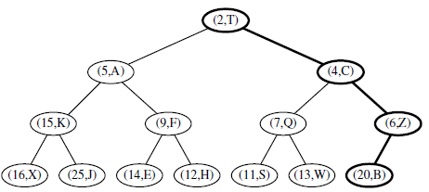
Heap
_heapify_up(): maintains heap property after insertion.
Consider an example: adding (2, T) to heap.

Slide 40
Heap
_heapify_down(): maintains heap property after deletion.
    Starts with the root element, which is replaced by the last element in the heap.
    Compares the new root with its children.
    If the element is larger (in a min-heap) or smaller (in a max-heap) than any of its children, it is swapped with the smallest (or largest) child.
    This process continues until the heap property is restored or the element reaches a leaf node.

Slide 41
Heap
_heapify_down(): maintains heap property after deletion.
Consider an example: removing (4, C) from the heap.

Slide 42
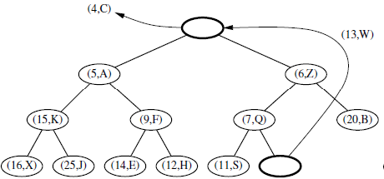
Heap
_heapify_down(): maintains heap property after deletion.
Consider an example: removing (4, C) from the heap.

Slide 43
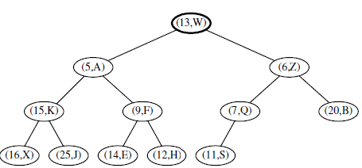
Heap
_heapify_down(): maintains heap property after deletion.
Consider an example: removing (4, C) from the heap.

Slide 44
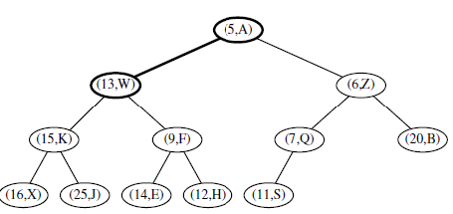
Heap
_heapify_down(): maintains heap property after deletion.
Consider an example: removing (4, C) from the heap.

Slide 45
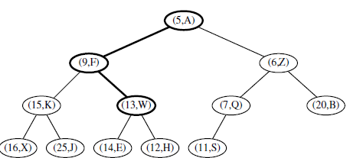
Heap
_heapify_down(): maintains heap property after deletion.
Consider an example: removing (4, C) from the heap.

Slide 46
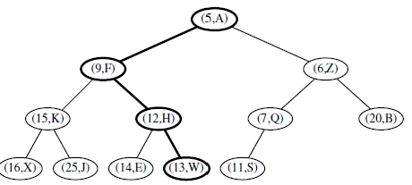
Heap
_heapify_down(): maintains heap property after deletion.
Consider an example: removing (4, C) from the heap.

Slide 47
Heap
Demo of Heap Class in Python
# Binary Heap in Python (Lecture-Code/Heap.py)
import heapq
# 1. Custom MinHeap from Scratch (Array-based)
heap = MinHeap()
for x in [10, 5, 20, 3, 7, 15, 25]:
heap.insert(x)
print('Min element:', heap.peek())
print('Extracted min:', heap.extract_min())
# 2. Built-in Python heapq Module (Production Grade)
data = [10, 5, 20, 3, 7, 15, 25]
heapq.heapify(data)
heapq.heappush(data, 1)
smallest = heapq.heappop(data)
print('3 Smallest:', heapq.nsmallest(3, data)) # [3, 5, 7]

Slide 48
Hash Table

Slide 49
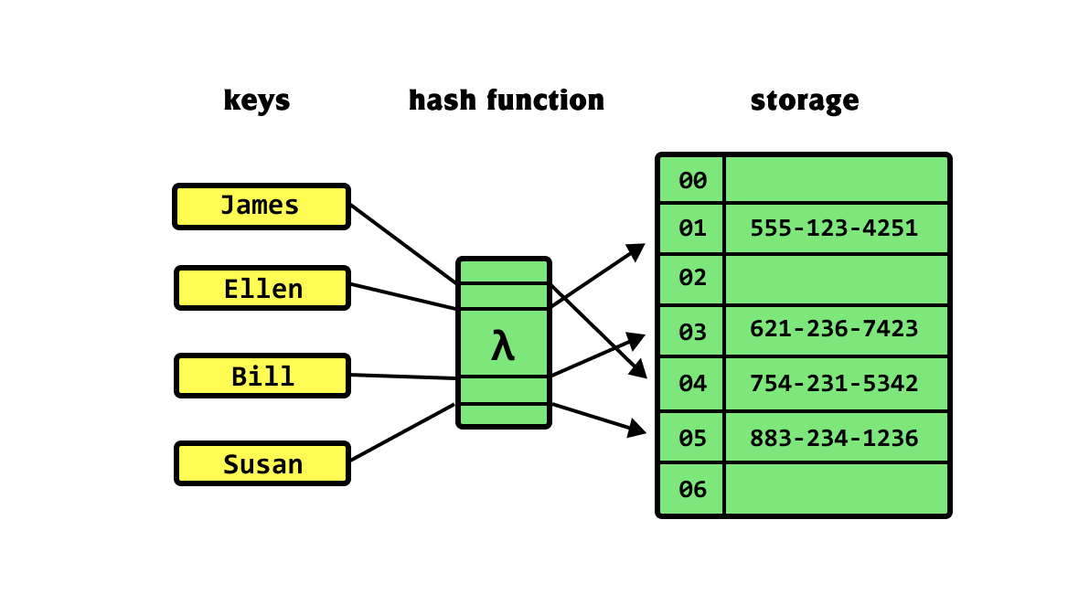
Hash Table
A hash table (low-level dictionary) is a data structure that maps keys to values using a hash function.
It’s efficient in operations: insertion, deletion, and lookup (often done in constant time).
Important Operations of Basic Hash Table:
_hash_function(key): Computes the index for a given key.
insert(key, value): for inserting key-value pair into to the hash table.
get(key): Retrieves the value associated with a given key.
delete(key): Removes a key-value pair from the hash table.

Slide 50
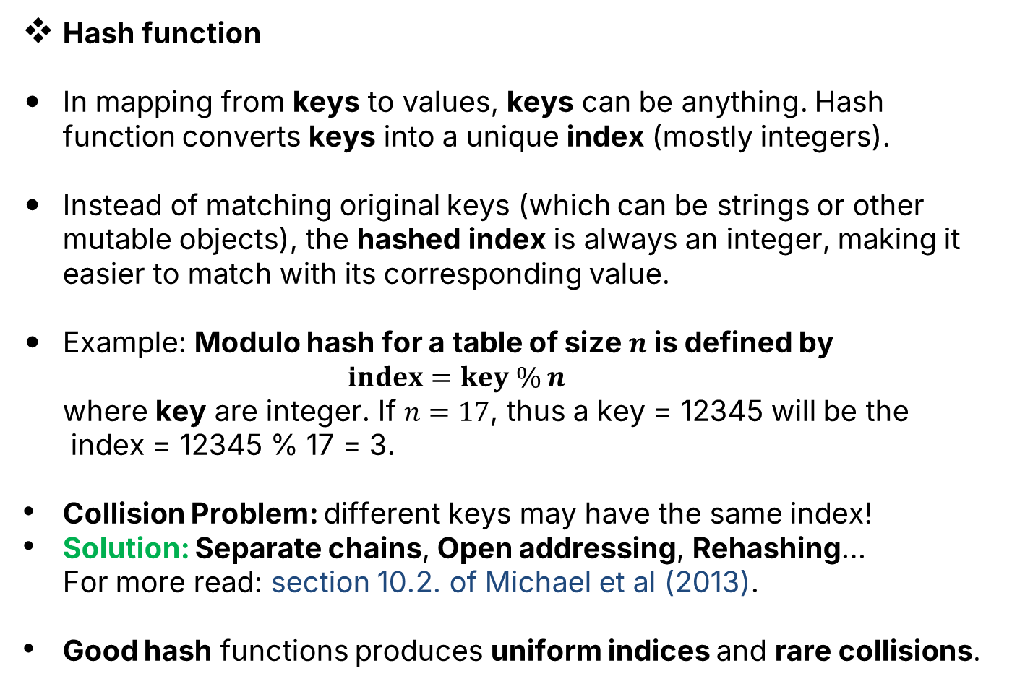
Hash Table
Hash function
In mapping from keys to values, keys can be anything. Hash function converts keys into a unique index (mostly integers).
Instead of matching original keys (which can be strings or other mutable objects), the hashed index is always an integer, making it easier to match with its corresponding value.
Example: Modulo hash for a table of size $n$ is defined by
$index=key \% n$
where keys are integers. If $n=17$, thus a key = 12345 will be the
index = 12345 % 17 = 3.
Collision Problem: different keys may have the same index!
Solution: Separate chains, Open addressing, Rehashing…
For more read: section 10.2. of Michael et al (2013).
Good hash functions produce uniform indices and rare collisions.

Slide 51
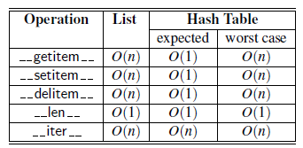
Hash Table
Python hash function: robust, efficient and secured.
Task3: Try Python built-in hash function:
  - hash(‘Apple’)
  - hash(‘Python’)
  - hash((1,2,3))
Complexity Analysis:
Although an in-depth complexity analysis is beyond our scope,
we provide a comparison of the complexity between lists and hash
tables below.

Slide 52
Hash Table
Demo of HashTable Class with Modulo hash function
# HashTable with Separate Chaining (Lecture-Code/HashTable.py)
class HashTable:
def __init__(self, size=7):
self.size = size
self.table = [[] for _ in range(size)] # Buckets for separate chaining
def _hash(self, key):
return hash(key) % self.size # Modulo compression function
def __setitem__(self, key, value):
idx = self._hash(key)
for kv in self.table[idx]:
if kv[0] == key: kv[1] = value; return # Update existing key
self.table[idx].append([key, value]) # Insert new key-value pair
def __getitem__(self, key):
idx = self._hash(key)
for k, v in self.table[idx]:
if k == key: return v
raise KeyError(key)
# Usage: ht = HashTable(); ht['apple'] = 100; print(ht['apple']) -> 100

Slide 53


Q & A
Lecture-Code:
  BinaryTree.py | Heap.py | HashTable.py

