Slide 1
Chapter 14 Tuples, Sets, and Dictionaries
COSC 221 (Computer Science B)

Slide 2
Section 2
Dictionary

Slide 3
Contents
Introduction
14.6.1. Creating Dictionaries
14.6.2 . Adding, Modifying, and Retrieving Elements
14.6.3. Deleting Items
14.6.8. Dictionary Methods
14.7. Applications

Slide 4
Objective
To understand the concept and structure of dictionaries.
To create and initialize dictionaries.
To add, modify, and retrieve elements in a dictionary.
To delete items from a dictionary using the del keyword.
To utilize essential dictionary methods like keys(), values(), items(), get(), pop(), popitem(), and clear().
To apply dictionaries in practical applications, such as data organization and word frequency counts.

Slide 5
Introduction

Slide 6
Introduction
Used to store key/value pairs.
Provides quick access to elements using keys.
A dictionary cannot contain duplicate keys
Example: my_dict = {"name": "Alice", "age": 25} g data

Slide 7
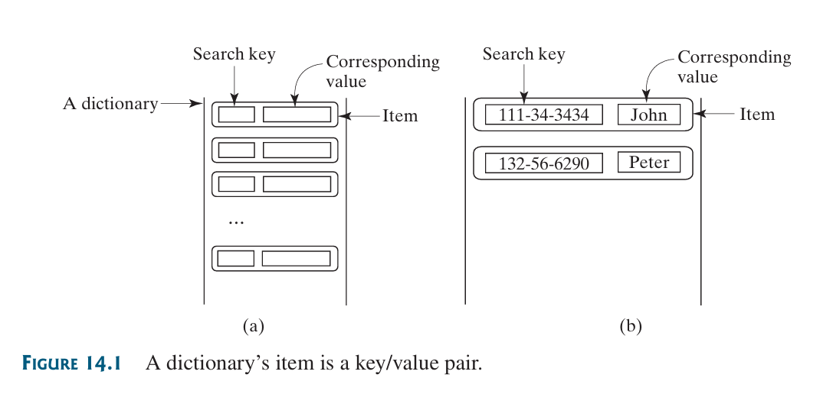
Introduction

Slide 8
14.6.1 Creating Dictionaries

Slide 9
Creating Dictionaries
A dictionary is created by enclosing key-value pairs within curly braces {}. Each item consists of:
A key followed by a colon :
A corresponding value
Items are separated by commas ,
Example:
students = {"111-34-3434": "John", "132-56-6290": "Peter"}
Key: 111-34-3434
Value: "John"

Slide 10
Creating Dictionaries
Note
Curly braces {} are used for both dictionaries and sets.
{} denotes an empty dictionary.
To create an empty set, use set().
Key Points
Hashable Keys:
Keys must be hashable (e.g., numbers, strings).
Flexible Values:
Values can be of any type.

Slide 11
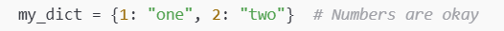

Creating Dictionaries
Example
Valid Keys (Hashable)

Slide 12
Creating Dictionaries
Example
Invalid Keys (Not Hashable)
Key Rule
If the key can change (like a list or dictionary), it cannot be used as a key.
If the key cannot change (like a number, string, or tuple), it can be used.

Slide 13
Creating Dictionaries Demo

Slide 14
14.6.2 . Adding, Modifying, and Retrieving Elements

Slide 15
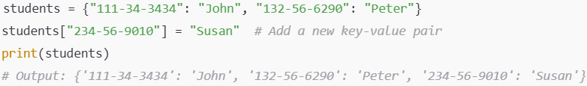
Adding, Modifying, and Retrieving Elements
Adding
You can add a new key-value pair to a dictionary using the syntax:
dictionaryName[key] = value
Example:

Slide 16

Adding, Modifying, and Retrieving Elements
2. Modifying Items
If the key already exists, assigning a new value to the key will replace the old value.
Example:

Slide 17
Adding, Modifying, and Retrieving Elements
Retrieving Values
To retrieve a value, use the syntax:
dictionaryName[key]
If the key exists, the corresponding value is returned.
Example:

Slide 18
Adding, Modifying, and Retrieving Elements: Demo

Slide 19
14.6.3. Deleting Items

Slide 20
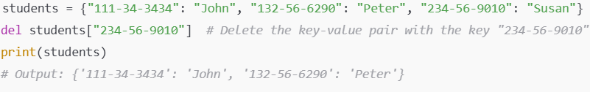
Deleting Items
To delete a key-value pair from a dictionary, use the del statement with the key.
Syntax:
del dictionaryName[key]
Example:

Slide 21

Deleting Items
Discussion Question

Slide 22
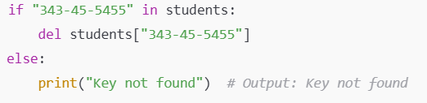
Deleting Items
Safe Way to Delete Items
To avoid a KeyError, check if the key exists in the dictionary before deleting it:
Key Notes
Use del carefully to avoid accidentally removing the wrong key-value pair.
Always verify that the key exists if there is uncertainty.

Slide 23
14.6.3. Deleting Items: Demo

Slide 24
14.6.8. Dictionary Methods

Slide 25
Dictionary Methods
The Python dictionary class (dict) provides several useful methods for manipulating dictionaries.
Below are the methods and examples:
1. keys()
Returns: A sequence of the dictionary's keys as a tuple.
Example:
values()
Returns: A sequence of the dictionary's values as a tuple.
Example:

Slide 26

Dictionary Methods
items()
Returns: A sequence of tuples, where each tuple is in the form (key, value).
Example:

Slide 27


Dictionary Methods
get(key)
Returns: The value for the specified key.
If the key does not exist, it returns None instead of raising a KeyError.
Example:
pop(key)
Returns: The value for the specified key, and removes the item from the dictionary
Example:

Slide 28


Dictionary Methods
popitem()
Returns: A randomly selected (key, value) pair as a tuple, and removes the selected item from the dictionary.
Example:
clear()
Returns: removes all items from the dictionary.
Example:

Slide 29
14.6.8. Dictionary Methods: Demo

Slide 30
14.7. Applications

Slide 31
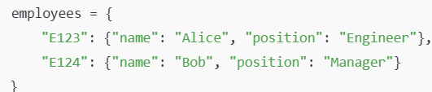
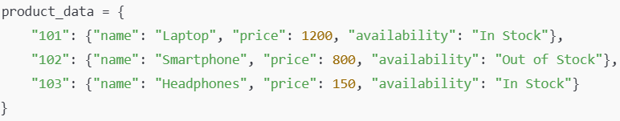
Applications
Dictionaries are powerful and versatile data structures that are widely used in many real-world applications.
Below are some common applications where dictionaries can be effectively utilized:
1. Employee directory:
Web Scraping and Data Organization

Slide 32
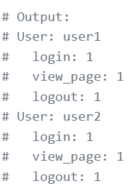
Applications
Other Application:
Tracking User Activity: In web applications, dictionaries can track how many times each user visits the site, stores their preferences, or logs events for analysis.

Slide 33
Applications
Other Application:
Word Frequency Counter: In text processing, dictionaries are often used to count the occurrences of each word in a document, which is a common task in Natural Language Processing (NLP).
Example: If the word "NLP" appears frequently, we can infer the document is about Natural Language Processing.

Slide 34
Mini Exercise
Create a dictionary with the following student grades:
"John": 85,
"Sarah": 92,
"Alex": 78,
"Linda": 88,
"David": 95
Add a new student, "Emily", with a grade of 91.
Modify Sarah's grade to 95.
Remove "Alex" from the dictionary.
Print the names of all students who scored above 90.
Expected Outcome:
Sarah
David
Emily

Slide 35

Summary
In this chapter:
In the Dictionary chapter, you learned how to store data using key-value pairs in Python dictionaries.
Keys must be hashable (e.g., strings or numbers), while values can be of any type. You can add, modify, retrieve, or delete items using simple syntax.
Important methods include keys(), values(), items(), get(), and pop().
Dictionaries are versatile and used in real-world applications such as contact management, configuration settings, and route mapping for algorithms, providing efficient data storage and access.

Slide 36
End
Text-book code practice
14.7 Case Study: Occurrences of Words, page 492

Slide 37


Q &A
Lecture-Code:
13.1 - 13.7

