Slide 1
1. Title
Notes:
state up front that every figure in this deck is measured on the

Slide 2
2. The problem in one line

Slide 3
3. What we found when we measured the grid
Notes:
this slide establishes credibility. Nobody else will have this.

Slide 4
4. The finding that changed the design
Notes:
say plainly — a system that claims ANPR on these feeds would be

Slide 5
5. So we built a platform that does not depend on plates
• Appearance alone never raises an alert. Two silver hatchbacks are not evidence.
• A matched plate is not argued down by disagreeing colour on a night camera.

Slide 6
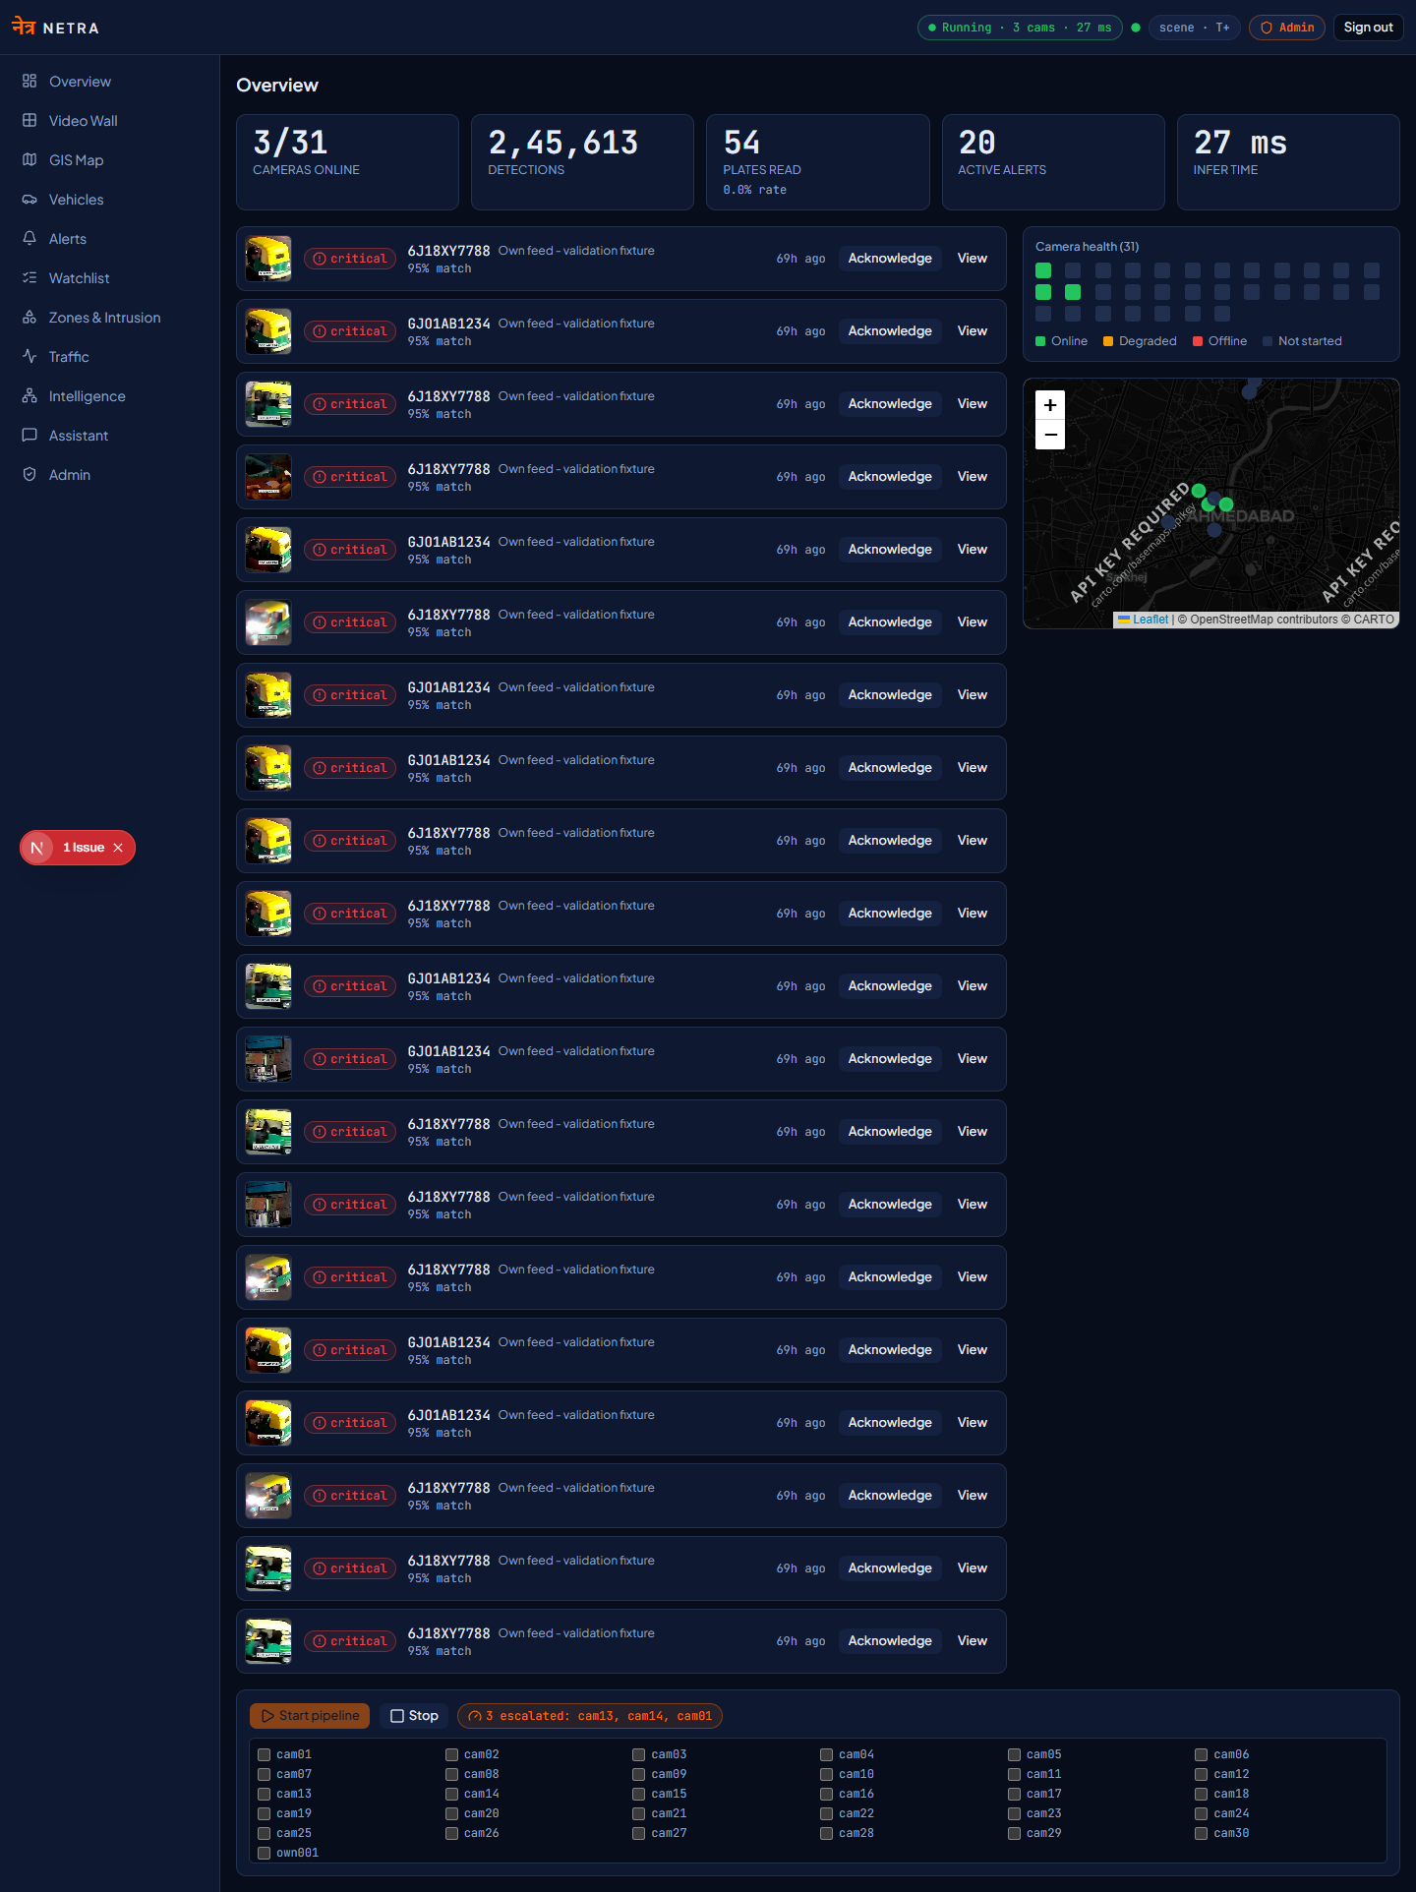
6. Architecture
• Registry (Model 1) — identity, geography, and capability discovered by probing
• Source adapters — RTSP / HLS / file behind one interface; new protocol = one adapter
• Ingest supervisor — PTS-driven timing, backoff reconnection, loop-cut handling
• Inference engine — sole GPU owner, two-tier scheduling
• Correlation — fusion matching, cross-camera tracing
• Console — GIS map, video wall, alerts, search, assistant

Slide 7
7. Two-tier scheduling: how it scales

Slide 8
8. Recovering time, so tracing means something

Slide 9
9. Measured performance

Slide 10
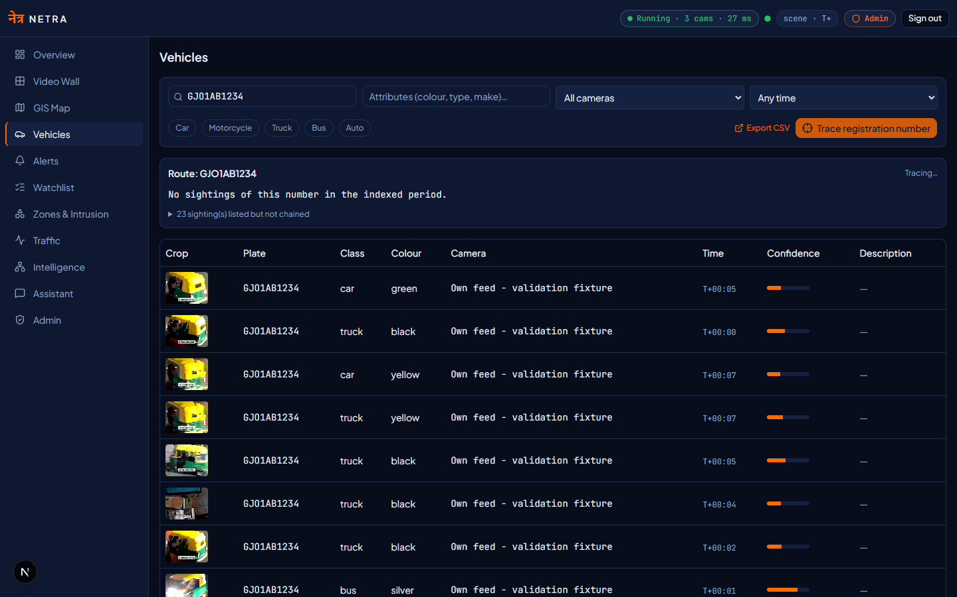
10. Demonstration: Government feed

Slide 11
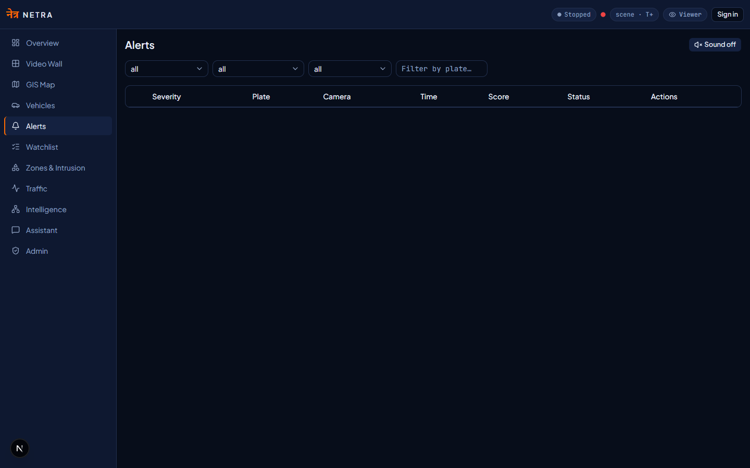
11. Demonstration: own feed

Slide 12
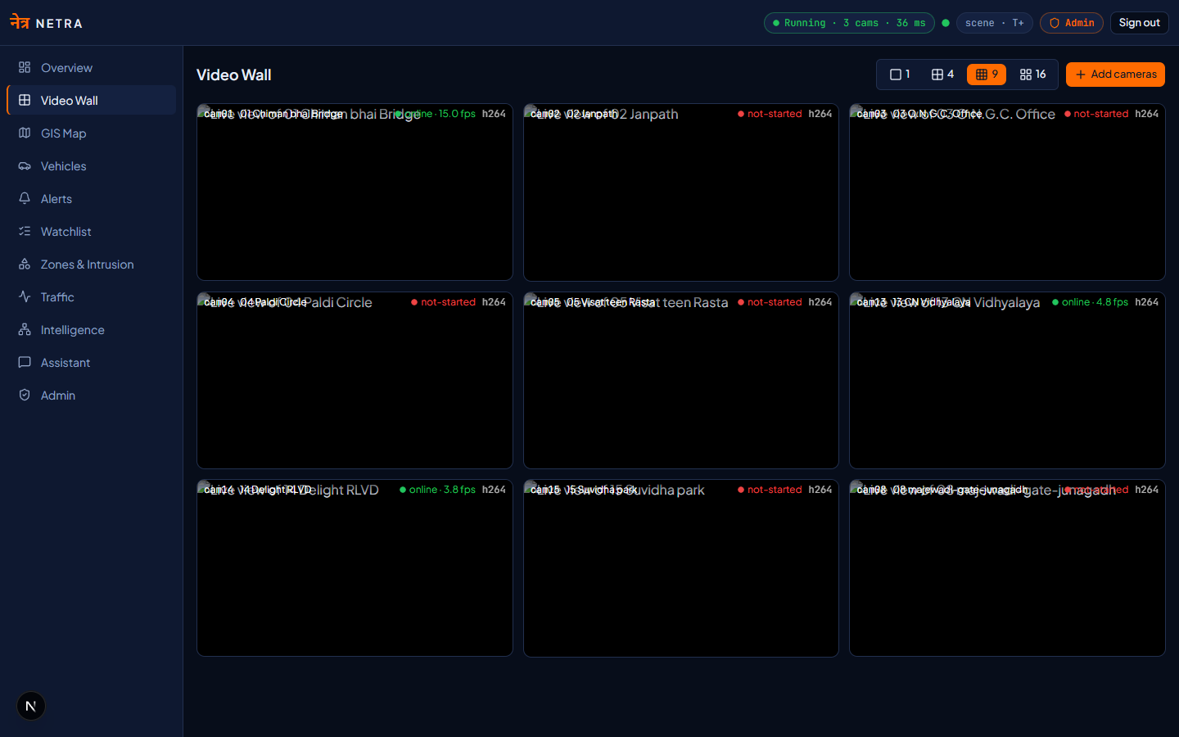
12. Beyond the mandatory requirements

Slide 13
13. Scaling to 80,000 cameras
• Edge inference — regional nodes ship metadata, not video
• Sizing — ~150–200 cameras per RTX 5050-class GPU at tier-1; ~400–550 nodes statewide, fewer with datacentre accelerators
• Storage — detection rows and evidence crops, tens of kilobytes, vs. gigabytes/camera/day for continuous recording
• Central tier — stateless APIs, PostgreSQL/PostGIS partitioned by time and district
• Onboarding — adding a department is a catalogue import, not an integration project
• Failure domain — a node outage affects one district

Slide 14
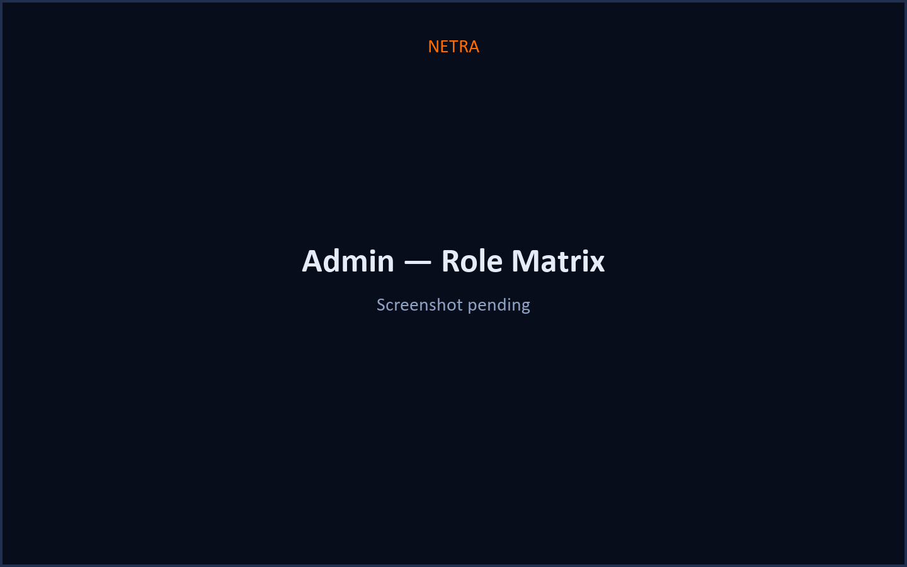
14. Security, privacy and accountability
• No centralised video recording. Evidence crops only, tied to a detection.
• Role-based access with department-scoped camera visibility
• Every registry, route and vehicle query written to an audit log
• Credentials never committed; supplied by environment
• RTSP forced over TCP; on-premise by design — police video does not leave the State network
• No unexplained machine judgements. Every alert carries its reasoning.

Slide 15
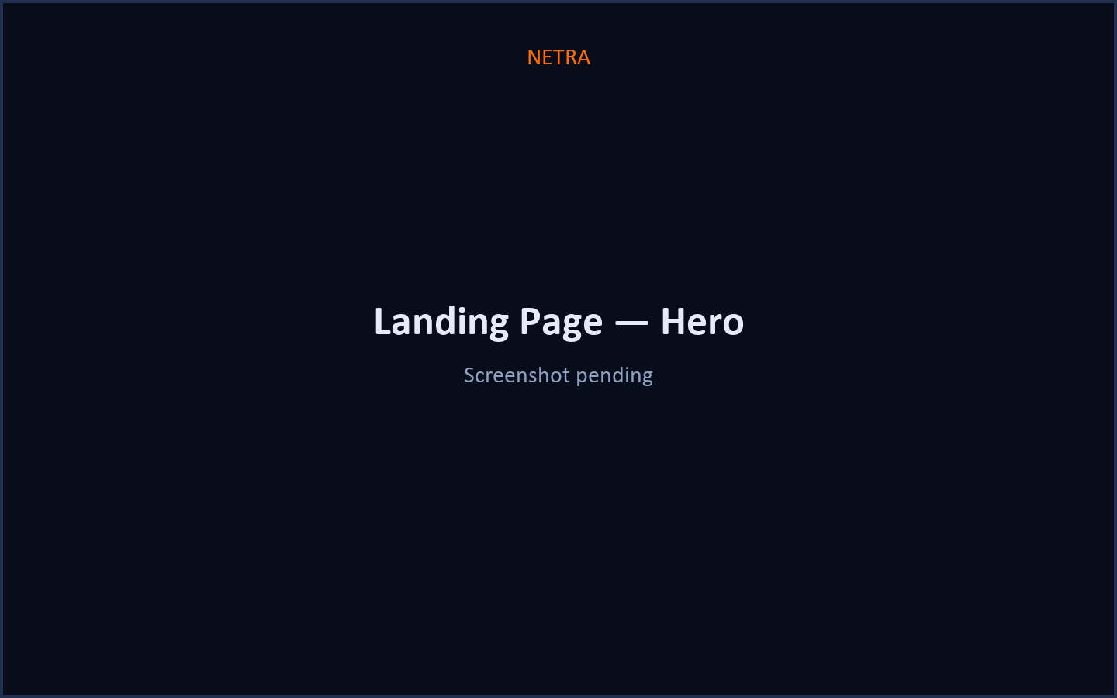
15. Hosted demo & access
• Hosted console: <<VERCEL_URL>>
• If the hosted link is unreachable, a quick-tunnel URL is provided at demo time as a fallback
• Operator key is supplied in the submission form — do not commit credentials
• Same build as the on-premise deployment; no functional difference for the demo
Notes:
say the hosted link is a convenience for reviewers — the production

Slide 16
16. What we are not claiming
• Plate recognition is not achievable on the wide-area night cameras of this grid, by any system — we measured it.
• Appearance matching produces ranked candidates for operator confirmation, not identification.
• Camera coordinates are junction-level approximations; no geography was supplied.
• Scaling figures are extrapolated from measured single-node throughput and would be confirmed by a district pilot.
Notes:
this slide wins trust. Deliver it confidently, not apologetically.

Slide 17
17. Close

