Slide 1




Sample presentation
Bank of Baroda Hackathon 2024
Your Team Name : Medusa
Your team bio : Srivatsa Palepu, Manipal University Jaipur, AIML Enthusiast
Srikruthi Neriyanuri, Manipal University Jaipur, IoT Enthusiast
Date : 30-06-2024

Slide 2

Problem Statement?
Why did you decide to solve this Problem statement?
Customer-Centric Innovation:
Personalization: Generative AI can provide highly personalized financial advice based on individual customer profiles, financial goals, and risk tolerance.
Real-Time Advisory: The ability to offer real-time financial advice that adapts to market conditions and personal circumstances.
Data-Driven Decisions:
Market Trends Analysis: Utilizing generative AI to analyze vast amounts of market data and trends helps in creating robust investment strategies.
Predictive Analytics: By leveraging predictive models, the bank can anticipate market movements and customer needs, providing proactive advice.
Operational Efficiency:
Automation: Automating the advisory process reduces the workload on human advisors, allowing them to focus on more complex cases and strategic planning.
Cost Reduction: AI-driven advisory services can be more cost-effective in the long run, as they can handle a large volume of customer interactions.

Slide 3
Pre-Requisite
What are the alternatives/competitive products for the problem you are solving?
Customer Financial Data Access
Market Data Integration
Regulatory Compliance
High-Performance computing Resources
User-Friendly Interface
Partnerships and Collaborations

Slide 4

Tools or resources
Azure tools or resources which are likely to be used by you for the prototype, if your idea gets selected
Azure Machine Learning:
Azure Databricks:
Azure Cognitive Services:
Azure API Management:
Azure Key Vault:
Azure Monitor:
Azure Cosmos DB:

Slide 5
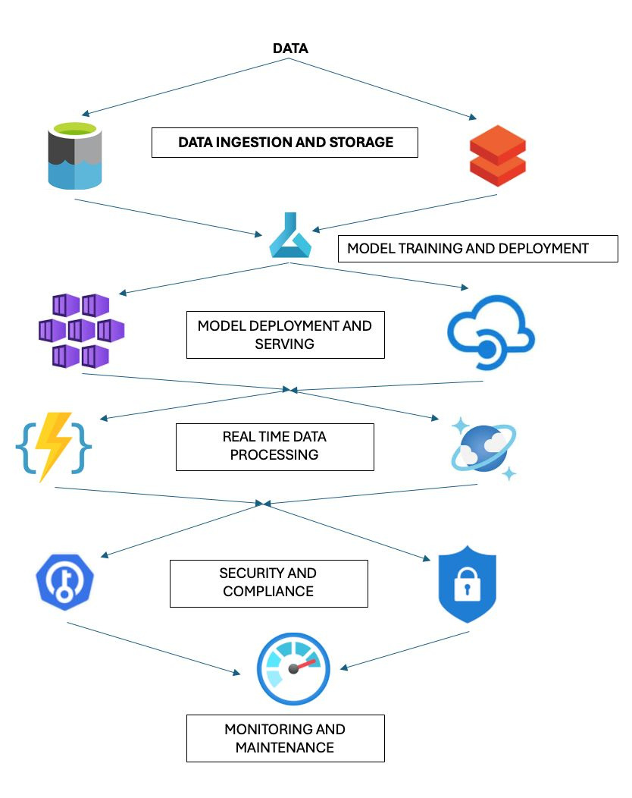
Proposed Solution:
Architecture
Present your solution, talk about methodology, architecture & scalability
Methodology
1. Data Collection and Preparation
Azure Databricks: Use this platform for big data processing and to clean, transform, and prepare data for analysis and model training.
2. Model Building and Training
Azure Machine Learning: Build, train, and validate machine learning models using Azure ML.
3. Model Deployment and API Management
Azure Kubernetes Service (AKS): Deploy machine learning models as microservices in a scalable and containerized environment.
Azure API Management: Create, publish, and manage APIs that allow external applications and services to interact with the deployed models.
4. Real-Time Advisory and Adaptation
Azure Cosmos DB: Database
5. Security and Compliance
Azure Key Vault: Securely manage sensitive information, including API keys, passwords, and certificates.
6. Monitoring and Continuous Improvement
Azure Monitor: Provide full-stack monitoring to track application performance, detect issues, and optimize the system.

Slide 6
Key Differentiators & Adoption Plan
How is your solution better than alternatives and how do you plan to build adoption?
Key Features of Our Solution:
Personalized, Real-Time Advice
Advanced Cognitive Capabilities
Robust Security and Compliance
Scalability and Performance
Adoption Strategy:
Customer Education and Awareness:
Partnerships with Financial Institutions
Freemium and Trial Models
Customer Testimonials and Case Studies
Seamless Onboarding and User Experience

Slide 7

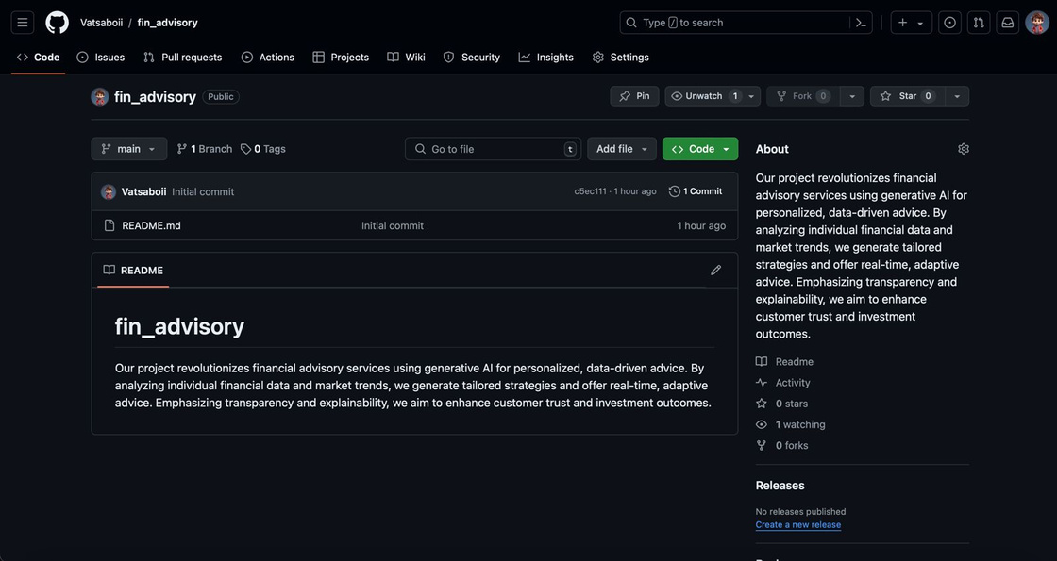
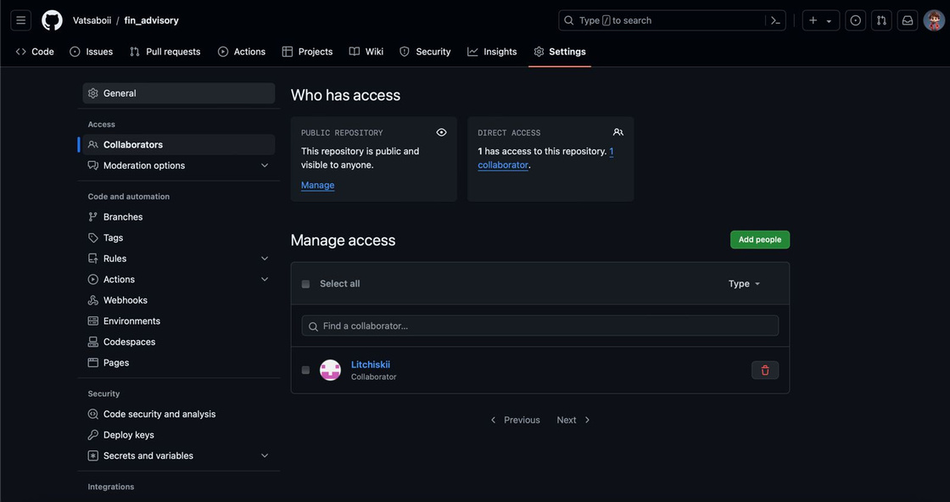
GitHub Repository Link & supporting diagrams, screenshots, if any
How far it can go?
GitHub Repository Link
https://github.com/Vatsaboii/fin_advisory

Slide 8

Business Potential and Relevance
What are the business applications of the problem you are solving?
1. Retail Banking
Personalized Financial Planning
Budgeting and Saving Recommendations
Loan and Credit Advice
2. Wealth Management
Investment Portfolio Management
Retirement Planning
3. Insurance
Policy Recommendations
Claims Processing
Risk Management
4. Corporate Finance
Financial Forecasting
Cash Flow Management
Expense Optimization
5. Brokerage Services
Real-Time Trading Recommendations
Market Analysis and Insights
Automated Portfolio Rebalancing
6. Financial Advisory Firms
Scalable Advisory Services

Slide 9

Uniqueness of Approach and Solution
What is the unique aspects of the proposed idea?
1.Hyper-Personalization
Deep Customer Insights
Behavioral Analysis
2. Real-Time Adaptive Advice
Dynamic Market Response
3. Comprehensive AI Integration
Multi-Layered AI Capabilities
Cognitive Interactions
4. Scalability and Performance
Global Reach
Scalable Infrastructure
5. Seamless Integration and User Experience
API Management
User-Friendly Interface

Slide 10

User Experience
How will your idea enhance the user experience?
1. Personalization and Relevance
Tailored Advice
- Behavioral Insights
2. Real-Time Updates and Adaptability
- Dynamic Adjustments
- Immediate Responses
3. User-Friendly Interface
- Intuitive Design
- Guided Onboarding
4. Interactive and Engaging Experience
- Natural Language Processing
6. Comprehensive Support
- 24/7 Availability
- Multi-Channel Access

Slide 11

Scalability
How effectively can your solution be scaled to accommodate growth without compromising performance?
Key scalability features include:
Azure Databricks: Handle large-scale data processing and storage needs.
Azure Kubernetes Service (AKS): Ensure the model deployment environment can scale up or down based on demand.
Azure Cosmos DB: Provide high availability and low latency for globally distributed data.
API Management: Ensure APIs can handle increasing numbers of requests and manage load effectively.
By leveraging these Azure tools and resources, we can build a robust, scalable, and secure financial advisory service that provides real-time, personalized financial advice, enhancing customer satisfaction and trust.
Future-Proofing:
Scalability: AI systems can easily scale to handle growing customer bases and increasing data volumes, ensuring that the advisory services can evolve with the bank’s growth.
Continuous Improvement: Machine learning algorithms can continuously learn from new data, improving the quality and accuracy of financial advice over time.

Slide 12
Ease of Deployment and Maintenance
How simple is your solution to implement and maintain on an ongoing basis?
Our AI-driven financial advisory solution, powered by Azure, ensures seamless integration, scalability, and robust security. Leveraging Azure AI services like Azure Machine Learning and Cognitive Services, we provide personalized financial advice through advanced algorithms and natural language processing. Azure Functions enable real-time updates, adjusting strategies based on market shifts and user data, ensuring advice remains current and relevant. Security is paramount with Azure Security Center and Azure Key Vault, safeguarding sensitive information through encryption and comprehensive threat protection. Azure DevOps facilitates automated deployment and updates via CI/CD pipelines, ensuring reliability and efficiency. Azure Monitor monitors system performance, offering insights for proactive maintenance. We maintain compliance with Azure’s comprehensive compliance offerings, ensuring adherence to regulatory standards like GDPR and CCPA. With Azure’s robust support and documentation, our solution is designed for simplicity in implementation and ongoing management, empowering users with effective financial guidance while maintaining high standards of security and compliance.

Slide 13

Security Considerations
What measures are incorporated to ensure the security and integrity of your solution?
To ensure the security and integrity of our AI-driven financial advisory solution, several measures are implemented:
Data Encryption
Access Control: Role-based access control (RBAC)
Authentication and Authorization: Multi-factor authentication (MFA)
Monitoring and Logging: monitoring of the application, network traffic,and system logs.
Incident Response Plan.
Compliance and Standards: regulatory standards and frameworks
Employee Training and Awareness.

Slide 14
Thank You
Team member names:
Srivatsa Palepu
Srikruthi Neriyanuri

