Slide 1

Exploratory Data Analysis
G2M insight for Cab Investment firm
08/07/2021

Slide 2
Business Problem
XYZ, a private firm in US, wants to invest in the cab industry due to the remarkable growth and multiple key players in it. As per the Go-to-Market strategy, they want to understand the market before making a decision.
Problem Statement – Produce actionable insights from the data for XYZ to help them make the choice of the right company to invest.
Analysis is divided into sections:
Understanding the data
Carrying out EDA
Profits and customer base analysis of the companies
Final Recommendations

Slide 3
Data Exploration
Four datasets containing the Cab, City, Transaction and Customer data.
A third-party dataset ‘US Holiday Dates (2004-2021).csv
Total number of features = 14 (1 derived feature)
Total number of observations = 359392
Timeline of the data: 2016-01-02 to 2018-12-31
City of ‘San Francisco CA’ does not have cab ride data
Assumptions considered:
To calculate Profit, used ‘Price Charged’ and ‘Cost of Trip’ features, and assumed
other features to be constant.
‘Users’ feature assumed as the total number of users of all types of cabs in each city.
City.csv
Customer_ID.csv
Transaction_ID.csv
Cab_Data.csv
US Holiday Dates (2004-2021).csv
Final Data

Slide 4
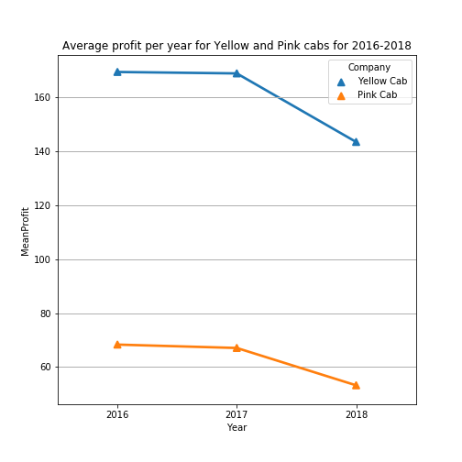
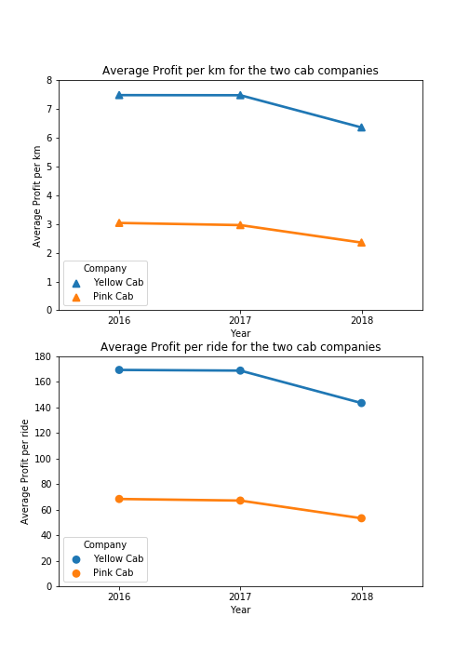
Profit Analysis
 | Yellow Cab | Pink Cab
Total net profit (in $) | 44.020 million | 5.307 million
Total km travelled (in km) | 6.199 million | 1.911 million
Total number of rides | 274681 | 84711

Slide 5
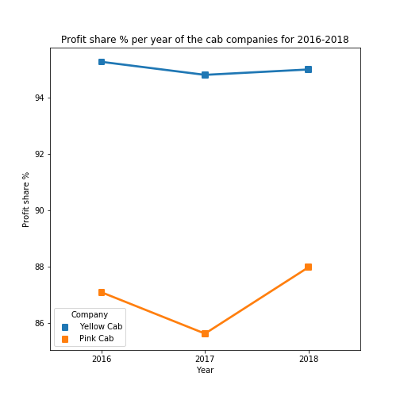
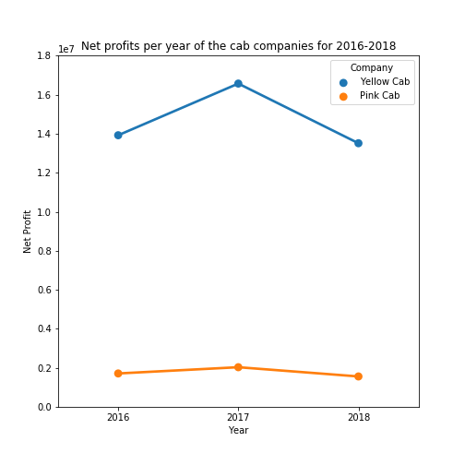
Profit-share per Year
Left: Profit-share % of the two cab companies per year. The Yellow cab earns profit on average 95% of the rides per year.
Right: Net profts of the two cab companies per year (2016-2018).
The Pink cab observes approximately 7 times less net profit per year than the Yellow Cab.

Slide 6
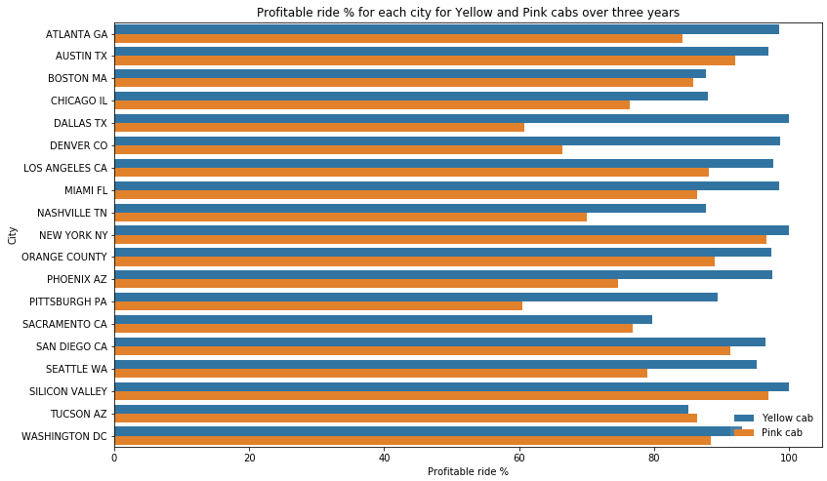
City-wise Profit Analysis
Yellow cab gives more profitable rides over majority of the cities than the Pink cab.
An exception being in the city of Tucson, Arizona.
In cities like Austin TX, Boston MA, New York NY, Sacremento CA, San Diego CA, Silicon Valley and Washington DC, the cab companies show stiff competition.
Yellow cab is profitable in certain cities like Dallas TX, Denver CO and Pittsburgh PA with a 30% gap with its competitor.

Slide 7
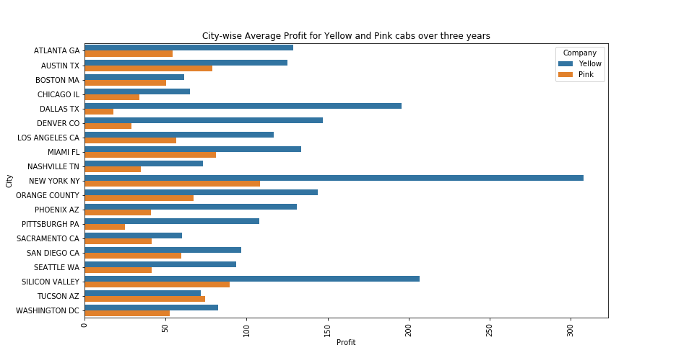
Average Profits per City
The Yellow cab earns significantly higher average profits in Dallas TX, Denver CO and New York NY.
In every city except Tucson AZ, the Yellow cab is more profitable than the Pink cab.

Slide 8
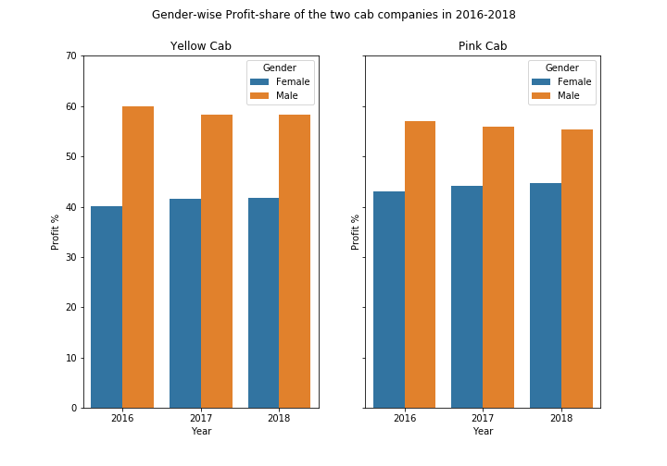
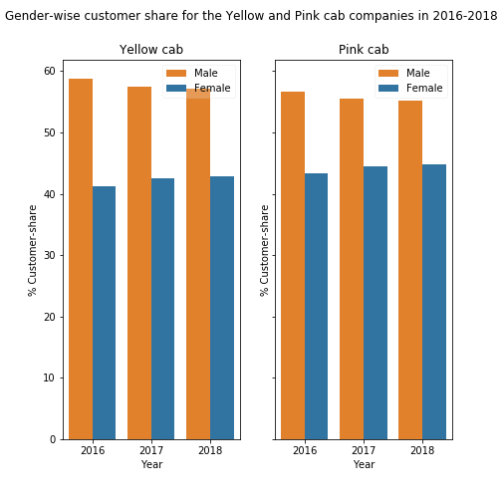
Customer Base Analysis

Slide 9
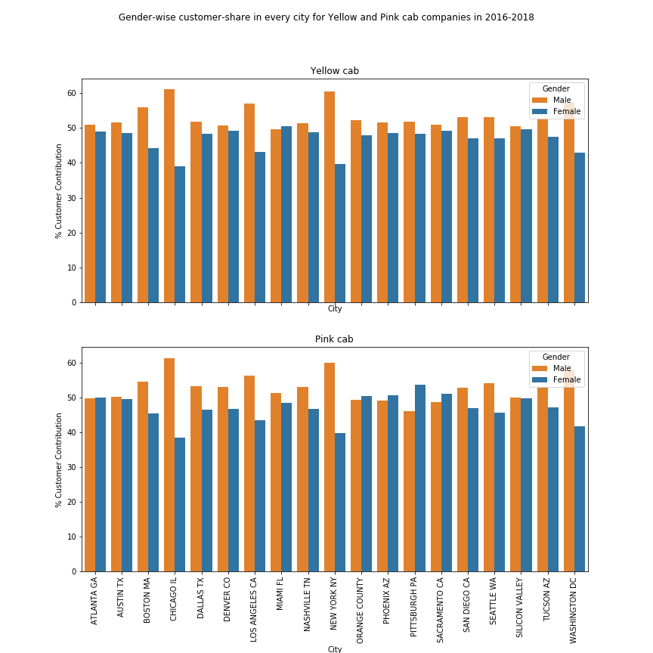
Gender based Analysis per City
Across all cities, Males have a higher share in the customer base of the Yellow cab. For the Pink cab, the same trend is followed in the majority of the cities, where there is a 20% margin between the gender groups in cities like Chicago IL, New York NY and Washington DC.
However, in some cities like Atlanta GA, Austin TX, Miami FL, Orange County, Pheonix AZ, Pittsburgh PA, Sacremento CA and Silicon Valley the Females customer share is on par or even greater than the Males for both cab companies.
In conclusion, the Males contribute higher than Females in profits and the customer base for the Yellow and Pink cab companies.

Slide 10
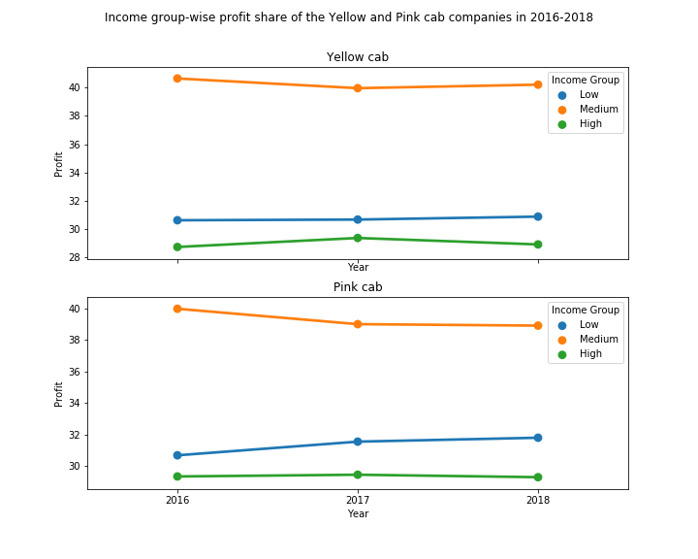
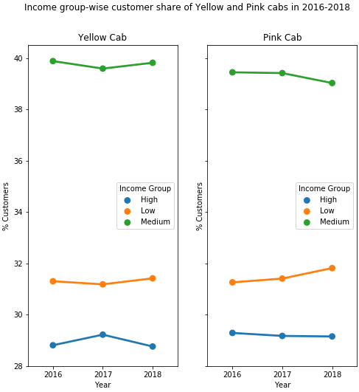
Income Group Analysis
For both the cab companies, the Medium income group (10-20k) is major contributor to the profit and customer share.
A 10% gap is maintained for the three years in both the profit and customer share between the Medium and other income groups.
High income group contributes the least to the profits and customer base of the two cab companies.

Slide 11
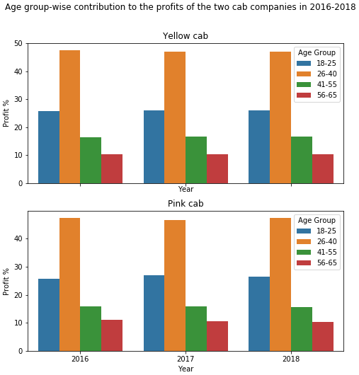
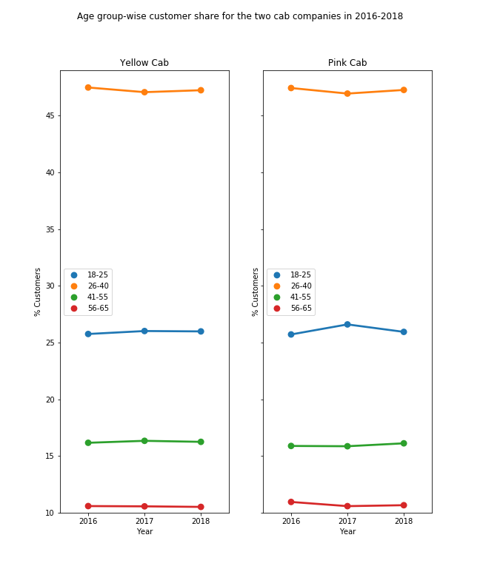
Age Group Analysis
The 26-40 age group is majority contributor to the profit and customer-share of the Yellow and Pink cabs.
A 20% gap is maintained with the next highest contributing age group 12-25.

Slide 12
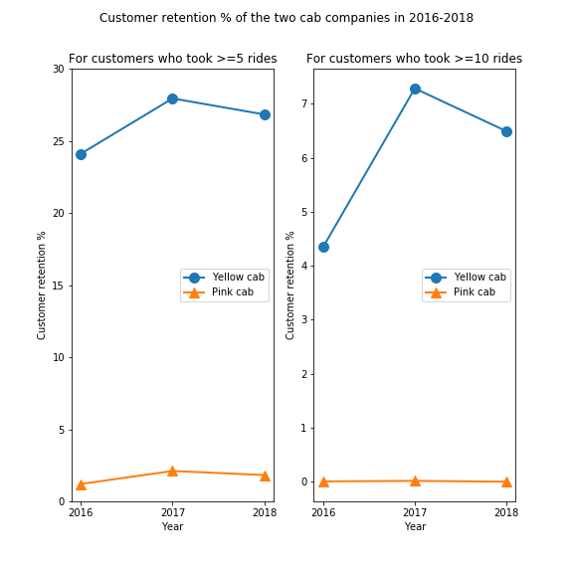
Customer Retention
Customer retention is calculated for two thresholds. The calculation only considers customers who took multiple rides with the same cab company.
From both plots, the Yellow cab is able to retain approximately 26% of its customers on average over the three years.
The customer retention can indicate the performance of the cab company in terms of ride services. Based on this, the Yellow cab appears to perform better than its competitor.

Slide 13
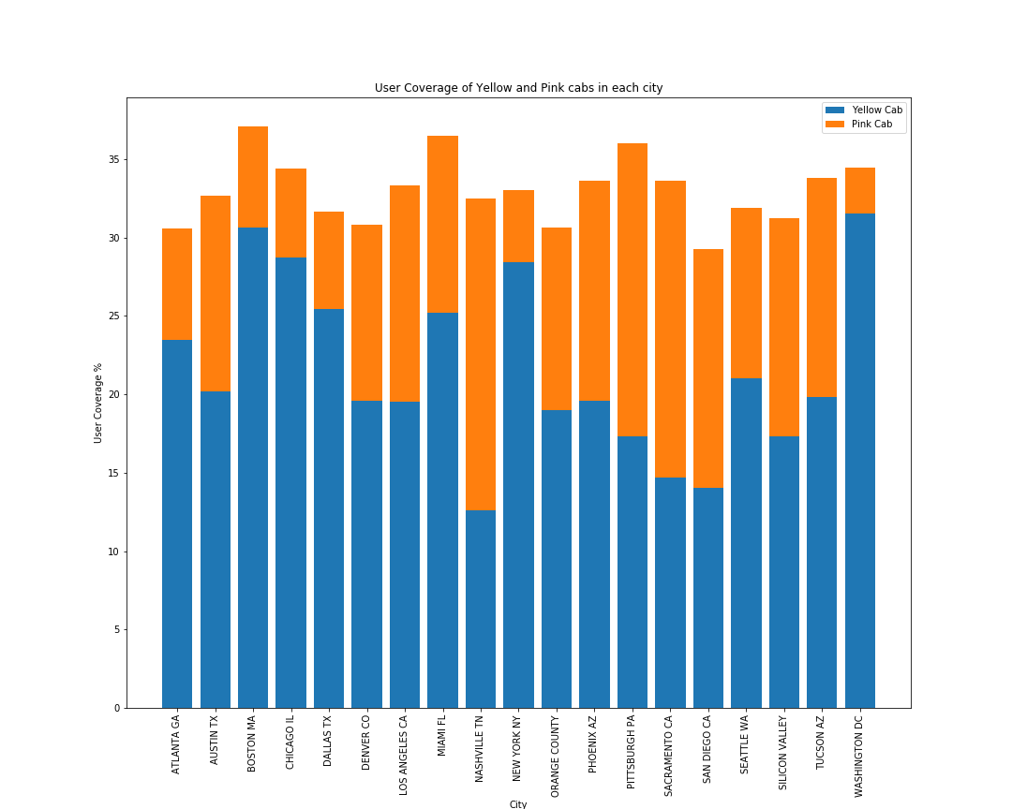
User Coverage
User coverage per city - % of users travelling with Yellow/Pink cabs out of all cab users in each city.
In majority of the cities, the Yellow cab has a higher user coverage with Boston MA, Chicago IL, Dallas TX, New York NY and Washington DC showing its dominance.
The Pink cab leads in user coverage in Nashville TN, Pittsburgh PA, Sacremento CA and San Diego CA.

Slide 14
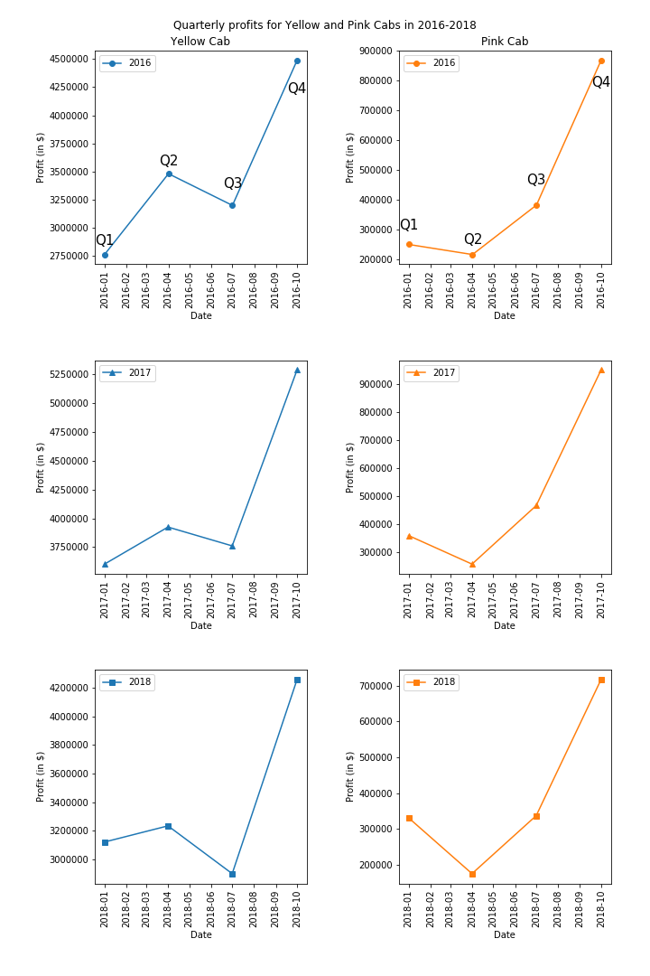
Seasonality in Profits
From the yearly profits of the Yellow and Pink cabs, there is a quarterly trend seen.

Slide 15
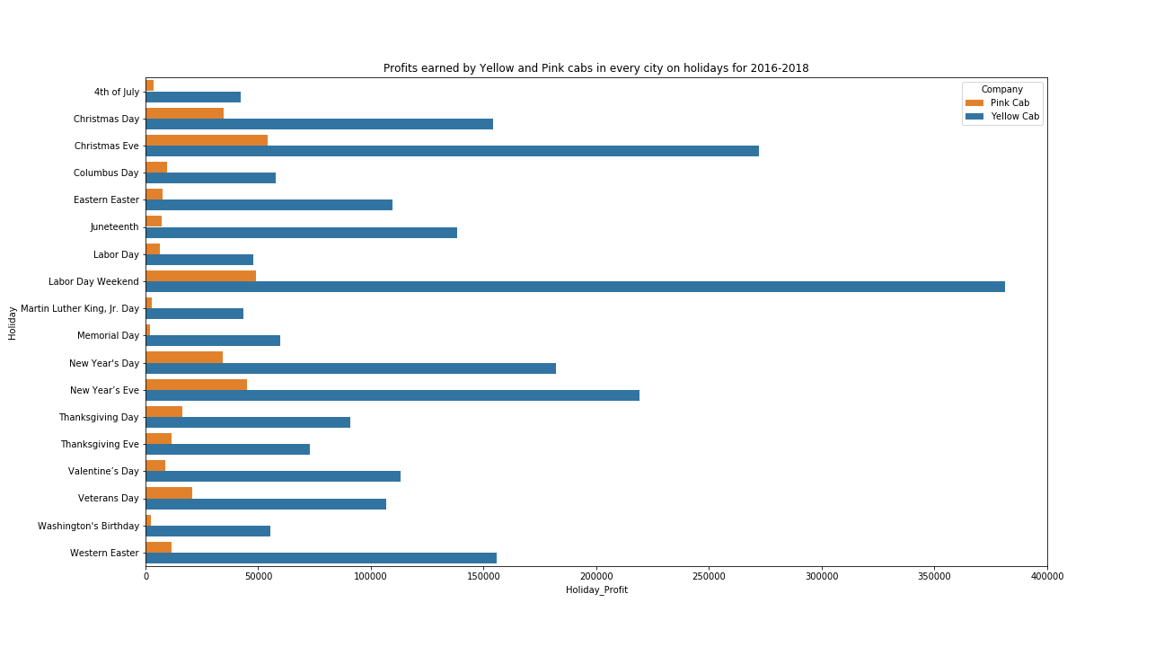
Holiday Travel Analysis – Profits
The Yellow Cab leads in the profits earned on the holidays from 2016-2018.
On Christmas, New Year and Labor Day weekend the Yellow Cab is significantly profitable than the Pink Cab.

Slide 16
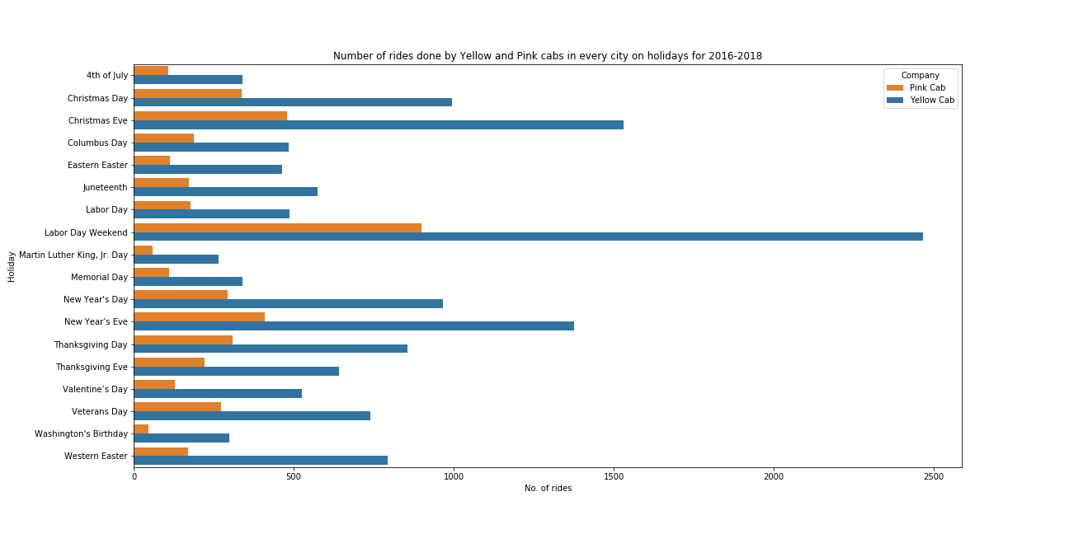
Holiday Travel Analysis - # of Rides
Similar trend of the Yellow Cab being very much the preferred choice on Holidays for the customers of each city seen here.
On popular holidays expecting more travel like the Labor Day Weekend, Christmas and New Year Eve, the Yellow Cab takes a larger share in the number rides done.

Slide 17
Recommendations
Below are the points considered while evaluating the Yellow and Pink cab companies:
User coverage: Yellow cab has a higher user coverage in 15 cities (including Boston MA, Chicago IL, Dallas TX, New York NY and Washington DC) than the Pink cab.
Holiday Travel: In all of the 19 cities, the Yellow cab earns more profits than the Pink cab for 2016-2018. In addition, number of rides done by the Yellow cab on holidays is significantly greater than its competitor in majority of the cities.
Customer Retention: Yellow cab performs better than the Pink cab for the three years. On average, 26% of customers are retained by the Yellow cab.
Profit share: From 2016-2018, the Yellow cab has a higher profit share in majority of the cities than the Pink cab. Tucson AZ is the exception where the Pink cab is ahead.
Age-group: The 26-40 age group remains the dominant contributor to the profits and customer base for both cab companies.
Income-group: Medium income group (10-20k) takes the leading share (~40%) in profit and customer base of the Yellow cab company from 2016-2018
City-wise performance: Yellow cab dominates in the profit and customer share in majority of the 19 US cities.

Slide 18
Thank You

