Slide 1
Operating Systems (CSE531)
Manish Shrivastava

Slide 2
General course information
Course Philosophy
Re-iterate what you know
Digress at key points
To go deeper
For better understanding
To be more up-to-date
Learn by doing
Have a look at OS concepts in action (Assignments)

Slide 3
General course information
Assignments and grading
Six programming assignments (6x6=36%)
One research paper presentation 10%
Two Quizzes (7x2=14%)
Two MidSems 10% each
EndSem 20%

Slide 4
What is an Operating System?
Software that abstracts the computer hardware
Hides the messy details of the underlying hardware
Presents users with a resource abstraction that is easy to use
Extends or virtualizes the underlying machine
Manages the resources
Processors, memory, timers, disks, mice, network interfaces, printers, displays, …
Allows multiple users and programs to share the resources and coordinates the sharing

Slide 5
Questions
What is a system ?
What is an operating system ?
What is a computer operating system ?

Slide 6
System
boundary
input
A system has nine characteristics
Components
Inter-related components
A boundary
A purpose
An environment
Interfaces
Input
Output
Constraints.
interfaces
environment
Components
interfaces
Inter-realtionship
output
A general depiction of a system

Slide 7
Characteristics…
Components:
A system is made up of components
A component is either an irreducible part or aggregation of parts that make-up a system. A component is also called a sub-system.
Interrelated:
The components of interrelated
Dependence of one subsystem on one or more subsystems.

Slide 8
Characteristics…
Boundary (Scope):
A system has a boundary, within which all of its components are contained and which establishes the limits of a separating the system from other systems.
Purpose
The overall goal of function of a system. The system’s reason for existing.

Slide 9
Characteristics…
Environment
Everything external to the system that interacts with the system.
Interface
Point of contact where a system meets its environment or subsystems meet each other.
Constraint:
A limit what a system can accomplish: Capacity, speed or capabilities.

Slide 10
Characteristics…
Input
Whatever a system takes from its environment in order to fulfill its purpose.
Output:
Whatever a system returns to its environment in order to fulfill its purpose.

Slide 11
Important System Concepts
Decomposition
Modularity
Coupling
Cohesion

Slide 12
Decomposition (Divide and Conquer)
It deals with being able to break down a system into its components.
Decomposition results in smaller and less complex pieces that are easier to understand than larger, complex pieces.
Decomposing a system also allows to focus on one particular part of a system, making easier to think of how to modify that part independently of the entire system.

Slide 13
Modularity
Modularity refers to dividing a system up into chunks or modules of a relatively uniform size.
You can replace or add any other module (or a component) without effecting the rest of the system.
It is a design strategy in which system is composed of relatively small and autonomous routines fit together.

Slide 14
Coupling
Coupling is the extent to which subsystems are dependent on each other.
Subsystems should be as independent as possible.
If a subsystem fails and other subsystems are highly dependent on it, the others will either fail themselves or have problems in functioning.

Slide 15
Cohesion
The extent to which a system or a subsystem performs a single function.

Slide 16
What is an operating system ?
Operating system is a system.
Operating system is a subsystem of any tool.
Each tool constitutes machine part and operating part.
The operating part of a tool is called as operating system of that tool.
The purpose of operating system is to facilitate the operation of the underlying machine or tool.
For a machine, the operating system abstracts the machine part in terms of simple services by hiding the details of the machine. The OS can provide services to users or other subsystems.
Examples of typical operating systems:
Car operating system, Telephone operating system, TV operating system and so on.

Slide 17
What is a computer operating system ?
A computer is also a tool that contains machine part and operating part.
The operating part of a computer is called Computer Operating System.
For a computer, the operating system abstracts the underlying hardware in terms of simple services by hiding the details of the hardware. The OS can provide services to users or other subsystems.
Examples of Computer operating systems:
WINDOWS 7, Macintosh, UNIX, SOLARIS, LINUX and so on.
In the rest of this course, operating system means computer operating system.

Slide 18
Computer System Components
1. Hardware – provides basic computing resources (CPU, memory, I/O devices).
2. Operating system – controls and coordinates the use of the hardware among the various application programs for the various users.
3. Applications programs – define the ways in which the system resources are used to solve the computing problems of the users (compilers, database systems, video games, business programs).
4. Users (people, machines, other computers).

Slide 19
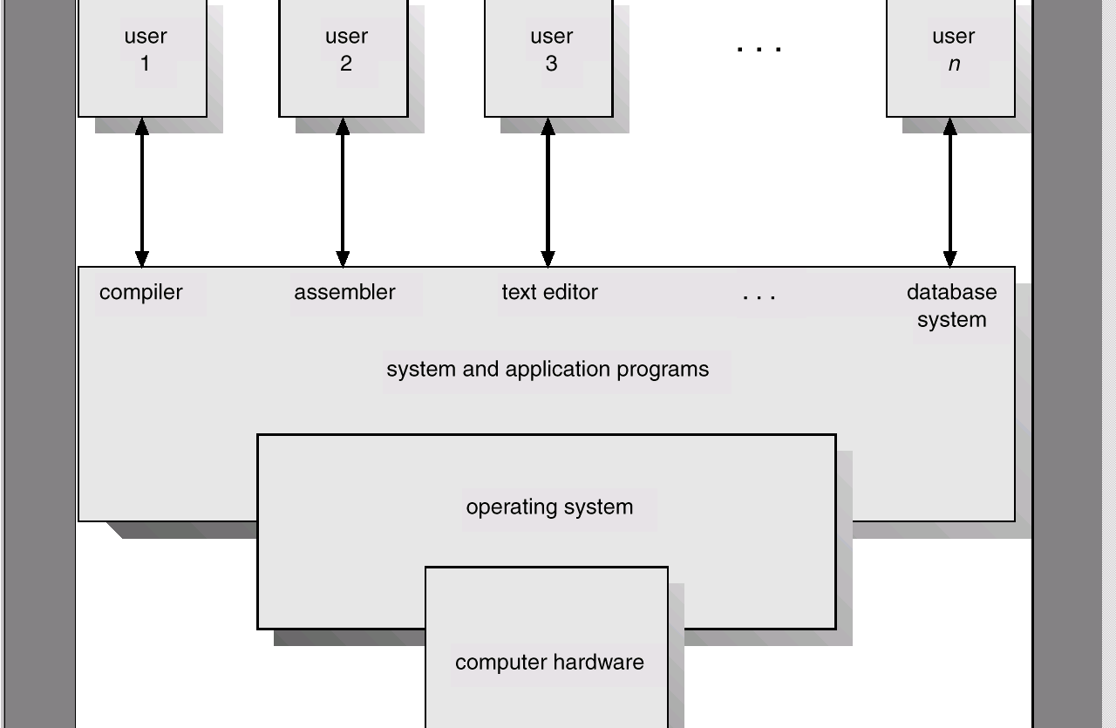
Abstract View of System Components

Slide 20
What is an Operating System?...
A program that acts as an intermediary between a user of a computer and the computer hardware.
Operating system goals:
Make the computer system convenient to use.
Use the computer hardware in an efficient manner.

Slide 21
Operating System Definitions…
Resource allocator – manages and allocates resources.
Resources: CPU time, Memory Space, file storage space, I/O devices and son on.
Control program – controls the execution of user programs and operations of I/O devices .
Kernel – the one program running at all times (all else being application programs).
The two goals, efficiency and convenience are sometimes contradictory
Much of OS theory is concentrates optimal use of resources.

Slide 22
Objectives
The main objective is to understand the operational part of any computer.
Understanding the general principles of OS design.
Focus on general-purpose, multi-user, uni-processor systems.
Emphasis on widely applicable concepts rather than any specific features of any specific OS.
Understanding problems, solutions and design choices.
Understanding the structure of specific OSs: UNIX, LINUX, WINDOWS XP

Slide 23
Course topics
Introduction (3 hours)
System Structures (3 hours)
Process management (9 hours)
Process concept, threading, process scheduling
Process coordination (9)
Synchronization and deadlocks
Memory management (6)
Storage management (6)
Protection and security (3)
Real time systems (1.5)
Multimedia systems(1.5)

Slide 24
References
Text books:
Silberschatz, A, Galvin, P, Gagne, G. Operating System Concepts, Addison-Wesley (8th or latest edition).
Other BOOKS:
William Stallings, Operating systems, Prentice-Hall, 1998.
Operating Systems, Gary Nutt, Pearson Education
Charles Crowley, Operating Systems: A design-oriented approach, Tata McGraw-Hill, 1997.
Operating Systems: Concepts and Design, Milan Milenkovic, TATA McGRAW-HILL
Tanenbaum, A., Modern Operating Systems, Prentice-Hall, second edition, 2000.

