Slide 1
Operating Systems: Introduction
Manish Shrivastava

Slide 2
Early systems (Serial processing)
1940-50:
The programmer interacted directly with the computer hardware.
Display light, switches, printer, card reader.
No OS.
Error is displayed through lights.
Problems:
Scheduling → Users spend lots of time at the computer.
Signup sheet was used.
Job Setup time
Loading and compiling
Mounting and Un-mounting of tapes
Setting up of card desks
Libraries of functions, linkers, loaders, debuggers, and I/O driver routines were available for all the users.

Slide 3
Early Systems…
Early computers were (physically) large machines run from a console.
The programmer would operate the program directly from the console.
The program is loaded to the memory from panel of switches, paper tape, and from punched cards.
As time went on, additional software and hardware were developed.
Card readers, line printers, and magnetic tape became common place.
Libraries, loaders, and common functions were created.
Software reusability.

Slide 4
Early Systems..
The setup time was a real problem
CPU is idle while tapes are being mounted or the programmer was operating the console.
In the early days, few computers were available and they were expensive (millions of dollars).
+operational costs: power, cooling, programmers.
Main question:
How to increase the utilization of CPU ?

Slide 5
Early Systems…
The solution was two fold.
First, a professional computer operator was hired.
Once the program was finished, he operator could start next job.
The operator sets up the job, produces the dump, and starts the next job.
The set up time was reduced due to operator’s experience.
Second, jobs with similar needs were batched together and run through the computer as a group.
For example, if there is a FORTRAN job, COBOL job, and FORTRAN job, two FORTRAN jobs were batched together.
However, during transition time CPU sat idle.
To overcome this idle time, people developed automatic job sequencing.
A first rudimentary OS was created
A small program called a resident monitor was developed.
The resident monitor always resided in memory.

Slide 6
Simple Batch Systems ( early 1960s)
In serial systems
Machines were very expensive
Wasting time was not acceptable.
To improve usage, the concept of batch OS was developed.
The main idea is the use of software known as monitor.
The user no longer has access to machine.
The user submits the job (tape) to the operator.
The operator batches the jobs together sequentially, places entire batch as an input device for use by the computer.

Slide 7
Features of Batch System
The batch OS is simply a program.
It relies on the ability of the processor to fetch instructions from various portions of main memory to seize and relinquish control.
Hardware features:
Memory protection: While the user program is running, it must not alter the memory area containing the monitor.
If such is the case the processor hardware should detect the error and transfer control to monitor. `
Timer: A timer is used to prevent the single job from monopolizing the system
Privileged instructions
Contains instructions that are only executed by monitor.
I/O instructions
If a program encounters them the control shifts through monitor..
Interrupts: It gives OS more flexibility.
Relinquishing control and regain control

Slide 8
Features of Batch System
With batch OS the machine time alters between execution of user programs and execution of monitor.
Two overheads
Machine time is consumed by the monitor.
Memory is consumed by the monitor.
Still, they improved the performance over serial systems.

Slide 9
Problems with Batch System
CPU is idle
Speed of mechanical devices is very slower than those of electronic devices.
CPU works in a microsecond range
Thousands of instructions/second
A card reader may read 1200 cards per minute (20 cards per second)
CPU speed has increased at a faster rate.
Tape technology improved the performance little-bit.
Main perceived problem
Turn-around time: upto two days
CPU often underutilized
Most of the time was spent reading and writing from tape.

Slide 10
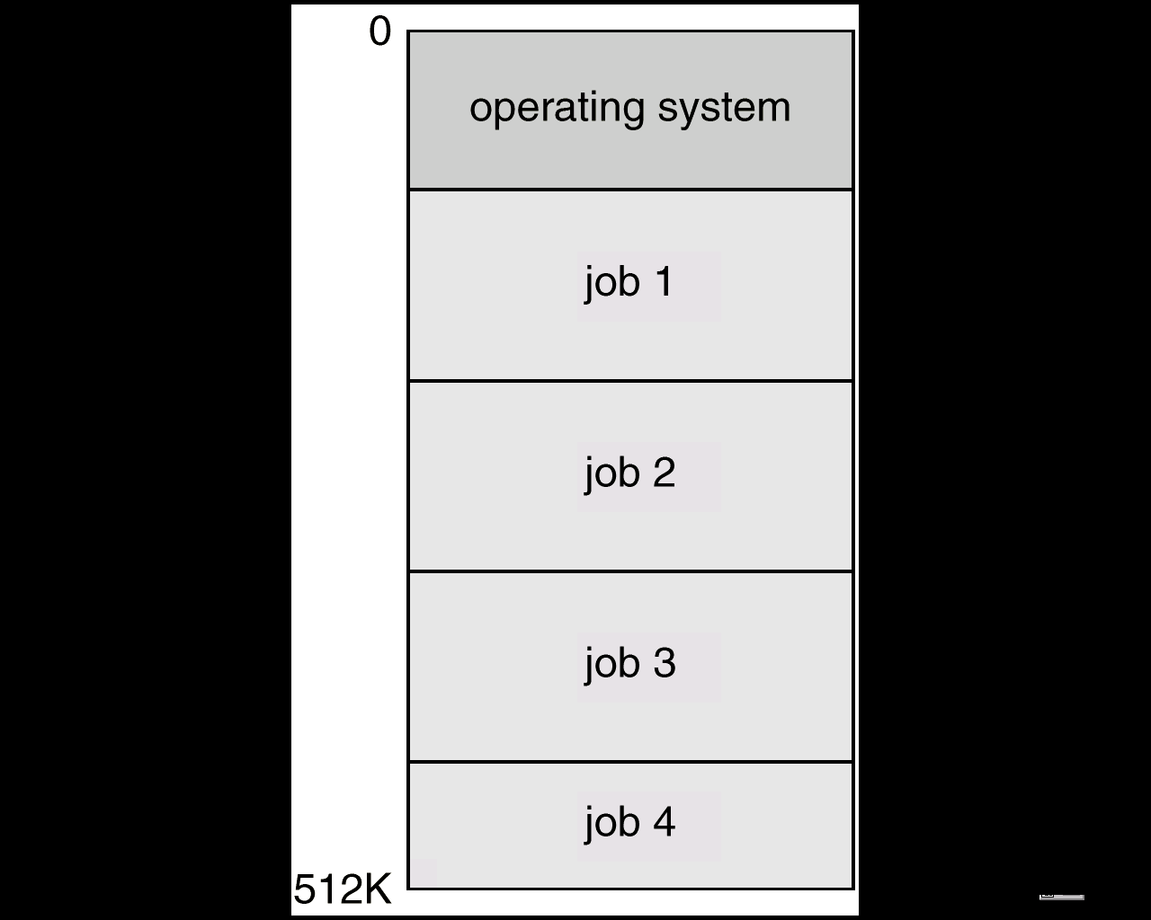
Multi-programmed Batched Systems (1960s) (or Multi tasking)
A single user can not keep either CPU or I/O busy.
Multiprogramming increases CPU utilization by organizing jobs such that the CPU always has one to execute.
The OS keeps several jobs in memory at a time and CPU is multiplexed among them

Slide 11
Multi-programmed Batch Systems
If CPU is executing a job and requires a tape to be mounted
In a non multi-programmed system
CPU sits idle.
In a Multi-programmed system
CPU takes up another job.
Multiprogramming is the first instance when the OS started taking decisions.
Job scheduling is done by OS.
Having several programs in the memory requires memory management.

Slide 12
OS requirements (1960s and late 1960s)
OS Research in 60s
MULTICS at MIT
Atlas (spooling, demand paging) at Manchester Univ.
OS research (late 1960s)
Multiprogramming
Memory allocation and protection
I/O operations were responsibility of OS.
Interactive systems
Scheduling issues
Swapping and virtual memory.
Users wanted permanent files
Hierarchical directory systems.
OSs in 1960s
Increased in size and complexity
Were not well understood
IBM: OS/360

Slide 13
UNIX (early 1970s)
Originally developed at Bell labs for the PDP-7
Ken Thomson
Dennis Ritchie
Smaller & Simpler
Process spawn and control
Each command creates a new process
Simple inter-process communication
Command interpreter not built in: runs as a user process
Files were streams of bytes.
Hierarchical file system
Advantages
Written in a high-level language
Distributed in source form
Powerful OS primitives on an inexpensive platform

Slide 14
Personal Computers (1980s)
Originally
Single user
Simplified OSs
No memory protection
MS-DOS
Now run sophisticated OSs
Windows NT, Linux
Windowing Systems (1980s)
Originally based on work at Xerox Parc
Popularized by the Macintosh
Characterized by
Graphical user interface
Mouse control

Slide 15
Networks of workstations ( 1990s)
High-speed network connections
Local & world-wide
Client-server systems
File systems
Remote windowing systems
Support a variety of node OSs
Unix, Windows XP, OS/2

Slide 16
Future
Distributed systems
Network is invisible
Micro-kernel and extensible OSs
Supports multiple OS flavors
E.g., Mach, Amoeba, WINDOWS XP
Embedded services and network computers
Computer runs a very thin OS (Java Virtual machine).

Slide 17
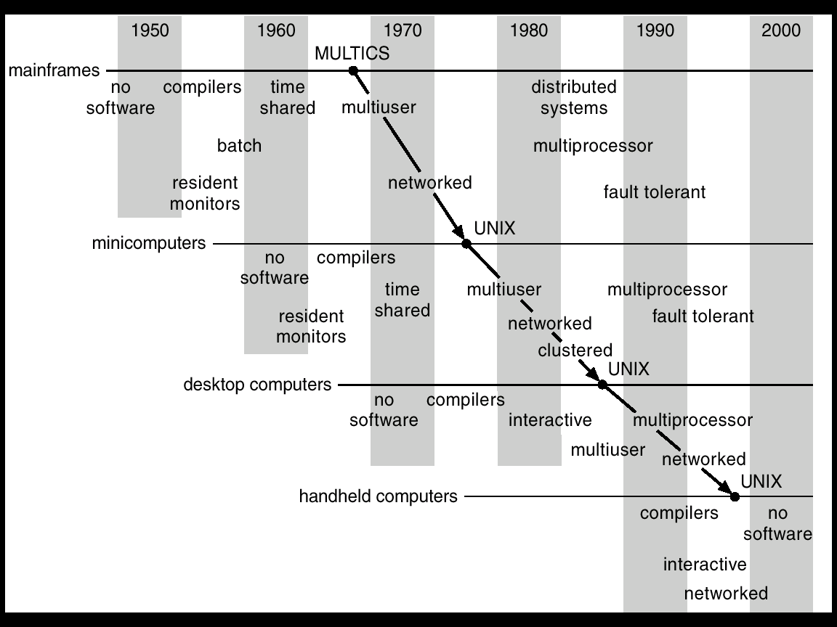
Migration of Operating-System Concepts and Features

Slide 18
Multiprocessor Systems
Multiprocessor systems with more than on CPU in close communication.
Tightly coupled system – processors share memory and a clock; communication usually takes place through the shared memory.
Advantages of multiprocessor system:
Increased throughput: more processors more work
Economical:
Increased reliability
graceful degradation: failure of one processor will not halt the system. Service is proportional to the level of surviving hardware.
Fault tolerant: Can suffer a failure of any single component and still continue operation.

Slide 19
Parallel Systems (Cont.)
Symmetric multiprocessing (SMP)
Each processor runs and identical copy of the operating system.
Many processes can run at once without performance deterioration.
Most modern operating systems support SMP
Asymmetric multiprocessing
Each processor is assigned a specific task; master processor schedules and allocated work to slave processors.
More common in extremely large systems

Slide 20
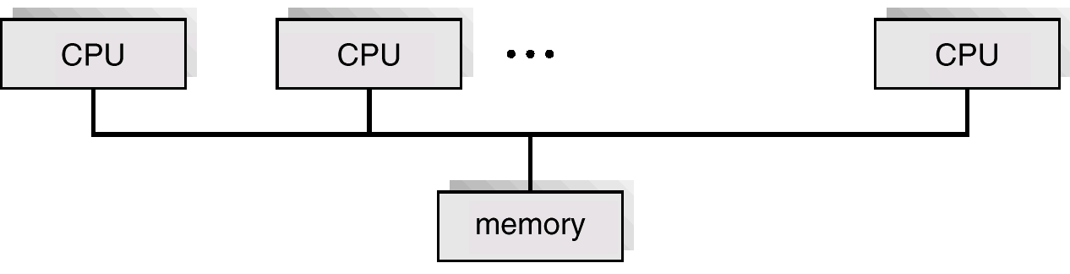
Symmetric Multiprocessing Architecture

Slide 21
Distributed Systems
Distribute the computation among several physical processors.
Loosely coupled system –
each processor has its own local memory;
processors communicate with one another through various communications lines
such as high-speed buses or telephone lines.
Advantages of distributed systems.
Resources Sharing
Ex: Laser printer
Computation speed up – load sharing
Reliability
Communications
Ex: E-mail

Slide 22
Real-Time Systems
Often used as a control device in a dedicated application such as controlling scientific experiments, medical imaging systems, industrial control systems, and some display systems.
Well-defined fixed-time constraints.
A process must complete within the defined constraints or system will fail.
Real-Time systems may be either hard or soft real-time.

Slide 23
Real-Time Systems (Cont.)
Hard real-time:
Guarantees that critical tasks complete within time.
All the delays in the system are bounded.
Secondary storage limited or absent, data stored in short term memory, or read-only memory (ROM)
Conflicts with time-sharing systems, not supported by general-purpose operating systems.
Soft real-time
Critical time tasks gets priority over other tasks, and retails that priority until it completes.
Limited utility in industrial control of robotics
Useful in applications (multimedia, virtual reality) requiring advanced operating-system features.

Slide 24
Concept of virtual computer
Multilevel implementation
also called layered
Resources
Hardware: provided to the OS
Logical ( virtual): created by the OS
Resource management
transformation
multiplexing
time and space

Slide 25
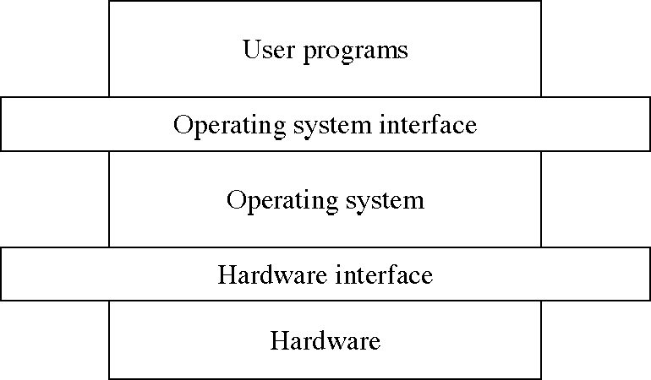
Levels in a computer system

Slide 26
Design: Two-level implementation
Two-level implementation
Lower level is a problem-specific language
Upper level solves the problem at hand
Lower level is reusable
In operating systems
mechanism: lower level of basic functions, does not change
policy: upper level policy decisions, easy to change and experiment

Slide 27
Operating system functions
Resource manager
manage hardware and software resources
Virtual machine manager
implement a virtual machine for processes to run in
a nicer environment than the bare hardware

Slide 28
Hardware resources
Processor: execute instructions
Memory: store programs and data
Input/output (I/O)controllers: transfer to and from devices
Disk devices: long-term storage
Other devices: conversion between internal and external data representations

Slide 29
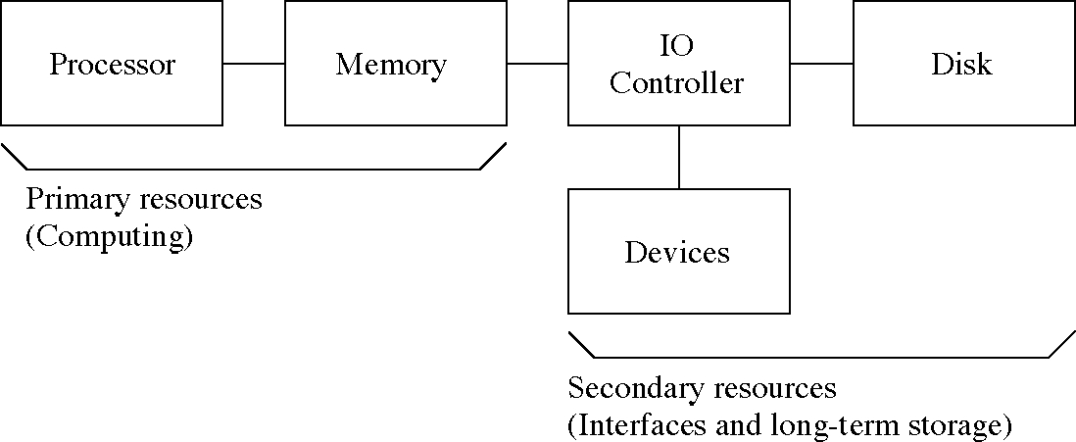
Hardware resources

Slide 30
Resource management functions
Transforming physical resources to logical resources
Making the resources easier to use
Multiplexing one physical resource to several logical resources
Creating multiple, logical copies of resources
Scheduling physical and logical resources
Deciding who gets to use the resources

Slide 31
Types of multiplexing
Time multiplexing
time-sharing
scheduling a serially-reusable resource among several users
Space multiplexing
space-sharing
dividing a multiple-use resource up among several users

Slide 32
Virtual computers
Processor virtualized to processes
mainly time-multiplexing
Memory virtualized to address spaces
space and time multiplexing
Disks virtualized to files
space-multiplexing
transforming

Slide 33
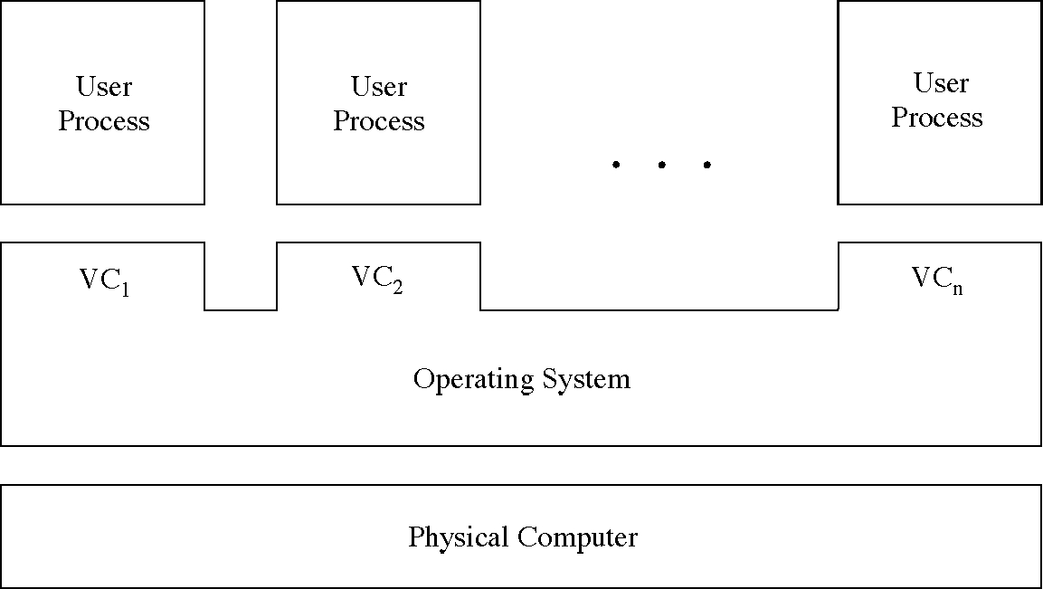
Multiple virtual computers

Slide 34
Do we need an OS?
Not always
Some programs run “stand-alone”
But they are very useful
Reusable functions
Easier to use than the bare hardware

