Slide 1
Interrupts, I/O and Storage
Manish Shrivastava

Slide 2
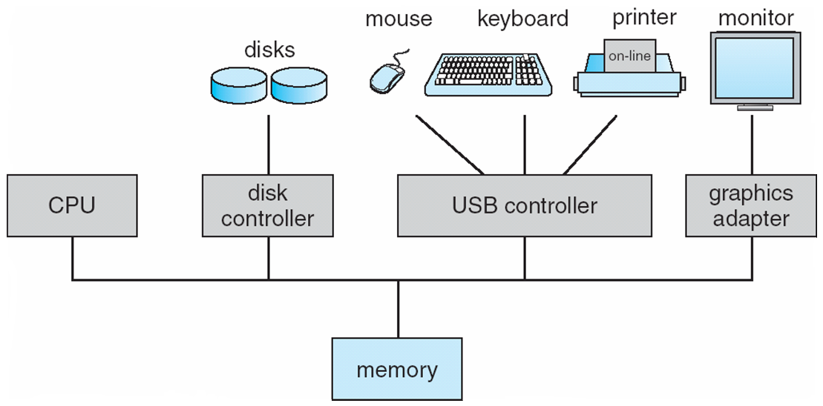
Computer System Organization
Computer-system operation
One or more CPUs, device controllers connect through common bus providing access to shared memory
Concurrent execution of CPUs and devices competing for memory cycles

Slide 3
Computer-Components
Computer consists of processor, memory, and I/O components, with one or more modules of each type. These modules are connected through interconnection network.
I/O devices and the CPU can execute concurrently.
Each device controller is in-charge of a particular device type.
Each device controller has a local buffer.
CPU moves data from/to main memory to/from local buffers
I/O is from the device to local buffer of controller.
Device controller informs CPU that it has finished its operation by causing an interrupt.

Slide 4
I/O Hardware
I/O devices can be roughly categorized as storage, communications, user-interface, and other
Devices communicate with the computer via signals sent over wires or through the air.
Devices connect with the computer via ports, e.g. a serial or parallel port.
A common set of wires connecting multiple devices is termed a bus.
Buses include rigid protocols for the types of messages that can be sent across the bus and the procedures for resolving contention issues.
Bus types commonly found in a modern PC:
The PCI bus connects high-speed high-bandwidth devices to the memory subsystem ( and the CPU. )
The expansion bus connects slower low-bandwidth devices, which typically deliver data one character at a time ( with buffering. )
The SCSI bus connects a number of SCSI devices to a common SCSI controller.
A daisy-chain bus, ( not shown) is when a string of devices is connected to each other like beads on a chain, and only one of the devices is directly connected to the host.

Slide 5
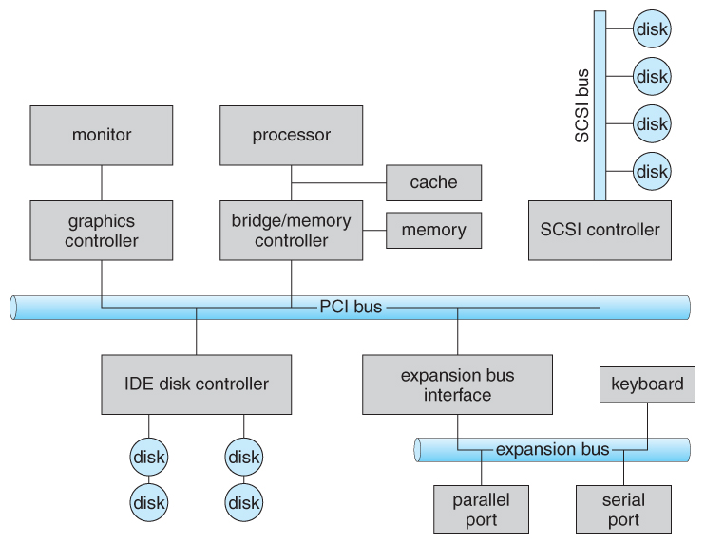
PC Bus Structure

Slide 6
Registers
One way of communicating with devices is through registers associated with each port. Registers may be one to four bytes in size, and may typically include ( a subset of ) the following four:
The data-in register is read by the host to get input from the device.
The data-out register is written by the host to send output.
The status register has bits read by the host to ascertain the status of the device, such as idle, ready for input, busy, error, transaction complete, etc.
The control register has bits written by the host to issue commands or to change settings of the device such as parity checking, word length, or full- versus half-duplex operation.

Slide 7
Memory mapped I/O
Another technique for communicating with devices is memory-mapped I/O.
In this case a certain portion of the processor's address space is mapped to the device, and communications occur by reading and writing directly to/from those memory areas.
Memory-mapped I/O is suitable for devices which must move large quantities of data quickly, such as graphics cards.
Memory-mapped I/O can be used either instead of or more often in combination with traditional registers. For example, graphics cards still use registers for control information such as setting the video mode.
A potential problem exists with memory-mapped I/O, if a process is allowed to write directly to the address space used by a memory-mapped I/O device.

Slide 8
Polling
One simple means of device handshaking involves polling:
The host repeatedly checks the busy bit on the device until it becomes clear.
The host writes a byte of data into the data-out register, and sets the write bit in the command register ( in either order. )
The host sets the command ready bit in the command register to notify the device of the pending command.
When the device controller sees the command-ready bit set, it first sets the busy bit.
Then the device controller reads the command register, sees the write bit set, reads the byte of data from the data-out register, and outputs the byte of data.
The device controller then clears the error bit in the status register, the command-ready bit, and finally clears the busy bit, signaling the completion of the operation.
Polling can be very fast and efficient, if both the device and the controller are fast and if there is significant data to transfer. It becomes inefficient, however, if the host must wait a long time in the busy loop waiting for the device, or if frequent checks need to be made for data that is infrequently there.

Slide 9
Architecture of a simple computer
Processor: Controls the operation of the computer and performs data processing functions. It is called CPU.
Main memory: Stores data and programs; it is volatile
I/O modules: Moves data between the computer and external environment.
System bus: mechanism of communication among processors, main memory, and I/O modules.

Slide 10
Simple Computer
Operation: Processor controls everything.
MAR: Memory address register: which specifies the address in memory for the next read or write.
MBR: Memory buffer register: which contains the data to be written into memory or which receives data read from memory.
I/O AR: Address of I/O device
I/O BR: Exchange of data between I/O and computer.

Slide 11
Simple Computer
Processor Registers: Within the processor there is a set of registers that provide a level of memory that is faster and smaller than main memory.
User visible registers: Available to programmer
Data registers: Can be used by the programmer.
Address Registers: Contains Main memory address of data and instructions.
Index register: Index to base value
Segment pointer: It contains a reference to a particular segment.
Stack pointer: Points top of the stack.
Control and status registers: These are employed to control the operation of the processor. Differ from machine to machine.
MAR, MBR,I/O AR, and I/O BR
Program Counter: Contains the address of the instruction to be fetched.
Instruction Register: Contains the instruction most recently fetched.
PSW: Program Status word: It is a register or a set of registers.

Slide 12
Simple Computer…
PSW: Program Status word: It is a register or a set of registers.
Sign: contains sign bit of last arithmetic operation
Zero: it is set if the result of arithmetic operation is zero
Carry: It is set if there is a carry or borrow.
Equal: If the compare result is equality
Overflow: It is set if the result is overflow.
Interrupt enable/disable: Used to disable or enable interrupts.
Supervisor: Indicates whether the processor is executing in supervisor or user mode.
Instruction execution:
Program execution is the main function of the computer.
Instruction fetch and execute
Start
Fetch the next instruction
Execute the next instruction
Halt

Slide 13
Simple computer…
Fetching: Bringing the instructions from the main memory.
PC: Contains the address of the next instruction to be fetched.
Incremented unless told otherwise
Execute:
The processor interprets the instructions and performs the required action.
Processor-memory: Transfer data from the memory
Processor-I/O- transfer data from peripheral device from the memory.
Data processing: Arithmetic and logic operations
Control: The instructions may specify the sequence of the next instruction to be fetched.

Slide 14
Interrupt processing
To improve the performance, interrupts are provided.
With interrupts, the processor can be engaged in executing other while an I/O operation is in progress.
Interrupt cycle is added to the instruction cycle.
Start
Fetch cycle
Fetch the next instruction
Execute cycle
Interrupts
Disabled
Execute the next instruction
Halt
Interrupts enables
Check for interrupt
Process Interrupt.
Interrupt cycle

Slide 15
Common Functions of Interrupts
Interrupt transfers control to the interrupt service routine generally, through the interrupt vector, which contains the addresses of all the service routines.
Interrupt architecture must save the address of the interrupted instruction.
Incoming interrupts are disabled while another interrupt is being processed to prevent a lost interrupt.
A trap is a software-generated interrupt caused either by an error or a user request.
An operating system is interrupt driven.

Slide 16
Interrupt Handling
To start I/O operation, CPU loads the appropriate registers within the device controller
The device controller examines the contents of these registers to determine what action to take.
If it s a read operation the controller transfers the data into local buffer.
Then it informs the CPU through interrupt.
The operating system preserves the state of the CPU by storing registers and the program counter.

Slide 17
Interrupt Handling…
Interrupt handler: The CPU hardware has a wire called interrupt request line; that CPU senses after executing every instruction.
When a CPU senses a signal, it saves the PC, and PSW on a stack and jump to the interrupt handler routine at a fixed address in memory.
Interrupt vector: It contains the memory addresses of specialized interrupt handlers.

Slide 18
Interrupts
Interrupts allow devices to notify the CPU when they have data to transfer or when an operation is complete, allowing the CPU to perform other duties when no I/O transfers need its immediate attention.
The CPU has an interrupt-request line that is sensed after every instruction.
A device's controller raises an interrupt by asserting a signal on the interrupt request line.
The CPU then performs a state save, and transfers control to the interrupt handler routine at a fixed address in memory. ( The CPU catches the interrupt and dispatches the interrupt handler. )
The interrupt handler determines the cause of the interrupt, performs the necessary processing, performs a state restore, and executes a return from interrupt instruction to return control to the CPU. ( The interrupt handler clears the interrupt by servicing the device. )
( Note that the state restored does not need to be the same state as the one that was saved when the interrupt went off. See below for an example involving time-slicing. )

Slide 19
I/O Structure
Two types of I/O
Synchronous I/O: After I/O starts, control returns to user program only upon I/O completion.
Wait instruction idles the CPU until the next interrupt
Wait loop (contention for memory access).
At most one I/O request is outstanding at a time, no simultaneous I/O processing.
Asynchronous I/O: After I/O starts, control returns to user program without waiting for I/O completion.
Device-status table contains entry for each I/O device indicating its type, address, and state.
Operating system indexes into I/O device table to determine device status and to modify table entry to include interrupt.

Slide 20
I/O Structure
Waiting for I/O operation
Loop: Jump Loop
The above loop continues until interrupt occurs.

Slide 21
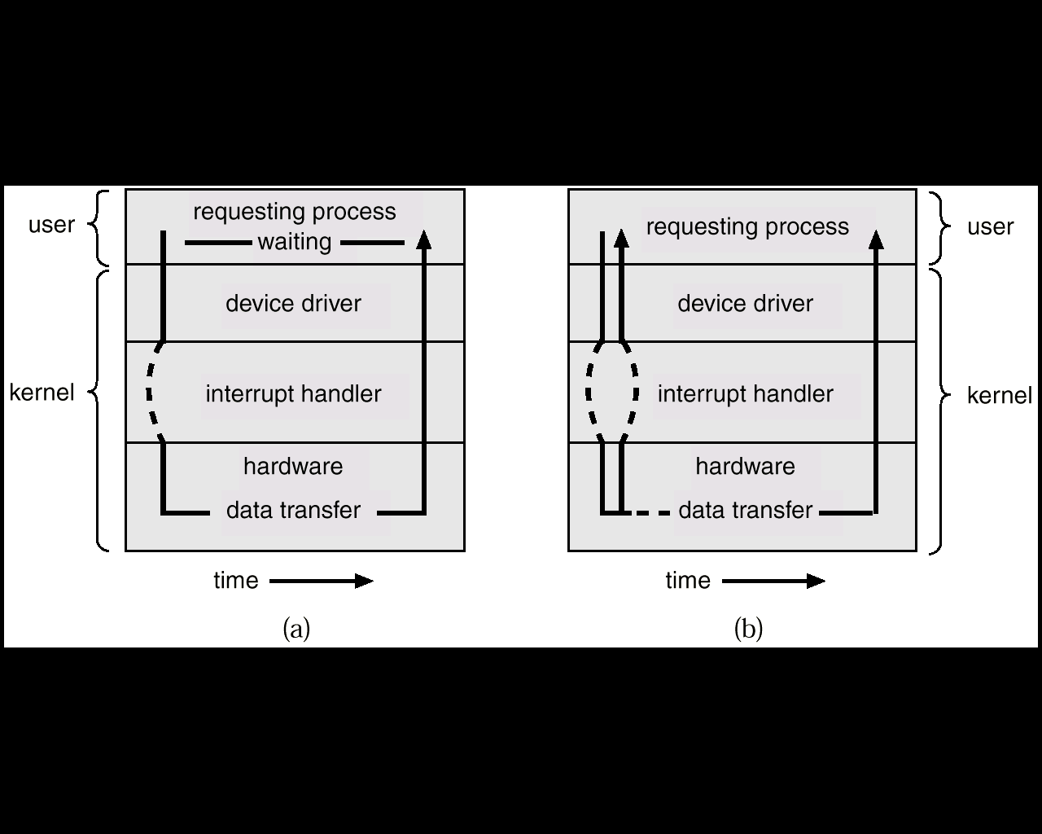
Two I/O Methods
Synchronous
Asynchronous

Slide 22
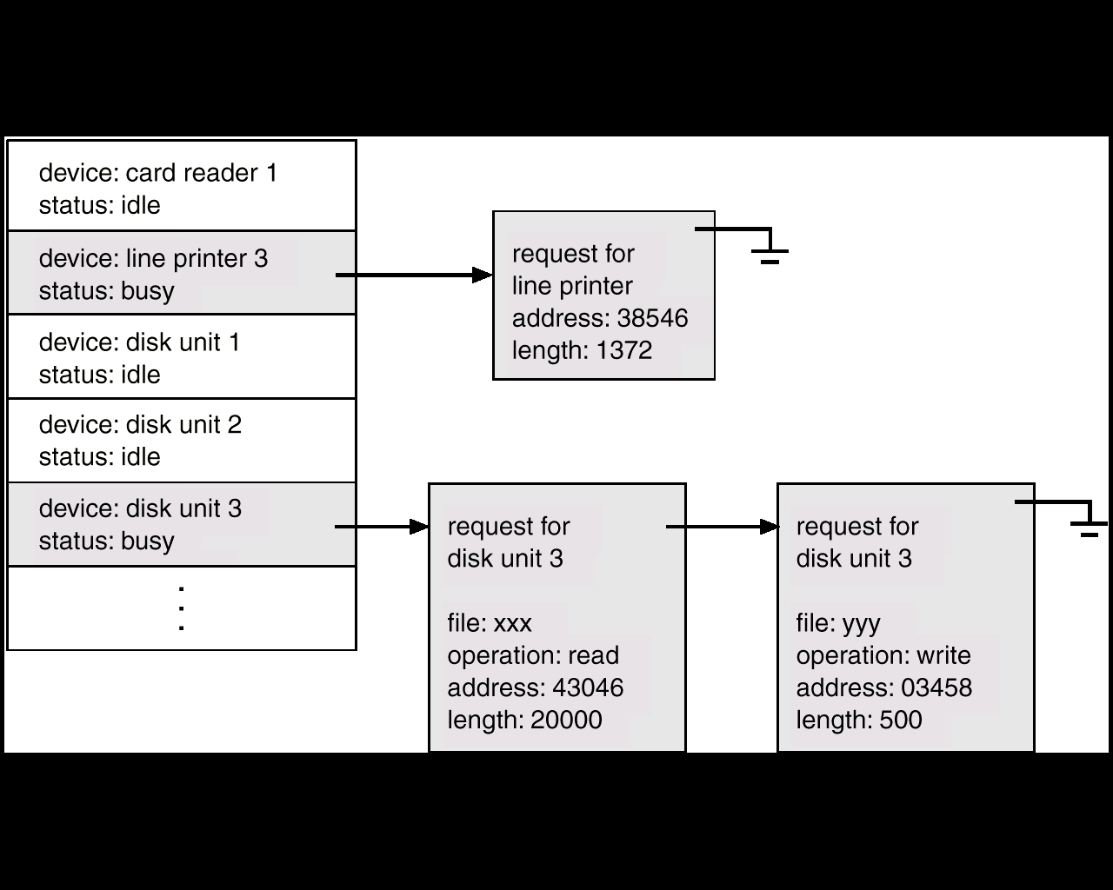
Device-Status Table

Slide 23
I/O communication techniques
Three kinds of data transfer
Program data transfer: CPU checks the I/O status
The I/O module does not interrupt the processor.
Processor is responsible for extracting the data from main memory and shifting data out of main memory.
It is a time-consuming process that keeps the processor busy unnecessarily.
Interrupt driven data transfer: when I/O is ready it interrupts the CPU
In programmed I/O the processor repeatedly interrogate the status of the I/O module.
In Interrupt driven data transfer, the I/O module will interrupt the processor to request service when it is ready to exchange data with the processor.

Slide 24
Modern Computer
The above description is adequate for simple interrupt-driven I/O, but there are three needs in modern computing which complicate the picture:
The need to defer interrupt handling during critical processing,
The need to determine which interrupt handler to invoke, without having to poll all devices to see which one needs attention, and
The need for multi-level interrupts, so the system can differentiate between high- and low-priority interrupts for proper response.

Slide 25
Interrupt Controller
These issues are handled in modern computer architectures with interrupt-controller hardware.
Most CPUs now have two interrupt-request lines: One that is non-maskable for critical error conditions and one that is maskable, that the CPU can temporarily ignore during critical processing.
The interrupt mechanism accepts an address, which is usually one of a small set of numbers for an offset into a table called the interrupt vector. This table ( usually located at physical address zero ? ) holds the addresses of routines prepared to process specific interrupts.
The number of possible interrupt handlers still exceeds the range of defined interrupt numbers, so multiple handlers can be interrupt chained. Effectively the addresses held in the interrupt vectors are the head pointers for linked-lists of interrupt handlers.
Modern interrupt hardware also supports interrupt priority levels, allowing systems to mask off only lower-priority interrupts while servicing a high-priority interrupt, or conversely to allow a high-priority signal to interrupt the processing of a low-priority one.

Slide 26
Interrupt Controller
At boot time the system determines which devices are present, and loads the appropriate handler addresses into the interrupt table.
During operation, devices signal errors or the completion of commands via interrupts.
Exceptions, such as dividing by zero, invalid memory accesses, or attempts to access kernel mode instructions can be signaled via interrupts.
Time slicing and context switches can also be implemented using the interrupt mechanism.
The scheduler sets a hardware timer before transferring control over to a user process.
When the timer raises the interrupt request line, the CPU performs a state-save, and transfers control over to the proper interrupt handler, which in turn runs the scheduler.
The scheduler does a state-restore of a different process before resetting the timer and issuing the return-from-interrupt instruction.

Slide 27
Some Interrupts
A similar example involves the paging system for virtual memory –
A page fault causes an interrupt, which in turn issues an I/O request and a context switch as described above, moving the interrupted process into the wait queue and selecting a different process to run. When the I/O request has completed then the device interrupts, and the interrupt handler moves the process from the wait queue into the ready queue.
System calls are implemented via software interrupts, a.k.a. traps. When a ( library ) program needs work performed in kernel mode, it sets command information and possibly data addresses in certain registers, and then raises a software interrupt. The completion of a disk read operation involves two interrupts:
A high-priority interrupt acknowledges the device completion, and issues the next disk request so that the hardware does not sit idle.
A lower-priority interrupt transfers the data from the kernel memory space to the user space, and then transfers the process from the waiting queue to the ready queue.
Some OSs (Solaris OS) use a multi-threaded kernel and priority threads to assign different threads to different interrupt handlers. This allows for the "simultaneous" handling of multiple interrupts, and the assurance that high-priority interrupts will take precedence over low-priority ones and over user processes.

Slide 28
Direct Memory Access
For devices that transfer large quantities of data ( such as disk controllers ), it is wasteful to tie up the CPU transferring data in and out of registers one byte at a time.
Instead this work can be off-loaded to a special processor, known as the Direct Memory Access, DMA, Controller.
The host issues a command to the DMA controller, indicating the location where the data is located, the location where the data is to be transferred to, and the number of bytes of data to transfer. The DMA controller handles the data transfer, and then interrupts the CPU when the transfer is complete.
A simple DMA controller is a standard component in modern PCs, and many bus-mastering I/O cards contain their own DMA hardware.
Handshaking between DMA controllers and their devices is accomplished through two wires called the DMA-request and DMA-acknowledge wires.
While the DMA transfer is going on the CPU does not have access to the PCI bus ( including main memory ), but it does have access to its internal registers and primary and secondary caches.
DMA can be done in terms of either physical addresses or virtual addresses that are mapped to physical addresses. The latter approach is known as Direct Virtual Memory Access, DVMA, and allows direct data transfer from one memory-mapped device to another without using the main memory chips.
Direct DMA access by user processes can speed up operations, but is generally forbidden by modern systems for security and protection reasons.

Slide 29
Storage Structure
Main memory – only large storage media that the CPU can access directly
Random access
Typically volatile
Secondary storage – extension of main memory that provides large nonvolatile storage capacity
Magnetic disks – rigid metal or glass platters covered with magnetic recording material
Disk surface is logically divided into tracks, which are subdivided into sectors
The disk controller determines the logical interaction between the device and the computer

Slide 30
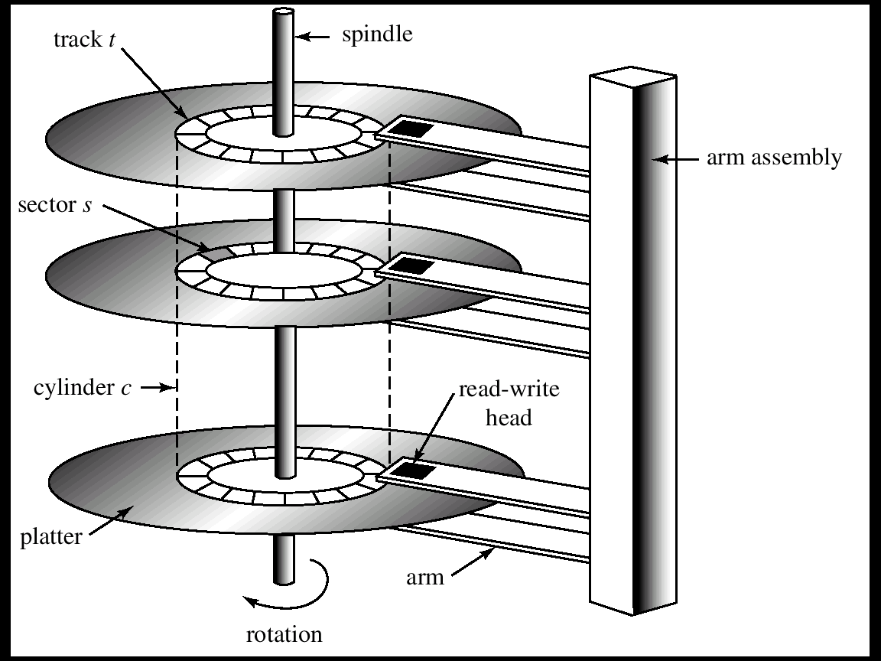
Moving-Head Disk Mechanism

Slide 31
Storage Hierarchy
Storage systems organized in hierarchy
Speed
Cost
Volatility
Caching – copying information into faster storage system; main memory can be viewed as a cache for secondary storage

Slide 32
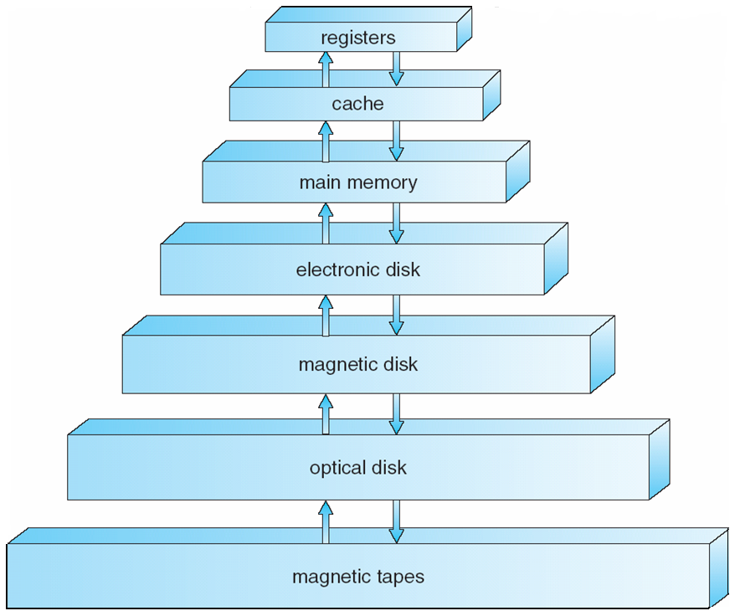
Storage-Device Hierarchy

Slide 33
Caching
Important principle, performed at many levels in a computer (in hardware, operating system, software)
Information in use copied from slower to faster storage temporarily
Faster storage (cache) checked first to determine if information is there
If it is, information used directly from the cache (fast)
If not, data copied to cache and used there
Cache smaller than storage being cached
Cache management important design problem
Cache size and replacement policy

Slide 34
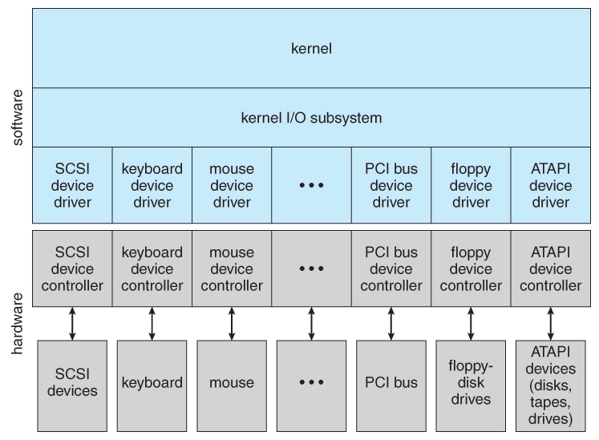
Application I/O Interface

Slide 35
Application I/O Interface
Block and Character Devices
Block : HDD Filesystems etc
Character : Any guesses ??
Network Devices
Socket Interfaces
Clocks and Timers
PIT: Programmable interrupt Timer
Results in system time
Drift

Slide 36
Types of I/O
Blocking or non-blocking I/O
With blocking I/O a process is moved to the wait queue when an I/O request is made, and moved back to the ready queue when the request completes
With non-blocking I/O the I/O request returns immediately, whether the requested I/O operation has ( completely ) occurred or not
Asynchronous I/O, in which the I/O request returns immediately allowing the process to continue on with other tasks, and then the process is notified when data becomes available

Slide 37
Kernel I/O handelling
I/O Scheduling
Buffering
Caching
Spooling and Device Reservation
SPOOL : Simultaneous Peripheral Operations On-Line
Error Handling
I/O Protection

Slide 38
I/O request and hardware
Users request data using file names, which must ultimately be mapped to specific blocks of data from a specific device managed by a specific device driver.
DOS uses the colon separator to specify a particular device ( e.g. C:, LPT:, etc. )
UNIX uses a mount table to map filename prefixes ( e.g. /usr ) to specific mounted devices. Where multiple entries in the mount table match different prefixes of the filename the one that matches the longest prefix is chosen. ( e.g. /usr/home instead of /usr where both exist in the mount table and both match the desired file. )
UNIX uses special device files, usually located in /dev, to represent and access physical devices directly.
Each device file has a major and minor number associated with it, stored and displayed where the file size would normally go.
The major number is an index into a table of device drivers, and indicates which device driver handles this device. ( E.g. the disk drive handler. )
The minor number is a parameter passed to the device driver, and indicates which specific device is to be accessed, out of the many which may be handled by a particular device driver. ( e.g. a particular disk drive or partition. )
A series of lookup tables and mappings makes the access of different devices flexible, and somewhat transparent to users.

Slide 39
Unix Streams
The streams mechanism in UNIX provides a bi-directional pipeline between a user process and a device driver, onto which additional modules can be added.
The user process interacts with the stream head.
The device driver interacts with the device end.
Zero or more stream modules can be pushed onto the stream, using ioctl( ). These modules may filter and/or modify the data as it passes through the stream.
Each module has a read queue and a write queue.
Flow control can be optionally supported, in which case each module will buffer data until the adjacent module is ready to receive it
Streams I/O is asynchronous ( non-blocking ), except for the interface between the user process and the stream head.
The device driver must respond to interrupts from its device - If the adjacent module is not prepared to accept data and the device driver's buffers are all full, then data is typically dropped.
Streams are widely used in UNIX, and are the preferred approach for device drivers.

Slide 40
QUESTIONS?

