Slide 1
System Structures
Manish Shrivastava

Slide 2
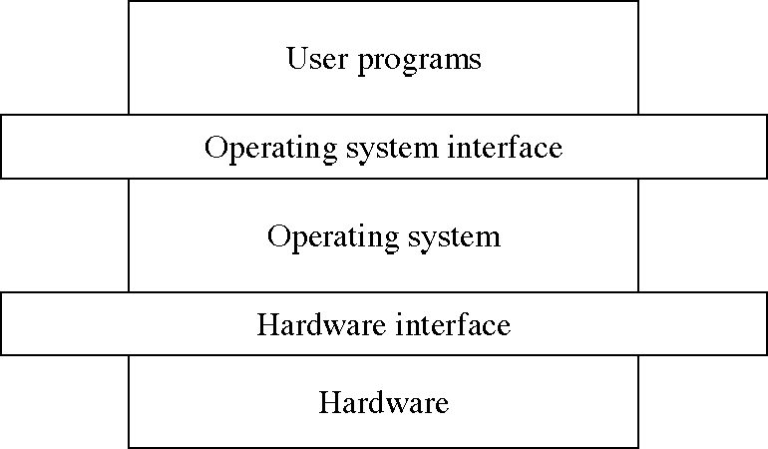
The OS Level Structure
(Current chapter)
(To be studied)

Slide 3
OS Services Structure
OS Services
User Functions: (G/C)UI, Program execution, I/O, FS manipulation
Process Communication, Error Detection, Resource allocation accounting, protection and security
User level Services
GUI/CLI

Slide 4
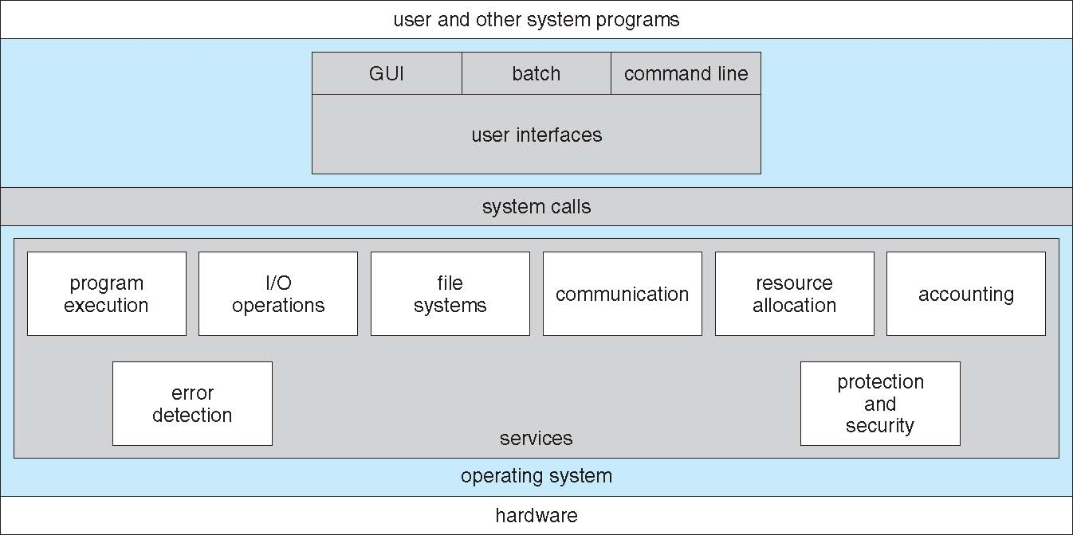
A View of Operating System Services

Slide 5
System Calls
Programming interface to the services provided by the OS
Typically written in a high-level language (C or C++)
Mostly accessed by programs via a high-level Application Program Interface (API) rather than direct system call use
Three most common APIs are Win32 API for Windows, POSIX API for POSIX-based systems (including virtually all versions of UNIX, Linux, and Mac OS X), and Java API for the Java virtual machine (JVM)
Notes:
5

Slide 6
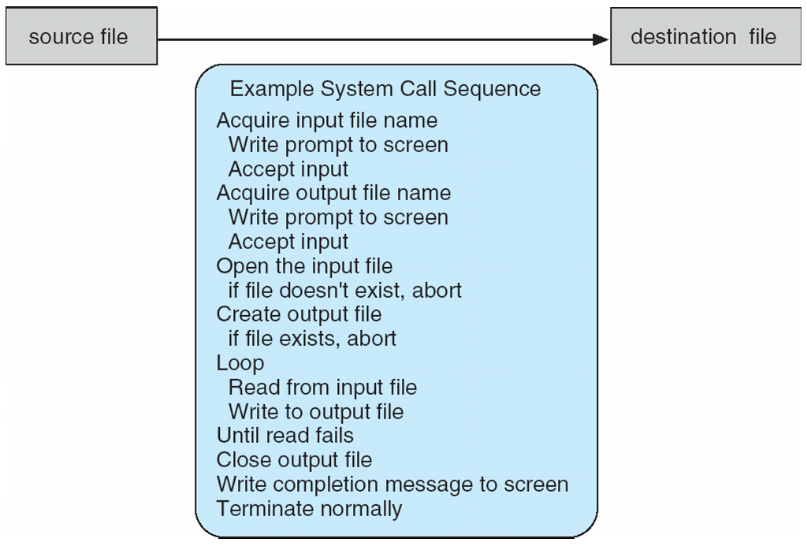
Example of System Calls
System call sequence to copy the contents of one file to another file
Notes:
6

Slide 7
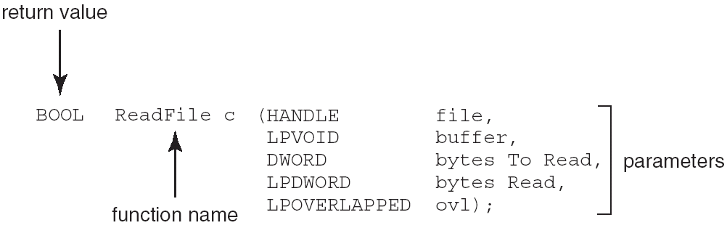
Example of Standard API
Consider the ReadFile() function in the
Win32 API—a function for reading from a file
A description of the parameters passed to ReadFile()
HANDLE file—the file to be read
LPVOID buffer—a buffer where the data will be read into and written from
DWORD bytesToRead—the number of bytes to be read into the buffer
LPDWORD bytesRead—the number of bytes read during the last read
LPOVERLAPPED ovl—indicates if overlapped I/O is being used
Notes:
7

Slide 8
System Call Implementation
Typically, a number associated with each system call
System-call interface maintains a table indexed according to these numbers
The system call interface invokes intended system call in OS kernel and returns status of the system call and any return values
The caller need know nothing about how the system call is implemented
Just needs to obey API and understand what OS will do as a result call
Most details of OS interface hidden from programmer by API
Managed by run-time support library (set of functions built into libraries included with compiler)
Notes:
8

Slide 9
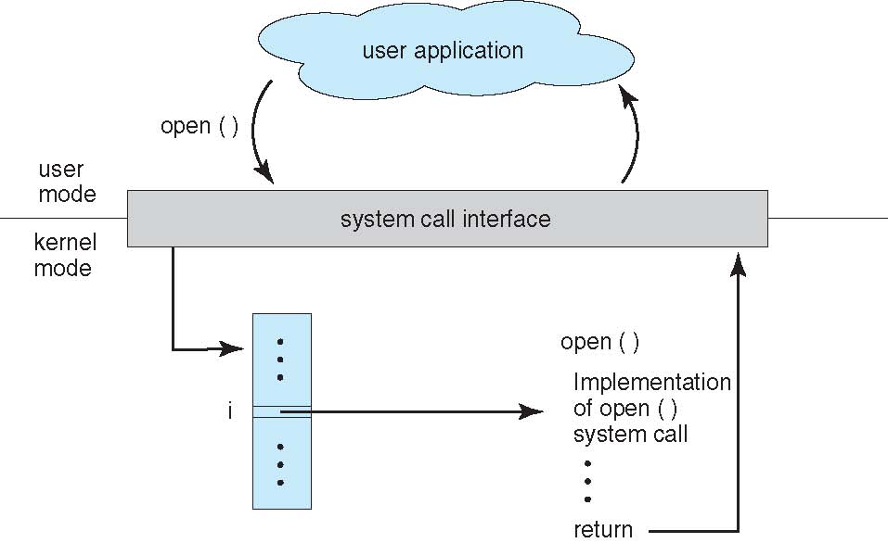
API – System Call – OS Relationship
Notes:
9

Slide 10
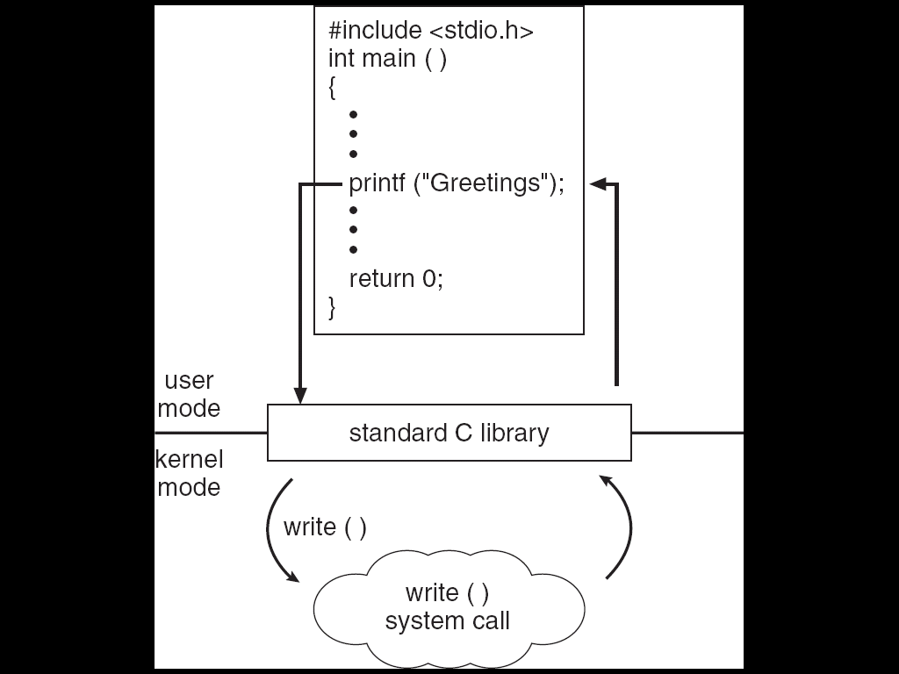
Standard C Library Example
C program invoking printf() library call, which calls write() system call
Notes:
10

Slide 11
System Call Parameter Passing
Often, more information is required than simply identity of desired system call
Exact type and amount of information vary according to OS and call
Three general methods used to pass parameters to the OS
Simplest: pass the parameters in registers
In some cases, may be more parameters than registers
Parameters stored in a block, or table, in memory, and address of block passed as a parameter in a register
This approach taken by Linux and Solaris
Parameters placed, or pushed, onto the stack by the program and popped off the stack by the operating system
Block and stack methods do not limit the number or length of parameters being passed
Notes:
11

Slide 12
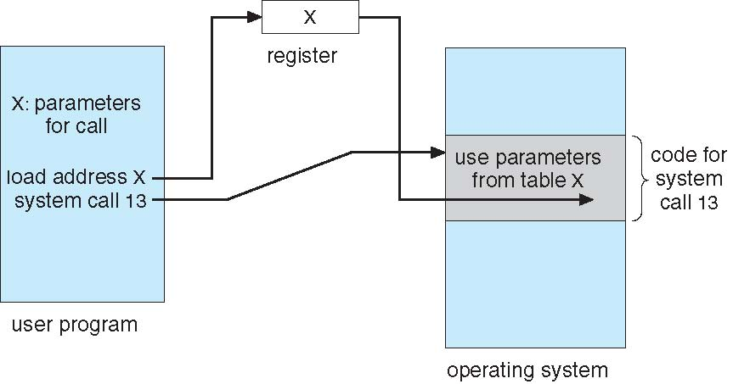
Parameter Passing via Table
Notes:
12

Slide 13
Types of System Calls
Process control
end, abort
load, execute
create process, terminate process
get process attributes, set process attributes
wait for time
wait event, signal event
allocate and free memory
File management
create file, delete file
open, close file
read, write, reposition
get and set file attributes
Notes:
13

Slide 14
Types of System Calls (Cont.)
Device management
request device, release device
read, write, reposition
get device attributes, set device attributes
logically attach or detach devices
Information maintenance
get time or date, set time or date
get system data, set system data
get and set process, file, or device attributes
Communications
create, delete communication connection
send, receive messages
transfer status information
attach and detach remote devices
Notes:
14

Slide 15
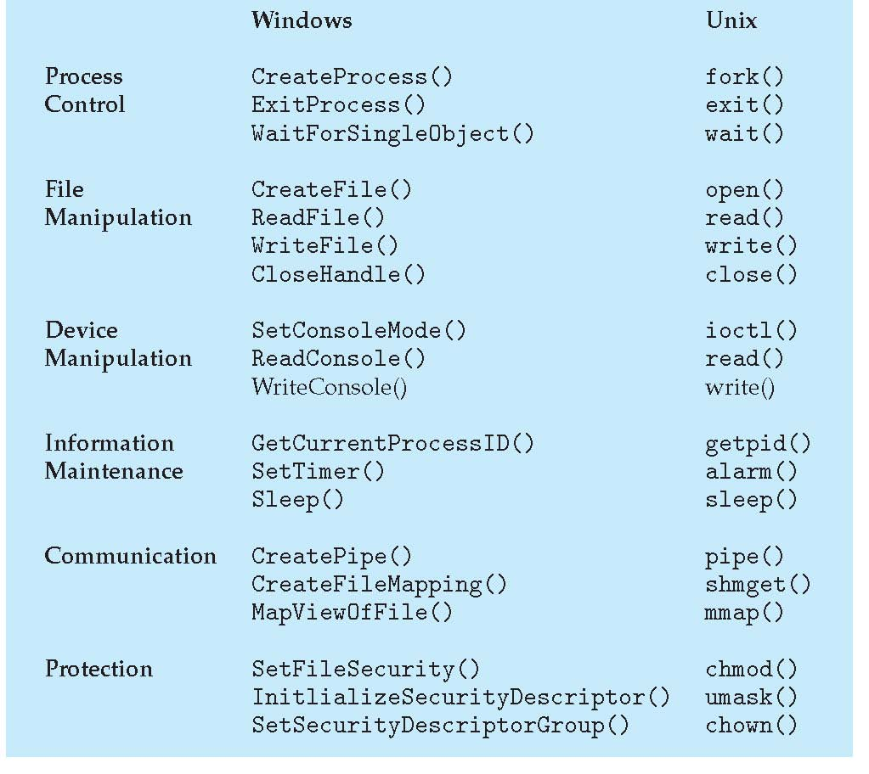
Examples of Windows and Unix System Calls

Slide 16
About System calls
The system calls are the instruction set of the OS virtual processor.

Slide 17
Types of System Calls: Process Control Example: MS-DOS
Single-tasking
Shell invoked when system booted
Simple method to run program
No process created
Single memory space
Loads program into memory, overwriting all but the kernel
Program exit -> shell reloaded

Slide 18
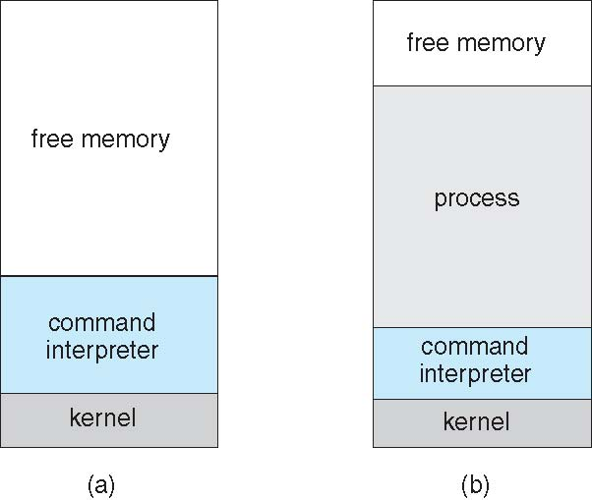
MS-DOS execution
(a) At system startup (b) running a program
Notes:
18

Slide 19
Process Control Example: FreeBSD
Unix variant
Multitasking
User login -> invoke user’s choice of shell
Shell executes fork() system call to create process
Executes exec() to load program into process
Shell waits for process to terminate or continues with user commands
Process exits with code of 0 – no error or > 0 – error code

Slide 20
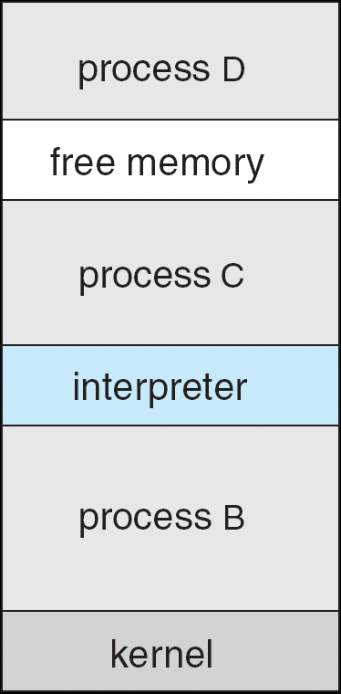
FreeBSD Running Multiple Programs
Notes:
20

Slide 21
Linux system calls
Operating systems offer processes running in User Mode a set of interfaces to interact with hardware devices such as
the CPU
disks
and
printers.
Unix systems implement most interfaces between User Mode processes and hardware devices by means of system calls issued to the kernel.

Slide 22
POSIX APIs vs. System Calls
An application programmer interface is a function definition that specifies how to obtain a given service.
A system call is an explicit request to the kernel made via a software interrupt.

Slide 23
From a Wrapper Routine to a System Call
Unix systems include several libraries of functions that provide APIs to programmers.
Some of the APIs defined by the libc standard C library refer to wrapper routines (routines whose only purpose is to issue a system call).
Usually, each system call has a corresponding wrapper routine, which defines the API that application programs should employ.

Slide 24
APIs and System Calls
An API does not necessarily correspond to a specific system call.
First of all, the API could offer its services directly in User Mode. (For something abstract such as math functions, there may be no reason to make system calls.)
Second, a single API function could make several system calls.
Moreover, several API functions could make the same system call, but wrap extra functionality around it.

Slide 25
Example of Different APIs Issuing the Same System Call
In Linux, the malloc( ) , calloc( ) , and free( ) APIs are implemented in the libc library.
The code in this library keeps track of the allocation and deallocation requests and uses the brk( ) system call to enlarge or shrink the process heap.

Slide 26
The Return Value of a Wrapper Routine
Most wrapper routines return an integer value, whose meaning depends on the corresponding system call.
A return value of -1 usually indicates that the kernel was unable to satisfy the process request.
A failure in the system call handler may be caused by
invalid parameters
a lack of available resources
hardware problems, and so on.
The specific error code is contained in the errno variable, which is defined in the libc library.

Slide 27
Execution Flow of a System Call
When a User Mode process invokes a system call, the CPU switches to Kernel Mode and starts the execution of a kernel function.
As we will see in the next section, in the 80x86 architecture a Linux system call can be invoked in two different ways.
The net result of both methods, however, is a jump to an assembly language function called the system call handler.

Slide 28
System Call Number
Because the kernel implements many different system calls, the User Mode process must pass a parameter called the system call number to identify the required system call.
The eax register is used by Linux for this purpose.
As we'll see in the section "Parameter Passing" later in this chapter, additional parameters are usually passed when invoking a system call.

Slide 29
The Return Value of a System Call
All system calls return an integer value.
The conventions for these return values are different from those for wrapper routines.
In the kernel
positive or 0 values denote a successful termination of the system call
negative values denote an error condition
In the latter case, the value is the negation of the error code that must be returned to the application program in the errno variable.
The errno variable is not set or used by the kernel. Instead, the wrapper routines handle the task of setting this variable after a return from a system call.

Slide 30
Operations Performed by a System Call
The system call handler, which has a structure similar to that of the other exception handlers, performs the following operations:
Saves the contents of most registers in the Kernel Mode stack.
This operation is common to all system calls and is coded in assembly language.
Handles the system call by invoking a corresponding C function called the system call service routine.
Exits from the handler:
the registers are loaded with the values saved in the Kernel Mode stack
the CPU is switched back from Kernel Mode to User Mode.
This operation is common to all system calls and is coded in assembly language.

Slide 31
Naming Rules of System Call Service Routines
The name of the service routine associated with the xyz( ) system call is usually sys_xyz( ); there are, however, a few exceptions to this rule.

Slide 32
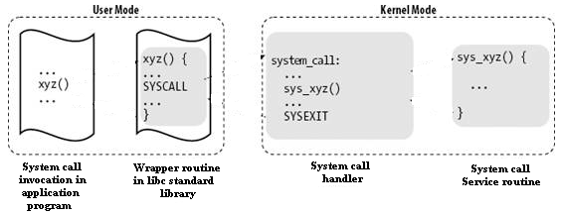
Control Flow Diagram of a System Call
The arrows denote the execution flow between the functions.
The terms "SYSCALL" and "SYSEXIT" are placeholders for the actual assembly language instructions that switch the CPU, respectively, from User Mode to Kernel Mode and from Kernel Mode to User Mode.

Slide 33
Examples : File Creation
/* creat.c */
#include <stdio.h>
#include <sys/types.h> /* defines types used by sys/stat.h */
#include <sys/stat.h> /* defines S_IREAD & S_IWRITE */
int main() {
int fd;
fd = creat("datafile.dat", S_IREAD | S_IWRITE);
if (fd == -1)
printf("Error in opening datafile.dat\n");
else {
printf("datafile.dat opened for read/write access\n");
printf("datafile.dat is currently empty\n");
}
close(fd);
exit (0);
}

Slide 34
Stat.h
#define S_IRWXU 0000700 /* -rwx------ */
#define S_IREAD 0000400 /* read permission, owner */
#define S_IRUSR S_IREAD
#define S_IWRITE 0000200 /* write permission, owner */
#define S_IWUSR S_IWRITE
#define S_IEXEC 0000100 /* execute/search permission, owner */
#define S_IXUSR S_IEXEC
#define S_IRWXG 0000070 /* ----rwx--- */
#define S_IRGRP 0000040 /* read permission, group */
#define S_IWGRP 0000020 /* write " " */
#define S_IXGRP 0000010 /* execute/search " " */
#define S_IRWXO 0000007 /* -------rwx */
#define S_IROTH 0000004 /* read permission, other */
#define S_IWOTH 0000002 /* write " " */
#define S_IXOTH 0000001 /* execute/search " " */

Slide 35
File Open
/* open.c */
#include <fcntl.h> /* defines options flags */
#include <sys/types.h> /* defines types used by sys/stat.h */
#include <sys/stat.h> /* defines S_IREAD & S_IWRITE */
static char message[] = "Hello, world";
int main() {
int fd; char buffer[80];
fd = open("datafile.dat",O_RDWR | O_CREAT | O_EXCL, S_IREAD | S_IWRITE);
if (fd != -1) {
printf("datafile.dat opened for read/write access\n");
write(fd, message, sizeof(message));
lseek(fd, 0L, 0); /* go back to the beginning of the file */
if (read(fd, buffer, sizeof(message)) == sizeof(message))
printf("\"%s\" was written to datafile.dat\n", buffer);
else
printf("*** error reading datafile.dat ***\n");
close (fd);
} else printf("*** datafile.dat already exists ***\n");
exit (0);
}

