Slide 1
System Structures and Virtual Machines
Manish Shrivastava

Slide 2
Simple Structure
MS-DOS – written to provide the most functionality in the least space
Not divided into modules
Although MS-DOS has some structure, its interfaces and levels of functionality are not well separated
Notes:
2

Slide 3
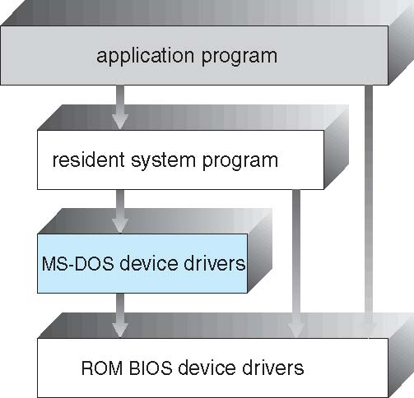
MS-DOS Layer Structure
Notes:
3

Slide 4
UNIX
UNIX – limited by hardware functionality, the original UNIX operating system had limited structuring. The UNIX OS consists of two separable parts
Systems programs
The kernel
Consists of everything below the system-call interface and above the physical hardware
Provides the file system, CPU scheduling, memory management, and other operating-system functions; a large number of functions for one level
Notes:
4

Slide 5
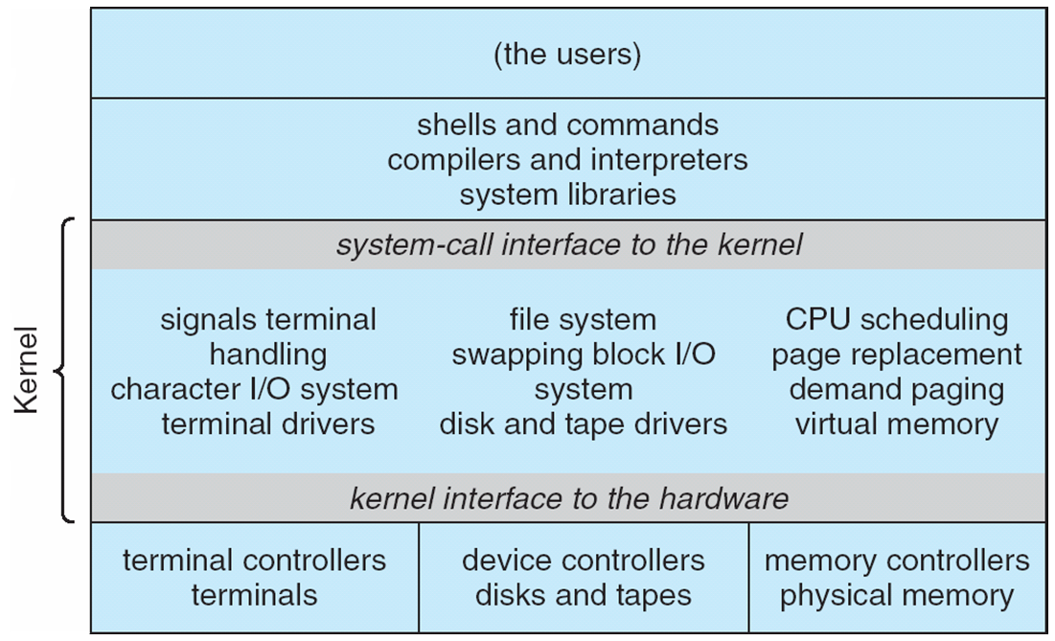
Traditional UNIX System Structure
Notes:
5

Slide 6
Structure view: Structure of OS designs
Traditionally adhoc and unstructured approaches.
Structured designs
Layered approach is followed to realize modularity
Encapsulate the modules separately
Have a hierarchy of layers where each layer calls procedures from the layers below.
The VENUS OS (Liskov)
Layer 0 : Hardware
Layer 1: Instruction interpreter
Layer 2: CPU scheduler
Layer 3: I/O channel
Layer 4: Virtual memory
Layer 5: device drivers and schedulers
Layer 6: user program layer
The THE OS (Dijkstra)
Layer 0 : Hardware
Layer 1: CPU scheduler
Layer 2: Memory manager
Layer 3: Operator-console device driver
Layer 4: I/O buffering
Layer 5: user program layer

Slide 7
Structure view: layered system design
A general philosophy that builds on the above approach
Decompose functionality into layers such that
Hardware is level 0, and layer t accesses functionality at layer (t-1) or less
Access via appropriately defined system calls.
Advantages
Modular design: well defined interfaces between layers
Prototyping/development
Association between function and layer eases overall OS design.
OS development and debugging is layer by layer.
Simplifies debugging and system verification
New
operations
Layer M
Hidden
operations
Layer
M-1
Existing
operations

Slide 8
Layered Approach
The operating system is divided into a number of layers (levels), each built on top of lower layers. The bottom layer (layer 0), is the hardware; the highest (layer N) is the user interface.
With modularity, layers are selected such that each uses functions (operations) and services of only lower-level layers
Notes:
8

Slide 9
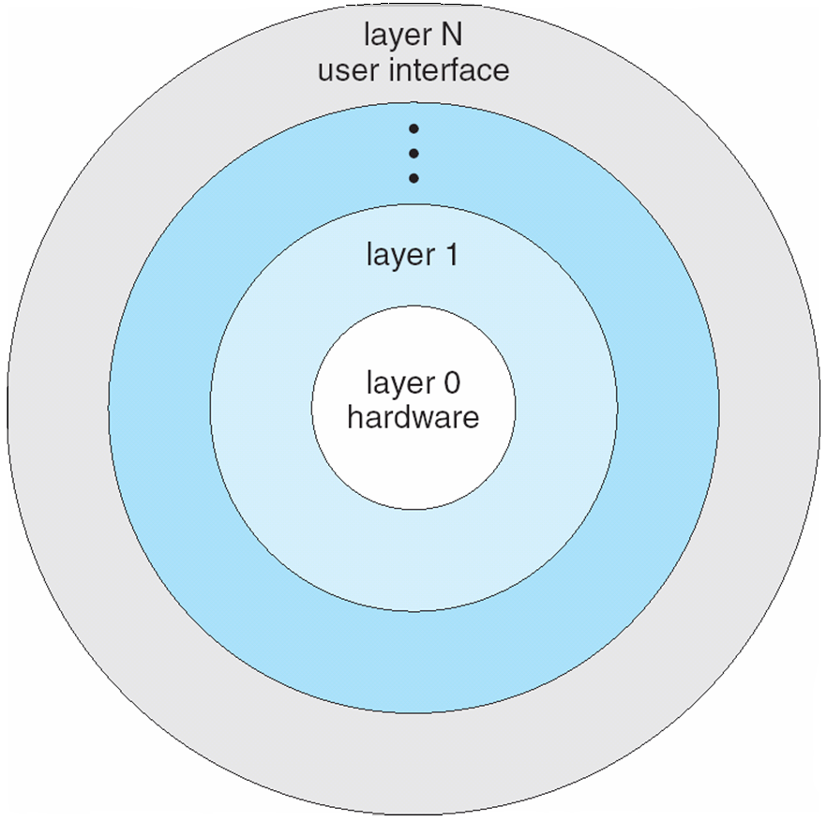
Layered Operating System
Notes:
9

Slide 10
OS design hierarchy: hypothetical model
Level | Name | Objects | Example operations
15 | Shell | User programming environment | Statements in shell language
14 | Directories (maintains association between external and internal identifiers of system resources and objects) | Directories | Create, destroy, search, list, access rights
13 | User Processes | User process | Fork, quit, kill, suspend, resume
12 | Stream I/O | streams | open., close
11 | Devices (access to external devices) | Printers, displays, and key boards | Create, destroy, open, close, read, write
10 | File system (long storage of named files) | files | Create, destroy, open, close
9 | Communications | pipes | Create, destroy, open, close, read, write
8 | Capabilities | Capabilities | Create, Validate, Attenuate
7 | Virtual memory (creating logical address space for programs) | Segments, pages | Read, write, fetch
6 | Local secondary storage (position of read/write heads) | Blocks of data, device channels | Read, write, allocate, free
5 | Primitive processes | Primitive process, semaphores, synchronization premitives | Suspend, resume, wait, signal
4 | Interrupts | Interrupts handling programs | Invoke, mask, unmask, retry
3 | Procedures | Procedures, call stack | Mark stack, call, return
2 | Instruction set | Evaluation, stack, micro-program, interpreter | Load, store, add, subtract, branch
1 | Electronic circuits | Registers, gates, busses | Clear, transfer, activate, complement

Slide 11
Design hierarchy: hypothetical model
Part of hardware
Layer 1: Operations are actions on logic gates
Layer 2: Operations are machine language instructions
Layer 3: Call and return operations of procedures
Layer 4: Interrupts Operations
Part of Core Operation system
Layer 5: Operations to support multiple processes include ability to suspend and revoke process. Synchronization
Layer 6: Operations on secondary storage devices (basic read, write and free blocks of data). Uses operations of layer 5.
Layer 7: Create logical address space (virtual memory): Organizes virtual memory into blocks.
Layer 8: Capabilities:
External to OSs
Layer 9: Deals with communication of information and messages between processes. Deals with richer sharing of information. Notion of “pipe” is provided which is defined as with its output from one process and its input into another process.

Slide 12
Design hierarchy: hypothetical model
External to OSs
Layer 10: Supports long term storage of named files. Data on secondary storage are viewed in terms of abstract, variable length entities. (Different from layer 6 which views storage as tracks, sectors, and fixed size blocks)
Layer 11: Provides access to external devices using standard interfaces
Layer 12: Stream I/O.
Layer 13: Operations on Directories: Maintains the association between the external and internal identifiers of the system’s resources and objects. External identifier is used by user. Internal identifier is used by lower levels of operating system to locate and control the object.
Layer 14: Provides full feature facility to support processes. Virtual address space, list of objects processes may interact other characteristics of processes the OS wants to use.
Layer 15: Provides Shell: which accepts user commands or job control statements, interprets these and starts processes as needed.

Slide 13
Microkernel System Structure
Moves as much from the kernel into “user” space
Communication takes place between user modules using message passing
Benefits:
Easier to extend a microkernel
Easier to port the operating system to new architectures
More reliable (less code is running in kernel mode)
More secure
Detriments:
Performance overhead of user space to kernel space communication through message passing.
Notes:
13

Slide 14
Modules
Most modern operating systems implement kernel modules
Uses object-oriented approach
Each core component is separate
Each talks to the others over known interfaces
Each is loadable as needed within the kernel
Overall, similar to layers but with more flexible
Notes:
14

Slide 15
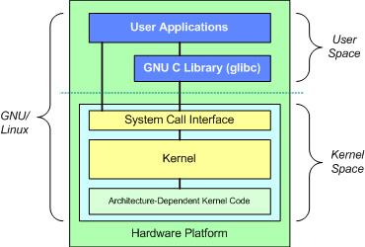
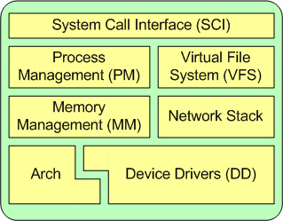
Linux

Slide 16
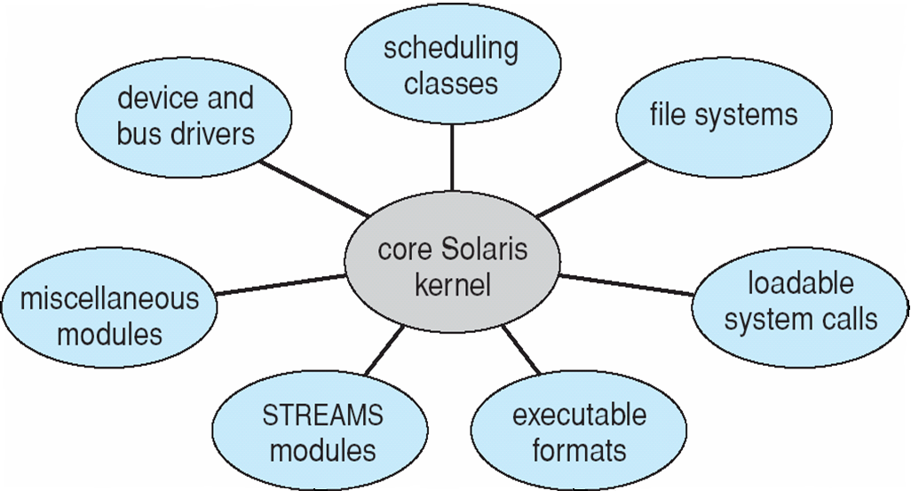
Solaris Modular Approach
Primary module is a core module and communicates with
other modules.
Modules need not invoke message passing for communication
Support different file systems with loadable modules.
Notes:
16

Slide 17
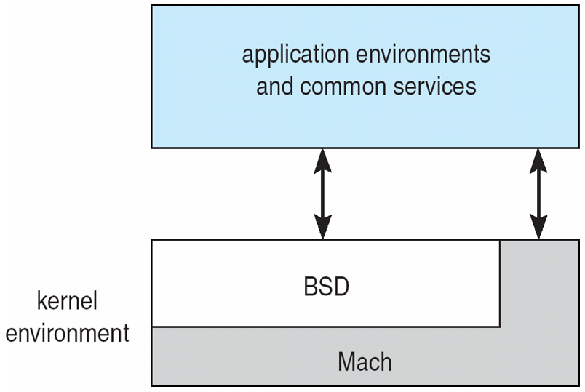
Mac OS X Structure: Hybrid Structure
Notes:
17

Slide 18
Structure view: Virtual machines
System programs above kernel can use either system calls or hardware instructions.
System programs treat the hardware and the system calls as though they both are at the same level.
In general application programs may view everything under them in the hierarchy as a part of machine itself, which leads to the concept of virtual machines..
The virtual machine approach provides an interface that is identical to the underlying bare hardware.
Each process is provided with a (virtual) copy of the underlying computer.
The resources of the physical computer are shared to create the virtual machines.
CPU scheduling and spooling are used.

Slide 19
Structure view: Virtual machines
Logical conclusion of layered approach.
The OS offers an abstract machine to execute on
Hides the specifics and details of hardware
Users are given their own VM, they can run any of the OS or software packages that are available on the underlying machine.
Provides a complete copy of underlying machine to the user
Pioneered under the name virtual machine (VM) by IBM
Became a household name with JAVA
Mechanism of creating this illusion
CPU scheduling
Sharing the CPU in a transparent way
Memory management
Having large virtual memory space to address
Additional features such as file systems and so on are offered through file management subsystems
Problem is with partitioning the disk
VM introduced minidisks such partitioning of tracks on the physical disk.

Slide 20
Virtual Machines
A virtual machine takes the layered approach to its logical conclusion. It treats hardware and the operating system kernel as though they were all hardware.
A virtual machine provides an interface identical to the underlying bare hardware.
The operating system host creates the illusion that a process has its own processor and (virtual memory).
Each guest provided with a (virtual) copy of underlying computer.
Notes:
20

Slide 21
Virtual Machines History and Benefits
First appeared commercially in IBM mainframes in 1972
Fundamentally, multiple execution environments (different operating systems) can share the same hardware
Protect from each other
Some sharing of file can be permitted, controlled
Commutate with each other, other physical systems via networking
Useful for development, testing
Consolidation of many low-resource use systems onto fewer busier systems
“Open Virtual Machine Format”, standard format of virtual machines, allows a VM to run within many different virtual machine (host) platforms
Notes:
21

Slide 22
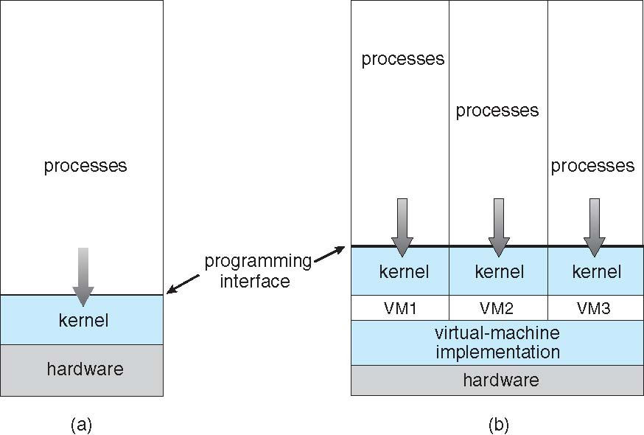
Virtual Machines (Cont.)
(a) Nonvirtual machine (b) virtual machine
Notes:
22

Slide 23
Para-virtualization
Presents guest with system similar but not identical to hardware
Guest must be modified to run on paravirtualized hardware
Guest can be an OS, or in the case of Solaris 10 applications running in containers

Slide 24
Virtualization Implementation
Difficult to implement – must provide an exact duplicate of underlying machine
Typically runs in user mode, creates virtual user mode and virtual kernel mode
Timing can be an issue – slower than real machine
Hardware support needed
More support-> better virtualization
i.e. AMD provides “host” and “guest” modes

Slide 25
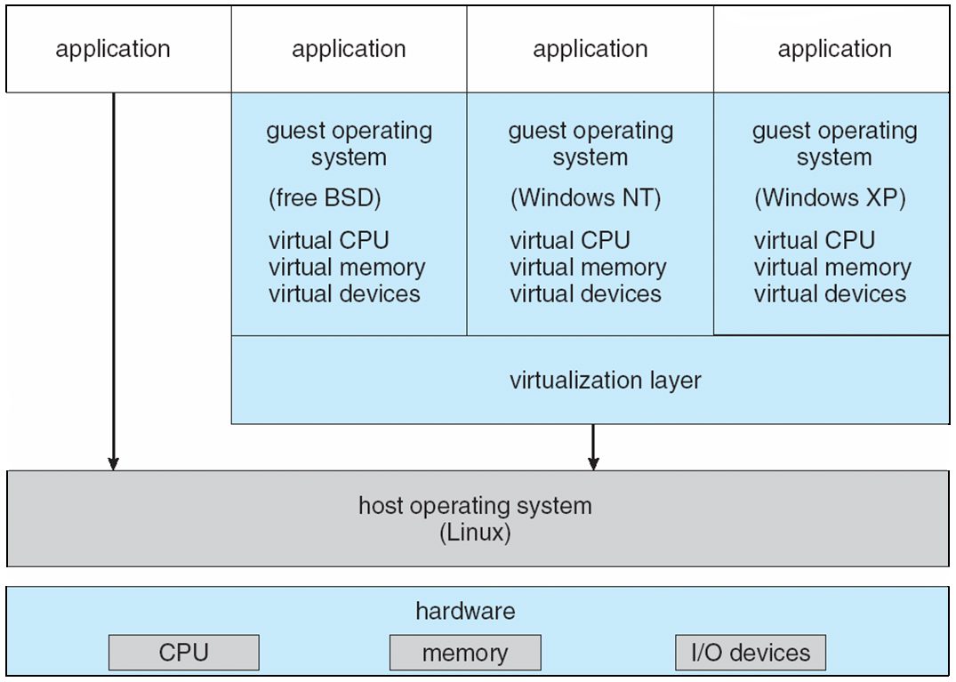
VMware Architecture
Notes:
25

Slide 26
Structure view: Virtual machines (cont..)
Operation
User-level code executes as is
Supervisor code executes at user level
Privileged instructions are simulated.
Generate trap to VM emulator
Hidden registers and I/O instructions are simulated.
Virtual machine software has two modes
User mode and monitor mode
The user program will execute in two modes
Virtual user mode
Virtual monitor mode

Slide 27
Structure view: Virtual machines (cont..)
Advantages
A software created abstraction that is a replica of the underlying machine
Additional functionality can be provided
Can run different OSs on different VMs.
Each VM is completely isolated from others, so secure.
Protection of various system resources.
It can be used for OS research and development.
System programs are given their own virtual machine.
Thousands of programs are available for MSDOS on Intel CPU-based systems.
SUN micro-systems and DEC use faster machines
To test MSDOS programs on the faster machines, the best way is to provide a virtual Intel machine.
System compatibility problems can be solved
Disadvantages
Performance degradation is inevitable

Slide 28
JAVA
JAVA is designed by SUN Micro systems.
JAVA compiler generates byte code output.
These instructions run on Java virtual machine.
JVM runs on many types of computer.
JVM is implemented in web browsers.
JVM implements a stack based instruction set.

Slide 29
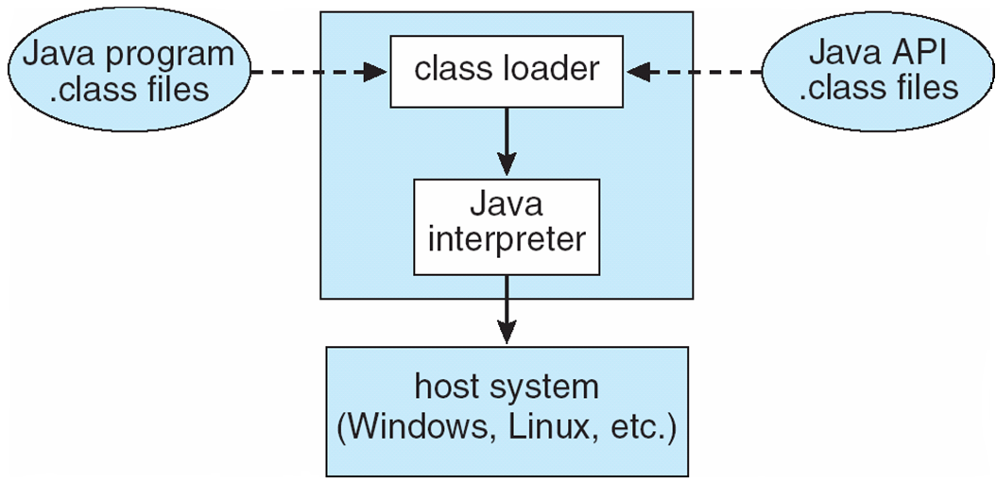
The Java Virtual Machine
Notes:
29

Slide 30
Types of multiplexing
Time multiplexing
time-sharing
scheduling a serially-reusable resource among several users
Space multiplexing
space-sharing
dividing a multiple-use resource up among several users

Slide 31
Virtual computers
Processor virtualized to processes
mainly time-multiplexing
Memory virtualized to address spaces
space and time multiplexing
Disks virtualized to files
space-multiplexing
transforming

Slide 32
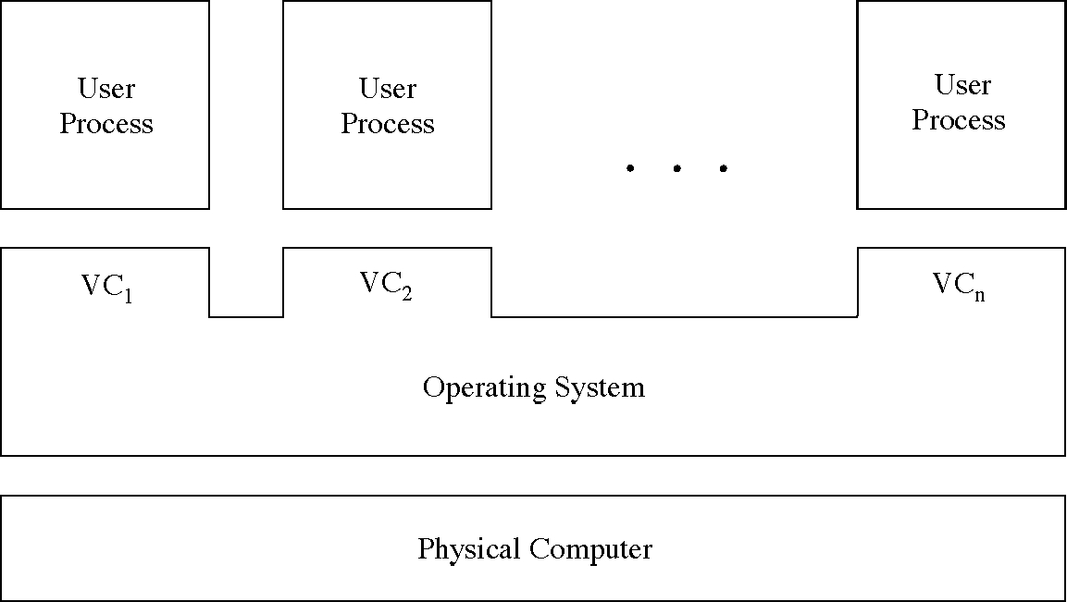
Multiple virtual computers

Slide 33
Boot :System generation (SYSGEN)
The OS program is normally distributed on disk or tape.
A special program SYSGEN reads from a given file and asks the operator regarding specific configuration of the system.
Probes the hardware directly to determine what components are there.
Regenerate/Configure the OS for new machine parameters
CPU type
Machine parameters include
Memory size, I/O device parameters, address maps etc.
Mechanisms describe how things are done
Devices
Options of OS
CPU scheduling algorithm, buffer size.
Approaches
Recompile
Have precompiled parameterized libraries: link rather than compiling
Use table driven run-time selection

Slide 34
Operating System Generation
Operating systems are designed to run on any of a class of machines; the system must be configured for each specific computer site
SYSGEN program obtains information concerning the specific configuration of the hardware system
Booting – starting a computer by loading the kernel
Bootstrap program – code stored in ROM that is able to locate the kernel, load it into memory, and start its execution
Notes:
34

Slide 35
System Boot
Operating system must be made available to hardware so hardware can start it
Small piece of code – bootstrap loader, locates the kernel, loads it into memory, and starts it
Sometimes two-step process where boot block at fixed location loads bootstrap loader
When power initialized on system, execution starts at a fixed memory location
Firmware used to hold initial boot code
Notes:
35

Slide 36
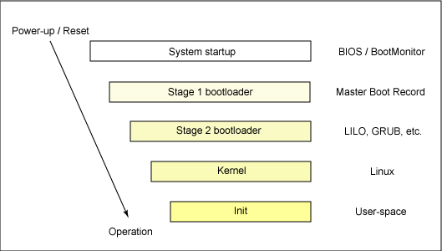
Linux Boot Process

