Slide 1
Inter-Process Communication
Manish Shrivastava

Slide 2
Cooperating Processes
The processes can be independent or cooperating processes.
Independent process cannot affect or be affected by the execution of another process.
Cooperating process can affect or be affected by the execution of another process
Advantages of process cooperation
Information sharing
Computation speed-up
Break into several subtasks and run in parallel
Modularity
Constructing the system in modular fashion.
Convenience
User will have many tasks to work in parallel
Editing, compiling, printing

Slide 3
Inter-process Communication (IPC)
IPC facility provides a mechanism to allow processes to communicate and synchronize their actions.
Processes can communicate through
shared memory
or message passing.
Both schemes may exist in OS.
The Shared-memory method requires communication processes to share some variables.
The responsibility for providing communication rests with the programmer.
The OS only provides shared memory.
Example: producer-consumer problem.

Slide 4
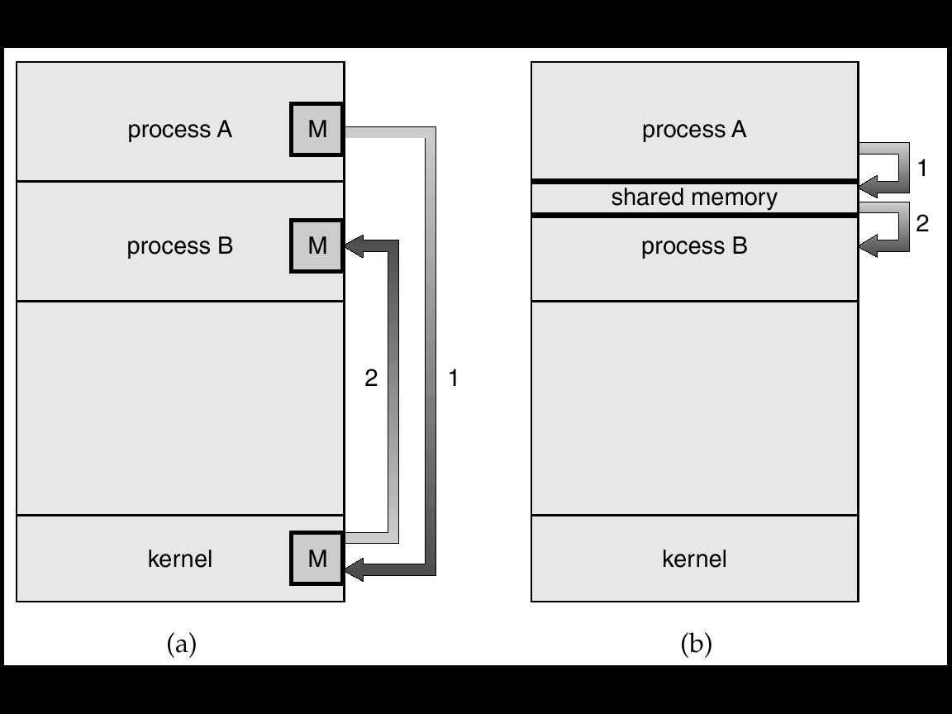
Communication Models
Msg Passing
Shared Memory

Slide 5
Producer-Consumer Problem: Shared memory
Producer process produces information that is consumed by a consumer process.
unbounded-buffer places no practical limit on the size of the buffer.
Producer can produce any number of items.
Consumer may have to wait
bounded-buffer assumes that there is a fixed buffer size.
Consumer or producer may have to wait

Slide 6
Shared Memory
Shared memory is memory that may be simultaneously accessed by multiple programs.
Life cycle of Shared Memory
Create Memory Block
Attach to number of process simultaneously
Read & Write
Detach Memory block
Free Memory block

Slide 7
Common chunk of read/write memory
among processes
MAX
Shared Memory
(unique key)
Create
ptr
ptr
Attach
0
Attach
Proc. 1
Proc. 2
ptr
ptr
ptr
Proc. 3
Proc. 4
Proc. 5

Slide 8
Shmget System Call
The shmget system call is used to create shared memory segment
Shmt System Call
Attaches block to process
int shmget (key_t key, int size, int shmflg);
Void * shmt(ShmID,..);
Arguments:
•
key_t key: key for creating or accessing shared memory
•
int size: size in bytes of shared memory segment to create. Use 0 for
accessing an existing segment.
•
int shmflg: segment creation condition and access permission.

Slide 9
Communicating Among Separate
:
1/5
Processes
1/5
Define the structure of a shared memory
segment as follows:
//Status of memory block
#define NOT_READY (­1)
#define FILLED (0)
#define TAKEN (1)
struct Memory {
int status; // used for Synchronization
int data[4]; // data to share
};
17

Slide 10
Communicating Among Separate
Processes
:
2/5
2/5
The “Server”
Prepare for a shared memory
void main(int argc, char *argv[])
{
key_t ShmKEY;
int ShmID, i;
struct Memory *ShmPTR;
ShmKEY = ftok(“./”, ‘x’);
ShmID = shmget(ShmKEY, sizeof(struct Memory),
IPC_CREAT | 0666);
ShmPTR = (struct Memory *) shmat(ShmID, NULL, 0);
18

Slide 11
Communicating Among Separate
Processes
:
3/5
3/5
shared memory not ready
ShmPTR­>status = NOT_READY;
filling in data
for (i = 0; i < 4; i++)
ShmPTR­>data[i] = atoi(argv[i]);
ShmPTR­>status = FILLED;
while (ShmPTR­>status != TAKEN)
sleep(1); /* sleep for 1 second */
shmdt((void *) ShmPTR);
shmctl(ShmID, IPC_RMID, NULL);
exit(0);
}
wait until the data is taken
detach and remove shared memory
19

Slide 12
Communicating Among Separate
Processes
:
4/5
4/5
void main(void)
The “Client”
{
key_t ShmKEY;
prepare for shared memory
int ShmID;
struct Memory *ShmPTR;
ShmKEY=ftok(“./”, ‘x’);
ShmID = shmget(ShmKEY, sizeof(struct Memory), 0666);
ShmPTR = (struct Memory *) shmat(ShmID, NULL, 0);
while (ShmPTR­>status != FILLED)
;
printf(“%d %d %d %d\n”, ShmPTR­>data[0],
ShmPTR­>data[1], ShmPTR­>data[2], ShmPTR­>data[3]);
ShmPTR­>status = TAKEN;
shmdt((void *) ShmPTR);
exit(0);
20
}

Slide 13
Important Notes
If you did not remove your shared memory
segments (e.g., program crashes before the
execution of
shmctl()
), they will be in the
system forever. This will degrade the system
performance.
Use the
Ipcs
command to check if you have
shared memory segments left in the system.
Use the
ipcrm
command to remove your
shared memory segments.
22

Slide 14
Inter-process Communication (IPC): Message Passing System
Message system – processes communicate with each other without resorting to shared variables.
If P and Q want to communicate, a communication link exists between them.
OS provides this facility.

Slide 15
IPC
IPC facility provides two operations:
send(message) – message size fixed or variable
receive(message)
If P and Q wish to communicate, they need to:
establish a communication link between them
exchange messages via send/receive
Implementation of communication link
physical (e.g., shared memory, hardware bus)
logical (e.g., logical properties)
We are concerned with logical link.

Slide 16
Implementation Questions
How are links established?
Can a link be associated with more than two processes?
How many links can there be between every pair of communicating processes?
What is the capacity of a link?
Is the size of a message that the link can accommodate fixed or variable?
Is a link unidirectional or bi-directional?

Slide 17
Fixed and variable message size
Fixed size message
Good for OS designer
Complex for programmer
Variable size messages
Complex for the designer
Good for programmer

Slide 18
Methods to implement a link
Direct or Indirect communication
Synchronous or asynchronous communication
Automatic or explicit buffering

Slide 19
Direct Communication
Symmetric: Processes must name each other explicitly:
send (P, message) – send a message to process P
receive(Q, message) – receive a message from process Q.
Asymmetric: Only sender names the recipient, the recipient is not required to name the sender.
The send and receive primitives are as follows.
Send (P, message)– send a message to process P.
Receive(id, message)– receive a message from any process.
Properties of communication link
Links are established automatically.
A link is associated with exactly one pair of communicating processes.
Between each pair there exists exactly one link.
The link may be unidirectional, but is usually bi-directional
Disadvantages: Changing a name of the process creates problems.

Slide 20
Indirect Communication
The messages are sent and received from mailboxes (also referred to as ports).
A mailbox is an object
Process can place messages
Process can remove messages.
Two processes can communicate only if they have a shared mailbox.
Operations
create a new mailbox
send and receive messages through mailbox
destroy a mailbox
Primitives are defined as:
send(A, message) – send a message to mailbox A
receive(A, message) – receive a message from mailbox A

Slide 21
Indirect Communication
Mailbox sharing
P₁, P₂, and P₃ share mailbox A.
P₁, sends; P₂ and P₃ receive.
Who gets a message ?
Solutions
Allow a link to be associated with at most two processes.
Allow only one process at a time to execute a receive operation.
Allow the system to select arbitrarily the receiver. Sender is notified who the receiver was.
Properties of a link:
A link is established if they have a shared mailbox
A link may be associated with more than two boxes.
Between a pair of processes they may be number of links
A link may be either unidirectional or bi-directional.
OS provides a facility
To create a mailbox
Send and receive messages through mailbox
To destroy a mail box.
The process that creates mailbox is a owner of that mailbox
The ownership and send and receive privileges can be passed to other processes through system calls.

Slide 22
Synchronous or asynchronous
Message passing may be either blocking or non-blocking.
Blocking is considered synchronous
Non-blocking is considered asynchronous
send and receive primitives may be either blocking or non-blocking.
Blocking send: The sending process is blocked until the message is received by the receiving process or by the mailbox.
Non-blocking send: The sending process sends the message and resumes operation.
Blocking receive: The receiver blocks until a message is available.
Non-blocking receive: The receiver receives either a valid message or a null.

Slide 23
Automatic and explicit buffering
A link has some capacity that determines the number of messages that can reside in it temporarily.
Queue of messages is attached to the link; implemented in one of three ways.
1. Zero capacity – 0 messages Sender must wait for receiver (rendezvous).
Bounded capacity – finite length of n messages -Sender must wait if link full.
Unbounded capacity – infinite length Sender never waits.
In non-zero capacity cases a process does not know whether a message has arrived after the send operation.
The sender must communicate explicitly with receiver to find out whether the later received the message.
Example: Suppose P sends a message to Q and executes only after the message has arrived.
Process P:
send (Q. message) : send message to process Q
receive(Q,message) : Receive message from process Q
Process Q
Receive(P,message)
Send(P,”ack”)

Slide 24
Exception conditions
When a failure occurs error recovery (exception handling) must take place.
Process termination
A sender or receiver process may terminate before a message is processed. (may be blocked forever)
A system will terminate the other process or notify it.
Lost messages
Messages may be lost over a network
Timeouts; restarts.
Scrambled messages
Message may be scrambled on the way due to noise
The OS will retransmit the message
Error-checking codes (parity check) are used.

Slide 25
Client-Server Communication
Sockets
Remote Procedure Calls
Pipes

Slide 26
Sockets
A socket is defined as an endpoint for communication.
A pair of processes communicating over a network employees a pair of sockets– one for each process.
Socket: Concatenation of IP address and port
The socket 161.25.19.8:1625 refers to port 1625 on host 161.25.19.8
Servers implementing specific services listen to well-known ports
telnet server listens to port 80
ftp server listens to port 21
http server listens to port 80.
The ports less than 1024 are used for standard services.
The port for socket is an arbitrary number greater than1024.
Communication consists between a pair of sockets.

Slide 27
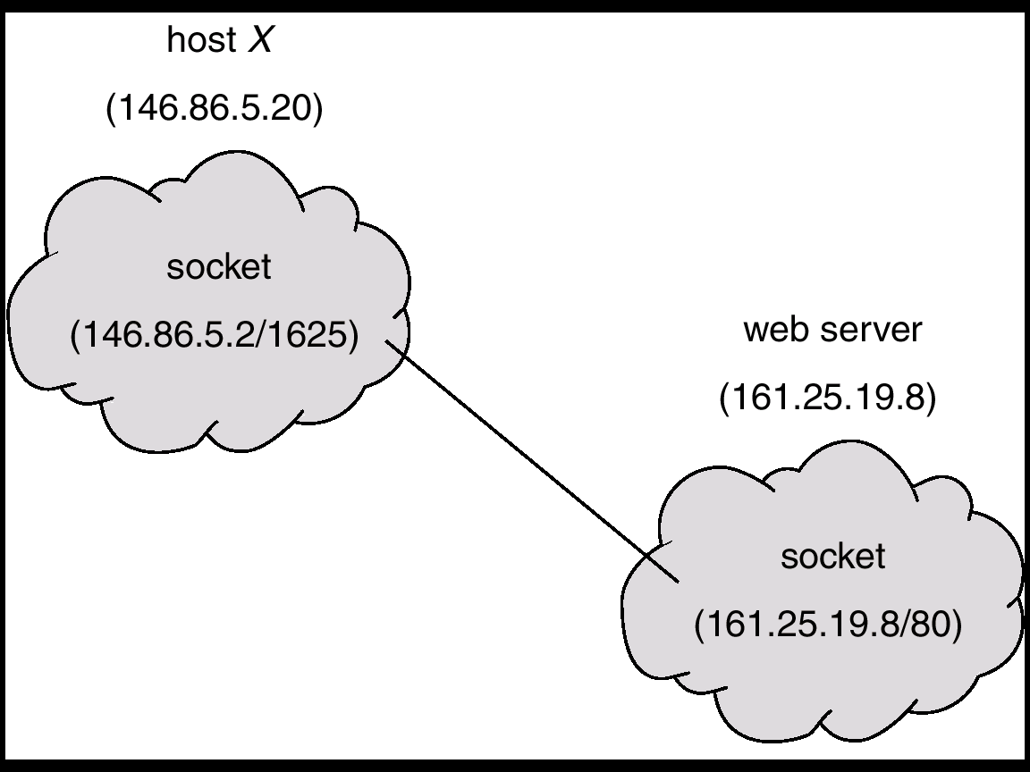
Socket Communication

Slide 28
Remote Procedure Calls
Remote procedure call (RPC) abstracts procedure calls between processes on networked systems.
Stubs – client-side proxy for the actual procedure on the server.
The client-side stub locates the server and marshals the parameters.
Marshalling: Parameter marshalling involves packaging the parameters into a form that can be transmitted over a network.
The server-side stub receives this message, unpacks the marshaled parameters, and performs the procedure on the server.

Slide 29
Remote Procedure Calls
There are several issues
Local procedure call can fail and RPCs can fail and re-executed
exactly once semantics: Local procedure calls may have exactly once semantics
In RPC, the server must implement “at most once” semantics send the ack to client to ensure no further communication.
The server detects the repeated messages.
Even client sends more messages those will be ignored.
Binding issues: linking loading and execution
Fixed or rendezvous
Applications: distributed file systems

Slide 30
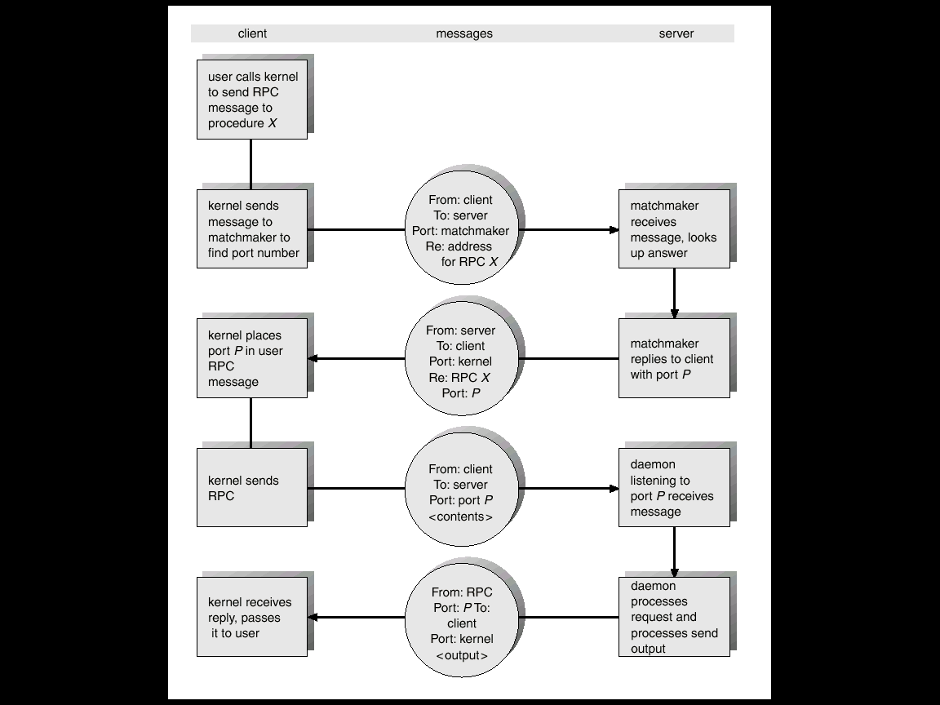
Execution of RPC

Slide 31
Pipes
Pipe: another IPC mechanism
uses the familiar file interface
not a special interface (like messages)
Connects an open file of one process to an open file of another process
Often used to connect the standard output of one process to the standard input of another process

Slide 32
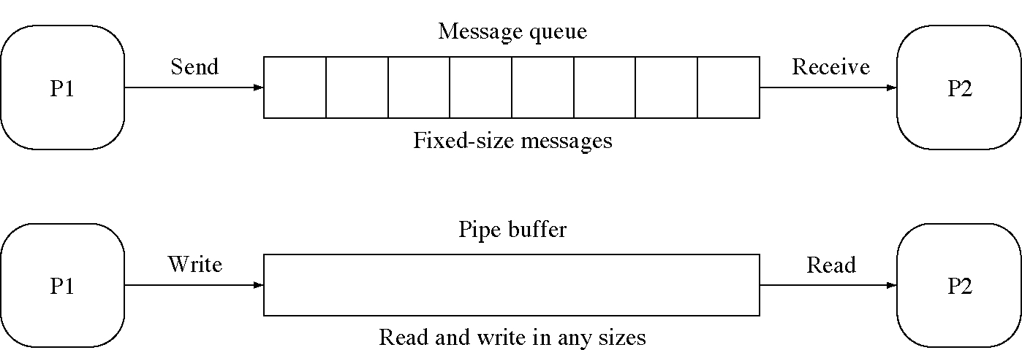
Messages and pipes compared

Slide 33
More about Pipes
Acts as a conduit allowing two processes to communicate
Issues
Is communication unidirectional or bidirectional?
In the case of two-way communication, is it half or full-duplex?
Must there exist a relationship (i.e. parent-child) between the communicating processes?
Can the pipes be used over a network?

Slide 34
Ordinary Pipes
Ordinary Pipes allow communication in standard producer-consumer style
Producer writes to one end (the write-end of the pipe)
Consumer reads from the other end (the read-end of the pipe)
Ordinary pipes are therefore unidirectional
Require parent-child relationship between communicating processes
Ordinary pipe can not be accessed from outside the process that creates it.

Slide 35
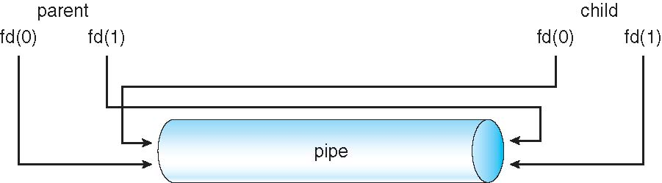
Ordinary Pipes
Unix function to create pipes: pipe(int fd[])
fd[0] is the read end. fd[1] is write end.

Slide 36
Named Pipes
Named Pipes are more powerful than ordinary pipes
Communication is bidirectional
No parent-child relationship is necessary between the communicating processes
Several processes can use the named pipe for communication
Provided on both UNIX and Windows systems

Slide 37
Pipes in Practice
ls | more

